Slide 1
Builder Pattern

Slide 2
Intent
Separate construction of complex object from its representation
  ⇒ same construction process can create different representations

Slide 3
Motivation
Reader that converts an RTF document to a different format
  Want to be able to add new conversions without modifying reader
Solution: RTFReader object – contain a TextConverter object
  TextConverter object – convert token & represent it in appropriate format
  Subclass TextConverter for different conversions & formats

Slide 4
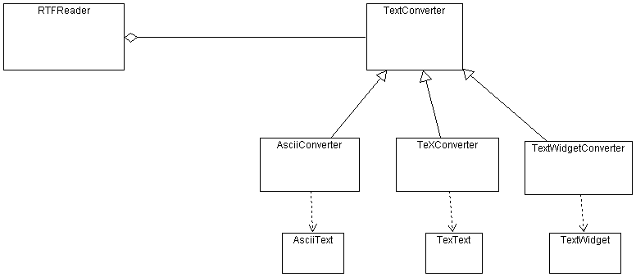

Slide 5
Applicability
Algorithm for creating object is independent of parts that make up object & how they are assembled
Construction process – must allow different representations for the object that is being constructed

Slide 6
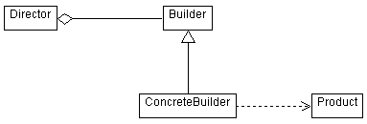
Structure

Slide 7
Participants
Builder
  Specifies abstract interface for creating parts of Product object
Concrete builder
  Constructs & assembles parts of product by implementing Builder
  Defines & keeps track of created representation
  Provides interface for retrieving product
Director
  Constructs object using Builder interface
Product
  Represents complex object under construction
  Includes classes that define constructed parts

Slide 8
Collaborations
Client creates Director object & configures it with the desired Builder object
Director object notifies builder whenever a part of the Product should be built
Builder handles request from director & adds parts to the product
Client retrieves product from Builder

Slide 9
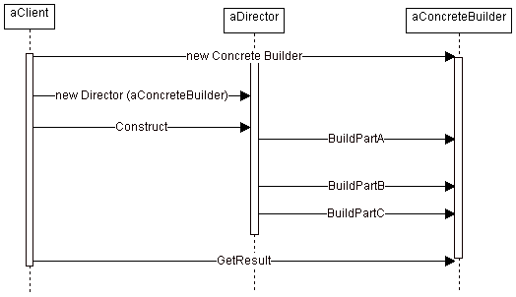

Slide 10
Consequences
Allows product’s internal representation to vary
Isolates code for construction & representation
Finer control over construction process

Slide 11
Implementation
Abstract Builder class – defines an operation for each component that could be created
Since Builders construct products step by step – Builder interface must be sufficiently general to allow construction for all types of products

Slide 12
  Usually – results of a constructor – appended to product
  If access to previously built components is necessary – Builder would store appropriate access & allow Director to access this stored information
Product being constructed – can greatly differ
  ⇒ very difficult to get common interface
Empty methods in Builder instead of abstract interface
  Override only operations that are relevant

Slide 13
Sample Code
C++
Java

Slide 14
