Slide 1
Chain of Responsibility Pattern

Slide 2
Intent
avoid coupling of sender of request to receiver
give more than 1 object chance to handle request

Slide 3
Motivation
motivating example: context-sensitive help for GUI
  user - get help by clicking on part of interface
    nature of help - depends upon context
  organize help information from specific to general
  decouple senders & receivers by passing message along chain until 1 of them handles it
    request has implicit receiver
  each object on chain - shares common interface for handling requests & for accessing successor

Slide 4
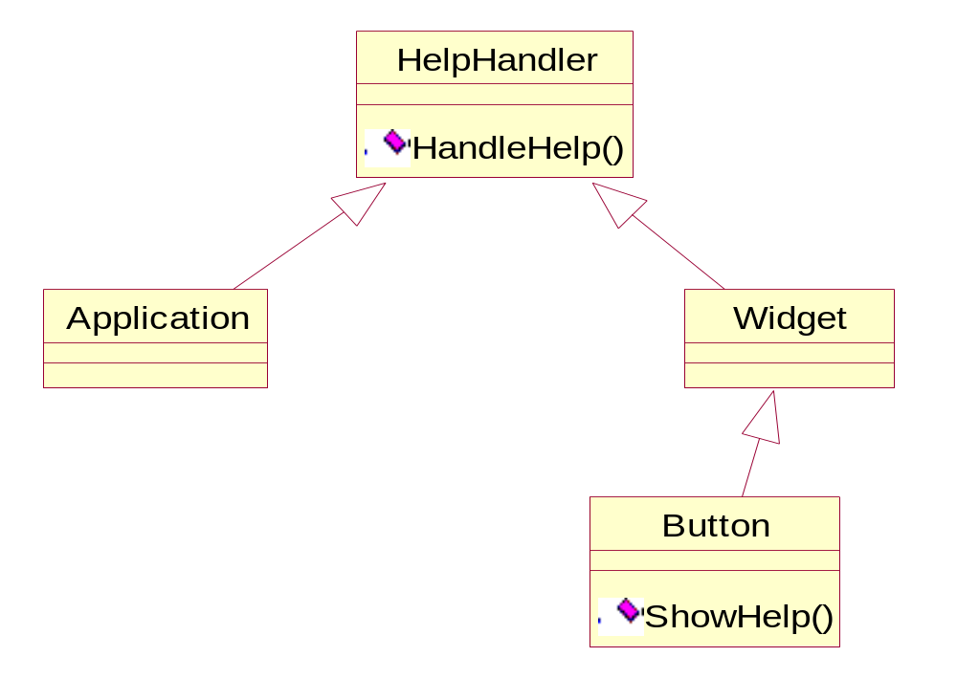

Slide 5
Applicability
more than 1 object may handle request - handler is not known ahead of time
want to issue request to one of several objects without specifying receiver explicitly
set of objects which can handle request - specified dynamically

Slide 6
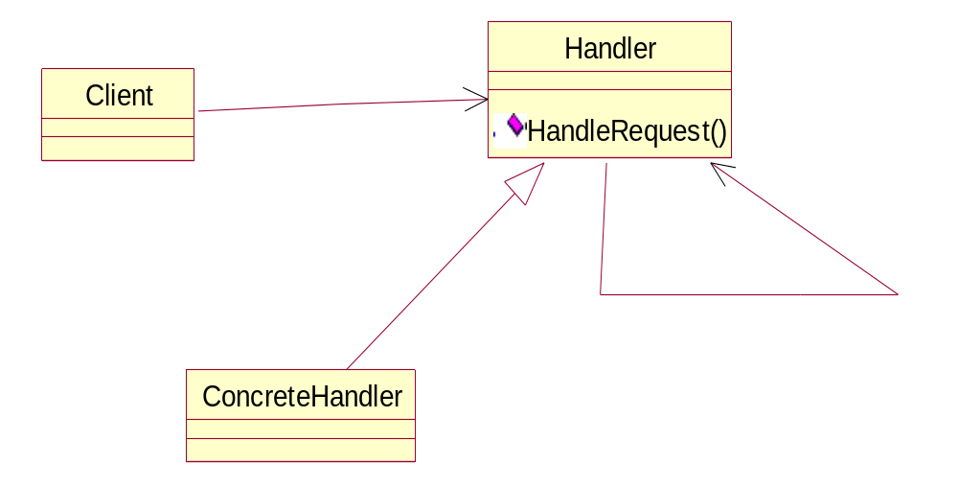
Structure

Slide 7
Participants
handler
  defines interface for handling requests
  possibly implements successor link
concrete handler
  handles request
  accesses successor
client
  initiates request to first concrete handler on chain

Slide 8
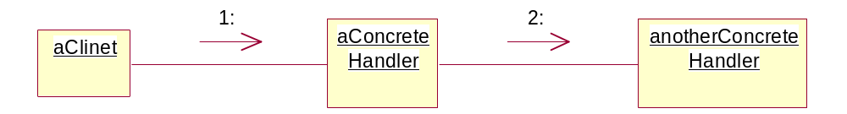
Collaborations
When client issues request - propagates along chain until handled by some concrete handler

Slide 9
Consequences
reduced coupling
  receiver & sender - have no explicit knowledge of each other
    object in chain - doesn't have to know about chain's structure
added flexibility in assigning responsibilities to objects
  addition or change in responsibilities - dynamically change chain at run-time
  subclassing - specialize handlers statically
receipt is not guaranteed
  request can fall off end of chain

Slide 10
Implementation
implementing successor chain
  define new links
  use existing links
  depends upon whether existing linnks support desired chain
connecting successors
  handler - can define interface for request & maintain successor
    ⇒ can provide default behavior for forwarding request

Slide 11
Class HelpHandler {
public:
  HelpHandler (HelpHandler* s) : _successor (s) {};
  virtual void HandleHelp ();
private:
  HelpHandler* _successor;
};
void HelpHandler::HandleHelp () {
  if (_successor)
    _successor -> HandleHelp (); }

Slide 12
representing requests
  hard coded requests
    convenient & safe
    fixed set of requests
  single handler function - request code as parameter
    send & receiver - agree on encoding
    no type-safe way of passing parameters
    can use request object - bundle request parameters
      ⇒ new kinds of requests by subclassing
    handler - must know kind of request
    run-time type information

Slide 13
void Handler::HandlerRequest (Request* the Request)
{ switch (theRequest -> GetKind ())
  {
    case Help:
      HandleHelp ((HelpRequest*) theRequest);
      break;
    case Print:
      HandlePrint ((PrintRequest*) theRequest);
      break;
    default: …
  }
}

Slide 14
can be extended by subclass overriding HandleRequest
class ExtendHandler: public Handler {
public:
  virtual void HandleRequest (Request* theRequest);
};
void Extended Handler::HandleRequest (Request* theRequest) {
  switch (theRequest -> GetKind ()) {
    case Preview: …
    default:
      Handler::HandleRequest (theRequest);
  }
}

Slide 15
Sample Code
C++
java

