Slide 1
Command Pattern

Slide 2
Intent
encapsulate a request as an object
  ⇒ can parameterize clients with different requests, queue or log requests, support undoable operations

Slide 3

Motivation
Sometimes have to issue requests without knowing the operation or the receiver
encapsulate request in an object
  abstract Command class - declares interface for executing operations
  concrete Command subclasses - specify receiver-action pair
    receiver – instance variable
decouples object which invokes operation from object with knowledge to perform operation
can replace dynamically
  =>can have context-sensitive user interface

Slide 4
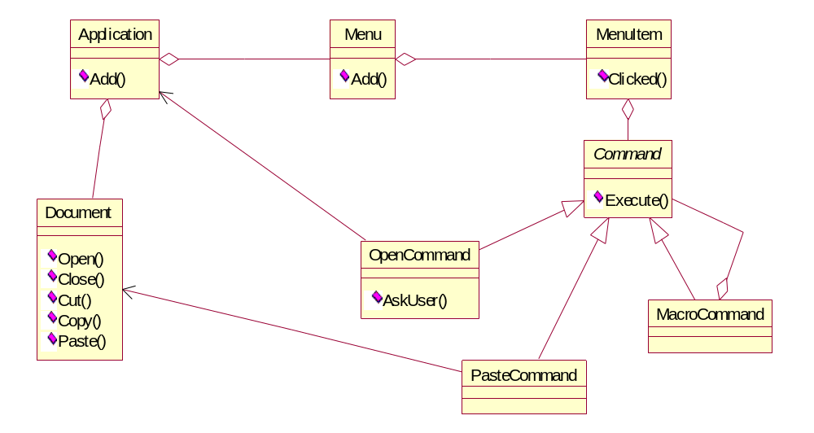

Slide 5
Applicability
Parameterize objects by an action to perform
  procedural language - callback function
specify, queue, execute requests at different times
  Command object - lifetime independent of original request
support undo
  Execute operation - can store state for reversing effects
    stored in a history list

Slide 6
support logging changes
  log Command objects on disk
structure a system around high-level operations built on primitive operations
  transaction - encapsulate set of changes to data
    => can be modelled with Commands

Slide 7
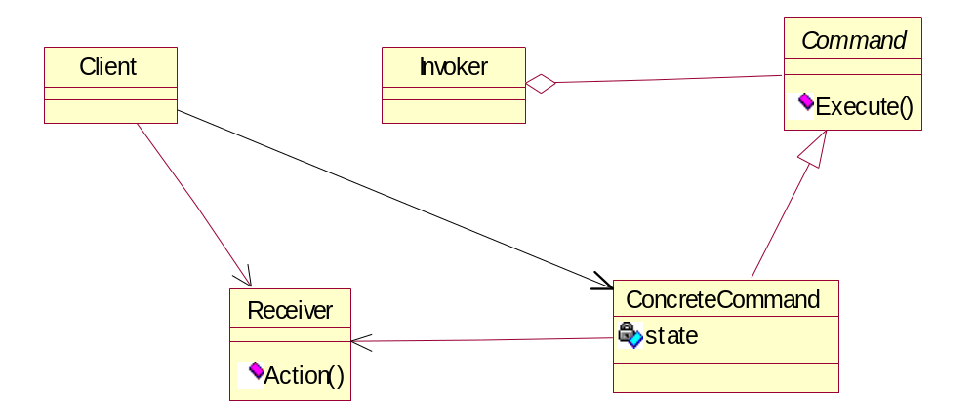
Structure

Slide 8

Participants
Command
  declares an interface for executing an operation
ConcreteCommand
  defines a binding between a Receiver object & an action
  implements Execute by invoking appropriate operations on Receiver
Client
  creates ConcreteCommand object & sets its receiver
Invoker
  asks the command to carry out request
Receiver
  knows how to perform operations associated with carrying out a request

Slide 9
Collaborations
client creates ConcreteCommand object & specifies its receiver
Invoker object - stores ConcreteCommand object
Invoker - issues request by calling Execute on command
ConcreteCommand object - invokes operations on receiver

Slide 10
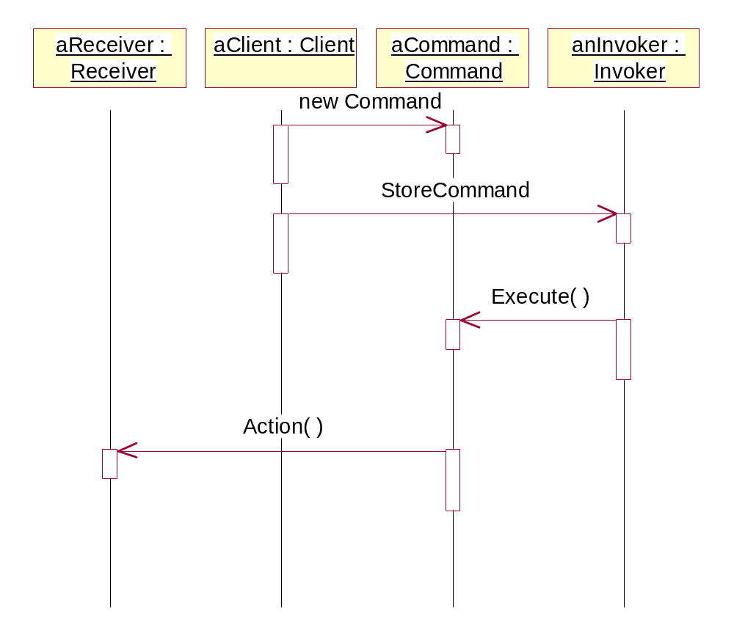

Slide 11
Consequences
decouples object that invokes operation from the one that knows how to perform it
commands - first class objects
  => can be manipulated like any other object
can assemble commands into a composite command
easy to add new commands
  subclassing

Slide 12
Implementation
how intelligent should a command be?
  one extreme - defines binding between receiver & actions
  other extreme – implements everything without delegating to receiver
    command - independent of existing classes
    no suitable receiver exists
    command knows its receiver implicitly

Slide 13
supporting undo & redo
  must provide way to reverse execution – might need to store state
    Receiver object
    arguments for operation
    any original values in receiver which could be changed by handling request
  multiple levels of undo & redo - need history list
avoiding error accumulation in undo process
using C++ templates
  command cannot be undoable & cannot have arguments
  avoid subclass proliferation

Slide 14
Sample Code
C++
JAVA

Slide 15
