Slide 1
Composite Pattern

Slide 2
Intent
compose objects into tree structures to represent part-whole hierarchies
objects & composites - treated uniformly

Slide 3
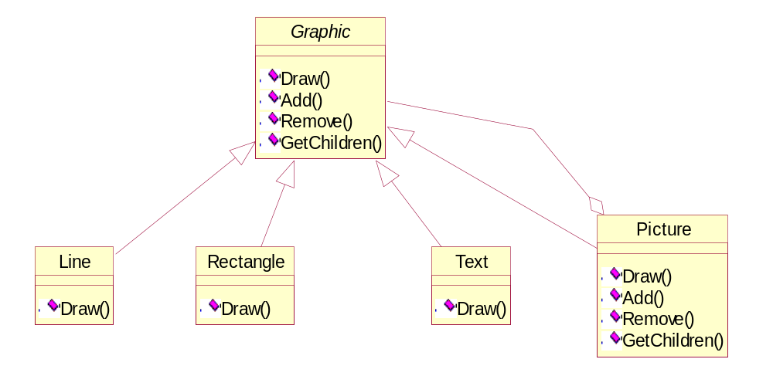
Motivation
graphics application - build complex diagrams out of simple components

Slide 4
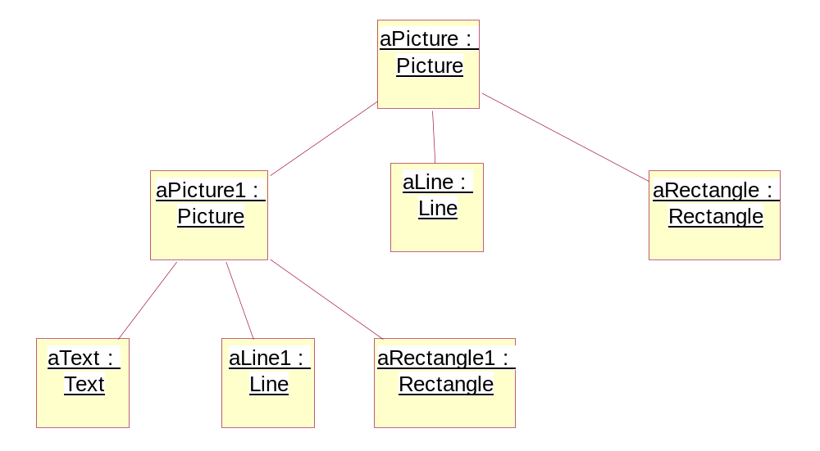
abstract class Graphic - represents both primitives & their containers
  draws operations for both primitives & their containers
typical object structure

Slide 5
Applicability
want to represent part-whole hierarchies of objects
want clients to treat all objects in composite structure uniformly

Slide 6
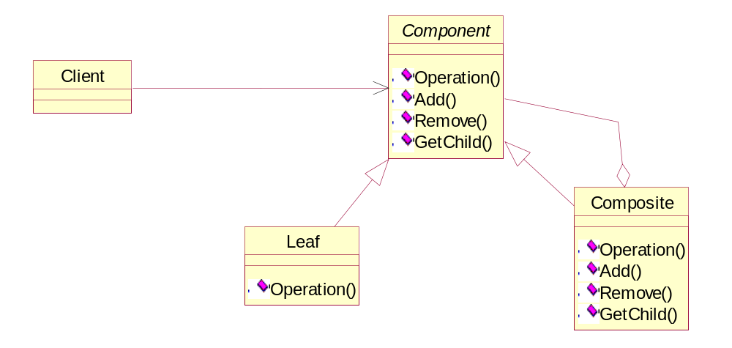
Structure

Slide 7
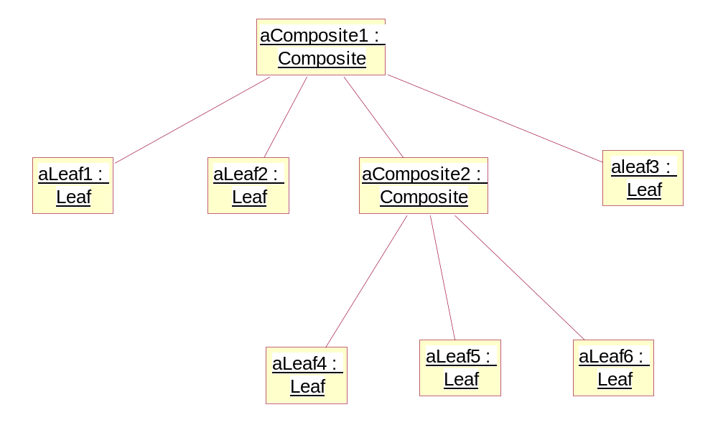

Slide 8
Participants
component
  declares interface for objects in composition
  implements default behavior for common interface
  declares interface for accessing & managing child components
  possibly define interface for accessing a component's parent

Slide 9
leaf
  represents leaf objects in composition
  defines behavior for primitive objects
composite
  defines behavior for components having children
  stores child components
  implements child related operations
client
  manipulates objects in composition through Component interface

Slide 10
Collaborations
clients use Component class interface to interact with composite structure
  if component object is a leaf - handle request directly
  if component object is a composite - request forwarded to child

Slide 11
Consequences
defines class hierarchies of primitive objects & composite objects
  whenever client expects a primitive object - it must also be able to take a composite object
makes client simple
  can treat composite structures & individual objects uniformly
easy to work with new kind of component
  client does not have to be change
can make design overly general
  difficult to restrict components - need run-time checks

Slide 12
Implementation
explicit parent references
  maintaining references from child to parent - simplify traversal & update
  can support Chain of Responsibility pattern
  define in Component class
    ⇒ inherited by leaf & composite classes
sharing components
  help improve memory efficiency
  problem - multiple parents
    one solution - flyweight pattern

Slide 13
maximizing Component interface
  if client is to be unaware of specific component or leaf, interface must contain all possible operation for components & leaves
    have some operations which are not meaningful for some classes
    need default implementation
declaring child management operations
  define child management interface in component class
    transparency - all components treated same
    allows clients to try to perform meaningless operations
  define child management in composite class
    only allows meaningful operations
    lose transparency
    need ability to determine when a component object is a composite object
      add Composite* GetComposite () operation to component interface
      returns either null pointer or composite object

Slide 14
class Component
{
public:
virtual Composite* GetComposite () {return 0;}
};
class Composite: public Component
{
public:
virtual Composite* GetComposite () {return this;}
};
define default behavior of throwing an exception for child management operations on leaves

Slide 15
should component implement list of components?
  problem: waste memory for leaf classes
    ⇒ better to have list implemented in composite class
child ordering
  may need children ordered
    ⇒ child access & management operations will need to manage ordering
caching to improve performance
  frequent traversals or searches - may want to cache some information about children in parent
  normal problems of data validity involved with caching
who should delete components?
  better to have parent responsible for deleting children (if not handled by garbage collection)
data structure for storing components
  no best choice - typical data structure selection question

Slide 16
Source Code
C++
Java

Slide 17
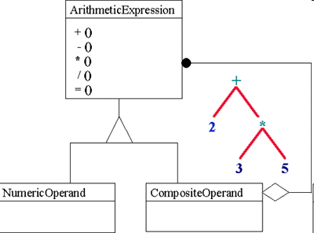

Slide 18
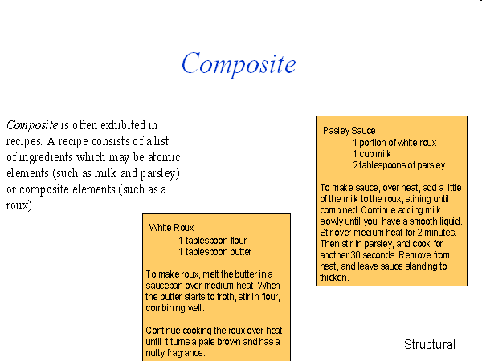

Slide 19
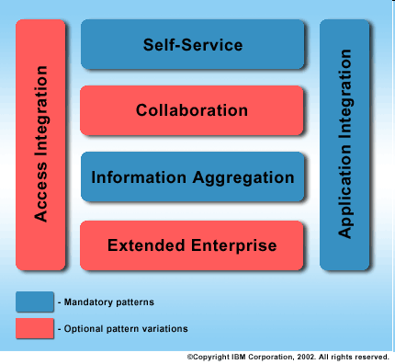
Electronic Commerce as a Composite Pattern

