Slide 1
Decorator Pattern

Slide 2
Intent
attach additional responsibilities to an object dynamically

Slide 3
Motivation
inheritance - static ⇒ inflexible
enclose component in another object – decorator
  Conforms to interface of component
  Transparent to component’s clients
  Forwards request to component possibly performing additional operations
  Can be nested recursively

Slide 4
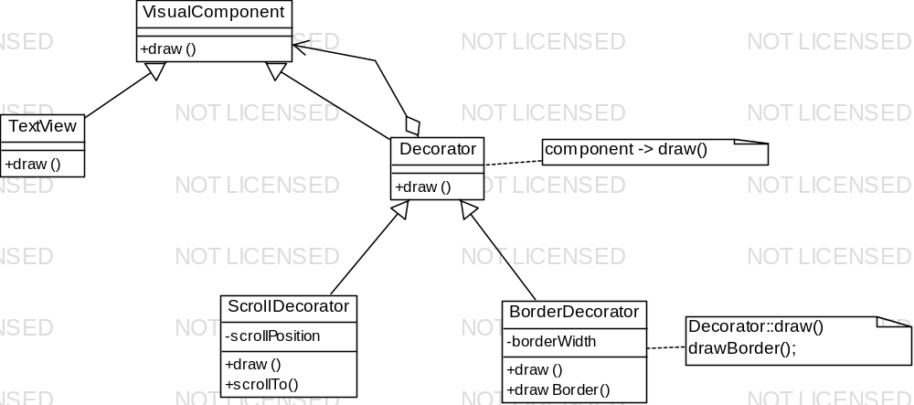
Motivation con't

Slide 5
Applicability
add responsibilities to individual objects dynamically & transparently
responsibilities can withdrawn
extension by subclassing is impractical prevent class proliferation

Slide 6
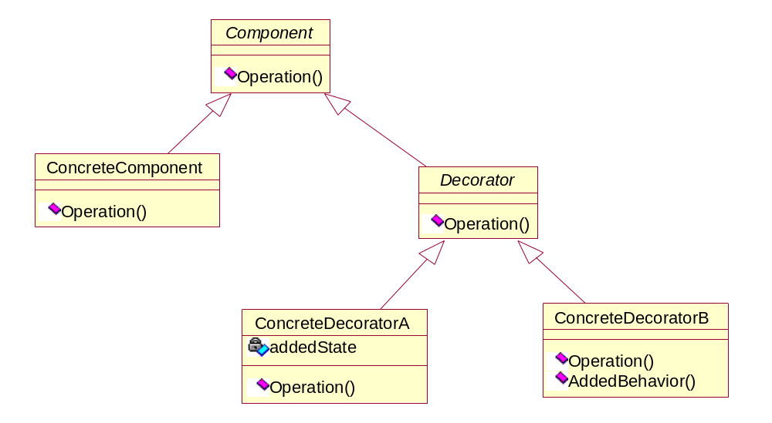
Structure

Slide 7
Participants
Component
  Defines interface for objects that can have responsibilities added dynamically
ConcreteComponent
  Defines object to which additional responsibilities can be added
Decorator
  Maintains reference to a Component object
  Defines interface which conforms to Component’s interface
ConcreteDecorator
  Adds responsibilities to Component

Slide 8
Collaborations
Decorator forwards requests to Component object possibly adding operations

Slide 9
Consequences
More flexibility than static interface
  Responsibilities can be added & removed at run-time
  Easy to mix & match responsibilities
  Easy to add a property more than once
Avoids feature laden classes high in class hierarchy
  Do not have to support all foreseeable features in class structure
Decorator & its components are not identical
  Decorator – transparent enclosure
    Cannot use object identity
  Lots of little objects
    Harder to learn & debug

Slide 10
Implementation
Interface conformance
  decorator object's interface must conform to interface of decorated components
  (C++) must inherit from common class
omitting abstract Decorator class
  If adding only 1 responsibility – do not need Decorator class
keeping Component classes lightweight
  components & decorators must inherit from common Component class
    Component class should just handle interface
    Data representation – put in subclasses

Slide 11
Implementation con’t
changing skin of object vs. changing its guts
  Decorator – changing skin
  Strategy – changing guts
  Component class – heavyweight
    strategy – better choice since cost of decorator would be high
  Decorator transparent to component
  Components – must know about strategies

Slide 12
Sample Code
C++
java

Slide 13
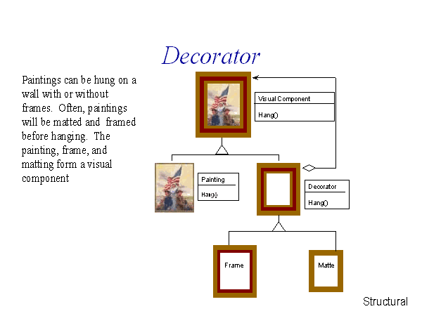

Slide 14
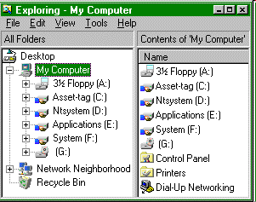
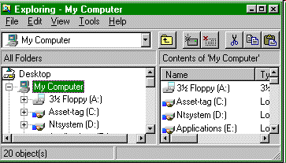

Slide 15
