Slide 1

Facade Pattern

Slide 2

Intent
provide unified interface to a set of interfaces
makes subsystem easier to use

Slide 3
Motivation
minimize dependencies between subsystems
ties together classes that provide subsystem functionality without totally hiding classes

Slide 4
Applicability
provide simple interface to complex subsystem
help decouple subsystem from clients & other subsystems
helps define entry point to each subsystem level in layering

Slide 5
Structure
package in UML

Slide 6

Participants
facade
  knows which subsystem classes are responsible for a request
  delegates client requests to appropriate subsystem objects
subsystem classes
  implement subsystem functionality
  handle work delegated by facade object
  no knowledge of facade

Slide 7
Collaborations
clients - send requests to fa₤ade

Slide 8

Consequences
shields clients from subsystem components
  makes subsystem easier to use
weak coupling between subsystem & its clients
  help layer system
  can eliminate circular dependencies
    minimize recompilation
doesn't prevent clients from using subsystems directly

Slide 9

Implementation
reducing client - subsystem coupling
  facade - abstract class
    concrete subclasses for different implementations of subsystem
      ⇒ clients - not need to know which implementation is used
alternative - facade has different subsystem objects
  select appropriate objects for implementation
public vs. private subsystem classes
  public interface - classes that all
  trouble with language support

Slide 10
Source Code
C++
Java

Slide 11
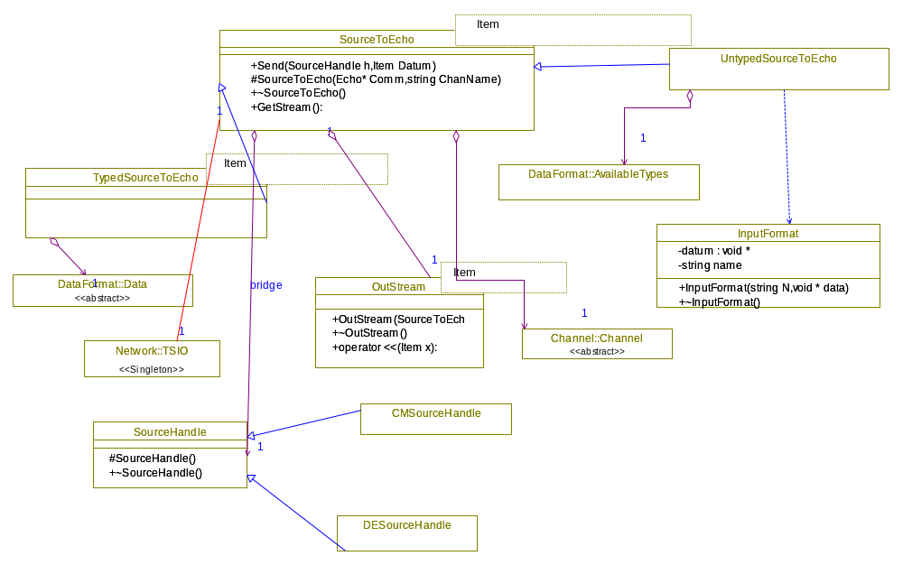

Slide 12
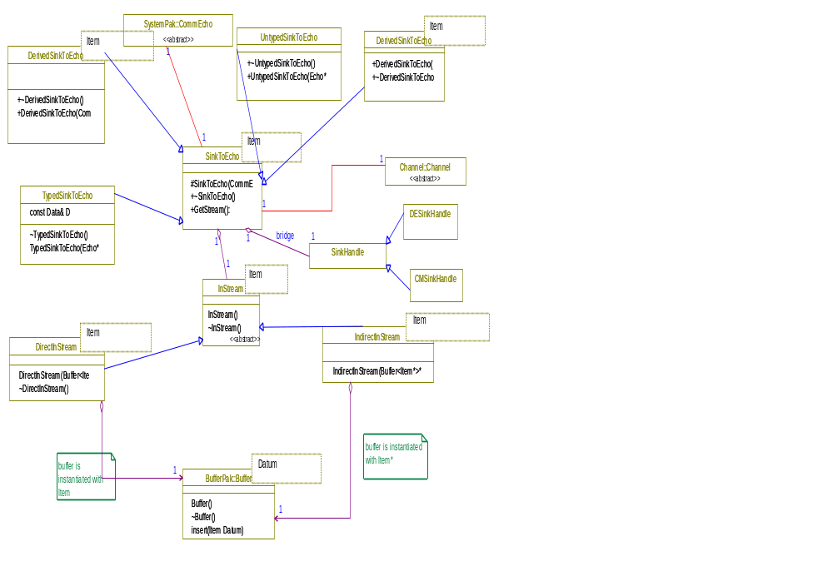

Slide 13
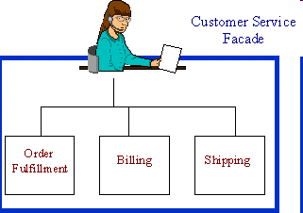

Slide 14
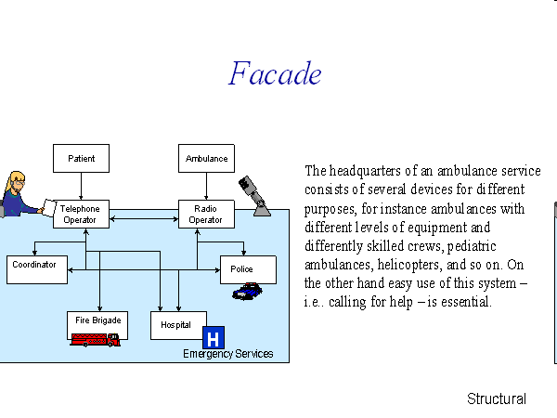

Slide 15
