Slide 1
Abstract Factory Pattern

Slide 2
Intent
provide interface for creating families of related objects without specifying concrete classes

Slide 3
Motivation
user interface toolkit which supports multiple look & feel standards
  cannot hard code widgets for a particular look & feel
define abstract WidgetFactory
  interface for creating each kind of widget
abstract class for each kind of widget
  concrete widget classes for each look & feel
    ⇒ clients are independent of particular look & feel
WidgetFactory - enforces dependencies between concrete widget classes
  all concrete classes used must have same look & feel

Slide 4
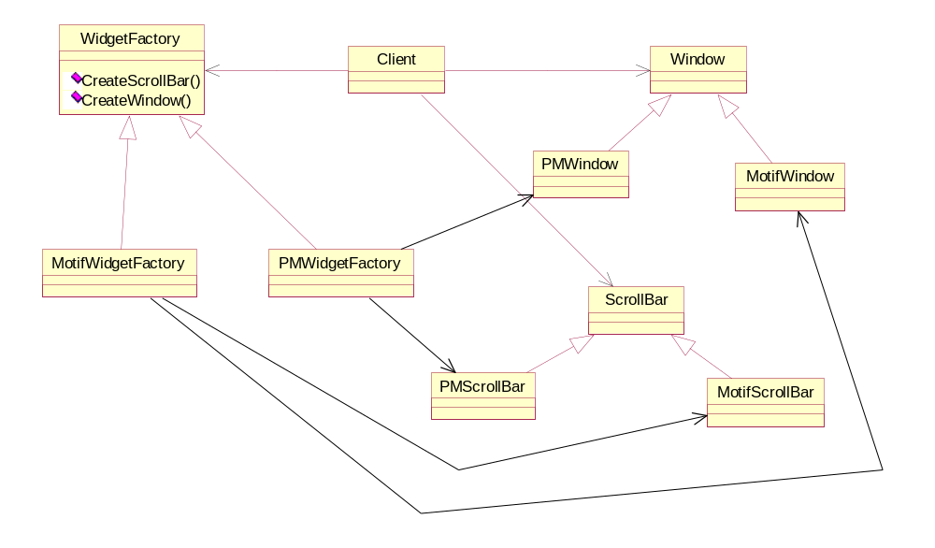

Slide 5
Applicability
system should be independent of how its products are created, composed, & represented
system should be configured with 1 of multiple families of products
family of related products - designed to be used together
want class library of products - just expose interface

Slide 6
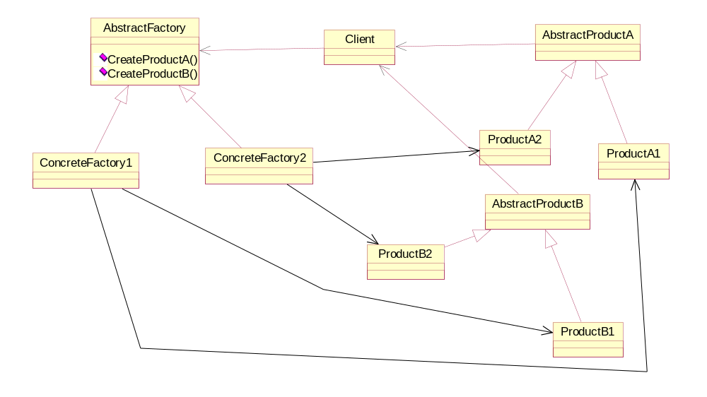
Structure

Slide 7
Participants
AbstractFactory
  defines interface to create abstract product objects
ConcreteFactory
  implements operations to create concrete product objects
AbstractProduct
  defines interface for type of product object
ConcreteProduct
  defines product object created by corresponding concrete factory
  implements AbstractProduct interface
Client
  uses interfaces created by AbstractFactory & AbstractProduct

Slide 8
Collaborations
isolates concrete classes
  helps control classes of objects created by application by isolating clients from concrete class
makes interchanging product families easy
  change concrete factory
promotes consistency among products
  guarantee only objects from same family are used
supporting new kinds of products is difficult
  would have to modify abstract factory & all the concrete factories

Slide 9
Implementation
factories are singletons
  guarantee only one instance of a concrete factory
creating the products
  one approach - define factory method for each product
    concrete factory - override factory method for each object
  another approach - prototype pattern
    concrete factory - initialized with prototype of each instance
    just have to modify prototype
defining extensible factories
  have single factory method which takes as a parameter the kind of object to be created
    return type for this create method must be able to handle all possible types of objects created
    all returned types have same abstract interface
      ⇒ dangerous downcast is necessary

Slide 10
Sample Code
Employee
  C++
  Java
  ada

