Slide 1
Flyweight Pattern

Slide 2
Intent
use sharing to support large number of fine-grained objects efficiently

Slide 3
Motivation
object oriented document editors - use objects to represent embedded elements
  too expensive to represent characters by objects
flyweight - shared object that can be that can be used in multiple contexts concurrently
  independent object - cannot tell whether sharable
  cannot make assumptions about context
  intrinsic state - does not depend upon context
    stored by flyweight

Slide 4
Motivation con't
extrinsic state - depends upon context
  stored by context
  passed to flyweight when needed
  example: character
    intrinsic - character code
    extrinsic - location of character in document
  logically - an object for every character in document
  physically - 1 shared flyweight object per character

Slide 5
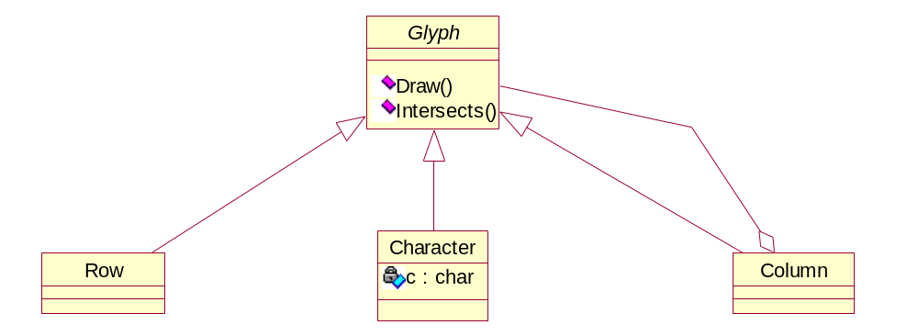
Motivation con't

Slide 6
Applicability
application uses a large number of objects
storage costs high because of quantity of objects
most of object state - extrinsic
many objects - can be replaced with a few shared objects after extrinsic state is removed
application - does not depend upon object identity

Slide 7
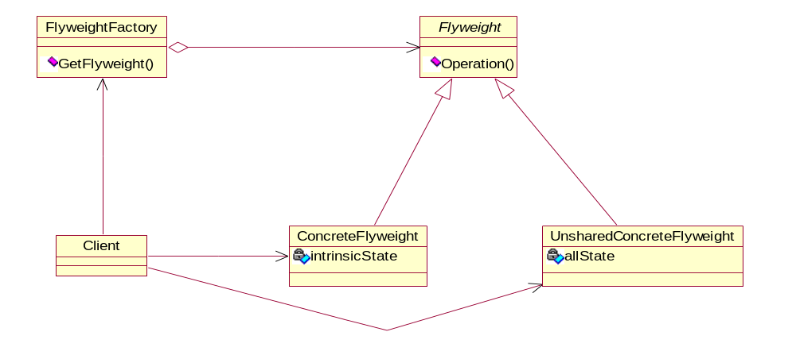
Structure

Slide 8
Participants
Flyweight
  declares an interface through which flyweights can receive & act on extrinsic state
ConcreteFlyweight
  implements Flyweight interface
  adds storage for intrinsic state
  must be sharable

Slide 9
Participants con't
UnsharedConcreteFlyweight
  Flyweight subclasses which are not shared
FlyweightFactory
  creates & manages flyweight objects
  ensures that flyweights are shared properly
Client
  maintains reference to flyweights
  stores extrinsic state of flyweights

Slide 10
Collaborations
state that flyweight needs - separated into intrinsic & extrinsic
  client handles extrinsic state
clients - should not instantiate ConcreteFlyweights directly
  go through FlyweightFactory object

Slide 11
Consequences
increased run-time costs - handling extrinsic state
storage savings - amount depends upon amount of sharing
  reduction in number of instances due to sharing
  amount of intrinsic state per object
  whether extrinsic state in computed or stored
when combined with Composite pattern
  Flyweight cannot store pointer to parent - part of extrinsic state

Slide 12
Implementation
removing extrinsic state
  must be easy to identify & remove extrinsic state
  need number of extrinsic states to be less than the amount of sharing
managing shared objects
  cannot be created by clients - use FlyweightFactory
  frequently use associative store to allow clients to look up flyweights
  may need garbage collection or reference counting

Slide 13
Sample Code
C++
Java

Slide 14
