Slide 1
Interpreter Pattern

Slide 2
Intent
given language - define representation for grammar & interpreter which will interpret sentences in language

Slide 3
Motivation
problems can sometimes be expressed in terms of sentences in a simple language
  Define grammar
  represent sentences in language
  interpret sentences
example - grammar for regular expressions
  expression ::= literal | alternation | sequence | repetition | '(' expression ')'
  alternation ::= expression '|' expression
  sequence ::= expression '&' expression
  repetition ::= expression '*'
  literal ::= 'a' | 'b' | 'c' | …{'a' | 'b' | 'c' | …}*
    where expression is the start symbol

Slide 4
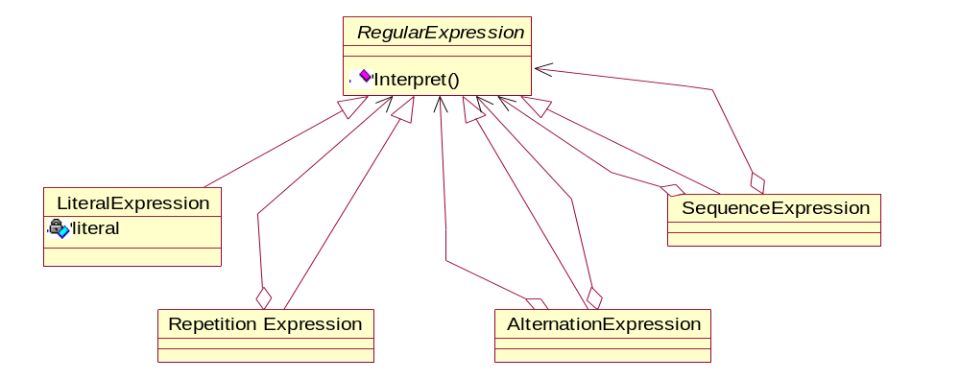
Motivation con't
regular expression - represented by an abstract syntax tree where each node is an instance of one of the classes

Slide 5
argument of Interpret () - context needed for interpretation
  input string
  how much of string has been matched
  function will then match next part of string

Slide 6
Applicability
when there is a language to interpret
statements - can be represented as an abstract syntax tree
works best
  grammar is simple
    class hierarchy - can become huge
  efficiency - not critical
    parse trees - inefficient structure for interpretation

Slide 7
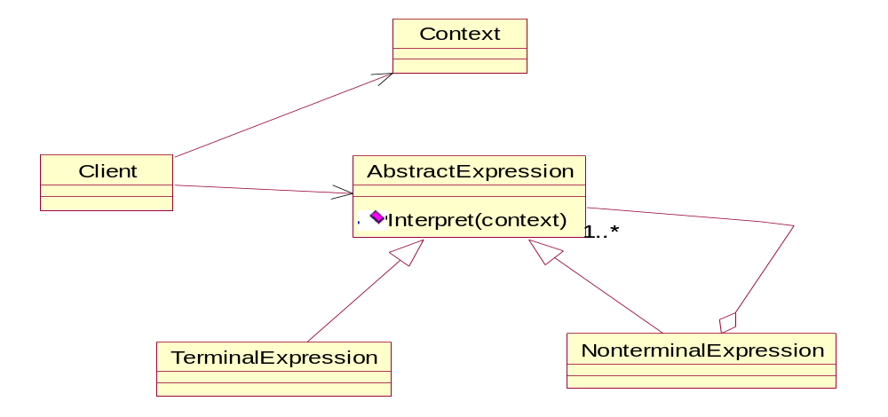
Structure

Slide 8
Participants
abstractExpression
  declares an abstract Interpret operation that is common to all nodes in abstract syntax tree
TerminalExpression
  implements an Interpret operation associated with terminal symbols in grammar
  required for every terminal symbol

Slide 9
NonterminalExpression
  1 class for every rule (production) in grammar
  maintains instance variables of type AbstractExpression for each grammar symbol on right side of production
  implements Interpret for nonterminal symbols in grammar
Context
  contains information global to interpreter
Client
  invokes Interpret operation

Slide 10
Consequences
easy to change & extend grammar
  extend inheritance tree
easy to implement grammar
  classes defining nodes - easy to write
complex grammars - hard to maintain
  complex grammars ⇒ large class structure
adding new ways to interpret expressions
  visitor pattern or strategy pattern

Slide 11
Implementation
creating abstract syntax tree
  does not address how abstract syntax tree is created (parsing)
defining interpret operation
  use Visitor pattern - put interpret into separate Visitor object
  can have many "interpret operations"
sharing terminals symbols
  sharing single copy of terminal symbol
  don't store information about location in syntax tree

Slide 12
Sample Code
C++
Java

Slide 13
