Slide 1
Memento Pattern

Slide 2
Intent
without violating encapsulation, capture & externalize an object's internal state

Slide 3
Motivation
Sometimes necessary to record internal states
  implementing breakpoints & undo mechanisms
  need to save state without violating encapsulation
motivating example: graphical editor - supports connectivity between objects
  2 rectangles connected with a line - move 1 rectangle- stay connected
  normal method: constraint solving system
    ⇒ Constraint Solver object
      records connections mathematically
      connections modified ⇒ calculated geometric form of resulting connection

Slide 4
undo - more than just calculations based upon original positions of rectangle
    rectangle – connection may have had special characteristics
      i.e. not straight lines
memento object - stores snapshot of originator's internal state
  undo - request memento from originator when checkpoint needed
    editor - requests memento from ConstraintSolver as a side effect of move operation
    ConstraintSolver - creates & returns a memento
    when undo is performed - editor gives memento back to ConstraintSolver
    ConstraintSolver - changes internal structures based upon information in memento

Slide 5
Applicability
snapshot of object's state must be saved for later usage
need to keep encapsulation of object's implementation

Slide 6
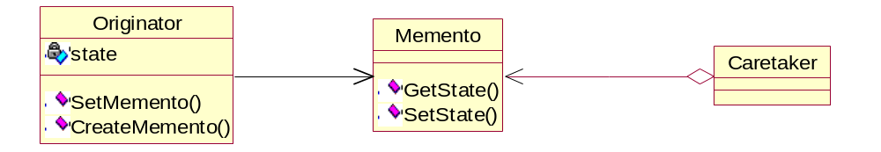
Structure

Slide 7
Participants
memento
  stores internal state of Originator object
  protects against access by objects other than Originator
    Caretaker - narrow interface
      can only pass Memento to other objects
    Originator - wide interface
      can access all necessary data to restore itself
originator
  creates memento containing snapshot of current internal state
  uses memento to restore its internal state
caretaker
  responsible for memento's safekeeping
  never accesses contents of memento

Slide 8
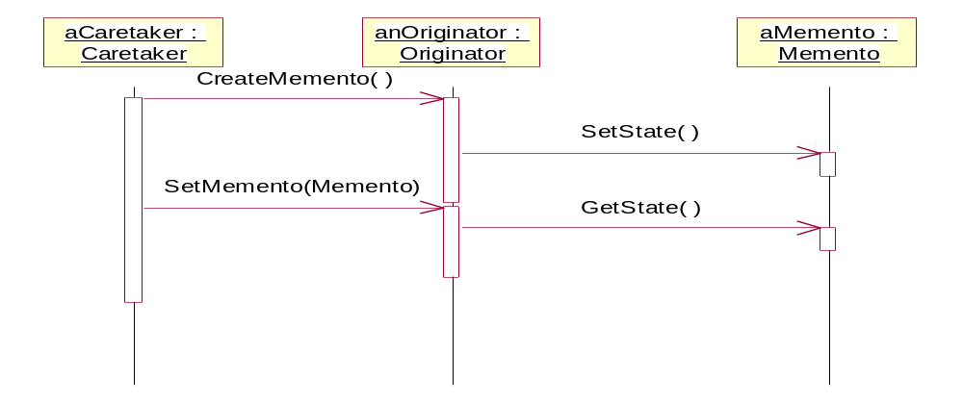
Collaborations
caretaker requests a memento from originator & eventually passes it back to originator
memento - passive

Slide 9
Consequences
preserving encapsulation boundaries
simplifies originator
  burden of managing versions of internal state on client
using mementos might be expensive
  large internal state ⇒ large memento
  frequent creation & returning of mementos ⇒ large overhead
defining narrow & wide interfaces
  implementation language - may not support multiple interfaces
hidden costs in caring for mementos
  caretaker - overhead costs in handling mementos

Slide 10
Implementation
language support
  C++
  Java
storing incremental changes
  memento - can save just incremental change
    undoable commands in history list - use mementos to be able to restore state
      ⇒ memento just needs to store incremental change caused by command

Slide 11
Sample Code
C++
Java

Slide 12
