Slide 1

Observer Pattern

Slide 2
Intent
define 1 to many dependency between objects so that when one object changes state - all dependents are notified & updated automatically

Slide 3
aliases
publish-subscribe

Slide 4
Motivation
consistency necessary between classes
many drawbacks with tightly coupled classes
subject & observer objects
  when subject is changed - observers are notified
  observer - query subject to get information necessary for the observer to change

Slide 5
Applicability
abstraction has 2 aspects - 1 dependent upon other
  encapsulation of 2 promotes reuse
when change to 1 object requires changing others & not known how many objects need changing
when object should notify other objects without specific knowledge of other objects

Slide 6
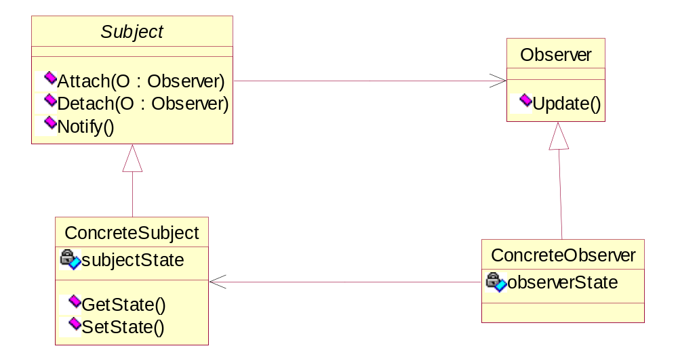
Structure

Slide 7
Participants
Subject
  knows it observers - arbitrary number
  provides interface for attaching & detaching Observer objects
Observer
  defines updating interface for objects that should be notified of changes

Slide 8
Participants con’t
ConcreteSubject
  stores state of interest to ConcreteObserver objects
  sends notification to its observers when state changes
ConcreteObserver
  maintains reference to ConcreteSubject object
  stores state that should stay consistent with the subject’s state
  implements Observer updating interface to keep its state consistent with the subject’s state

Slide 9
Collaborators
ConcreteSubject - notifies observers when a change occurs
after being informed of change - ConcreteObserver may query subject & then modify state

Slide 10
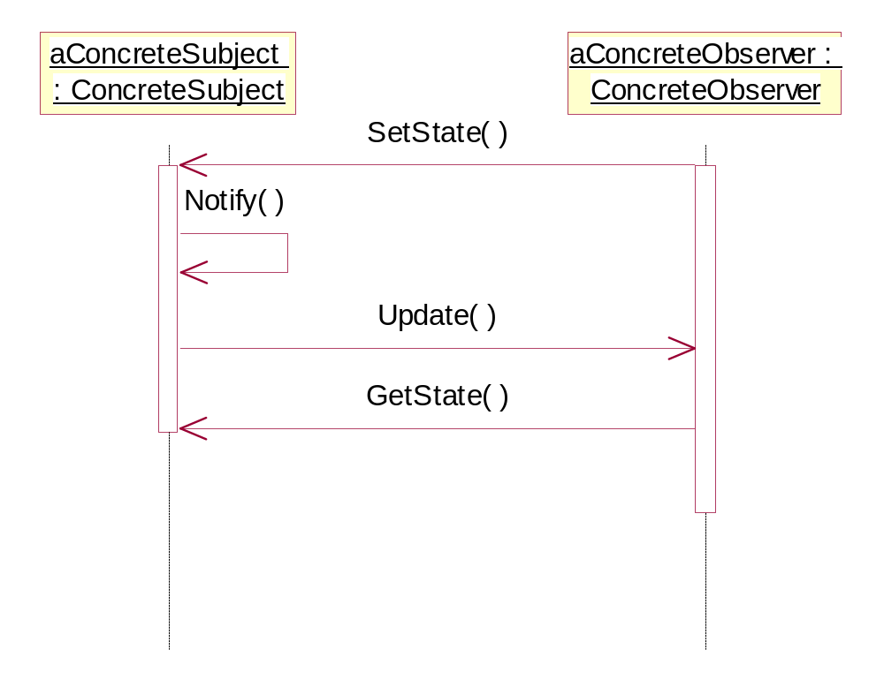

Slide 11
Consequences
vary subjects & observers independently
  greater reusability
abstract coupling between Subject & Observer
  can belong to different layers of abstraction
support for broadcast communication
  can add or remove observers dynamically

Slide 12
Consequences con’t
unexpected updates
  simple change in subject - can cause excessive change in observers
  observer
    just informed that the change was made
    may have no effect
    have to query to find out

Slide 13
Implementation
mapping subjects to observers
  subject could store references to observers
    could be expensive - duplicate information (multiple references to same observer)
  have separate storage - hash table
    increased access time
observing more than 1 subject
  need to extend notify operation to include which subject
  pass itself as a parameter

Slide 14
Implementation con’t
who triggers the update?
  state changing operations on Subject call Notify
    client does not need to know about notifying observers
    could have sequence of updates instead of 1 big update
  clients responsible for calling Notify
    avoid sequence of inefficient updates - just 1 update after changes have been made
    additional responsibility on client

Slide 15
Implementation con’t
dangling references to deleted subjects
  force subject to notify observers when being deleted
  generally - do not want to delete observers
making sure that Subject state is self-consistent before notification
    notification should occur only after update of subject is complete & class invariants have been reestablished

Slide 16
Implementation con’t
avoiding observer specific update protocols: push & pull models
  can have subject send information about update in notify
  extremes
    push model
      detailed information sent
      make observers less reusable
    pull model
      minimal information sent
      inefficient - observer has to query for needed information

Slide 17
Implementation con’t
specifying modifications of interest explicitly
  could extend subject’s registration interface
  register observers for only specific events
encapsulating complex update semantics
  ChangeMaster - object that captures dependency relationships between Subject & Observer

Slide 18
Implementation con’t
  minimize work for observers
    could buffer changes
    map subject to observer - provide an interface to maintain mapping
    update strategy
    updates all dependent observers at request of subject

Slide 19
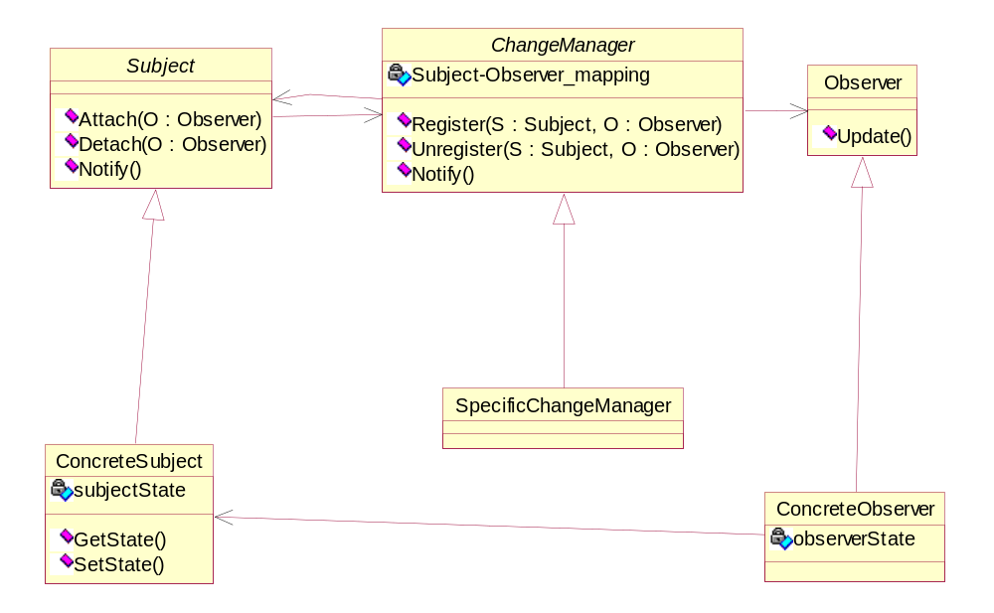

Slide 20
Sample Code
C++
Java

