Slide 1
Prototype Pattern

Slide 2
Intent
Specify kinds of objects to create using a prototypical instance
Create new objects by copying this prototype

Slide 3
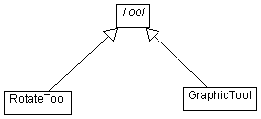
Motivation
Context: create editor for music scores from a general framework for graphical editors by adding new objects representing notes, rests, …
Problem – GraphicTool does not know anything about application specific objects (notes, rests, …)

Slide 4
Subclassing GraphicTool – leads to explosion in size of class hierarchy
One solution: have GraphicTool construct new graphics by “copying” an instance of a Graphic subclass
Instance – called prototype
GraphicTool – parameterized by prototype it should clone & add to document

Slide 5
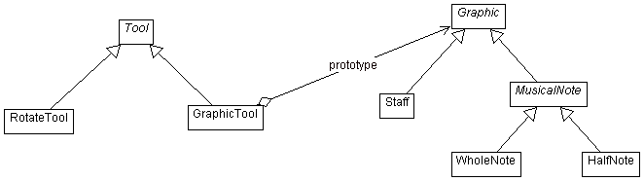

Slide 6
Applicability
System should be independent of how its products are created, composed, & represented and
  When classes to instantiate are specified at run-time
    or
  Avoid building class hierarchy of factories parallel to class hierarchy
    or
  When instances of class can have one of only a few different combinations of state
    Clone prototypes instead of manually instantiating classes

Slide 7
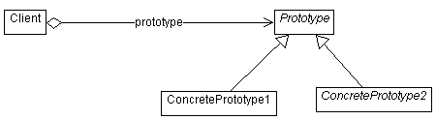
Structure

Slide 8
Participants
Prototype
  Declares an interface for cloning itself
ConcretePrototype
  Implements an operation for cloning itself
Client
  Creates new object by asking a prototype to clone itself

Slide 9
Collaborations
Client asks a prototype to clone itself

Slide 10
Consequences
Hides concrete product classes from client
Lets client work with application specific classes without modification
Client can install & remove prototypes at run-time
Can define new kinds of objects by instantiating existing classes & registering these instances as prototypes
  Delegate new responsibility to the prototype

Slide 11
Specifying new objects by varying structure
  Add composite object as a prototype
Reduced subclassing
Configuring an application with classes dynamically
  If classes can be loaded dynamically – system dependent
Each subclass of Prototype must implement clone operation
  Can be difficult depending upon structure of class

Slide 12
Implementation
Particularly useful in languages in which classes are not first-class objects
Using a prototype manager
  Keeps track of available prototypes
Implementing clone operation
  Difficult if object structure involves circular references
  Shallow copy vs. deep copy problem
Initialization of clones
  What should initial state be?

Slide 13
Sample Code
C++
Java

Slide 14
