Slide 1
Proxy Pattern

Slide 2
Intent
provide placeholder for another object to control access

Slide 3
Motivation
defer full cost of creation & initialization until needed

Slide 4
Applicability
whenever need more versatile reference than just pointer
remote proxy - provides local representative for an object in a different address space
virtual proxy - creates expensive objects on demand
protection proxy - controls access to original object
  different objects - have different access rights
Smart reference - performs additional operations when object is referenced
  counting number of references
  loading persistent object into memory
  lock manipulation

Slide 5
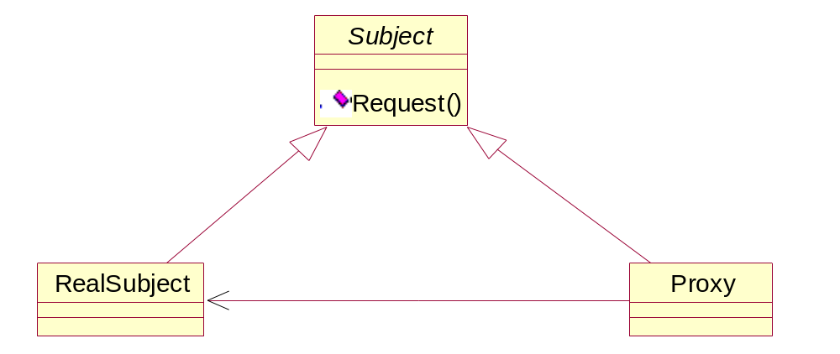
Structure

Slide 6
Participants
Proxy
  maintains reference that lets Proxy access real subject
  provides interface identical to Subject so that Proxy may be substituted for Subject
  controls access to RealSubject - possible creation & destruction
  remote Proxy - encode request with arguments - send to RealSubject
  virtual Proxy - may cache information
  protection Proxy - check permissions
Subject
  defines common interface
RealSubject
  defines real object

Slide 7
Collaborations
Proxy - forwards requests to RealSubject

Slide 8
Consequences
introduces level of indirection
  remote Proxy - can hide location of RealSubject
  virtual Proxy - optimization
  protection Proxy & smart references - additional housekeeping
can postpone copying process until necessary
  use reference counter - keep track of number of virtual copies

Slide 9
Implementation
can exploit certain language features
  C++
    class ImagePtr {
    public:
      ImagePtr (const char* imageFile);
      virtual ~ImagePtr ();
      virtual Image* operator -> ();
      virtual Image& operator * ();
    private:
      Image* LoadImage ();
      Image* _image;
      const char* _imageFile;
    };

Slide 10
Implementation con't
    Image* ImagePtr::operator -> ()
    { return LoadImage (); }
    Image& ImagePtr::operator * ()
    { return *LoadImage ();}
    Disadvantage: no ability of Proxy to control operation dependent access

Slide 11
Implementation con't
  Smalltalk - doesNotUnderstand
    message sent by client which receiver does not understand
    can be redefined by Proxy
Proxy - does not have to know type of real subject
  abstract interface to real subject

Slide 12
Sample Code
C++
Java

Slide 13
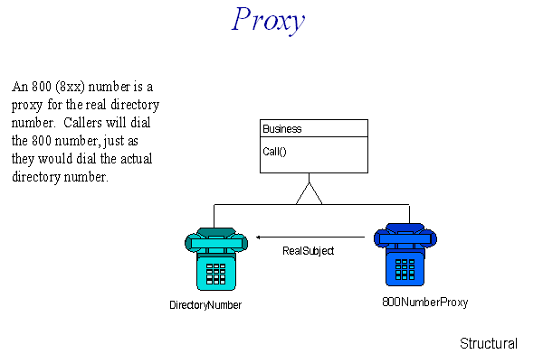

Slide 14
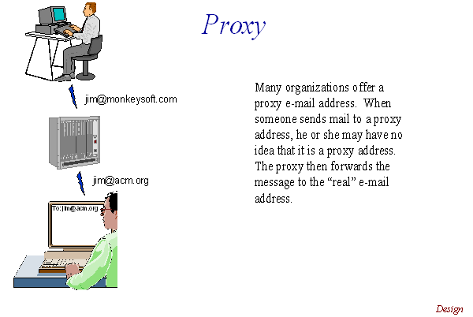

Slide 15
