Slide 1
Proxy and Stairway to Heaven
Managing Third Party API’s
by
Robert Martin

Slide 2

Incorporating 3rd Party API’s in Model Code
Tends to hide logical model
Binds logical model to 3rd party API
Example – on line ordering system

Slide 3
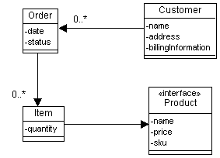

Slide 4
public void addItem (Product p, int qty, String sku)
{
Item item = new Item (p, qty, sku);
itsItems.add(item);
}
public void addItem (int orderId, String sku, int qty)
{
Statement s = itsConnection.CreateStatement();
S.executeUpdate ("insert into items values(" +
orderId + ", " + sku + ", " + qty + ")");
}

Slide 5
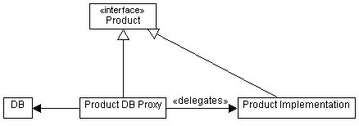
Proxy Static Model

Slide 6
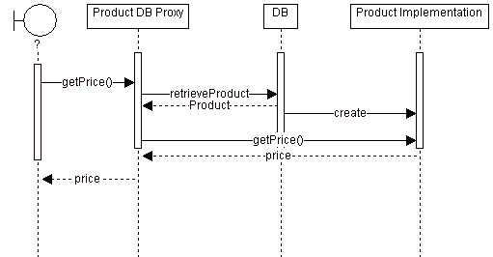
Proxy Static Model

Slide 7
Analysis of Proxy Model
Actual creation of Proxy Implementation Object is optional
  Depends upon whether there are business rules in the Proxy Implementation class
Client & Product Implementation objects are not aware of ProductDBProxy

Slide 8
Analysis of Proxy Implementation
Product implementation class adds nothing
  Case where we do not use separate implementation class
Order implementation class add business rules in calculating total

Slide 9
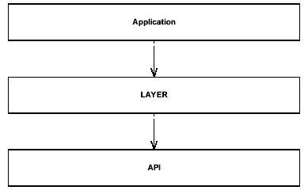

Slide 10

Third Party API’s
LAYER – all code using 3rd party API & all concepts related to API rather than business rules
ODBC & JDBC – examples of such layers
Application may need to be insulated from LAYER
Transitive dependency from application to API
Need to invert dependency between application & LAYER

Slide 11
Accomplished by proxy pattern
Large concentration of knowledge concentrated in Proxy
  “nightmares” concentrated in proxies
Use proxies if
  Frequent schema changes
  API thrashing
  Potentially different database engines or middleware engines

Slide 12
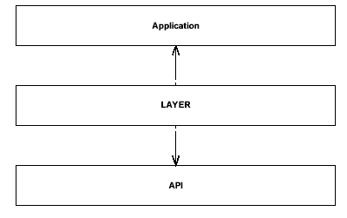

Slide 13
