Slide 1
Singleton Pattern

Slide 2
Intent
Ensure class only has 1 instance
Provide global access to it

Slide 3
Motivation
Many cases where need only 1 object of a particular class

Slide 4
Applicability
Must have only 1 instance of a class & have a well-known access point
When only instance should be extended by subclassing - classes should not have to modify code to use extended instance

Slide 5
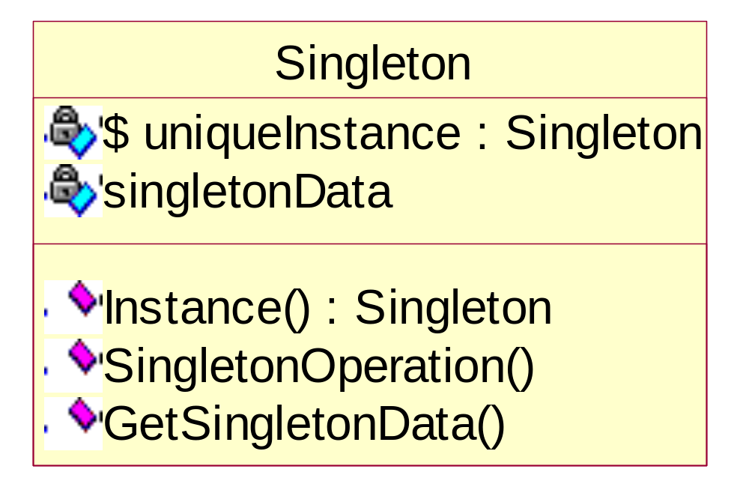
Structure

Slide 6
Participants
Singleton
  Defines an Instance operation (class operation) that lets clients access its unique instance
  May be responsible for creating its own unique instance

Slide 7
Collaborations
Clients access a Singleton instance solely through Singleton's interface

Slide 8
Consequences
Controlled access to sole instance
Reduced name space
  Avoids global variables
Permits refinement of operations & representation
  Subclassing allows selection at run-time
Permits variable number of instances
  Change operation that grants access to the Singleton instance
More flexible than class operations
  Static functions in C++ - cannot be virtual

Slide 9
Implementation
Ensuring a unique instance
  Can hide operation that creates the instance behind a class operation
    Can guarantee that creation & initialization occur correctly
  Since _instance is a pointer to a Singleton object - change can be made at run-time to a different Singleton object (subtyping)
  Allows instantiation of object at time client specifies
    Static initialization time is not under control of client

Slide 10
Subclassing the Singleton class
  Question: which subclass instance
    Put decision in Singleton's Instance operation
    Put implementation of Instance in subclass
      ⇒ programmer needs to select correct subclass
    Registry of singletons
      Singleton classes - register their singleton instance in a known location
      Registry - maps between string names & singletons
        When singleton is needed - registry is searched
        ⇒ common interface required for all Singleton classes
      registration - cannot occur in constructor – circular
      Workaround
        static implementation of each subclass & have constructor register subclass singleton

Slide 11
Code
C++
Java

Slide 12
