Slide 1
State Pattern

Slide 2
Intent
allow an object to alter its behavior when its internal state changes

Slide 3
Motivation
consider a class TCPConnection for network connection
  possible states: established, listening, closed
  response to requests depends upon current state
  introduce abstract class TCPState - represent states of network connection
    establish common interface
    subclasses - state specific
  TCPConnection - maintains a state object
    delegates all state specific requests to state object
    ⇒ can change state by changing TCPState subclass

Slide 4
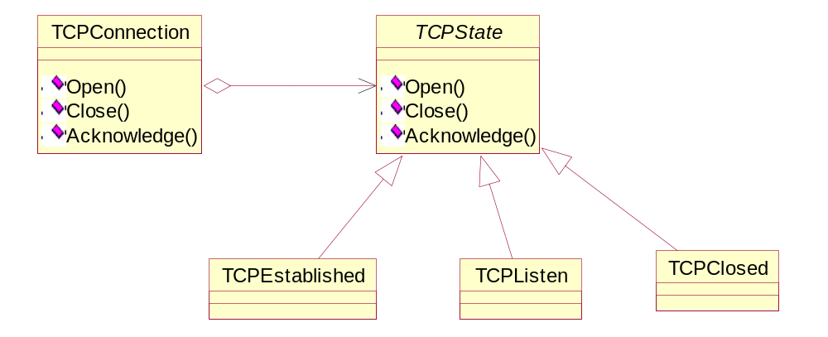

Slide 5
Applicability
object's behavior depends upon its state
  change behavior at run-time depending upon state
operations have large multipart selection structures - different options for each state
  ⇒ each option in a separate class

Slide 6
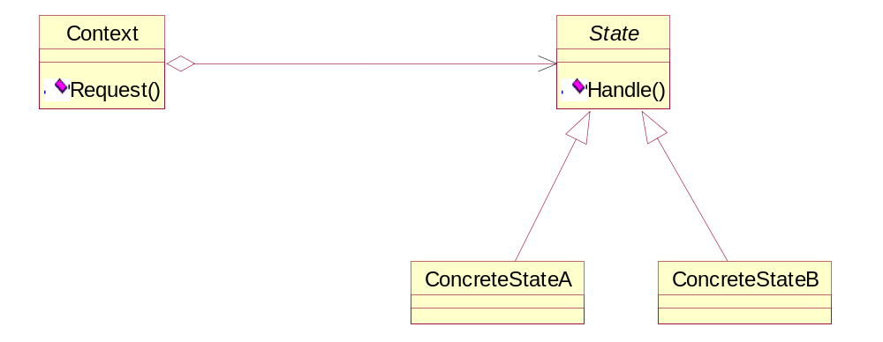
Structure

Slide 7
Participants
Context
  defines interface for client
  maintains instance of ConcreteState subclass
State
  defines interface for behavior associated with state
ConcreteState subclasses
  implements behavior associated with a particular state

Slide 8

Collaborations
Context delegates state specific requests to current ConcreteState object
Context - can pass itself as an argument to ConcreteState object
Context - primary interface for clients
  clients - do not need to deal with State directly
Context or ConcreteState object - can decide changing of ConcreteState object

Slide 9
Consequences
localizes state specific behavior
  easy to add new states - new concrete subclasses
  increases size of class structure
makes state transitions explicit
  eliminates potential for inconsistent internal states
state objects can be shared
  if have no instance variables

Slide 10
Implementation
who defines state transitions?
  fixed criteria - can be implemented in Context
  more flexible - implement in State subclasses
    need ability for State to see Context
    State subclass - must have knowledge of other State subclasses
      ⇒ dependencies

Slide 11
Implementation (cont)
table based alternative
  table - map inputs to transitions
    converts selection structure to table look-up
  change transition criteria by changing table - not code
  disadvantages
    table look-up - possibly less efficient than virtual function call
    more difficult to follow transition criteria
    difficult to add actions to accompany state transitions

Slide 12
Implementation (cont)
  difference
    table driven - focuses on defining state transitions
    State pattern - models state specific behavior
creating & destroying State objects
  create State objects only when needed & destroy them when no longer needed
    preferable when don't know in advance when states will be needed & have infrequent state changes

Slide 13
Implementation (cont)
  create all State objects ahead of time & do not destroy them
    preferable when state changes occur frequently
    Context - must keep references to all create State objects
using dynamic inheritance
  change object's class at run-time
    not supported by most languages

Slide 14
Sample Code
C++
Java

Slide 15
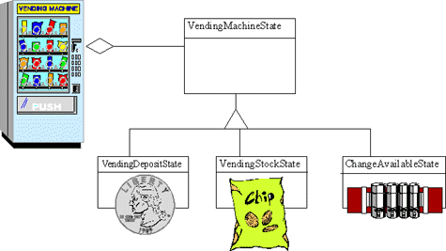

Slide 16
