Slide 1
Strategy Pattern

Slide 2
Intent
define family of algorithms, encapsulating each one, & make them interchangeable
let algorithm vary independently from clients

Slide 3
Motivation
linebreaking algorithms - do not want to hard code
  put code in clients ⇒ clients much more complex
  different algorithms - appropriate at different times
  difficult to add new algorithms or modify existing ones
encapsulate different linebreaking algorithms in a class - strategy class

Slide 4
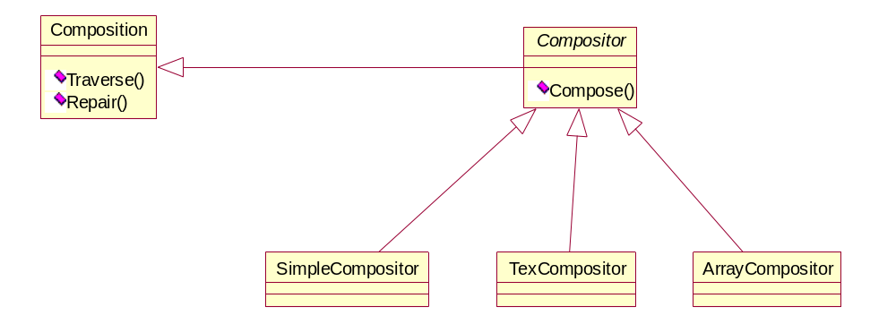
Motivation con't

Slide 5
Motivation con't
composition class - responsible for maintaining & updating linebreaks of text
linebreaking strategies - implemented in subclasses of abstract Compositor class
  SimpleCompositor - determines linebreaks 1 at a time
  TeXCompositor - TeX algorithm for finding linebreaks
    uses global optimization

Slide 6
Motivation con't
  ArrayCompositor - each row has fixed number of items
Composition - maintains reference to a Compositor object

Slide 7
Applicability
Many related classes differ only in their behavior
need different variants of an algorithm
algorithm uses data that clients should not know about
    hide in strategy class
class defines many behaviors
move conditional branches into own Strategy class

Slide 8
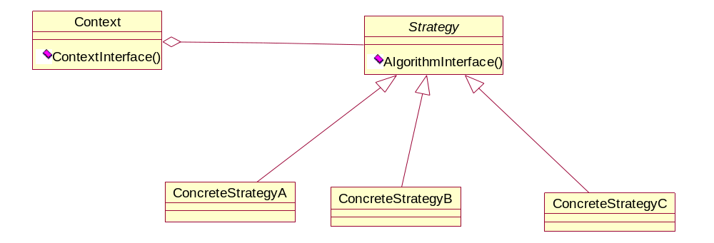
Structure

Slide 9
Participants
Strategy
  declares common interface to all algorithms
ConcreteStrategy
  implements algorithm using Strategy interface
Context
  configured with ConcreteStrategy object
  maintains reference to a Strategy object
  define interface to let Strategy access data

Slide 10
Collaborations
Strategy & Context - interact to implement algorithm
  Context - pass data to Strategy
  Context - pass itself as an argument to Strategy
Context - forwards requests from client to Strategy

Slide 11
Consequences
families of related algorithms
  hierarchies of Strategy classes - family of algorithms
  can factor out common functionality with inheritance
alternative to subclassing
  subclassing Context - hardcodes behavior into subclass
  makes Context harder to understand

Slide 12
Consequences con't
strategies eliminate conditional statements
  encapsulate different possible behaviors in different concrete strategy classes
  without strategies
    void Composition::Repair () {
      switch (_breakingStrategy) {
        case SimpleStrategy:
        ComposeWithSimpleCompositor ();
        break;
        case TeXStrategy:
        ComposeWithTeXCompositor ();
        break; } }

Slide 13
Consequences con't
  using strategies
    void Composition::Repair ()
    {
      _composition -> Compose ();
    }

Slide 14
Consequences con't
choice of implementation
  client can choose strategy with best time/space tradeoff
clients must be aware of different strategies
  client - must understand how strategies differ
    ⇒ implementation issues

Slide 15
Consequences con't
communication overhead between Strategy & Context
  strategy classes all have same interface
    ⇒ get same arguments whether or not data is needed
increased number of objects
  if strategy object is stateless - can be shared using Flyweight pattern

Slide 16
Implementation
defining strategy & context interfaces
  each must have sufficient access to the other
  Context pass data to Strategy
    decouples
    potential influencing - passing data that is not needed
  Context pass itself as an argument
    Strategy - gets data directly from Context
  Strategy - store reference to Context
  consequences of last 2 alternatives
    wider interface for Context
    more strongly coupled

Slide 17
Implementation con't
strategies as template parameters
  strategy must be selected at compile time & does not have to be changed at run-time
  template <class AStrategy>
  class Context {
    void Operation () {theStrategy. DoAlgorithm ();}
  private:
    Astrategy theStrategy };

Slide 18
Implementation con't
  class MyStrategy {
  public:
    void DoAlgorithm (); };
  Context<MyStrategy> aContext;
making strategy objects optional
  Context - checks to see if it has a strategy object
  if yes - calls it - otherwise performs default operation

Slide 19
Sample Code
C++
Java

