Slide 1
Visitor Pattern

Slide 2
Intent
represent an operation to be performed on elements on an object structure
define new operations without changing classes

Slide 3
Motivation
compiler which represents programs as abstract syntax trees
  ⇒ variety of operations to be performed on abstract syntax tree
operations - treat the different types of nodes in abstract syntax tree differently
particular set of nodes - depend upon language

Slide 4
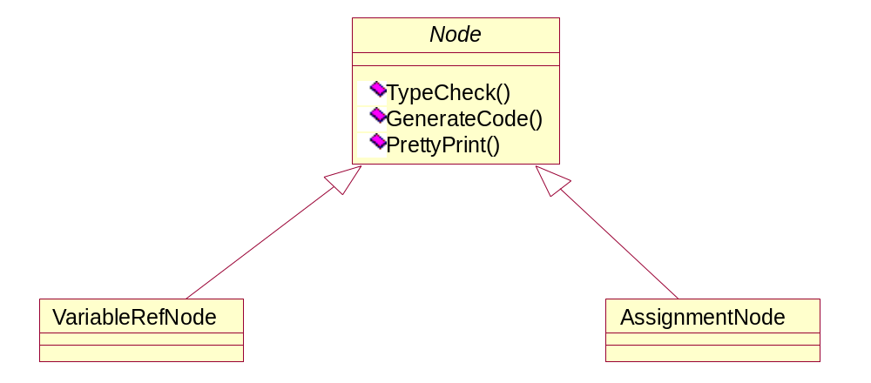

Slide 5
this approach is very difficult to maintain & modify
package related operations from each class in a separate object – visitor
  pass to visitor elements of abstract syntax tree as it is being traversed
  when an element accepts the visitor, it sends a request to the visitor that encodes the element's class
  visitor executes operation for that element
  abstract NodeVisitor class
declare an operation for each node class
  specific applications - declare concrete subclasses
    ⇒ operations are encapsulated in subclasses

Slide 6
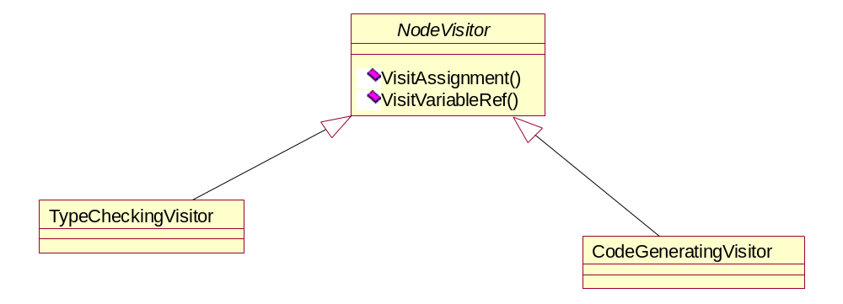
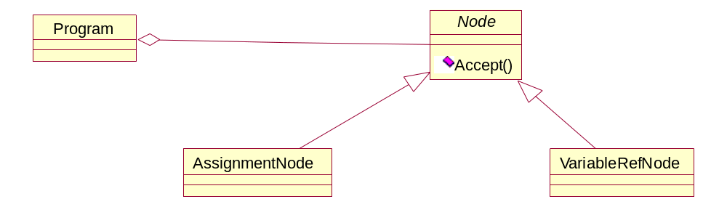

Slide 7
Applicability
object structure contains many classes of objects with differing interfaces
  perform operations on these objects - depend upon their concrete classes
many distinct & unrelated operations performed on objects in object structure
  keeps node class structure simpler
  application just uses visitor classes it needs
classes defining object structure seldom change - often add new operations

Slide 8
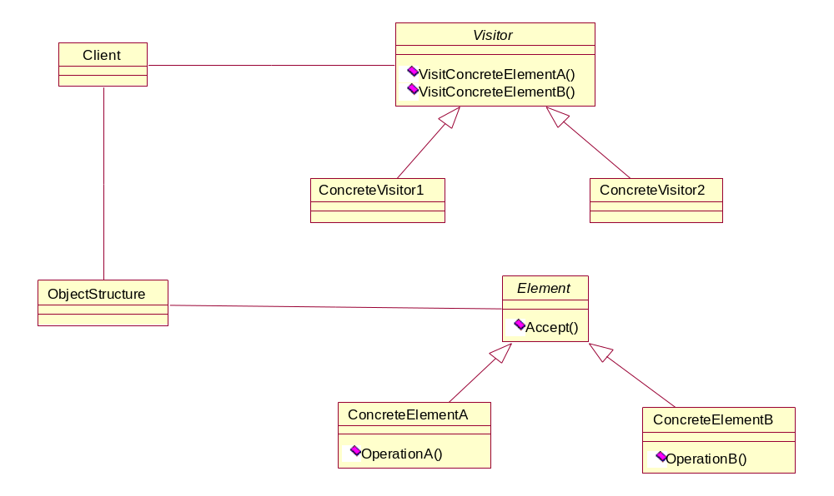
Structure

Slide 9
Participants
Visitor
  Declares Visit operation for each class of ConcreteElement in object structure
  operation signature identifies class that sends Visit request to visitor
  ⇒ visitor can access element
ConcreteVisitor
  implements each operation declared by Visitor
  operation - implements part of algorithm corresponding to object
  provides context for algorithm & stores local state

Slide 10
Element
  defines Accept operation that takes a visitor as an argument
ConcreteElement
  implements an Accept operation that takes a visitor as an argument
ObjectStructure
  can enumerate its elements
  Provide high-level interface to allow visitor to visit its elements
  may be a composite or a collection

Slide 11
Collaborations
client that uses Visitor pattern - must create a ConcreteVisitor object & then traverse object structure visiting each element with the visitor
when an element is visited - calls Visitor operation that corresponds to its class

Slide 12
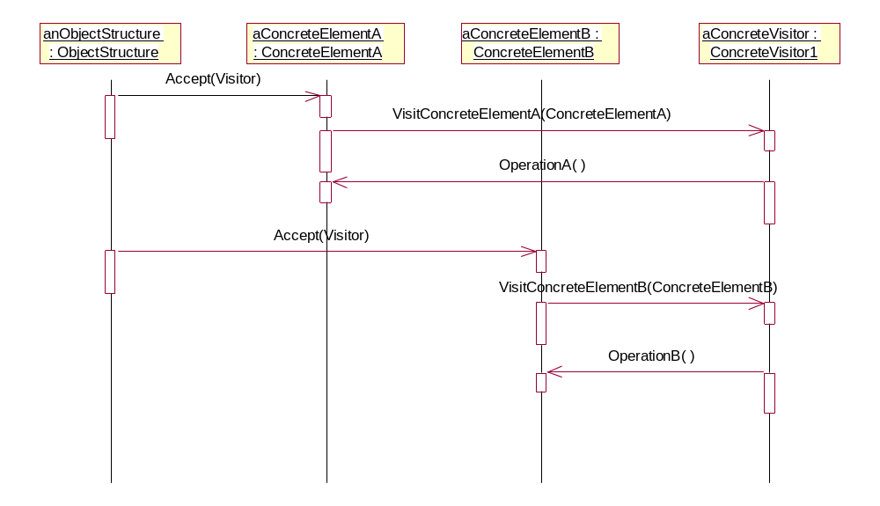

Slide 13
Consequences
visitor makes adding new operations easy
  add a new operation by adding a new visitor
visitor gathers related operations & separates unrelated ones
  related behavior - localized in a visitor
  ⇒ algorithm specific data structures - hidden in visitor
adding new ConcreteElement is difficult
  requires adding new operation in Visitor class & new implementation in each ConcreteVisitor class

Slide 14
Visiting across class hierarchies
  iterator pattern requires all objects in structure being traversed to be related via inheritance
  no such restriction on visitor pattern
accumulating state
  visitor can accumulate state as visits each element
  state - does not have to appear in interface
breaking encapsulation
  ConcreteElement interface must allow visitor to do its job
  ⇒ might require exposing more through interface

Slide 15
Implementation
abstract visitor class declares VisitConcreteElement operation for each class of ConcreteElement
each visit operation declares its argument to be a specific ConcreteElement
ConcreteVisitor classes - override each Visit operation to implement visitor specific behavior
  class Visitor {
  public:
    virtual void VisitElementA (ElementA*);
    virtual void VisitElementB (ElementB*);
  protected:
    Visitor ();
  };

Slide 16
each class of ConcreteElement implements Accept operation - calls corresponding Visit operation
  ⇒ operation called depends upon class of element & class of visitor
could use operator overloading
  class Element {
  public:
    virtual ~Element ();
    virtual void Accept (Visitor&) = 0;
  protected:
    Element ();
  };

Slide 17
class ElementA : public Element
{
public:
  Element A ();
  virtual void Accept (Visitor& v) {v.VisitElementA (this);}
};

Slide 18
class ElementB : public Element
{
public:
  ElementB ();
  virtual void Accept (Visitor& v) {v.VisitElementB (this);}
};

Slide 19
class CompositeElement : public Element
{
public:
  virtual void Accept (Visitor&);
private:
  List<Element*>* _children;
};

Slide 20
void CompositeElement::Accept (Visitor& v)
{
  ListIterator <Element*> I(_children);
  for (I.Front (); !I.IsDone (); I.Next ())
    I.CurrentItem () -> Accept (v);
  v.VisitCompositeElement (this);
}

Slide 21
Implementation issues
  double dispatch
    add operations to classes without changing the classes
    operation getting executed - depends on kind of request & types of 2 receivers
who is responsible for traversing the object structure
  object structure
    Accept operation – traverse composite element's children calling Accept recursively on each one
  Iterator
    internal or external
  Visitor
    duplication - in each ConcreteVisitor
    can let traversal depend on result of operations on object structure

Slide 22
Sample Code
C++
Java

Slide 23
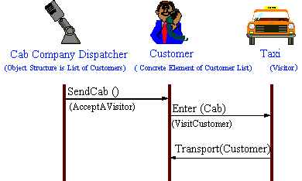

Slide 24
