Slide 1


MOSFET Channel Engineering and Scaling Study using COMSOL® Multiphysics Simulation Software
Divas Subedi ’22
Dr. Deborah A. Fixel
Department of Engineering, Trinity College,
Hartford, CT 06106, USA
October 3, 2019

Slide 2
Overview
Structure of MOSFET
Short Channel effect
FIBMOS and its Structure
Methods
Results
Conclusion

Slide 3
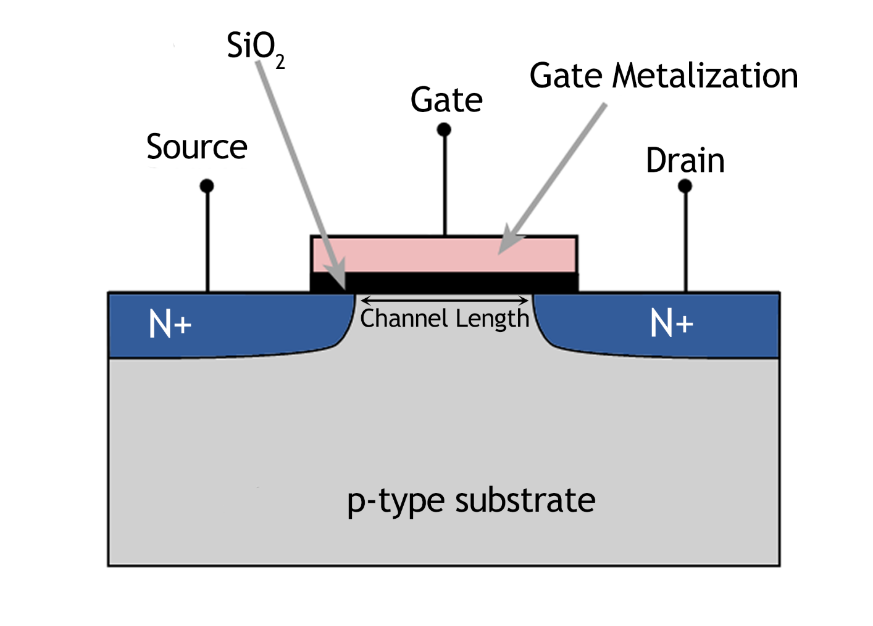
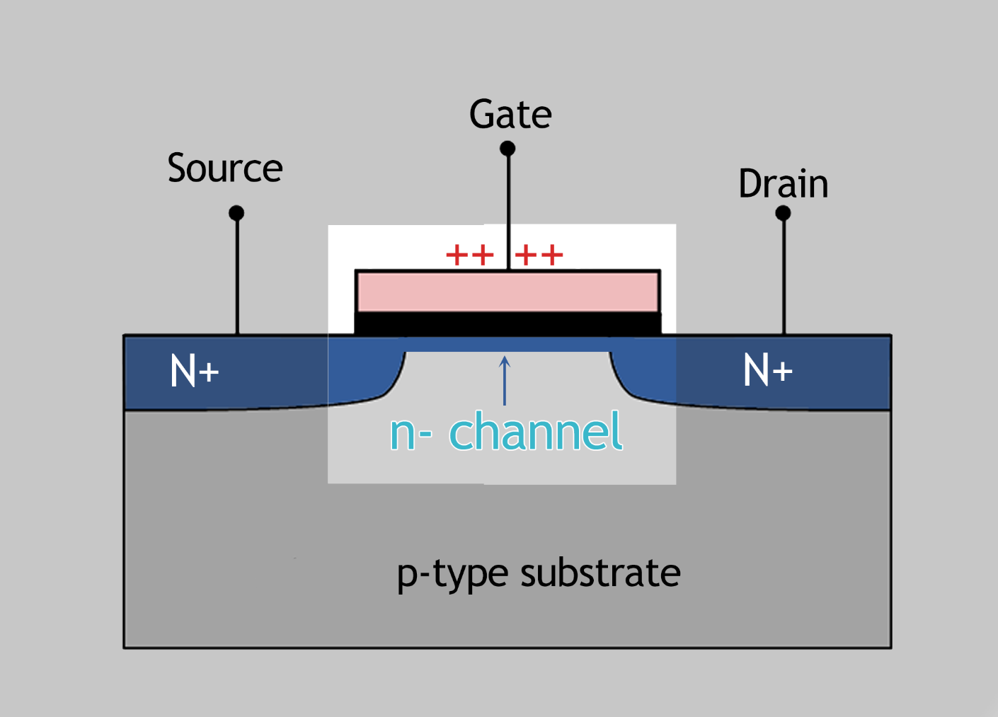
MOSFET
Fig 1. Structure of an n-type MOSFET

Slide 4
Short Channel Effects
Threshold instability
Punchthrough effect
Reduced Output resistance
Hot electron degradation
Notes:
Threshold instability
- Decreasing voltage as there is CEFS
Punchthrough effect
- Current without reaching the threshold
Reduced Output resistance
- Current increases even after saturation
Hot electron degradation
- Higher Electrical Field means more energetic electron which inject into the gate

Slide 5
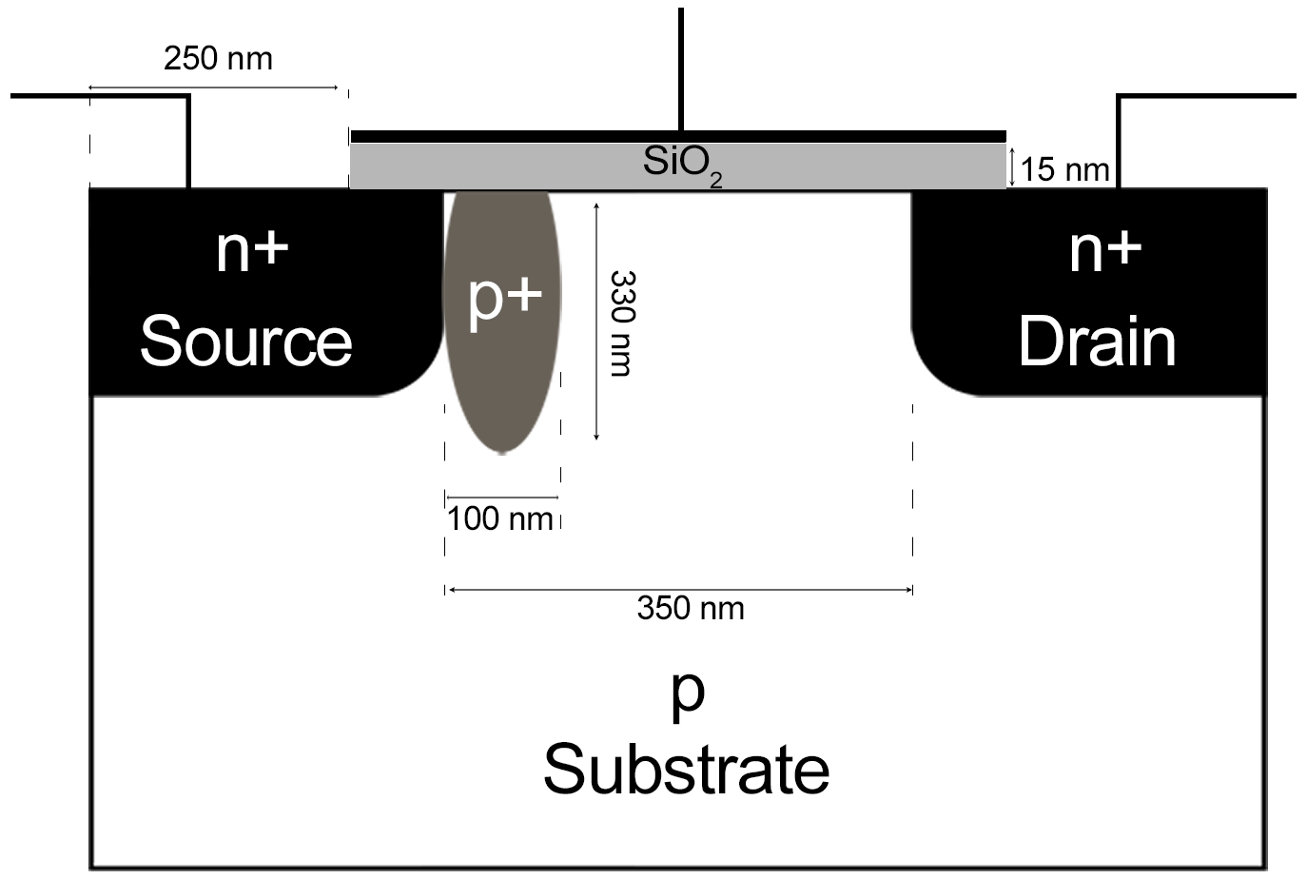
FIBMOS
Fig 2. Device Structure of FIBMOS

Slide 6
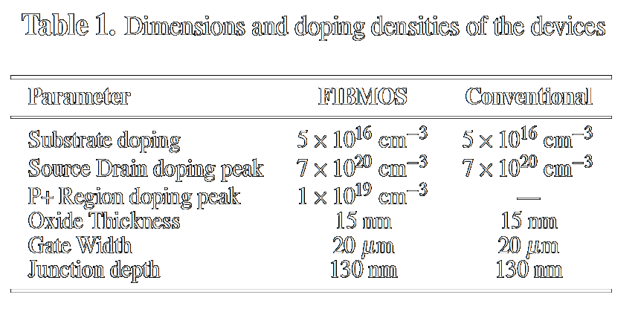
Device Parameters

Slide 7
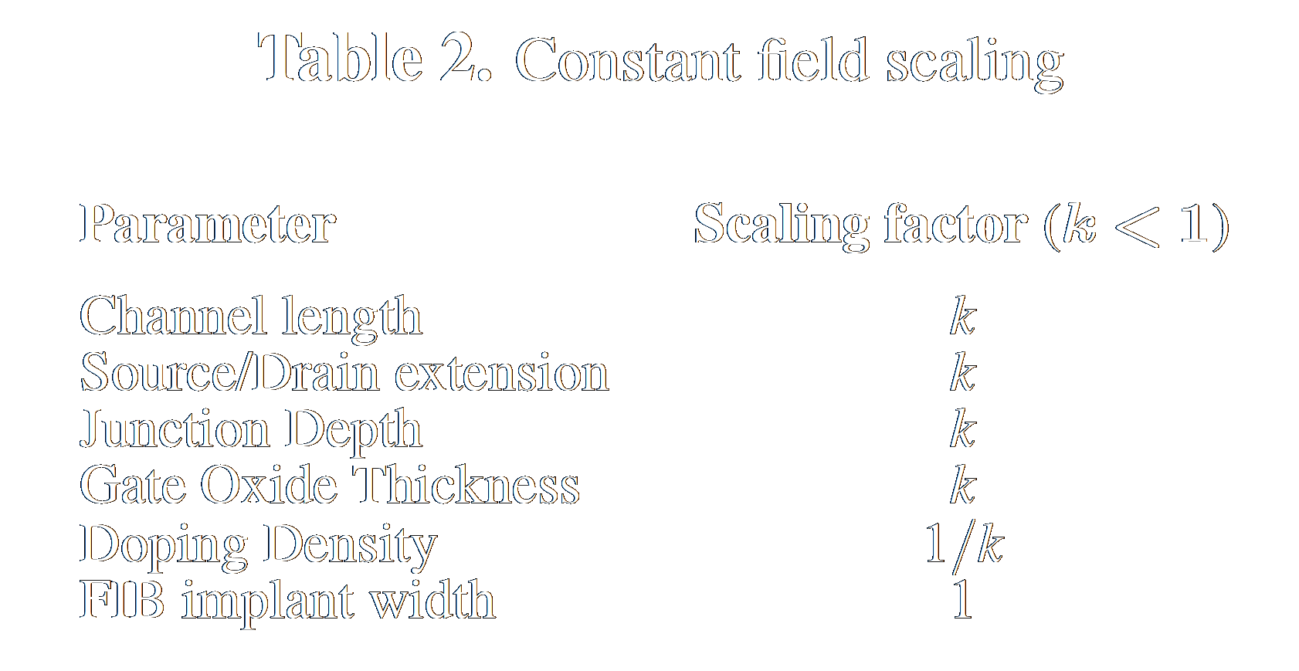
Constant Field Scaling

Slide 8
METHODS
Semiconductor Module was used in order to design the devices and perform study on them
350-nm devices were designed and were scaled further down by factor of k = {0.7, 0.5, 0.35} that is channel length of {245-nm, 175-nm, 122.5-nm} using parametric sweep
Two different user-defined mesh were made according to needs of the simulation
Mobility Model and Recombination Model were implemented to increase fidelity of the physics
Solver settings were changed accordingly to facilitate the models used and to converge to a solution
Fermi-Dirac Distribution of particle was implemented

Slide 9
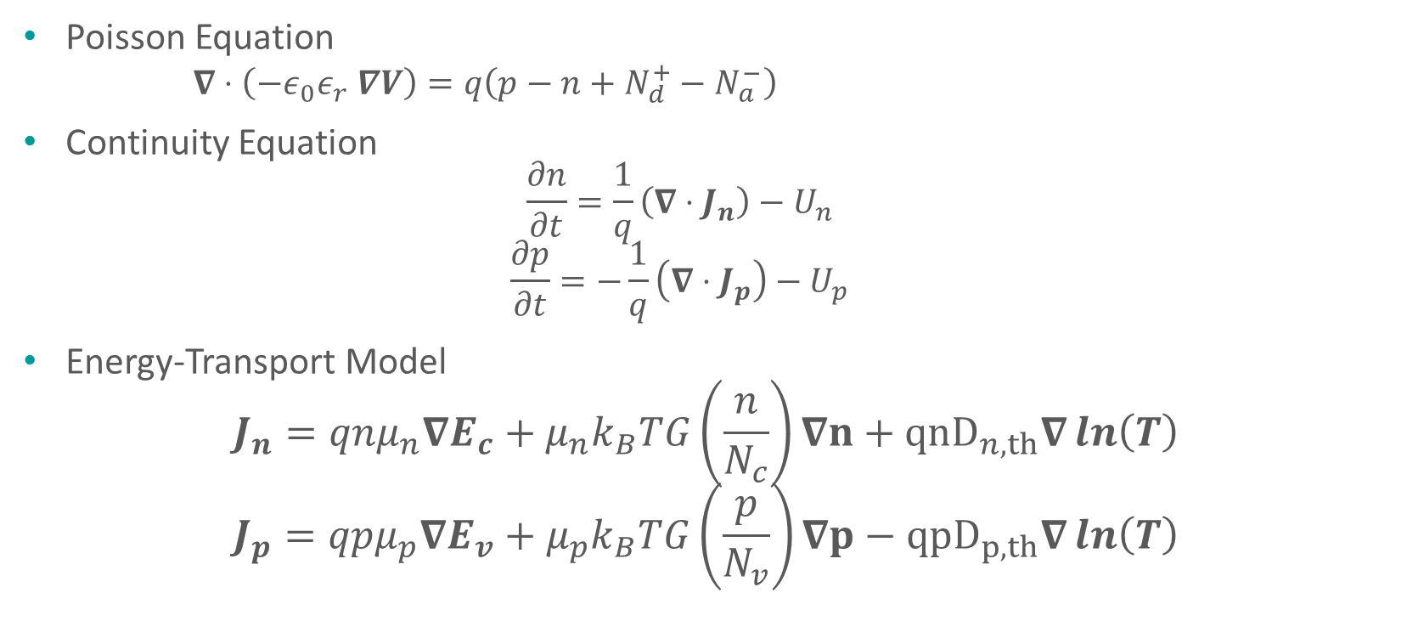
Equation Used
Poisson Equation
$∇⋅\left(−ε_{0}ε_{r} ∇V\right)=q\left(p−n+N_{d}^{+}−N_{a}^{−}\right)$
Continuity Equation
$$\frac{∂n}{∂t}=\frac{1}{q}\left(∇⋅J_{n}\right)−U_{n}$$
$$\frac{∂p}{∂t}=−\frac{1}{q}\left(∇⋅J_{p}\right)−U_{p}$$
Energy-Transport Model
$$J_{n}=qnμ_{n}∇E_{c}+μ_{n}k_{B}TG\left(\frac{n}{N_{c}}\right)∇n+{qnD}_{n,th}∇\ln\left(T\right)$$
$$J_{p}=qpμ_{p}∇E_{v}+μ_{p}k_{B}TG\left(\frac{p}{N_{v}}\right)∇p−{qpD}_{p,th}∇\ln\left(T\right)$$

Slide 10
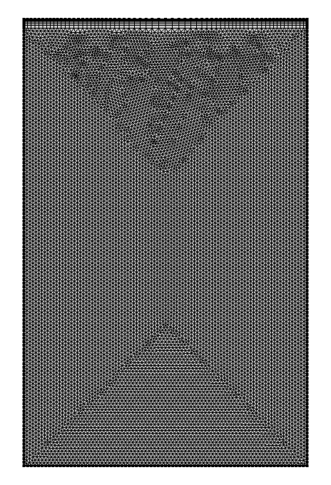
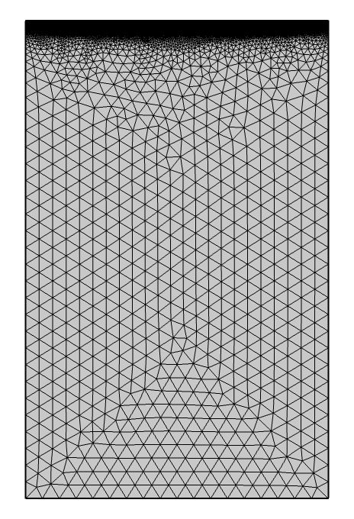
Mesh
24592 domain elements
398 boundary elements
25910 domain elements
1068 boundary elements
Fig 3. User-defined meshes

Slide 11
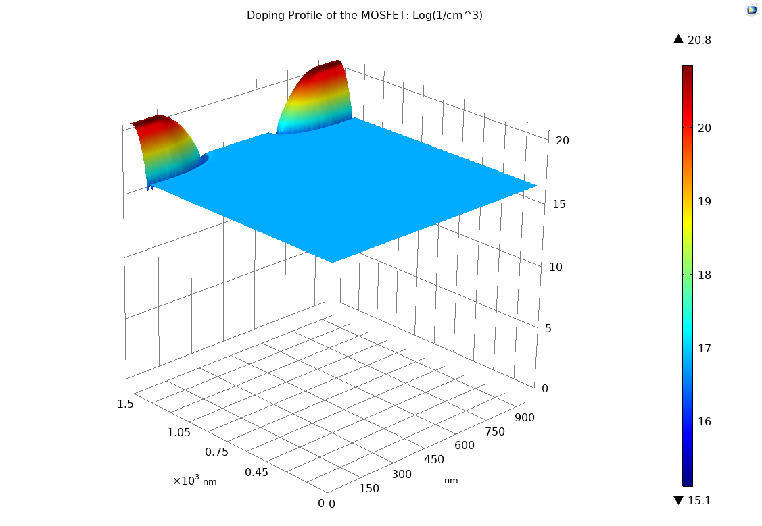
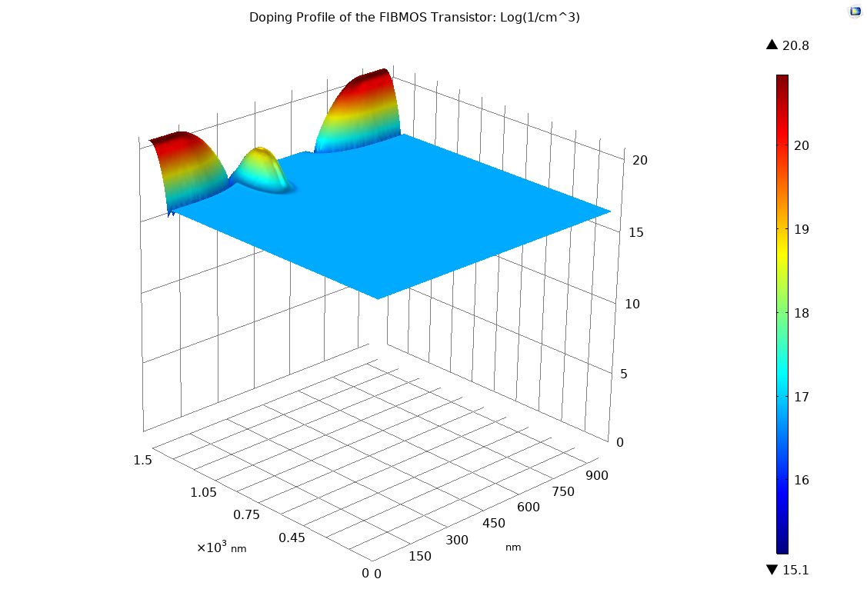
Doping Profile
(a)
(b)
Fig 4. Doping Profile of (a) MOSFET and (b) FIBMOS device

Slide 12
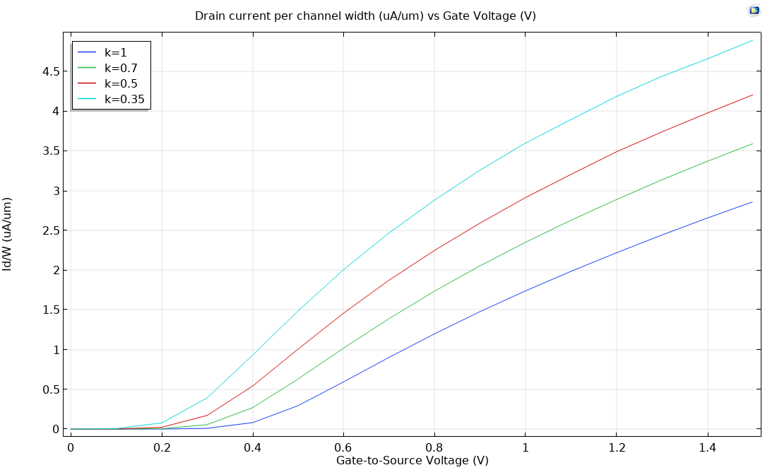
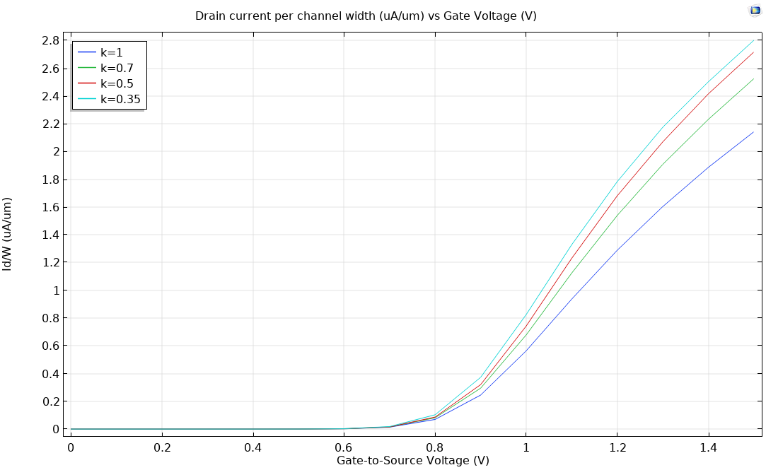
Transfer Characteristics
(a)
(b)
Fig 5. Transfer Characteristics of (a) MOSFET and (b) FIBMOS device

Slide 13
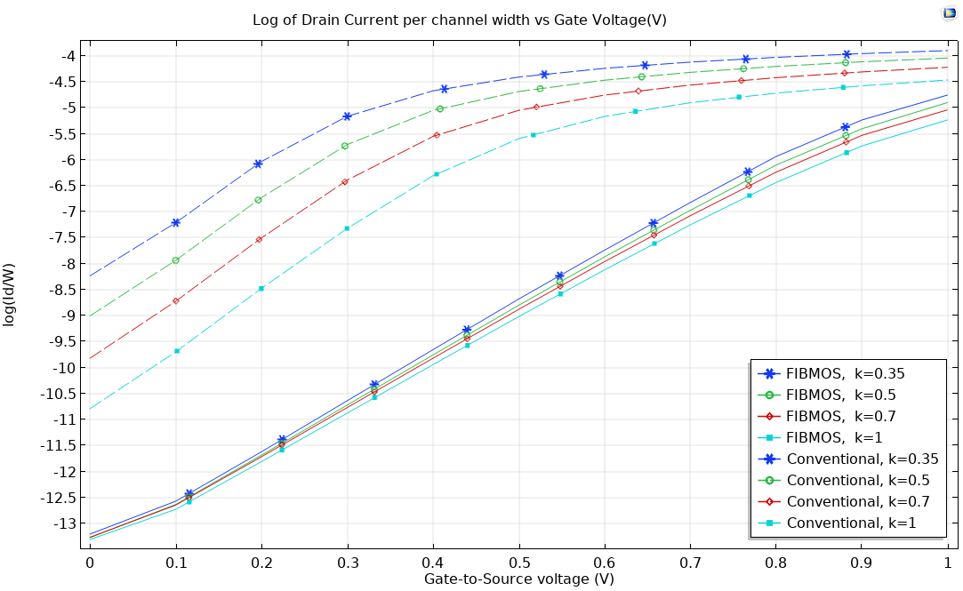
Subthreshold Conduction
Fig 6. Subthreshold current of MOSFET (dashed) and FIBMOS device (solid)

Slide 14
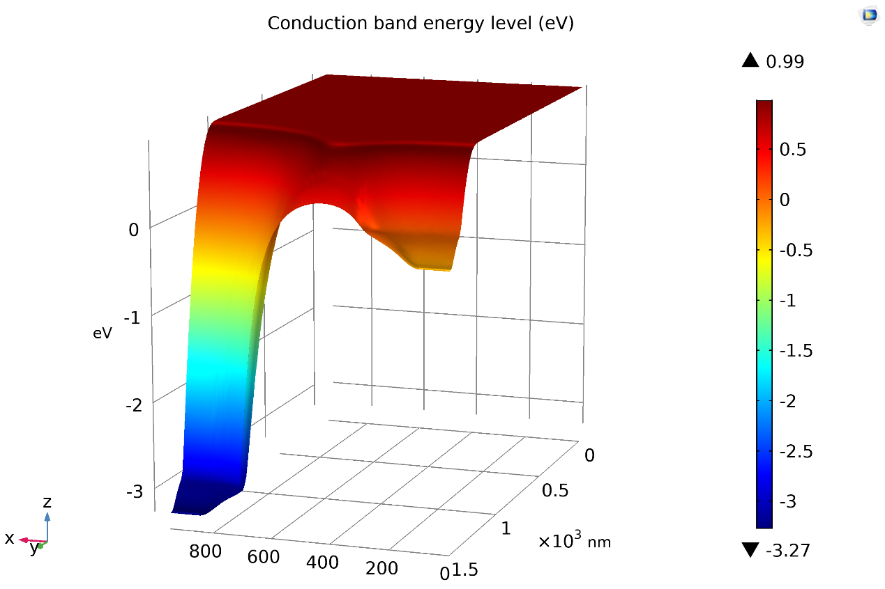
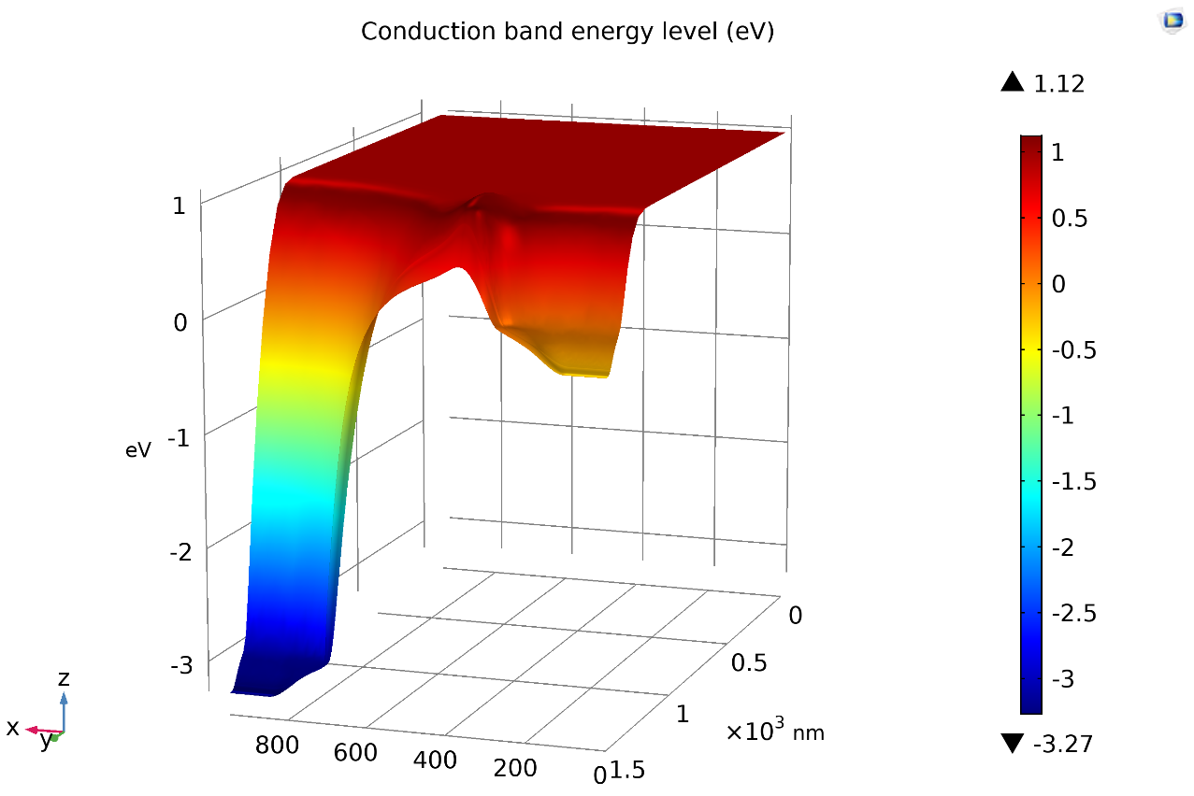
Conduction band energy level
(a)
(b)
Fig 7. Conduction band energy level of (a) MOSFET and (b) FIBMOS device

Slide 15
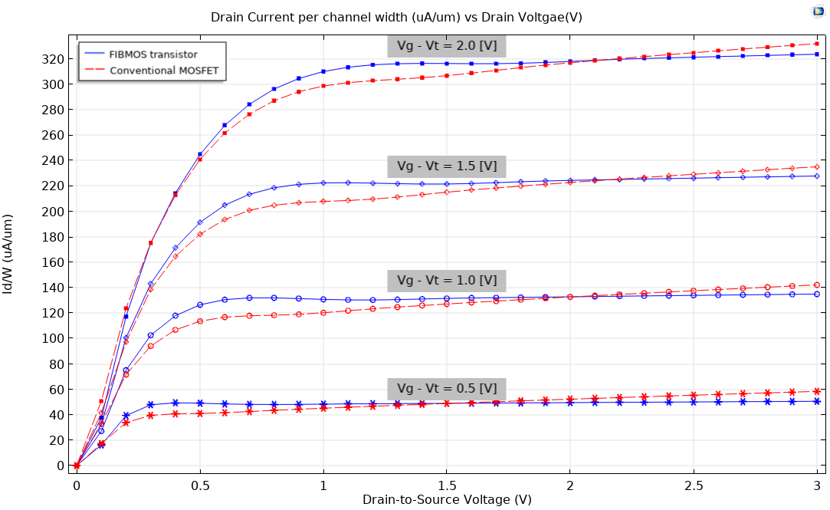
Output Characteristics
Fig 8. Output Characteristics of MOSFET (red) and FIBMOS device (blue)

Slide 16
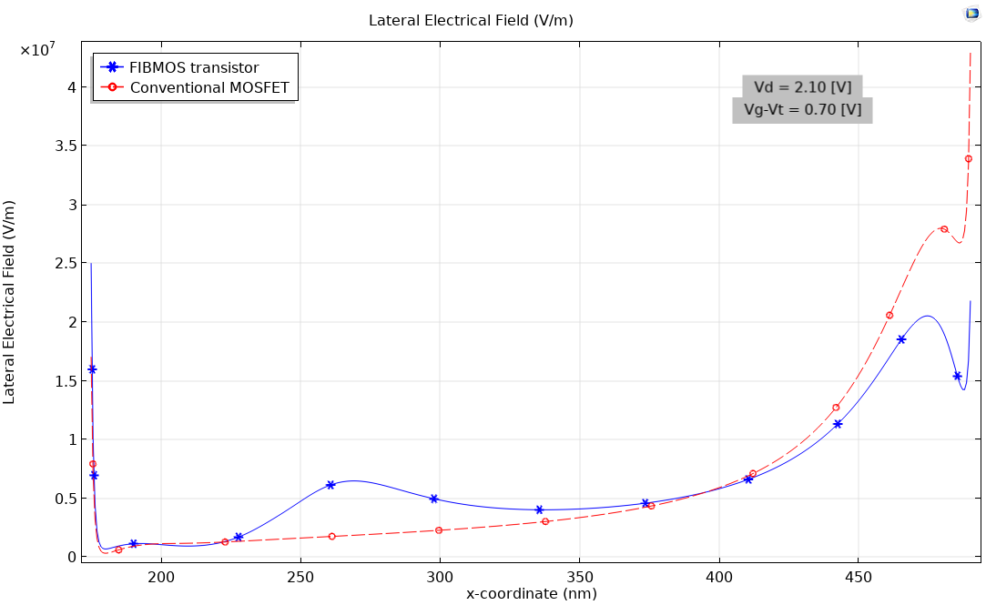
Lateral Electrical Field
Fig 9. Lateral Electrical Field inside the channel of MOSFET (red) and FIBMOS device (blue)

Slide 17
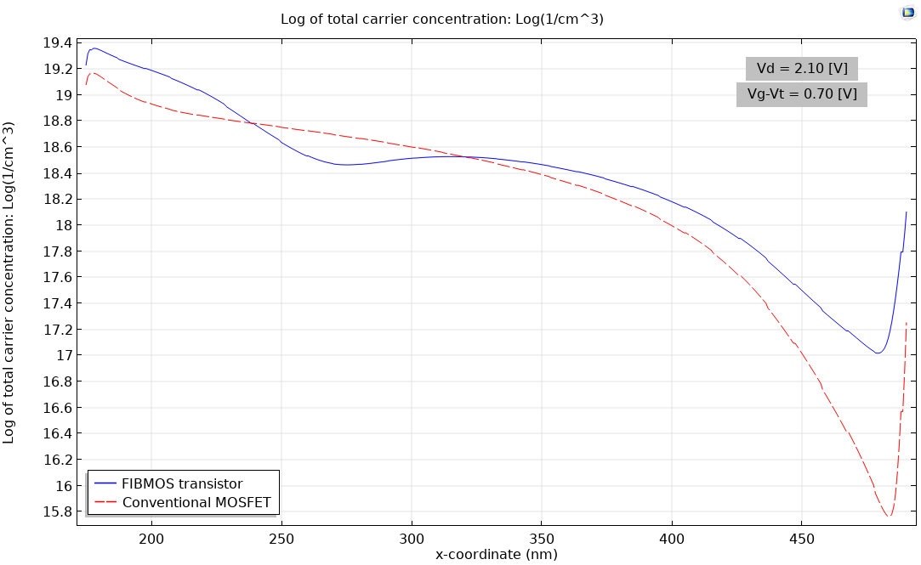
Electron Concentration inside the channel
Fig 10. Electron Concentration inside the channel of MOSFFET (red) and FIBMOS device (blue)

Slide 18
Conclusion
Threshold stability
Greater resistance against Punchthrough effect
Higher Output resistance
Greater resistance against Hot electron degradation
Hence, FIBMOS shows characteristics closer to ideal transistors

Slide 19
References
Chih-Chieh Shen, J. Murguia, N. Goldsman, M. Peckerar, J. Melngailis, and D.A. Antoniadis. Use of focused-ion-beam and modeling to optimize submicron MOSFET
Donald A. Neamen. Semiconductor Physics And Devices: Basic Principles. McGraw-Hill, 2012.
J Kang, X He, D Vasileska, and D K Schroder. Optimization of FIBMOS Through 2d Silvaco ATLAS and 2d Monte Carlo Particle-based. VLSI Design, 13(1-4):251–256, 2001.
Kevin Kramer and W. Nicholas G. Hitchon. Semiconductor Devices: A Simulation Approach. Prentice Hall PTR, 1997.

Slide 20
THANK YOU
Question?

Slide 21
Appendix

Slide 22

Mobility Model
Arora Mobility Model
Phonon scattering and Impurity scattering
Fletcher Mobility Model
Carrier-carrier scattering
Lombardi Mobility Model
Surface scattering (Perpendicular Electrical Field)
Caughey-Thomas Mobility Model
High Field Velocity Scattering (Lateral Electrical Field)
Notes:
Mobility Models are the models in COMSOL Multiphysics that

Slide 23
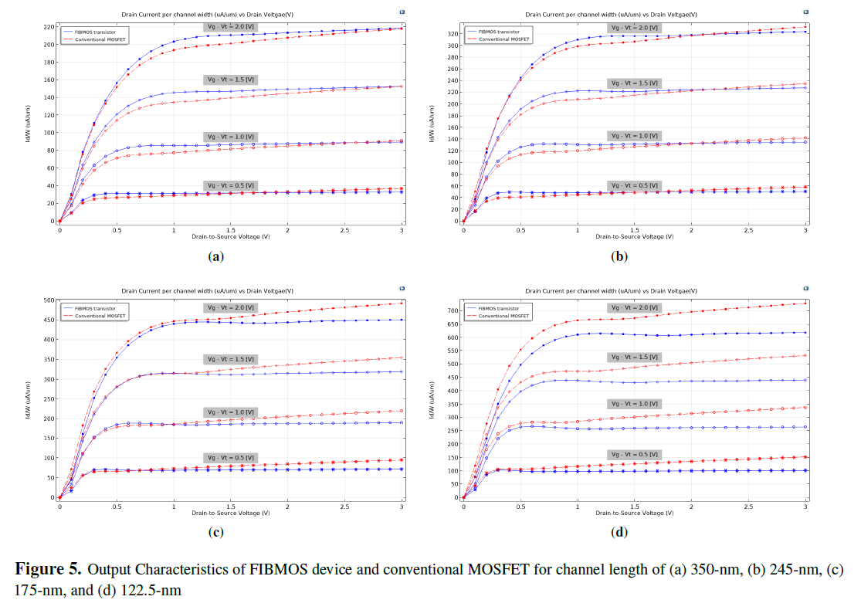

Slide 24
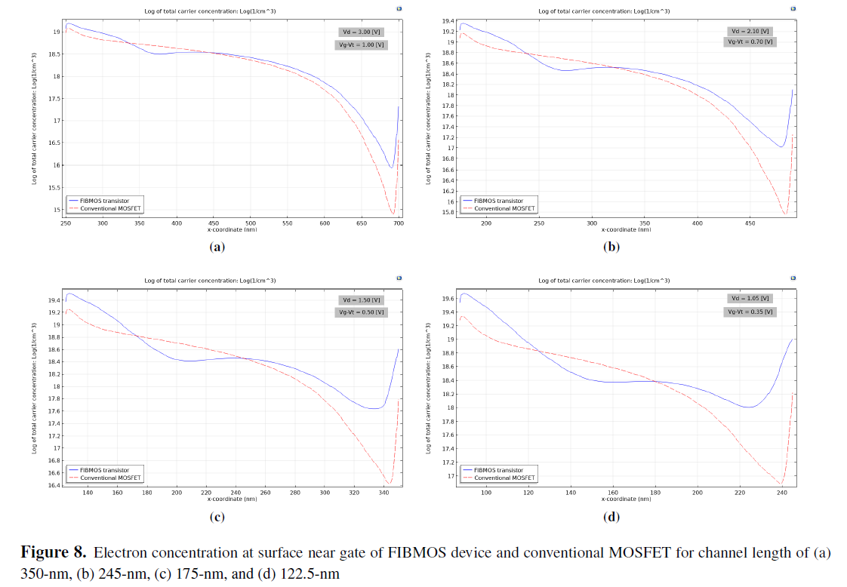

Slide 25
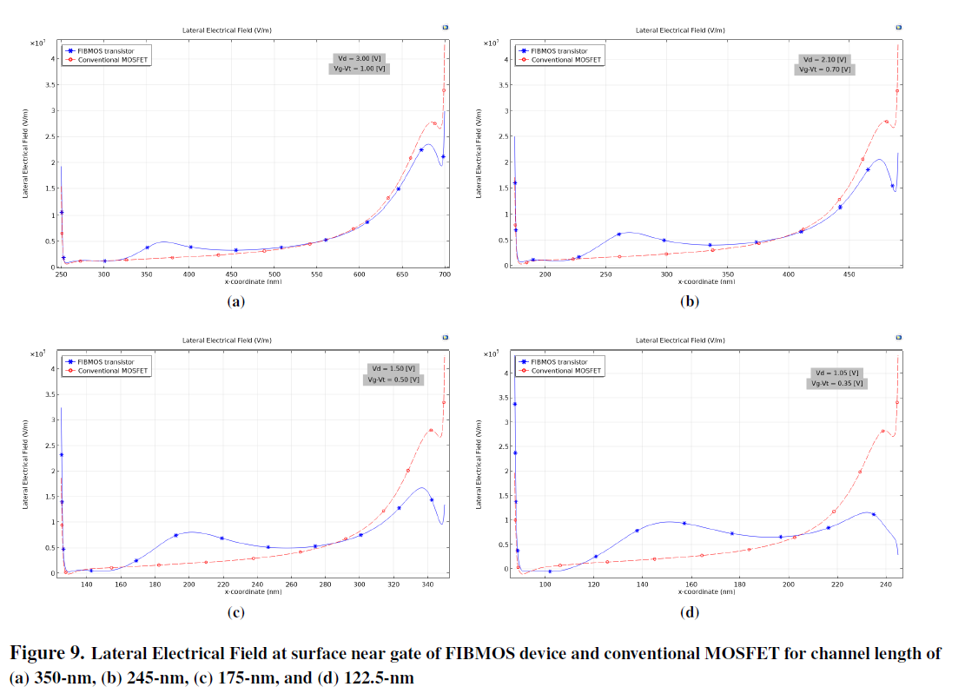

Slide 26
