Slide 1
Time Series Classification for Engine Data using Transformers
By Team ADAA Boost

Slide 2
Task Description
Given: Engine noise data from an automotive subsystem, with 2 labels indicating whether a certain symptom exists or not in the system
Task : Classification of the time series data using transformers, and comparison of generated model performance with LSTM model

Slide 3
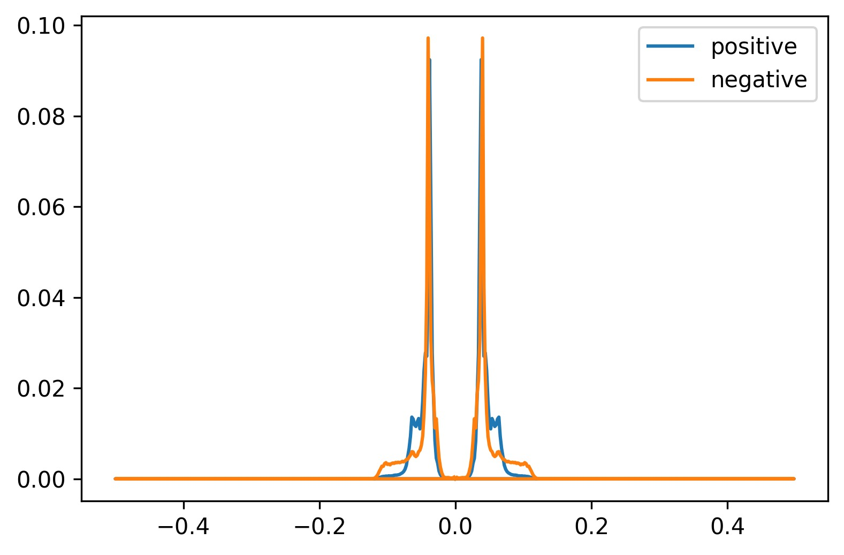
Fourier Analysis
Averaged, Normalised Power Spectrum

Slide 4
Data Analysis
Mean = 0, Std Deviation = 1
No NAN values
Minimal noise
No outliers outside 6 sigma
Hence no processing was required

Slide 5
Model Description
Layers :
Input layer
Position encoding layer
Transformer encoder
Layer normalisation
Multihead Attention layers
Dropout
Layer normalisation
1D Convolution
Dropout
1D Convolution
Classification Neural network
Average Pooling
Fully connected layer
Sigmoid

Slide 6
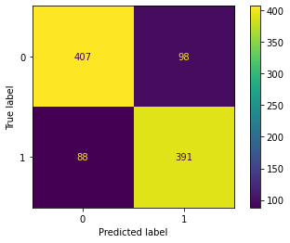
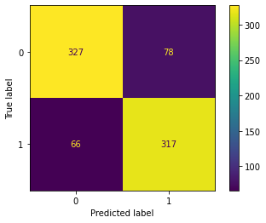
Model Evaluation
Transformer model accuracy : 81.1
LSTM model accuracy : 81.7

Slide 7
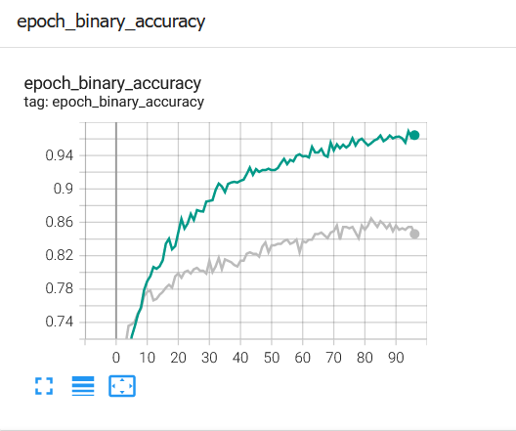
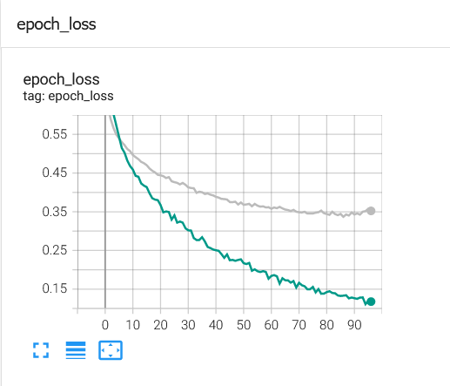
Model Evaluation
Using Tensorflow to evaluate results:

Slide 8
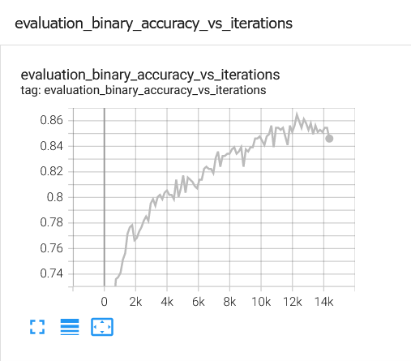
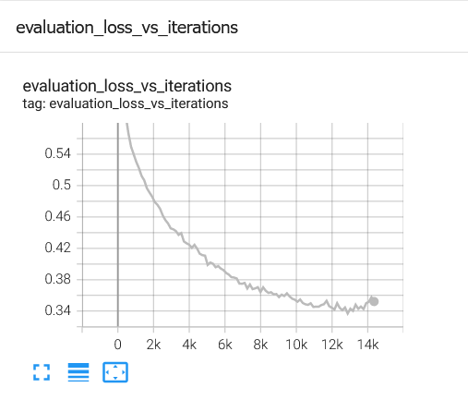
Model Evaluation continued

Slide 9
Regression for Prediction of Flank Wear of a CNC Milling Tool

Slide 10
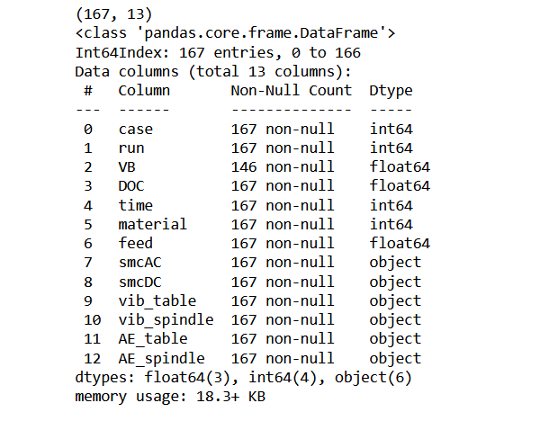
Data Exploration

Slide 11
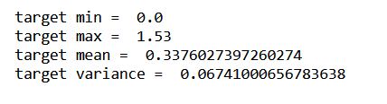
Data Exploration
Analysis of Output Target Variable (VB)
Target Variable Description: VB represents the Flank wear , measured after runs
Target Variable Statistics:
Inferences:
1. Final layer of the neural network cannot have a sigmoid activation function as the target variable values exceed 1.

Slide 12
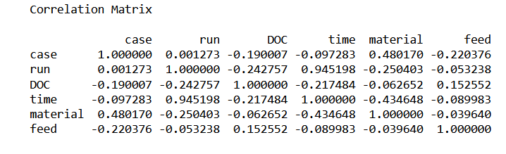
Data Exploration
Correlation Analysis (Spearman)
Inferences:
The features run and time are highly correlated
Dimensionality reduction can be performed through PCA Analysis

Slide 13
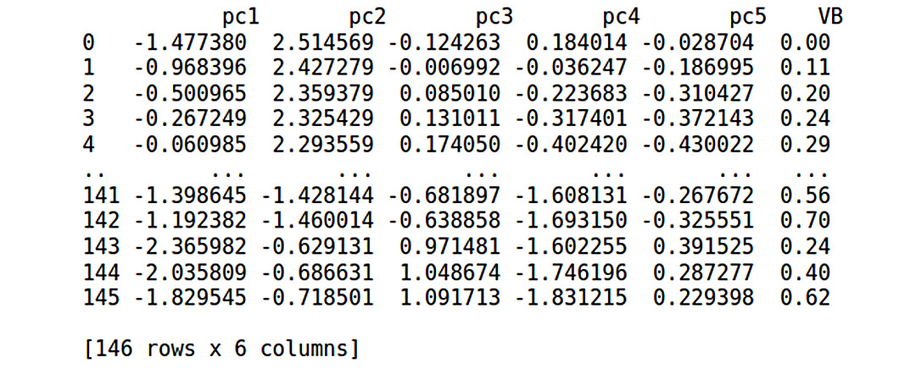
PCA Analysis
case, run , DOC ,time , material , feed
pc1 , pc2 , pc3, pc4 , pc5

Slide 14
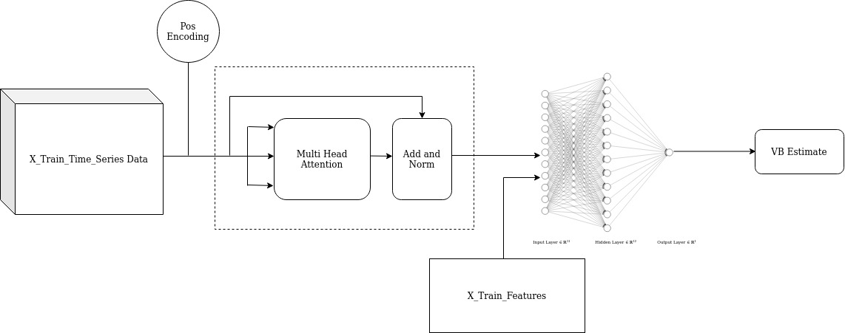
Proposed model
6x time series input embedding : (9000 x 6 )

