Slide 1
Using Customer Profiles: Acquisition, Retention, and Optimization
Sonia Figueroa, Matthias Murray, Daavid Stein, Diana Sujanto

Slide 2

Questions
Who are Ned Davis Research’s clients?
What are they interested in?
When are they accessing these products and services?
Why? What current events are driving this interest?

Slide 3
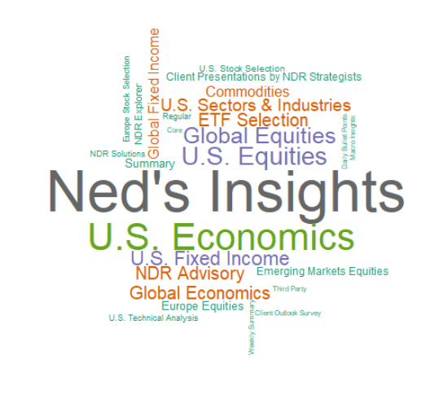
What are NDR’s customers interested in?
Top 10 Products
Ned’s Insights
U.S. Economics
U.S. Equities
Global Equities
U.S. Fixed Income
NDR Advisory
ETF Selection
Global Economics
U.S. Sectors & Industries
Commodities

Slide 4
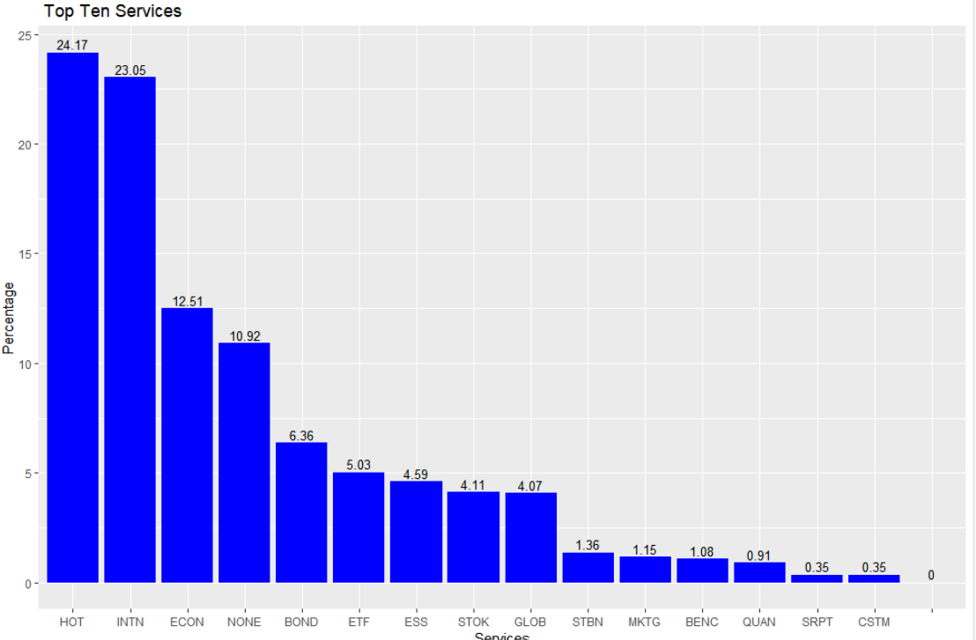
Popular Services

Slide 5
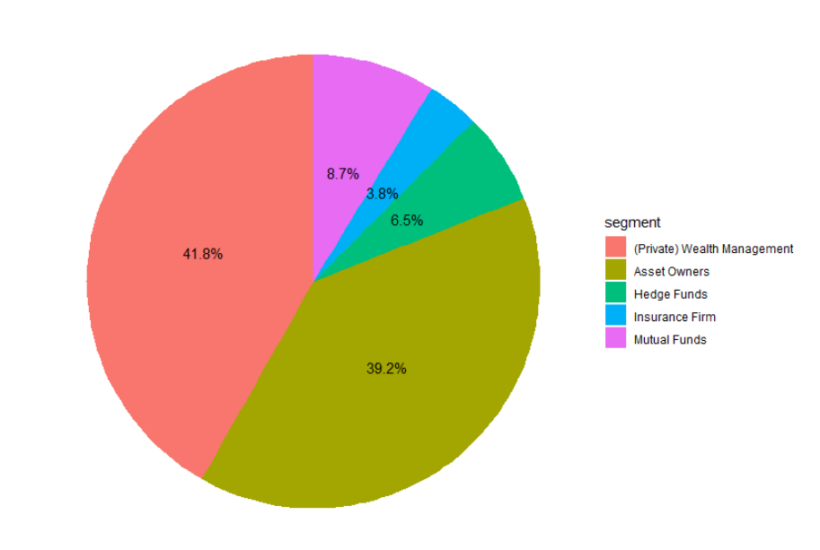
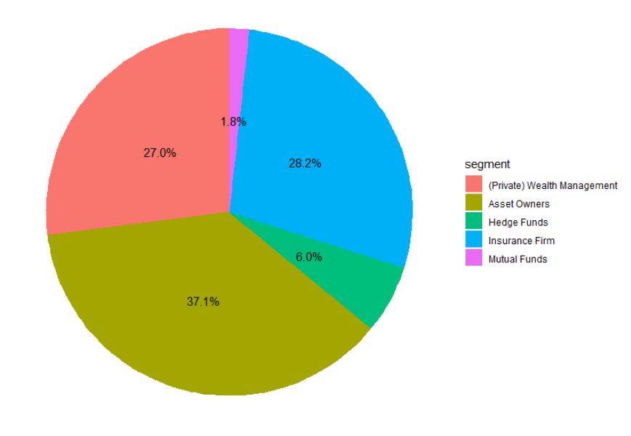
Who are NDR’s Current and Prospective Clients?
Current Clients
Prospective Clients

Slide 6
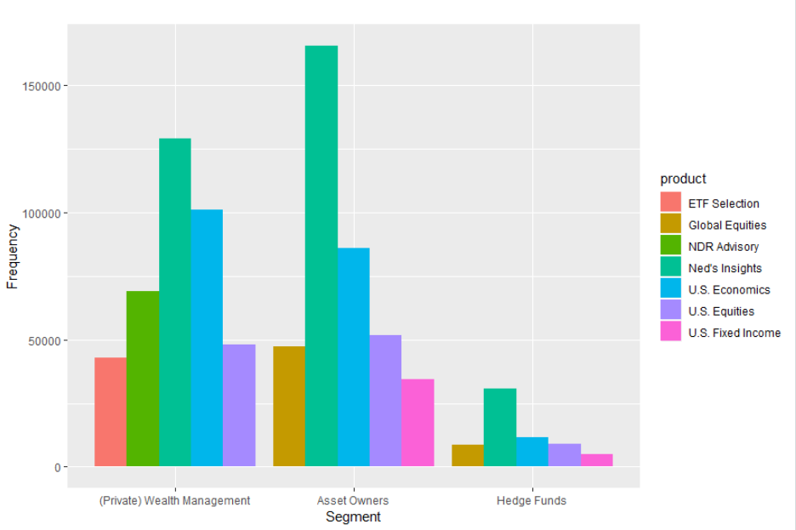
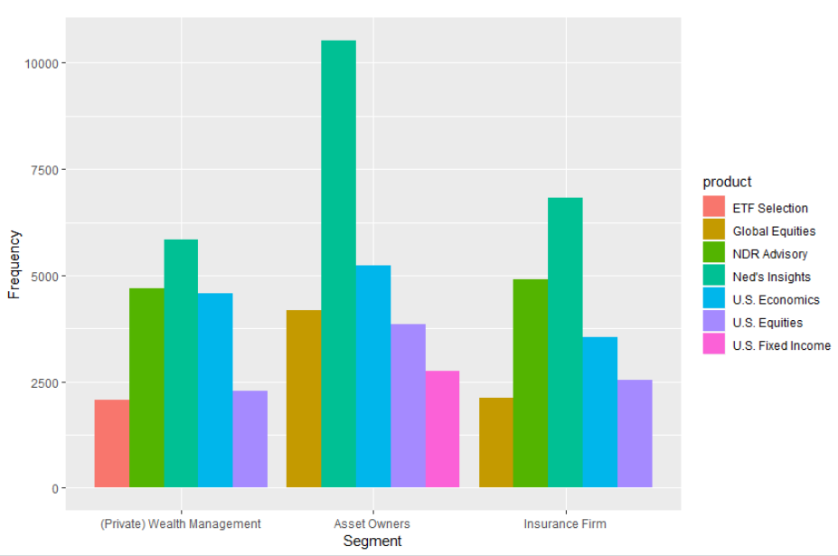
NDR Clients: Products of Interest
Current Clients
Prospective Clients

Slide 7
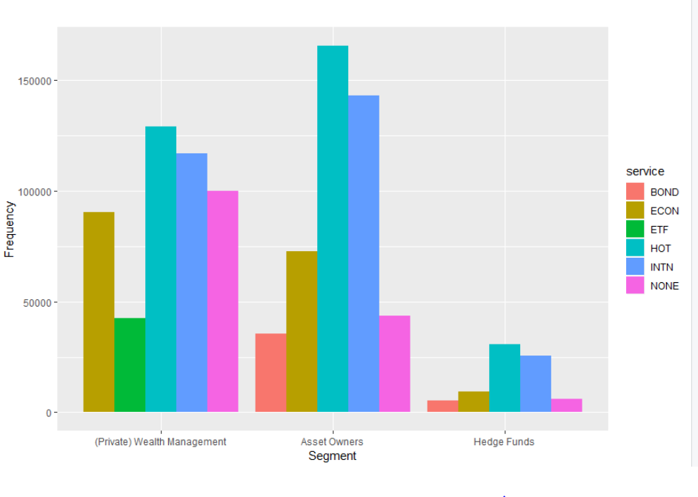
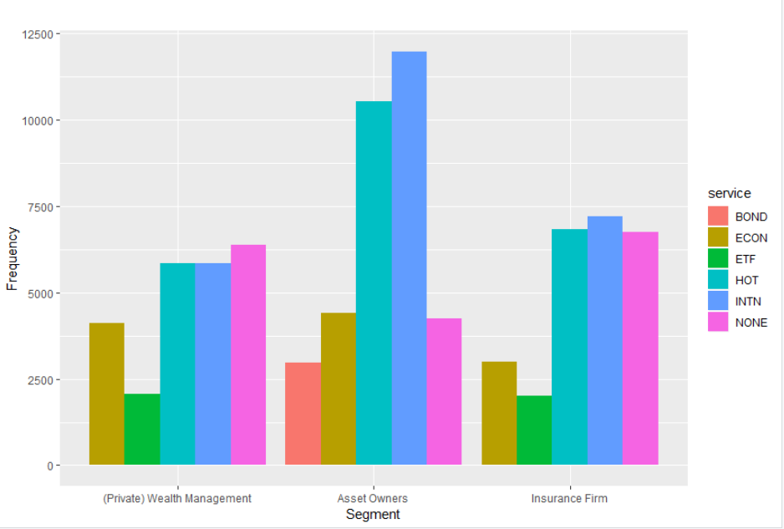
NDR Clients: Services of Interest
Current Clients
Prospective Clients

Slide 8
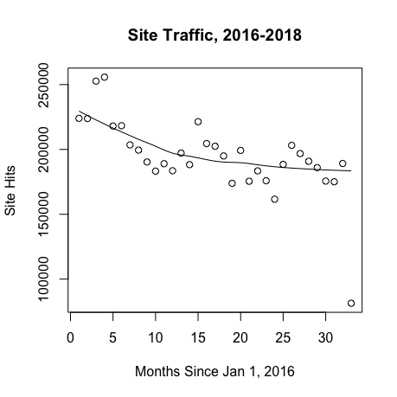
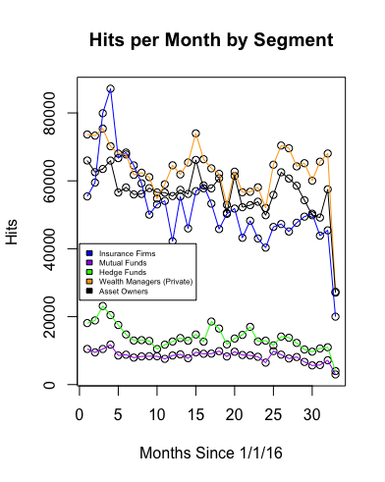
Monthly Site Traffic
All Clients
Active Clients by Segment

Slide 9
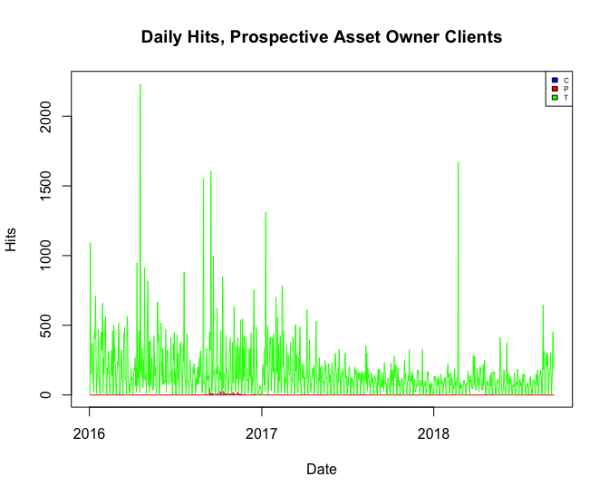
NDR Prospective Clients: Asset Owners
37% Daily Hits
Tax Season
Politics
Market Turmoil

Slide 10
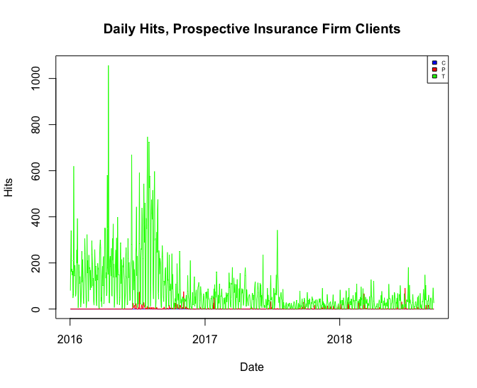
NDR Prospective Clients: Insurance Firms
28% Daily Hits
Natural Disasters
(Earthquakes, Seasons)
Broad Market

Slide 11
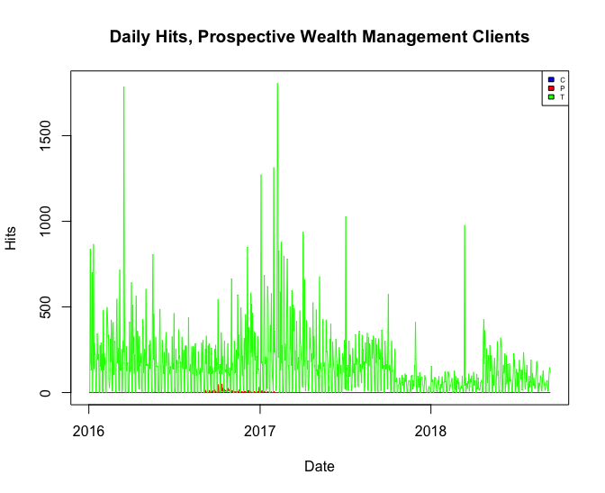
NDR Prospective Clients: Private Wealth Management
27% Daily Hits
Tax Season
Super Users

Slide 12
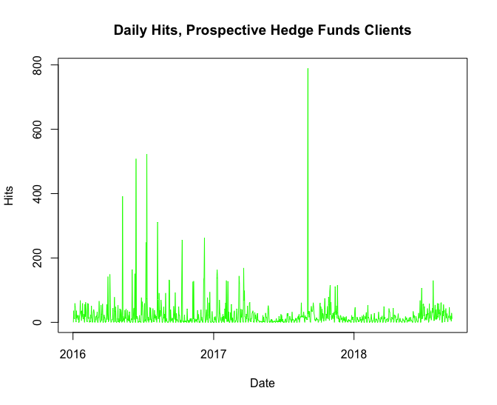
NDR Prospective Clients: Hedge Funds
6% Daily Hits
Trump (5/9/16)
May (7/11/16)
NK
VIX

Slide 13
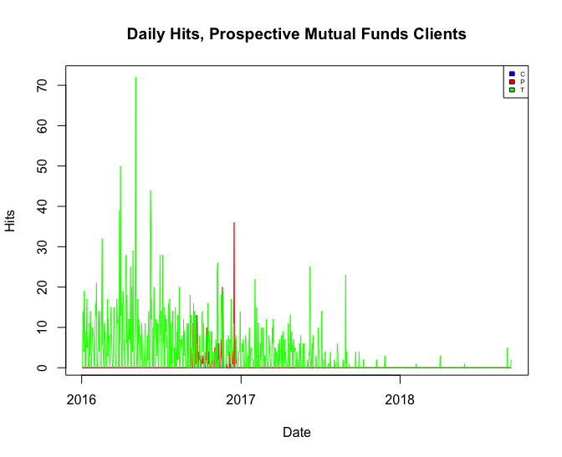
NDR Prospective Clients: Mutual Funds
2% Daily Hits
Oil Price
2016 US Politics

Slide 14
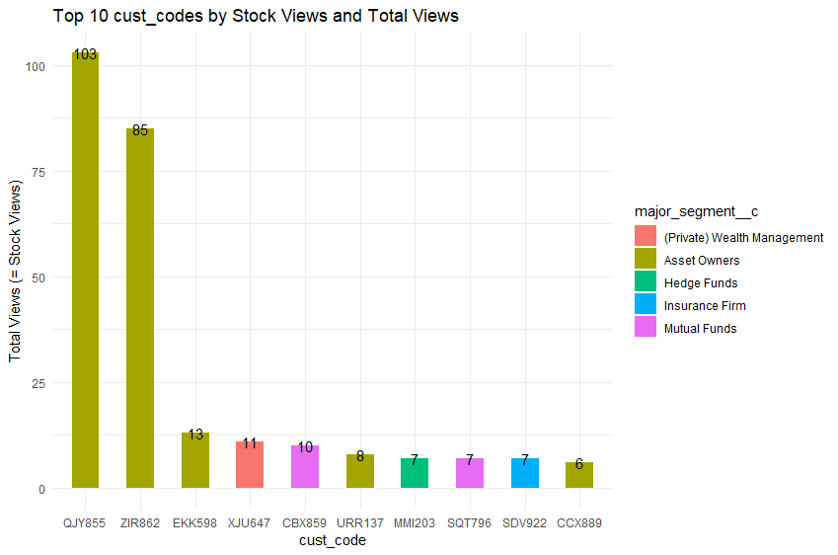
Customers who are interested in stocks
Stock Views:
U.S. Equities
Global Equities
Europe Equities
U.S. Stock Selection
Europe Stock Selection
ETF Selection
U.S. Sectors & Industries
Emerging Markets Equities

Slide 15
Recommendations
Customer acquisition: targeted advertising for trial memberships
Fee structure for superuser clients
Segment-specific content focus

