Slide 1
Requirements Analysis and Use-Case Diagrams

Slide 2
How are design ideas communicated in a team environment?
If the software is large scale, employing perhaps dozens of developers over several years, it is important that all members of the development team communicate using a common language.
This isn’t meant to imply that they all need to be fluent in English or C++, but it does mean that they need to be able to describe their software’s operation and design to another person.
That is, the ideas in the head of say the analyst have to be conveyed to the designer in some way so that he/she can implement that idea in code.
Just as mathematicians use algebra and electronics engineers have evolved circuit notation and theory to describe their ideas, software engineers have evolved their own notation for describing the architecture and behaviour of software system.
That notation is called UML. The Unified Modelling Language. Some might prefer the title Universal Modelling language since it can be used to model many things besides software.

Slide 3
What is UML ?
UML is not a language in the same way that we view programming languages such as ‘C++’, ‘Java’ or ‘Basic’.
UML is however a language in the sense that it has syntax and semantics which convey meaning, understanding and constraints (i.e. what is right and wrong and the limitations of those decisions) to the reader and thereby allows two people fluent in that language to communicate and understand the intention of the other.
UML represents a collection of 13 essentially graphical (i.e. drawing) notations supplemented by textual descriptions designed to capture requirements and design alternatives. You don’t have to use them all, you just chose the ones that capture important information about the system you are working on.
UML is to software engineers what building plans are to an architect and an electrical circuit diagrams is to an electrician.
Note: UML does not work well for small projects or projects where just a few developers are involved. If you attempt to use it in this environment it will seem more of a burden than an aid, but then it was never intended for that. It works best for very complex systems involving dozens of developers over a long period of time where it is impossible for one or two people to maintain the structure of the software in their head as they develop it.

Slide 4
What are the 7 most important diagram types?
Use Case Diagrams:
A simple but very effective model used during the analysis phase for analysing requirements through the process of exploring user interactions with the system.
The process involves documenting
Who initiates an interaction,
What information goes into the system,
What information comes out and
What the measurable benefit is to the user who initiates the interaction (i.e. what they get out of it).
Requirements analysis attempts to uncover and document the services the system provides to the user.

Slide 5
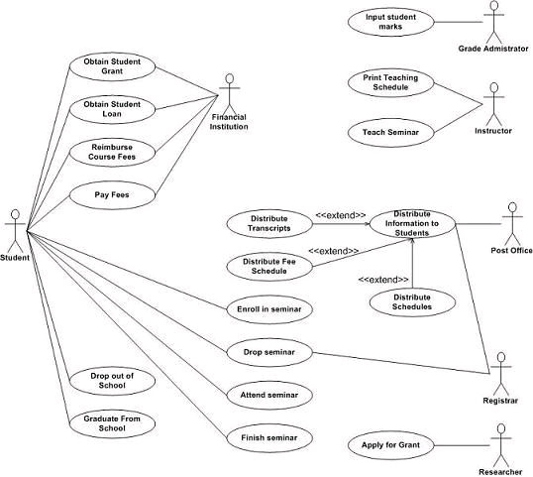
Example Use-case Diagram for a student database

Slide 6
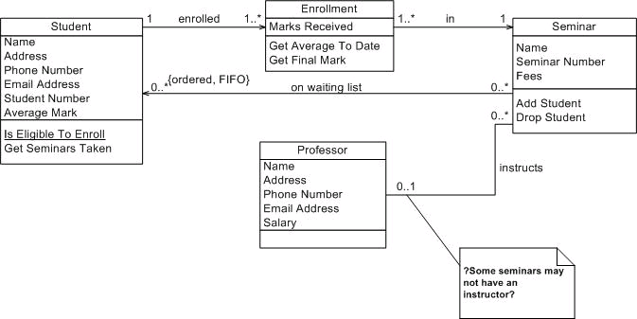
Class Diagrams:
A powerful tool for exploring architecture, functionality and relationships between objects in our system (i.e. instances of classes).
Example Class Diagram

Slide 7
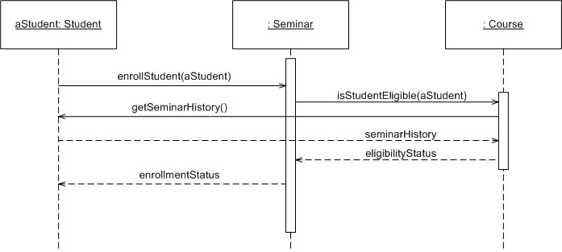
Sequence and Communication (Collaboration) Diagrams:
These two diagrams model the interaction of a set of collaborating objects through a process of message passing as they attempt to achieve the functionality expressed in one or more use cases.
In essence they model the behaviour of our system in response to inputs from the external world.
Example Sequence Diagram

Slide 8
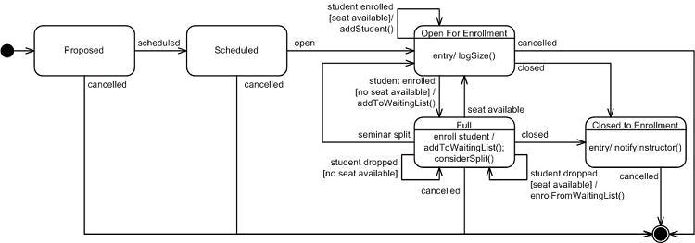
State Charts:
An extension of state transition diagrams.
Model the time dependent behaviour of objects or systems in response to messages sent to it over a period of time.
State
State Transition following an event
Starting State
Terminating State

Slide 9
Activity Diagrams.
Used during analysis to explore areas of parallelism or concurrency in the customer business model.
Useful in areas of business systems modelling where many processes or activities within the business are carried out in parallel, e.g. simultaneously raising an invoice while at the same time producing a delivery note and shipping the goods or order.
Gives an indication to the designer of things that happen in parallel and things that happen in sequence.
A bit like a flowchart but with parallelism and synchronisation built in.
Can be useful in modelling concurrent processes/threads

Slide 10
Deployment Diagrams:
Deployment diagrams show how complex software will be deployed across a complex distribution of computers and networks, and probably have the weakest syntax of all the diagram types (i.e. almost anything goes)
They are essentially a sketch of the system’s physical architecture e.g. computers, disk drives, GUI’s, databases, hardware interfaces, networks, programs running on system X and Y.
(see http://www.agilemodeling.com/essays/umlDiagrams.htm )

Slide 11
Object Oriented Analysis and the Role of Domain Experts
During the early stages of any project development, much of your time will be spent in the analysis phase, attempting to understand ‘what’ the system must do and how it interacts with the real world.
That is, what interfaces, functionality and behaviour the system should provide for your customer.
Such analysis is often conducted in the presence of one or more ‘domain experts’, i.e. somebody who is intimately familiar with the business process or procedures that you are trying to automate (i.e. the problem domain) and can describe them to somebody else, often in a non-technical way.
In simple terms, a domain expert is somebody who understands or knows how to do the job before it has been automated.

Slide 12
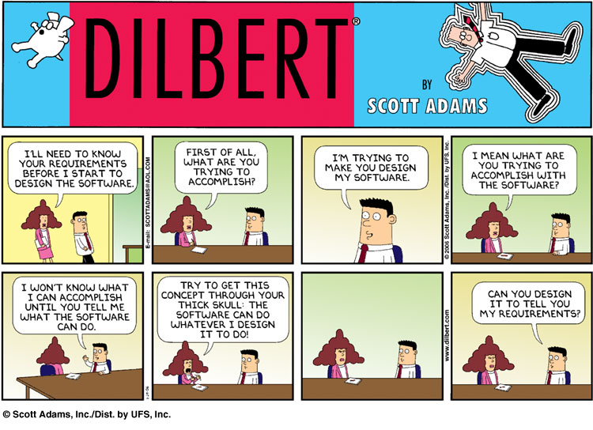

Slide 13
Example Domain Experts
An accountant, could be considered to be a domain expert in the sense that he/she knows intimately the procedures, forms, rules and regulations to be followed when dealing with the Revenue Canada.
Likewise, Architects and Electricians are domain experts when it comes to obtaining advice on building and planning regulations and electrical installations.
In a much simpler vein, Mary sat at a supermarket checkout, or Fred assembling engines for Toyota are also domain experts since their experience makes them uniquely qualified to comment on the processes involved. In fact Mary and Fred's experience makes them especially useful, since they may well have evolved new tips-and-techniques for ‘getting the job done’ that may only exist inside their head (as opposed to a procedures manual) and as such, it is very important to get them working with you.

Slide 14
User Interaction Analysis – Use Cases
There are a number of different techniques that can be used to uncover this expertise or functionality, (see analysis techniques in SE readings) but one of the most powerful is to concentrate on user interactions that will take place within the system.
For example, consider the process of automating an antiquated library where all books, membership and loan details are stored on some kind of paper based card indexing system that is maintained manually by a librarian.
A librarian represents one particular kind of domain expert, as he or she understands the rules and regulations governing how the library does business i.e. rules for loaning/returning books, fines associated with late returns etc.

Slide 15
Example Library user Interaction - Use Cases
As a user, you expect a library to offer you the following services and the librarian, being a domain expert will know how to perform these tasks.
Checking out a book for loan.
Checking in a returned book.
Checking if a book is in stock and where to find it.
Reserving a book that is currently out on loan.
Dealing with payment of overdue fines.
Adding new members to the library.
Deleting old members from the library.
Dealing with changes of members details e.g. name address etc.
In this case the librarian is part of the system that we are trying to automate and he/she may or may not be present in the automated version or at the very least he or she may find their job has changed
So we need to interview him/her to gain the knowledge inside their head.
Library Use-cases

Slide 16
User Interaction Analysis – Use Cases
Likewise a head librarian (who is a more specialised librarian) represents another kind of a domain expert but from a different perspective.
Adding new copies of a book to the library.
Deleting old copies of a book from the library.
Issuing ‘Book Overdue’ letters and fines.
Each of the previous bulleted points represents in UML terminology, a specific ‘Use-Case’.

Slide 17
Definition of a Use-Case
A process or procedure, describing a user’s interaction with the system (e.g. library) for a specified, identifiable purpose. (e.g. borrowing a book).
As such, each Use-Case describes a step-by-step sequence of operations, iterations and events that document
The Interaction taking place.
The Measurable Benefits to the user interacting with the system.
The Effect of that Interaction on the system.
It is important to document these use-cases as fully as possible as each use-case captures some important functionality that our system will have to provide in the automated version of the library.

Slide 18
Documenting an Example Use-case
Let’s consider one of the library ‘Use-Cases’ given previously, e.g. borrowing a book, and document the step-by-step interaction that takes place between a user (the library member or person wishing to borrow the book) and the System (in this case the librarian with his/her card indexing system which represents the system in its current manual state – i.e. prior to automation).
A simple statement of the overall objective of this use-case is often the place to start and could be obtained by interviewing a domain expert to uncover what he/she knows about the rules and procedures for carrying out that task manually.
Initially we start off by seeking only to define the objectives of the use-case, from the point of view of the user. i.e. who is the user, what interaction takes place from their perspective and what benefits the user gets from that interaction?
How much detail you capture in this initial statement of objective is down to the individual, as analysis is an iterative process which we revisit many times before we are happy with the results of it.

Slide 19
General Statement of Objective - Use-Case “Borrow Book”
The member identifies him or herself to the librarian and indicates which books they wish to borrow.
If it is acceptable for them to borrow these books, i.e. they are not marked “for reference only”, or the number of books on loan to the customer is less than some predetermined maximum, then the books are loaned to the customer for a specified loan period.
The members loan record is updated to reflect the loaned books.
The libraries card index system is updated to show who has borrowed the books.
Once a general statement of objective has been documented, we could attempt to ‘flesh-out’ the detail by re-interviewing all interested parties, and attempt to expand our understanding of these objectives in more detail perhaps including the library’s business logic.

Slide 20
More Detailed Description - Use-Case “Borrow Book”
Use-Case: Borrow Book
The borrower/member identifies himself or herself to the librarian using their membership card.
The borrower/member presents one or more books to the Librarian.
The Librarian checks the books to make sure they can be loaned.
The Librarian checks the membership card to make sure it is valid.
The Librarian looks up the member’s records in his/her card indexing system and checks that the number of loaned books will be less than 6 (the maximum that can be loaned at any time to a library member).
If acceptable, each book is then stamped with the appropriate return date (2 weeks from today).
Each book has its identifying card removed from the inside cover.
The Librarian updates the member’s loan details by placing the identifying cards into that members record maintained by the library.
End
Once we have a good understanding of how users borrow books and the libraries business logic and rules, we can then think about how a machine may be able to automate some of these procedures, e.g. Bar codes to identify members and books, a database to replace the card indexing system and maybe even the librarian (either completely or in part).

Slide 21
Exercise:
See if you can describe overall objectives and detailed use-case descriptions for the other use cases associated with the library system. In particular identify
Who are the users that initiate the interaction,
What are the benefits to the user from that interaction and
What is the effect on the system, i.e. how is it updated or changed by this interaction.
Some other use cases:
Checking in a returned book.
Checking if a book is in stock and where to find it.
Reserving a book that is currently out on loan.

Slide 22
Example 2. A Cash Dispenser/ATM.
As another example of use-case analysis, let’s attempt to identify a user interaction with a cash dispenser or ATM.
In essence, this system (a completely automated system, as opposed to a manual one) provides the following functionality.
Request Cash
Request Balance
Request Statement
Request Cheque book
Let’s take the ‘Request Cash’ use-case and identify the interaction that takes place between user (a person with an ID card wishing to borrow money) and the system (the cash dispenser/ATM).

Slide 23
General Statement of Objective - Use-Case “Request Cash”
The user identifies him/her self to the system and requests a withdrawal for an amount of cash.
A check is made, to make sure their account would remain in credit after the withdrawal, and if so, they are dispensed the cash and their account is debited accordingly.

Slide 24
More Detailed Description - Use-Case “Request Cash”
Use Case Request cash
The user inserts their ID card into the system.
The system reads the magnetic strip from the card to identify user & account.
The system contacts the banks central computer to request the PIN number for the card and their account details.
The system prompts the user to enter their PIN.
The user enters their PIN.
If PIN is authenticated the user is prompted for the amount of the withdrawal. If not, the card is returned to the user with an appropriate failed identification message.
The system prompts for the amount of the cash withdrawal.
The user enters the amount of the cash withdrawal.
The system checks with the banks central computer to ensure that the user has sufficient funds to make the cash withdrawal.
If there are sufficient funds, the cash is dispensed and the customer’s account at the Bank Central Computer is debited accordingly, otherwise an appropriate “insufficient funds” message is displayed
The card is returned to the user and a receipt is printed.
End
Question: How much detail should we include in a use-case? What about descriptions of data, e.g. PIN, Magnetic Strip, Account Details etc, are these important to document?
Exercise: See if you can describe in detail the other use cases for an ATM.

Slide 25
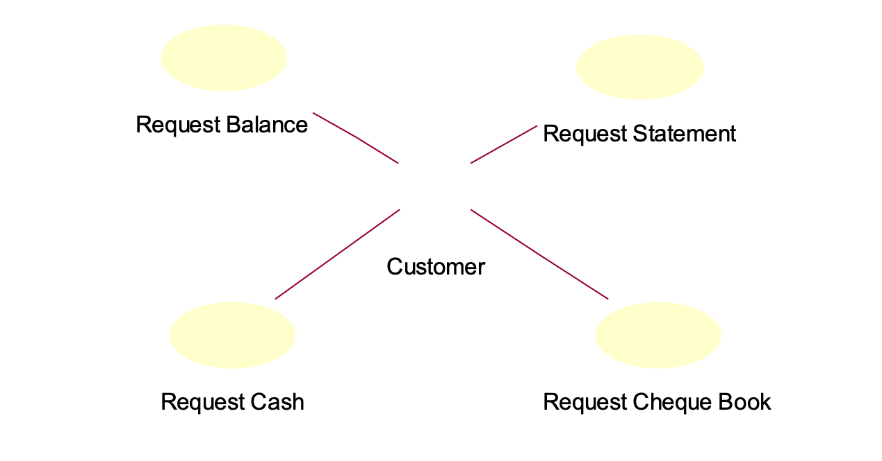
Capturing Use-Cases: The Use Case Diagram
Use cases are captured in UML on a ‘Use-Case Diagram’, as shown below.
You will notice that it is a very simple diagram, involving just two symbols, a stick figure referred to as an ‘actor’, and a named oval representing each of the identified use-cases.
ATM Use-Case Diagram

Slide 26
What does the Oval represent?
The oval represents a unique use-case which attempts to capture high level requirements or functionality that our system must provide to its users. As such, all use-cases must be initiated by Actors.
Each use-case is documented elsewhere with a detailed description of the interaction between user and system and the benefits to the user.

Slide 27
What is an Actor?
An actor represents an external entity outside the domain of the system we are modelling. Most commonly these are the users of the system who initiate one or more use-cases and are typically people, but could be other hardware.
Note that some people involved in the execution of a use-case are NOT necessarily actors. For example, we would probably not show people that happen to take part in the execution of a use case as an actor, (such as a librarian or the staff who refill the ATM with cash).
The UML is quite clear about this, an Actor must be somebody/something that initiates an interaction with the system and gets some measurable benefit from that interaction.

Slide 28
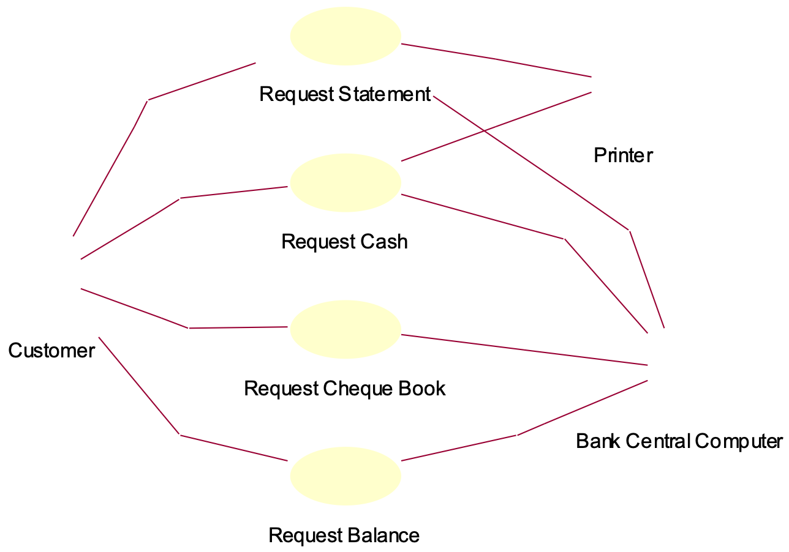
Would we show the Bank Computer and Printer as Actors?
Possibly, but because they do not initiate a use-case, the UML refers to them as “secondary” actors, a bit like a librarian in an automated library system, he or she is involved when a user (the primary actor) borrows a book, but does not initiate the borrowing.

Slide 29
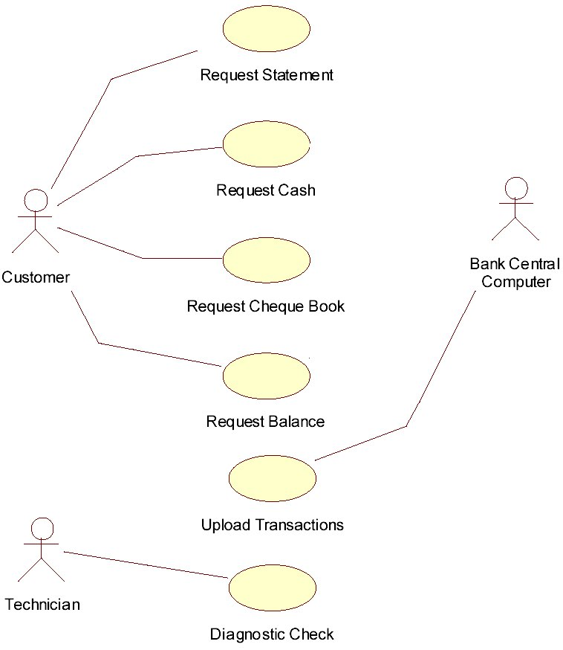
What if a computer did initiate a use-case?
Suppose another use-case exists which allows the bank central computer to request the ATM upload details of all the transactions that had taken place that day.
Suppose also a new use case called ‘Diagnostic Check’ which is run by a new actor called Technician, which involves the use of the Bank Central Computer.

Slide 30
A Use case diagram looks so simple, why bother with it?
Firstly it shows the BIG-PICTURE without getting bogged down in the details of design and implementation (i.e. It’s pretty much independent of hardware, OS, GUI, programming language, databases, networks etc) so it focuses on what needs to be done, not on how it will be done.
Secondly, the customer can easily relate to a use-case diagram and identify the major objectives of their business within it.
This means that any major or miss-understood functionality required from the system is less likely to be overlooked during analysis (very important) or incorrectly interpreted.
From a developers point of view they can immediately assess the functionality required and assess the risk involved in implementing each use case. Resources, hiring and training can then be allocated appropriately as part of the project planning.

Slide 31
The software development manager can also begin to plan delivery schedules, estimate costs, hire new developers, buy the tools and training needed to successfully deliver the product.
Because modern software development follows an iterative approach, each new release of the software can be based around the implementation of one or more use-cases. Thus it is easy to identify what functionality is required with each new release. In fact, the customer should be actively involved in the planning and release process by prioritising the use cases in terms of must-haves and nice-to-haves, thus they get to chose the functionality of each new release.

Slide 32
Use-Case Scenarios
When we talk about use-cases, we always end up discussing scenarios.
In essence, a scenario is a specific instance of a use case that is played out between actor and system at run time. What does this mean?
Well take for example the ATM Request Cash use-case. What could happen when a particular customer comes to make a cash withdrawal.
Well ideally, we would like the user to enter the correct PIN and have sufficient money in their account to make the requested withdrawal.
This is certainly one particular scenario that could be played out between user and system and is probably the primary or most commonly acted out scenario for this use case. Certainly it is the one the bank had in mind when it decided to offer the cash withdrawal functionality inside their ATM.

Slide 33
However, it is easy to envisage a different scenario whereby the customer incorrectly enters their PIN and the transaction is aborted.
This is a different use-case scenario since the user interaction and outcome are not the same as someone who interacts and successfully obtains money.
Put simply, you will probably have a scenario for every ‘what-if’ type question that can be posed during analysis. For example
What if the users PIN is incorrectly entered?
What if the user has insufficient funds in their account?
What if the cash dispenser cannot read the cards magnetic strip?
What if the cash dispenser is out of money?
What if the bank central computer is off-line?

Slide 34
It’s important to realise that scenarios are NOT Errors since they may well reflect important business logic and rules of operation for the customers business and thus the system must be made aware of the different outcomes and be able to deal with them.
A scenario then captures the many different possible interactions and outcomes that could occur when executing a specific use-case.
Put another way, a use-case binds together a set of scenarios that a user could face when interacting with the system for a specific goal, objective or aim.
Documenting Scenarios in a Use Case
There are many different ways to document scenarios in a use-case.
The important thing obviously is to document all those ‘what-happens-if’ type situations that could arise so that the developers implement them. Don’t get hung up trying to evolve a clever formal procedure for documenting them, just chose the one that best captures the type of scenario you are faced with documenting.

Slide 35
One simple way to document a scenario is to use structured pseudo-code in your use-case description as shown (next slide) for the cash dispenser use-case ‘Request Cash’, although other means are acceptable to for example
Formulas (e.g. cost of heating a home based on square feet)
Look up tables: A mapping of inputs to outputs (e.g. income tax bands (e.g. $10-25k = 20%, $25-50k = 25% etc.)
Algorithms (description of step-by-step method for working something out)
Flowcharts (describing business rules etc.)
Decision Trees: (a cross between a look up table and flowchart)
Ask yourself one simple question. Is my description reasonably unambiguous, complete, and understandable by others? If so, then it’s good enough (at least to start with), it doesn’t have to be perfect, (analysis like most other software development activities, is an iterative technique).

Slide 36
Documenting Simple Scenarios in the Use-Case Request Cash
Start of Primary scenario/transaction
The user inserts their ID card into the system.
The system reads the magnetic strip from the card.
If the system cannot read the card then <<Scenario 1>>
The system contacts the banks central computer to request the PIN number for the card and their account details.
If bank central computer cannot access users account then <<Scenario 2>>
The system prompts the user for their PIN.
The user enters their PIN.
If PIN cannot be authenticated <<Scenario 3>>
The user is prompted for the amount of the withdrawal.
The user enters the amount of withdrawal.
The system checks with the banks central computer
If the user has insufficient funds <<Scenario 4>>
The cash is dispensed and the customer’s account at the Bank Central Computer is debited with the withdrawal amount.
The card is returned to the user and a receipt issued.
End-Of-Transaction
Scenario 1: The users card is returned. End of Transaction
Scenario 2: The users card is returned. End of Transaction
Scenario 3: The user is given two more attempts to enter a correct PIN. If this fails the card is kept and the transaction ends. Otherwise resume primary scenario.
Scenario 4: The user is given the opportunity to enter a lesser amount or cancel the transaction. If cancel is chosen, the card is returned and the transaction ends. If the lesser amount is acceptable then resume primary scenario.

Slide 37
Use Case Relationships – Includes
When designing use-cases it is sometimes apparent that there exists some commonality or replication between the steps involved in the execution of one or more use cases. For example take the ATM once again.
In each one of the four use cases below:
Request Cash
Request Balance
Request Statement
Request Cheque Book
the user is required to insert their ID card and enter their PIN, which is then verified by the bank central computer.
Rather than duplicate this common user interaction within each of the above four use-case descriptions, we might extract it and chose to represent it with a mini-use-case called ‘identify user’ whose functionality is included as part of the other four use-cases.
Such an ‘includes’ relationship is shown in the simplified diagram (next slide). The dashed line indicates a dependency relationship i.e. one use-case depending upon another. The arrow points to the use-case that will be included, thus

Slide 38
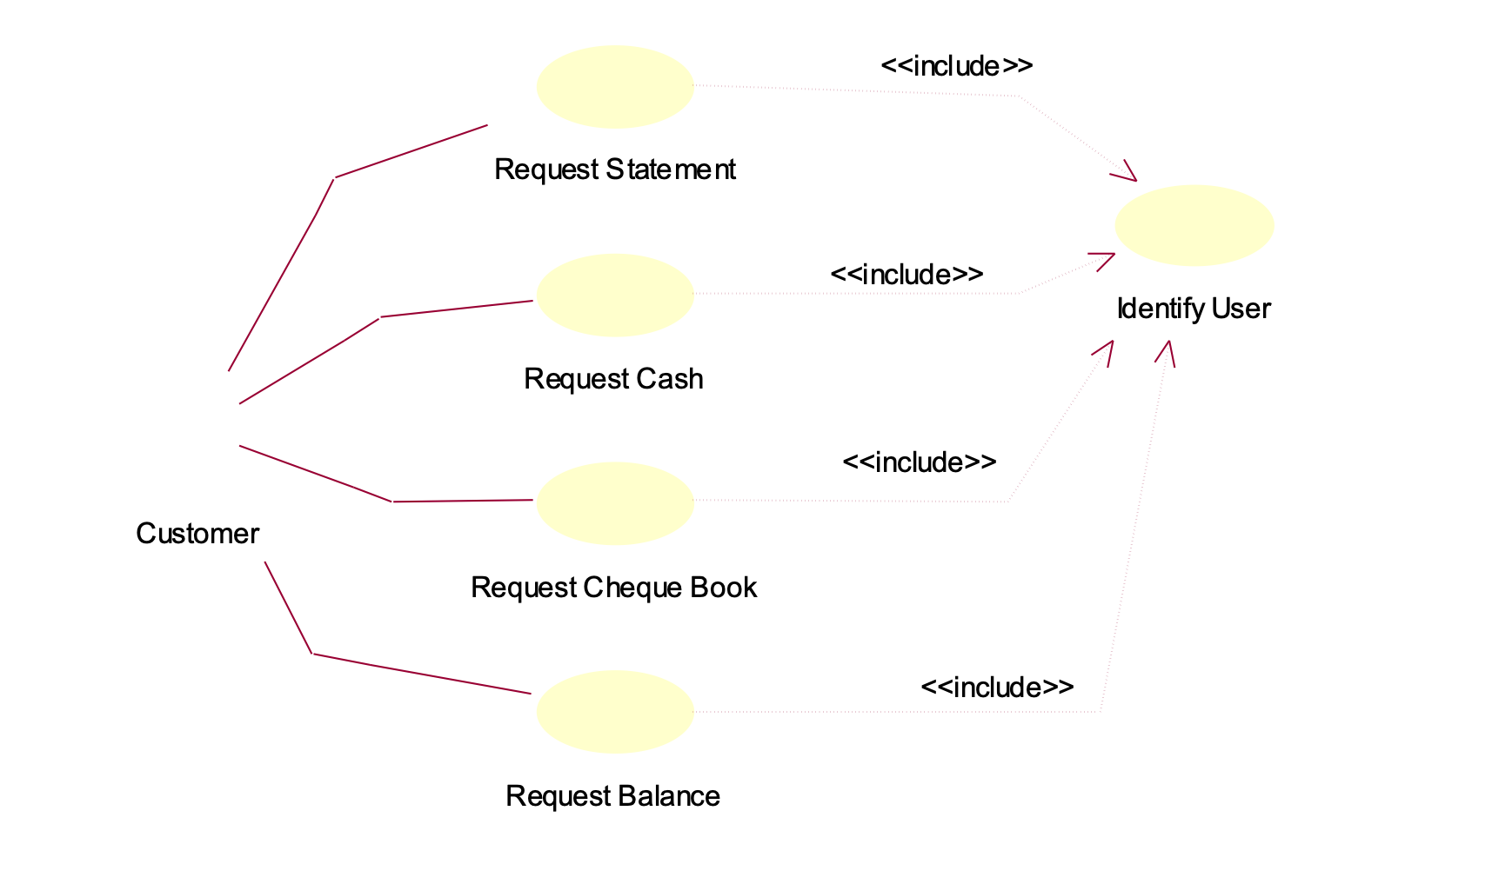
Exercise: See if you can document this new mini use-case. What changes would you now make to the documentation of the other use cases?
VERY Important Note:
Don’t fall into the trap of treating use-cases like functions in a program where you continually apply hierarchical decomposition to break them down into smaller entities.
Use-cases, (even mini ones like ‘Identify-User’), should always involve some documentable interaction between the actor and the system and be able to describe the measurable benefit to the user and effect on system, otherwise they simply aren’t use-cases.
Although not always a definitive question, try asking yourself if the customer would be happy to pay for a release of the software involving your new use case. If not then it’s probably not very interesting to them because it’s an implementation detail or functionality that is simple just a part of a bigger use-case and probably not a use-case in its own right.

Slide 39
For example, The mini-use case below ‘Verify User with main computer’ may be something that is essential to the success of the use-case ‘Identify User’ and similarly, “Get Balance of Account” may be common to both request cash’ and ‘request balance’, but neither of these two should be shown as mini-use cases because
There is no user interaction in either use-case.
There is no direct, immediate, measurable benefit to the user from the execution of that use-case. If the user is not aware of the execution or outcome of the use-case, then it simply isn’t a use-case because there IS NO USER.
In summary, if a use-case does not contain any user-interaction OR, does not lead to any direct, measurable benefit for the user, then it is NOT a use-case, it is simple functionality that will eventually be embedded or hidden within another larger use-case and should not appear on a use-case diagram.
<<include>>
Verify User with Main Computer
NOT really Use-cases
<<include>>
Customer
<<include>>
Get Balance of Account

Slide 40
Documenting ‘Includes’ relationships in a Use-Case: Request Cash
Start of Primary scenario/transaction
Include Identify User (a prerequisite or precondition for the execution of this use-case)
The user is prompted for the amount of the withdrawal. **note the assumption of success**
The user enters the amount of withdrawal.
The system checks the account balance with the banks central computer
If the user has insufficient funds <<Scenario 1>>
The cash is dispensed and the customer’s account at the Bank Central Computer is debited with the withdrawal amount.
The card is returned to the user and a receipt issued.
End-Of-Transaction
Scenario 1: The user is given the opportunity to enter a lesser amount or cancel the transaction. If cancel is chosen, the card is returned and the transaction ends. If the lesser amount is acceptable, resume.
Start of Included scenario/transaction
The user inserts their ID card into the system.
The system reads the magnetic strip from the card.
If identification fails << Scenario 1>>
The system contacts the banks central computer to request the PIN number for the card and their account details.
If bank central computer cannot access users account <<Scenario 2>>
If PIN cannot be authenticated <<Scenario 3>>
End-Of-Transaction
Scenario 1: The users card is returned. End of Transaction
Scenario 2: The users card is returned. End of Transaction
Scenario 3: The user is given two more attempts to enter a correct PIN. If this fails the card is kept and the transaction ends. Otherwise resume primary scenario.

Slide 41
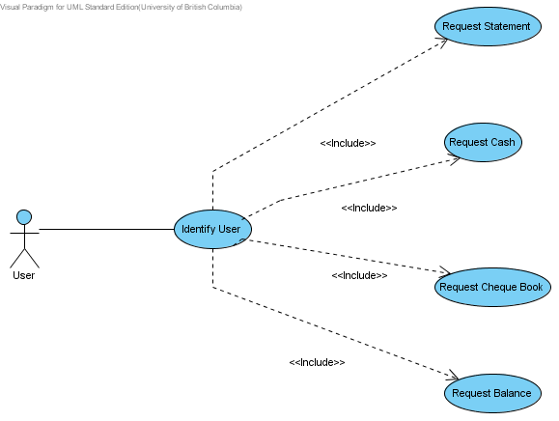
What’s wrong with this use-case diagram ?

Slide 42
Use Case Relationships – Generalisation
Another useful relationship that can occur between use-cases is one of generalisation.
This occurs when two of more use-cases attempt to achieve the same goal or objective but achieve it via different means.
For example, suppose an ID card with a magnetic strip were not the only way that you could identify yourself to a ATM.
Let’s suppose that fingerprint and retina scan are also acceptable.
One could imagine that a user might be offered the choice of which method of identification to use when they arrive at the ATM.
Alternatively a range of different ATM models might be produced with only one of these 3 means of identification built in, thus their interaction with the user would vary but the outcome/benefits to the user would be the same, namely that the users identification is established.
It is therefore possible to identify three different use-cases bound together by the common objective of identifying the user.

Slide 43
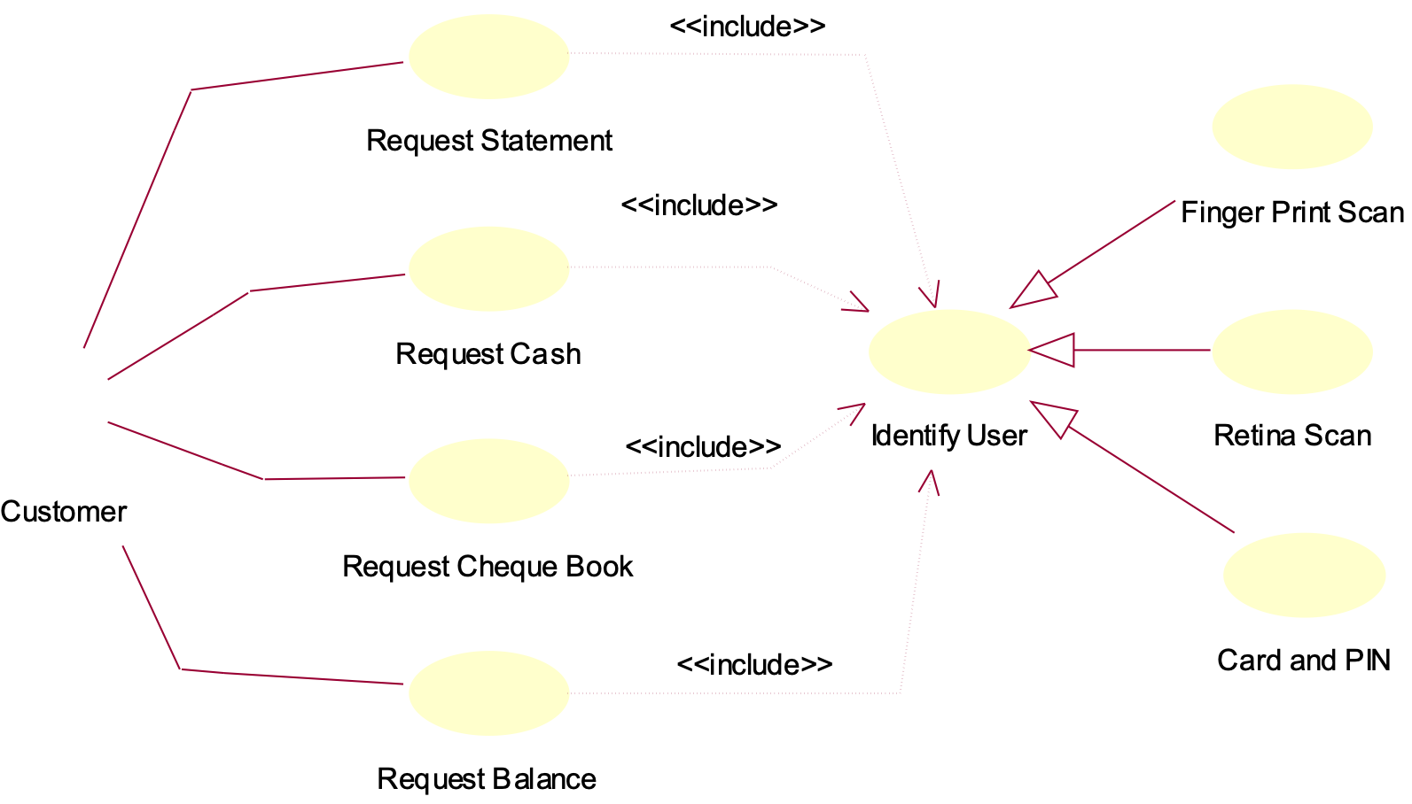
We would represent these three use-cases using a generalisation relationship, which is shown below. You can relate this to the previous use case diagrams.
‘Finger Print Scan’, ‘Retina Scan’ and ‘Card and Pin’ are all ‘kinds of’ use case that identify the user

Slide 44
This diagram should be interpreted to mean that there are three possible methods for identifying a user. Thus the four major use cases
Request Cash
Request Balance
Request Statement
Request Cheque Book
will obviously invoke only one of these three means of identification. The choice may be one made by the user, or imposed upon them by the model of ATM they are using.
When documenting generalisation use cases the base or root use-case (i.e. Identify User) should be documented in very general terms, i.e. it should just list the objectives of the use-case. For instance the following should suffice.
“Identify the user”
obtain their account details from the bank central computer
The three specific or derived use-cases can be documented with specific details.
Generalisation then is about isolating common user objectives and expressing that commonality in the base use-case.
The various specific details of achieving that can be documented in the derived (real) use-cases.

Slide 45
Use Case Relationships – Extends
The final use-case relationship is one that allows extensions to be made to a use-case.
This can be used to model optional behaviour, particularly interesting and important scenarios within a use-case.
For example, in the ATM, the use-case ‘Request Cash’ contained a number of different scenarios that could be acted out when a customer requests cash.
We could of course document these scenarios with carefully chosen textual descriptions placed within the use-case documentation itself as shown previously.
However, if the scenarios were particularly interesting (and they involved some user-interaction with a direct measurable benefit to the user) then we could document them in their own mini-use cases and add an extends relationship to their parent or containing use-case (the one documenting the primary use-case)

Slide 46
Example: In the diagram below, we see two separate mini use-cases that extend their containing use-case. These use-cases deal with optional user-interaction that might (or might not) occur when their containing use case is executing. (Note the emphasis on ‘might occur’. If the mini use-case always gets executed when the parent use-case runs, then the mini use-case should be modelled with an ‘includes’ relationship, if it’s optional, model with extends)
Note the direction of the arrow from extended use-case back to parent or containing use-case. In other words “Receipt Needed” and “Choose $$$ Notes” both extend the functionality contained within the use-case “Request Cash”.
Of course to qualify as a use-case, the user still has to be involved with some significant interaction within the system and there must be some measurable benefit that can be identified. In the case of these two mini-use cases, the benefits to the user are that they get a paper receipt and get to choose the type of ‘$’ notes that they are given.
<<extends>>
Receipt Needed?
Customer
Request Cash
<<extends>>
Choose $$$ Notes

Slide 47
Documenting a Use-Case with Extends
Use-Case Request Cash
. . .
. . .
If( users wants to chose type of $ notes)
Extends Choose $$$ Notes
If user chooses to have a receipt
Extends Print Receipt
. . .
. . .
The card is returned to the user and a receipt is issued.
End-Of-Transaction
Notice how the extended use case is called just by referring to its name, this isn’t a precise syntax, but its understandable and thus works as well as any other approach.
Thus in step 5 above, the extended use-case “Print Receipt” is invoked if the user asks for a receipt.
It’s important not to get hung up on a specific syntax and notation for describing use-cases, they are not precise programming statements, they capture requirements in an written manner that both analyst and customer can understand.
We model them more precisely using sequence diagrams.

