Slide 1
Understanding data types in Python Reference: Python Data Science Handbook, Jake VanderPlas, O'Reilly
Python is a dynamically typed language:
x = 4
x = "four"
This code would cause a compilation error in C:
int x = 4;
x = "four" // FAILS
The standard Python implementation is written in C.

Slide 2
Python integer represented under the hood in C
struct _longobject {
long ob_refcnt;
PyTypeObject *ob_type;
size_t ob_size;
long ob_digit[1];
}
ob_refcnt: reference count for memory allocation/deallocation
ob_type: type of variable
ob_size: size of the following data
ob_digit: actual integer value of Python variable

Slide 3
Python integer represented under the hood in C
That is four pieces of information just for an integer!
PyObject_HEAD
1
digit: 1
C Integer
Python Integer

Slide 4
Python list inefficiency
An integer in C is simply a label for a position in memory for bytes encoding an integer value
An integer in Python is a pointer to a Python object containing all the information just discussed.
This information comes at a cost.
Python list: a pointer to a block of pointers that each point to a full Python object.
NumPy array: fixed type array; more efficient for storing and manipulating data.

Slide 5
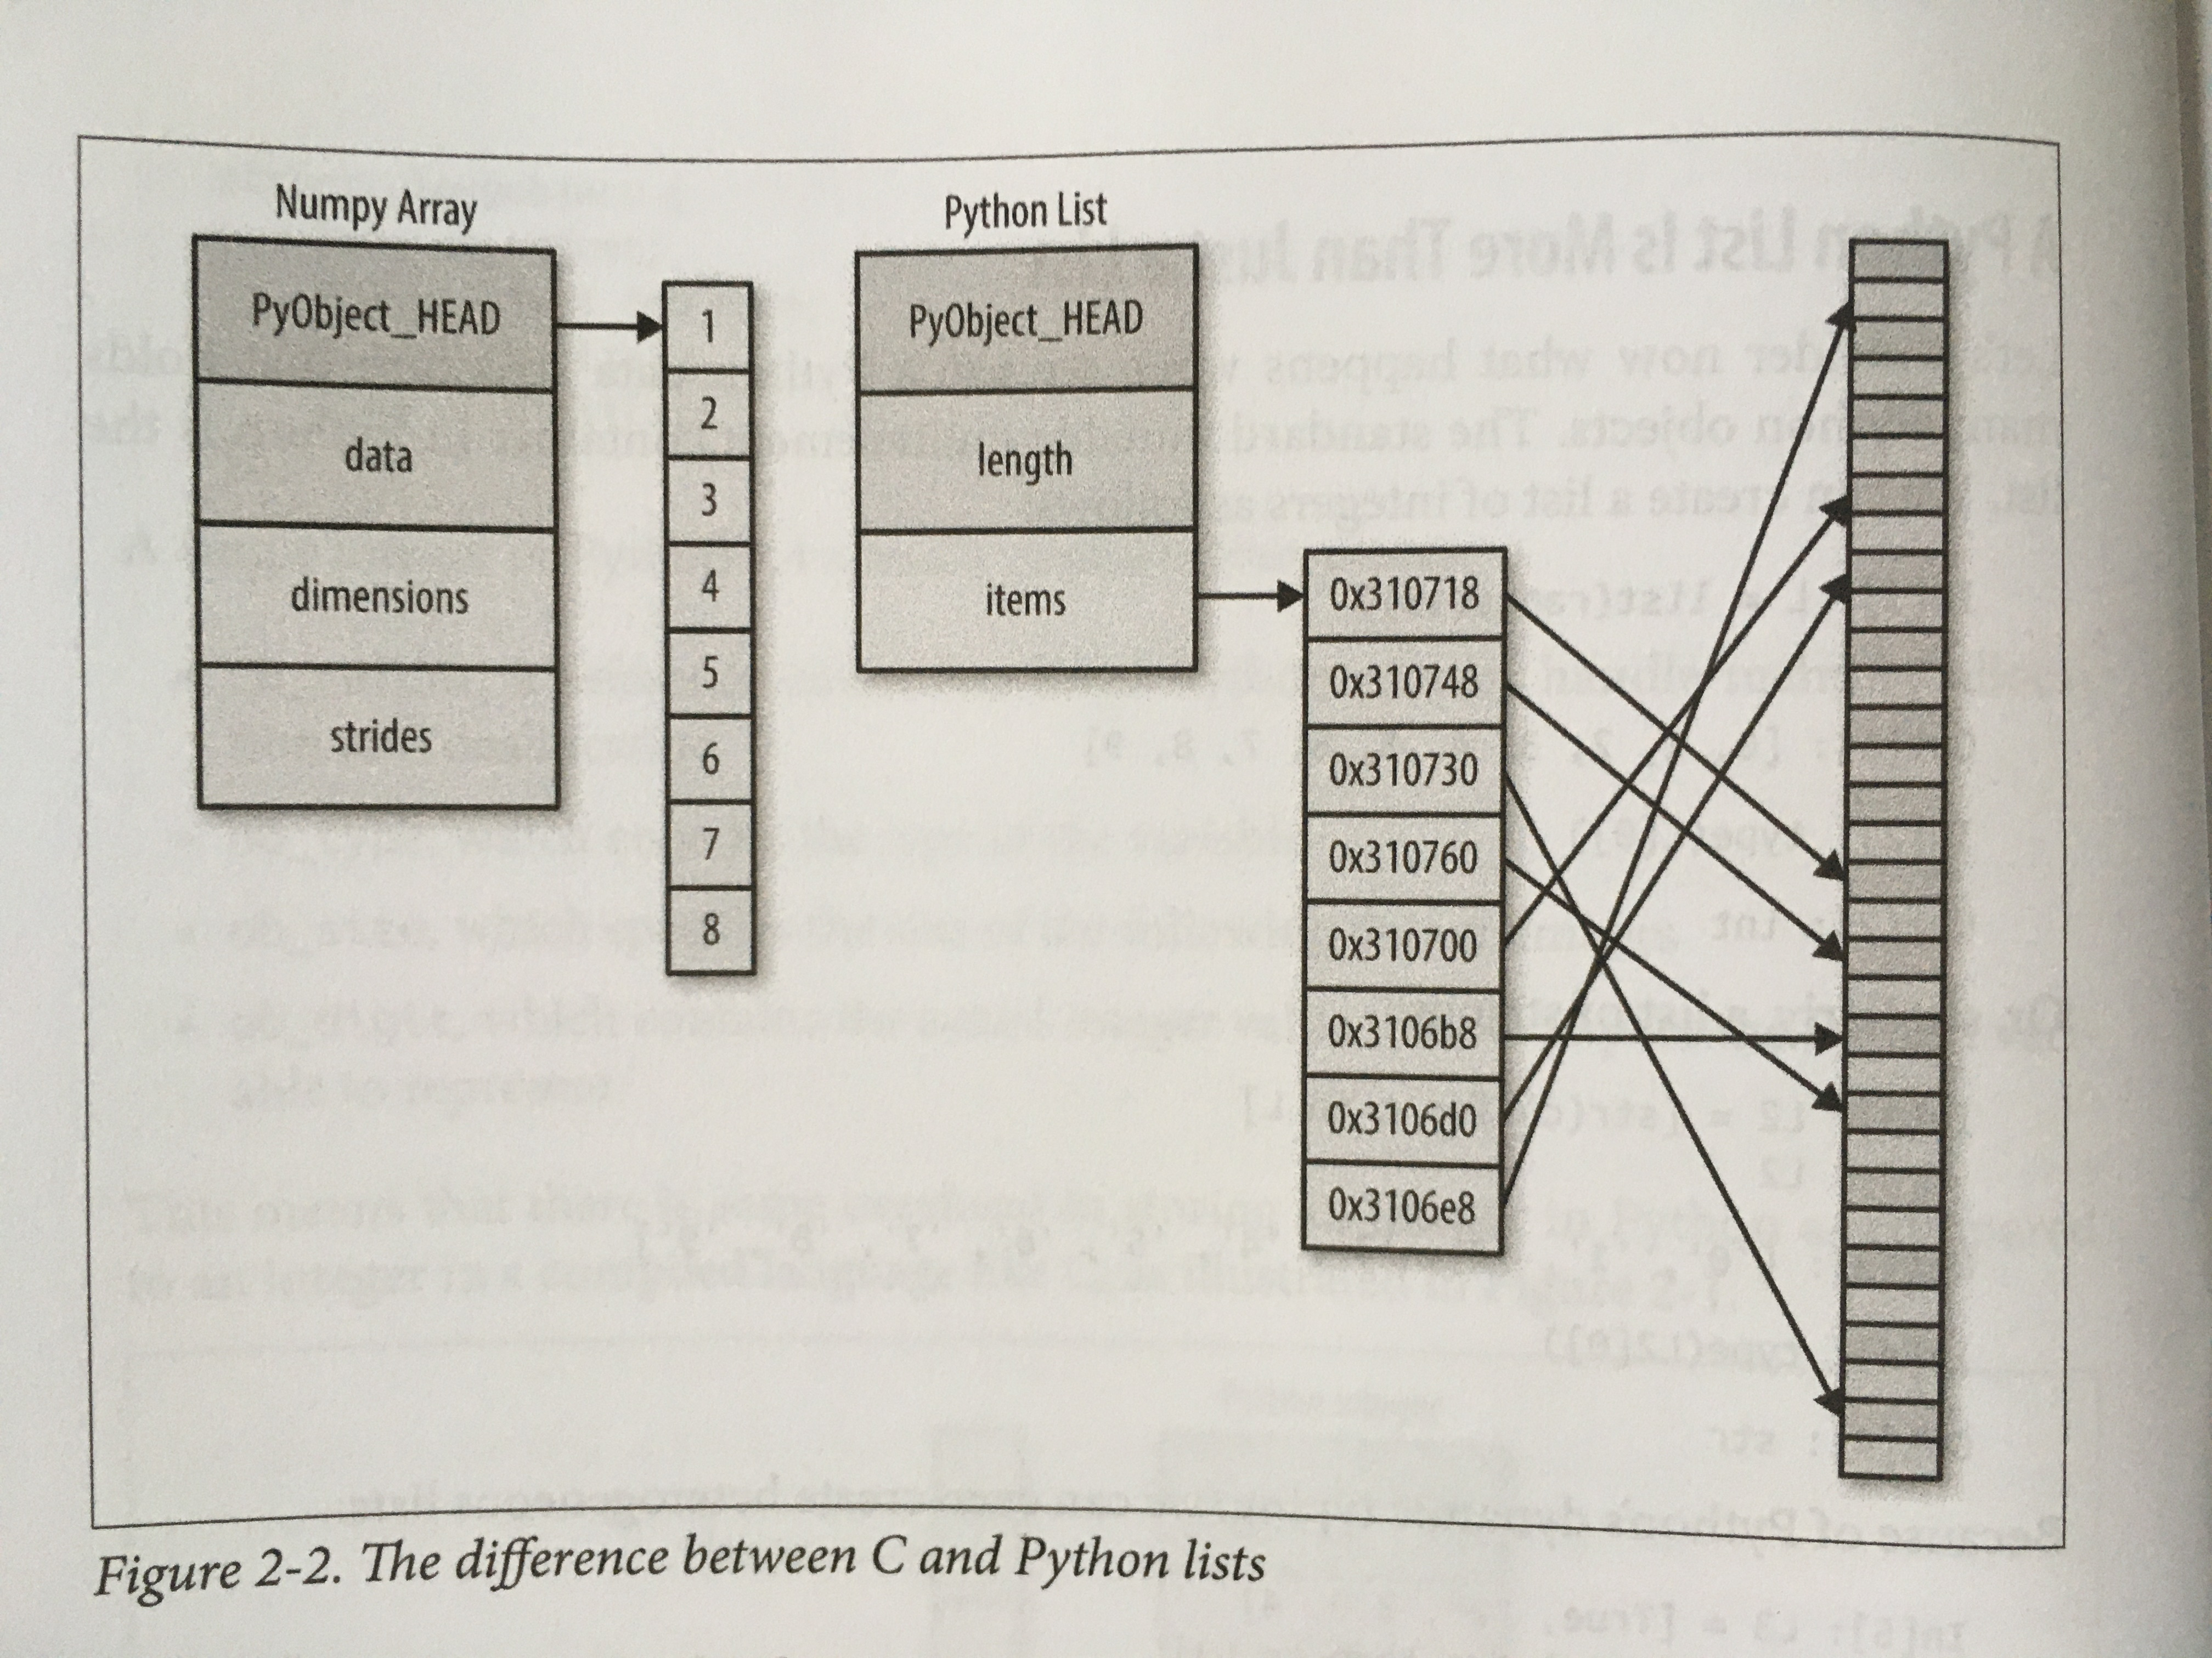
The difference between C and Python lists Image source: Python Data Science Handbook, Jake VanderPlas, O'Reilly

Slide 6
Why the emphasis on arrays?
Most real-world data can be represented by arrays of numbers:
Text: represented as binary digits
Images: represented as 2-dimensional array of pixels
Sound: sound intensity over time
Manipulation of these arrays is the key to data science.

