Slide 1
Understanding data types in Python Reference: Python Data Science Handbook, Jake VanderPlas, O'Reilly
Python is a dynamically typed language:
x = 4
x = "four"
This code may cause a compilation warning or error in C:
int x = 4;
x = "four" // FAILS
The standard Python implementation is written in C.

Slide 2
Python integer represented under the hood in C
struct _longobject {
long ob_refcnt;
PyTypeObject *ob_type;
size_t ob_size;
long ob_digit[1];
}
ob_refcnt: reference count for memory allocation/deallocation
ob_type: type of variable
ob_size: size of the following data
ob_digit: actual integer value of Python variable

Slide 3
Python integer represented under the hood in C
That is four pieces of information just for an integer!
PyObject_HEAD
1
digit
1
C Integer
Python Integer

Slide 4
Python list inefficiency
An integer in C is simply a label for a position in memory for bytes encoding an integer value
An integer in Python is a pointer to a Python object containing all the information just discussed.
This information comes at a cost.
Python list: a pointer to a block of pointers that each point to a full Python object.
NumPy array: fixed type array; more efficient for storing and manipulating data.

Slide 5
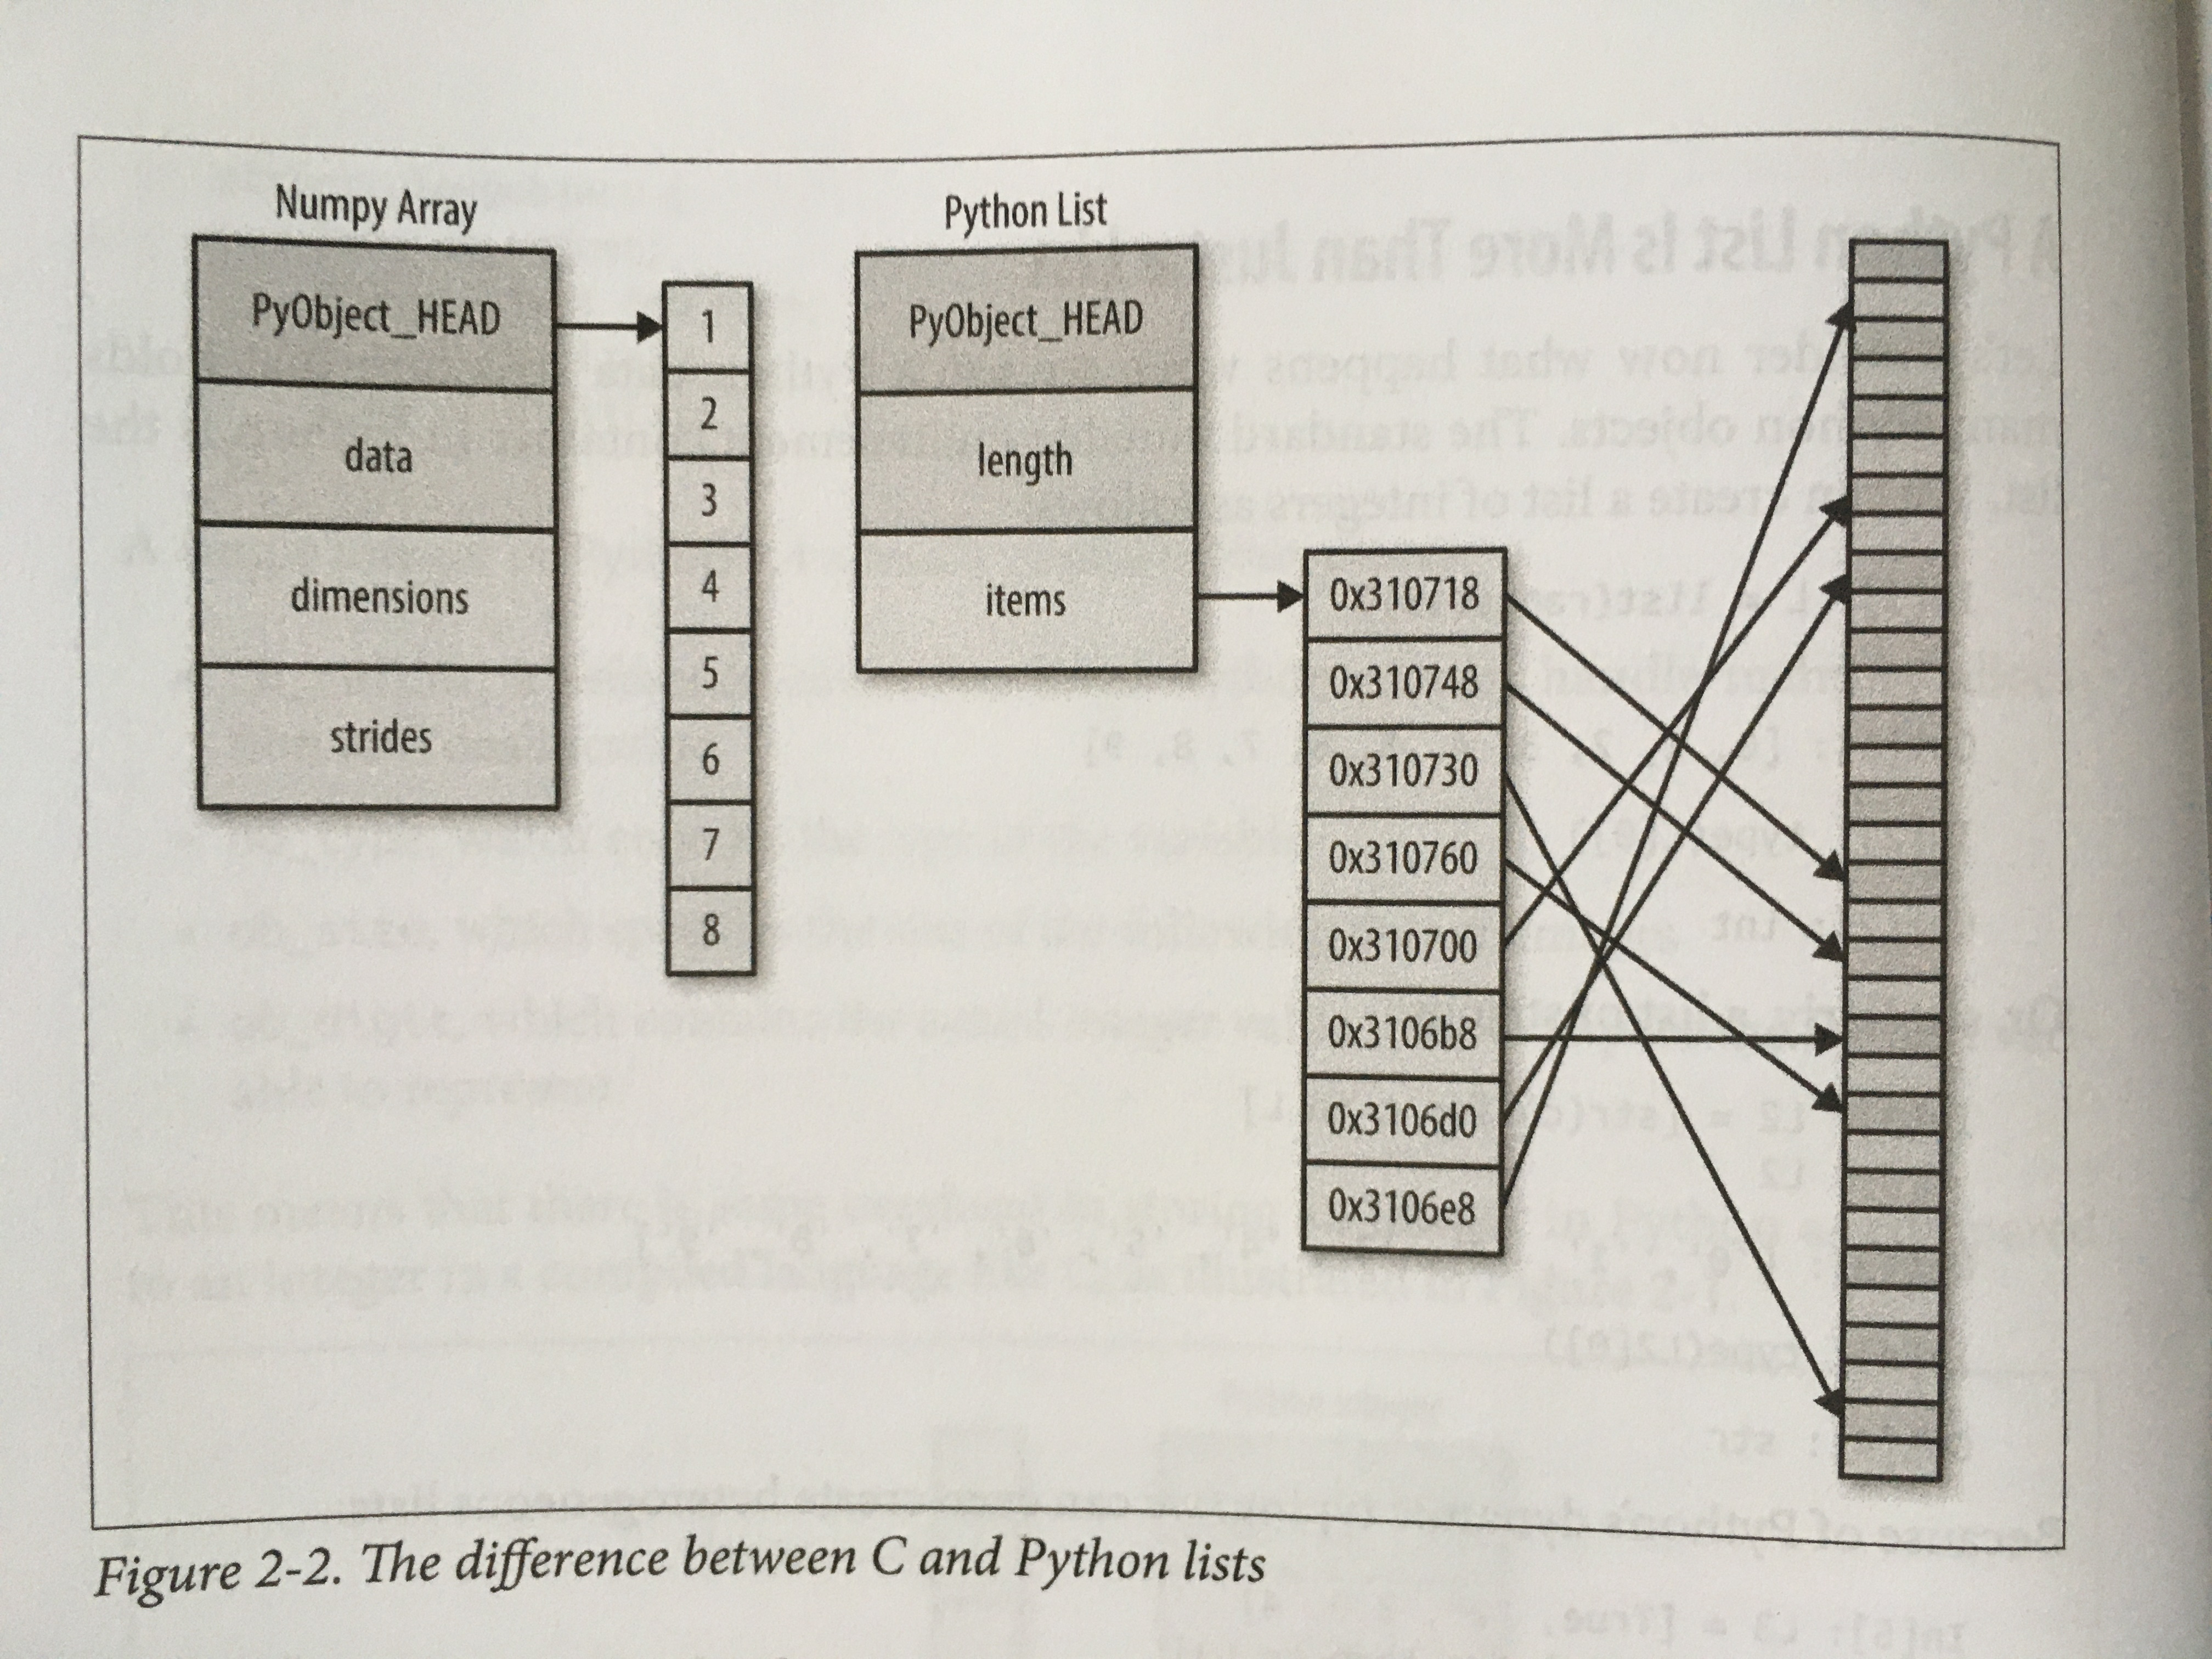
The difference between C and Python lists Image source: Python Data Science Handbook, Jake VanderPlas, O'Reilly

Slide 6
Why the emphasis on arrays?
Most real-world data can be represented by arrays of numbers:
Text: represented as binary digits
Images: represented as 2-dimensional array of pixels
Sound: sound intensity over time
Manipulation of these arrays is the key to data science.

Slide 7
NumPy array manipulations
Attributes
Determining size, shape, memory consumption, data types
Indexing
Getting, setting individual elements
Slicing
Getting smaller subarrays within arrays
Reshaping
Changing the shape of arrays
Joining and splitting
Combining multiple arrays into one, or splitting one into many

