Slide 1
Primary Keys
AUTO_INCREMENT
Foreign Keys
Constraints
Primary Key
Foreign Key
NOT NULL
Creating a database diagram from your tables
Enhanced Entity Relationship (EER) diagrams

Slide 2
Definitions
Primary key: At least one column that uniquely identifies each row of a table.
Foreign key: A column in one table that points to the primary key of another table, thereby establishing a relationship between the two tables.
Foreign keys establish relationship-level integrity

Slide 3
Creating a database diagram for the college DB
From Workbench, use the menu
Database > Reverse Engineer
Click "Continue" twice
From the "Select Schemas to Reverse Engineer" menu, select the college database and click "Continue" twice.
From the "Select Objects to Reverse Engineer" menu, click "Execute"
Click "Continue" and "Close"
An EER Diagram should now be visible showing the two tables and their FK relationship.
Detailed instructions here.

Slide 4
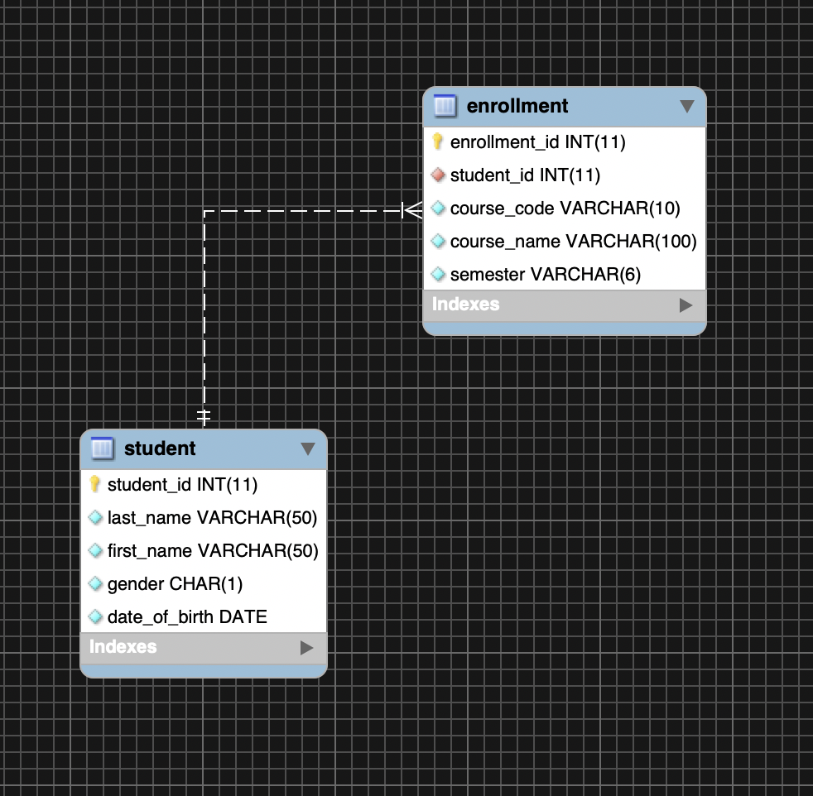
college DB EER diagram

Slide 5
Good database design
UNIQUE constraints
Removing duplicate rows (normalization)

Slide 6
UNIQUE constraints
Let's add an email column to the students table.
No two students can have the same email address, i.e., it needs to be UNIQUE
Therefore we create a UNIQUE constraint on the email field.

Slide 7
create table students (
student_id int primary key,
last_name varchar(50) not null,
first_name varchar(50) not null,
email varchar(100) not null unique,
gender char(1) not null,
date_of_birth date not null
);

Slide 8
students
student_id | last_name | first_name | email | gender | date_of_birth
1234 | Smith | Dave | dsmith@test.com | M | 2000-01-01
1235 | Kay | Mary | mkay@test.com | F | 1995-01-01
1236 | Kim | John | jkim@test.com | M | 1996-01-01
1237 | Klein | Calvin | cklein@test.com | M | 1998-11-19
enrollments
enrollment_id | student_id | course_code | course_name | semester
1 | 1234 | CIT-236 | SQL Programming | Spring
2 | 1234 | CIT-129 | Mobile App Development | Spring
3 | 1235 | CIT-236 | SQL Programming | Spring
4 | 1235 | CIT-129 | Mobile App Development | Spring
5 | 1236 | CIT-240 | Advanced Databases | Fall
6 | 1236 | CIT-129 | Mobile App Development | Fall
7 | 1237 | CIT-236 | SQL Programming | Fall
8 | 1237 | CIT-240 | Advanced Databases | Fall

Slide 9
Notice that the enrollments table has repeating course code and course name values, e.g., there are three rows with "SQL Programming".
This is an inefficient use of database space; if there were 100 students enrolled in "SQL Programming", this name string would be repeated 100 times in enrollments.
Let us move all course codes and names to a new table called courses.

Slide 10
courses
COURSE_ID | COURSE_CODE | COURSE_NAME
10 | CIT-129 | Mobile App Development
20 | CIT-236 | SQL Programming
30 | CIT-240 | Advanced Databases
enrollments
Replace course_name and course_name fields with course_id. This will still capture the same enrollment data with
a more efficient use of space! This is called NORMALIZATION.
enrollment_id | student_id | course_id | semester
1 | 1234 | 10 | Spring
2 | 1234 | 20 | Spring
3 | 1235 | 10 | Spring
4 | 1235 | 20 | Spring
5 | 1236 | 10 | Fall
6 | 1236 | 30 | Fall
7 | 1237 | 10 | Fall
8 | 1237 | 30 | Fall

Slide 11
The database diagram before normalization
students
student_id int PK
last_name varchar(50)
first_name varchar(50)
email varchar(100)
gender char(1)
date_of_birth date
enrollments
enrollment_id int PK
student_id int FK
course_code varchar(10)
course_name varchar(100)
semester varchar(6)
1
*

Slide 12
The database diagram after normalization
students
student_id int PK
last_name varchar(50)
first_name varchar(50)
email varchar(100)
gender char(1)
date_of_birth date
enrollments
enrollment_id int PK
student_id int FK
course_id int FK
semester varchar(6)
1
*
*
courses
course_id int PK
course_code varchar(10
course_name varchar(100)
1

