Slide 1
The college database diagram after normalization
student
student_id int PK
last_name varchar(50)
first_name varchar(50)
email varchar(100)
gender char(1)
date_of_birth date
enrollment
enrollment_id int PK
student_id int FK
course_id int FK
semester varchar(6)
1
*
*
course
course_id int PK
course_code varchar(10
course_name varchar(100)
1

Slide 2
Data can be fetched from each individual table
select * from student;
select * from course;
select * from enrollment;

Slide 3
But how do we fetch related data from multiple tables in a single SELECT statement?
By joining the student and enrollment tables using an INNER JOIN statement:
select * from student
inner join enrollment
on student.student_id = enrollment.student_id;

Slide 4
Now fetch only a subset of columns
select student.student_id,
student.last_name,
student.first_name,
enrollment.course_id,
enrollment.semester from student
inner join enrollment on student.student_id = enrollment.student_id;

Slide 5
The previous statement returns course_id
Now perform an additional join between the enrollment and course tables to return the full course names:
select student.student_id,
student.last_name,
student.first_name,
enrollment.course_id,
enrollment.semester,
course.course_name from student
inner join enrollment
on student.student_id = enrollment.student_id
inner join course
on enrollment.course_id = course.course_id;

Slide 6
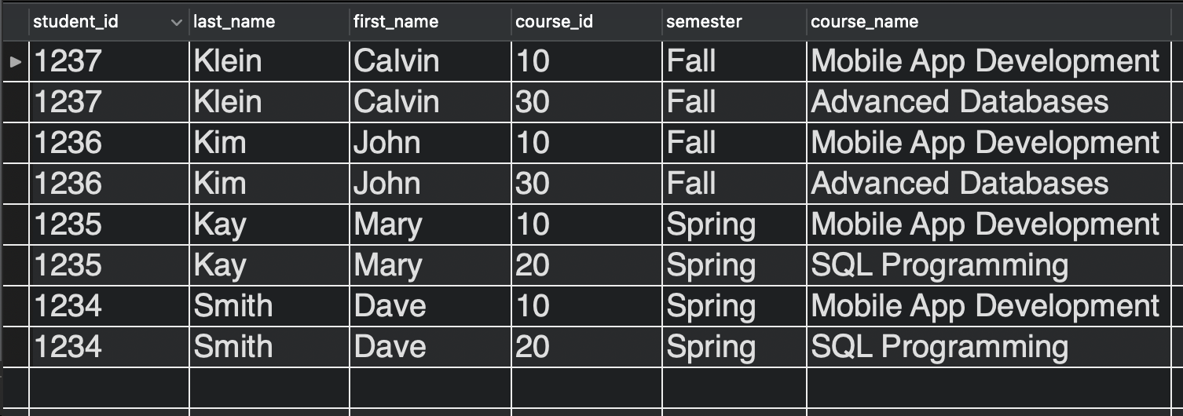
The result set should look like this

Slide 7
Now format the SELECT statement
select concat(student.first_name, ' ', student.last_name) as student_name,
course.course_name,
enrollment.semester
from student
inner join enrollment
on student.student_id = enrollment.student_id
inner join course
on enrollment.course_id = course.course_id
order by student.first_name, student.last_name;

Slide 8
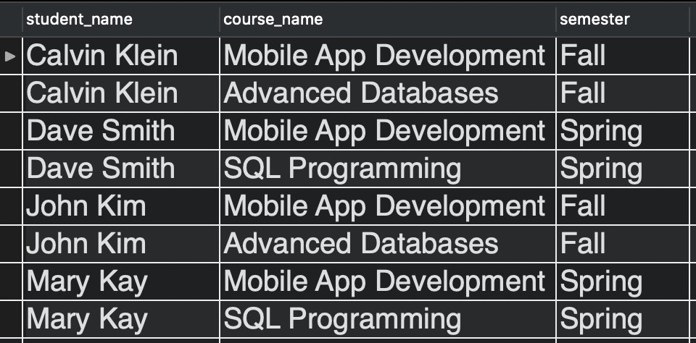
For the following result set

Slide 9
Joined statements can be filtered using the WHERE clause
select concat(student.first_name, ' ', student.last_name) as student_name,
course.course_name,
enrollment.semester
from student
inner join enrollment
on student.student_id = enrollment.student_id
inner join course
on enrollment.course_id = course.course_id
where enrollment.semester = 'Fall'
order by student.first_name, student.last_name;

Slide 10
Simplify the statement using aliases
select concat(s.first_name, ' ', s.last_name) as student_name,
c.course_name,
e.semester
from student s
inner join enrollment e
on s.student_id = e.student_id
inner join course c
on e.course_id = c.course_id
where e.semester = 'Fall'
order by s.first_name, s.last_name;

Slide 11
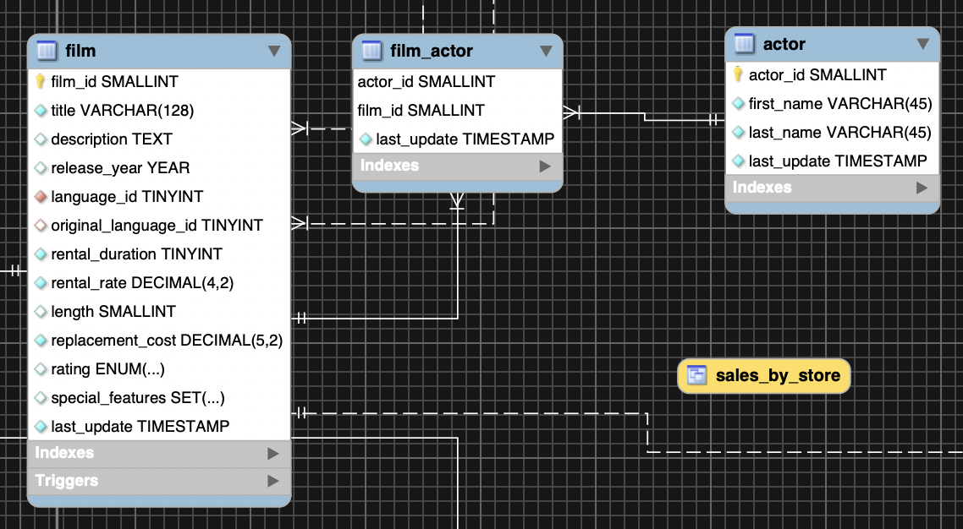
Exercises using the sakila database
Examine the film, actor, and film_actor tables

Slide 12
Exercises using the sakila database
Join the film and film_actor tables
Join the film, film_actor and actor tables
Filter the above joined statement to get all rows matching the film title 'ACADEMY DINOSAUR'
Narrow down the column list to get all actors who were in 'ACADEMY DINOSAUR'

Slide 13
Exercises using the sakila database
Referring to the staff, store and address tables
Get the street address of the store managed by Mike Hillyer
Get the number of films that are not in English
Get a list of all films available in inventory at the store on '47 MySakila Drive'

Slide 14
Concepts learned
INNER JOINs
Filtering statements that use INNER JOINs
concat() string function
Table aliases

