Slide 1
Deep Learning Terrorist Detection
Daniel S. Lee

Slide 2
Problem
Problem Set
Suppose a terrorist (or terrorists) intruded a government building. How can they be identified using elevator data?
Data
Simulated using Python. 20k+ datapoints produced for the month of May.
Following variables contained:
Passenger ID
Elevator ID
Entrance TS
Exit TS
Floor In
Floor Exit

Slide 3
Features
Pandas and Network X libraries used to derive features
Main Features (52 features generated)
Current Trip Features (i.e. entrance & exit timestamps and floors)
Passenger Profile Features (i.e. probability mass function of visits across day of week)
Traffic Features (i.e. # of people who visited the building)
Social Network Features (i.e. # of encounters and centrality)
Lag Window Features (i.e. most frequent floor entered in the past X days)

Slide 4
Unsupervised Neural Networks
Autoencoder used. Instead of prediction of class, prediction on X generated.
Model architecture:
4 Layers – 14, 7, 7, 29 neurons respectively
Parameters
Batch size = 40
Epoch = 200
Evaluation
Reconstruction Error = Euclidean Distance(X, X predict)

Slide 5
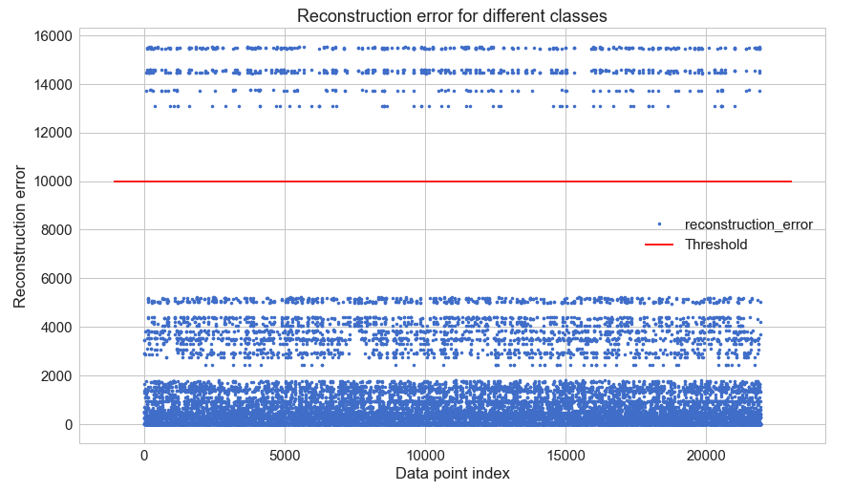
Flagging
Each trip is flagged as anomalous if the reconstruction error is higher than a threshold.

Slide 6
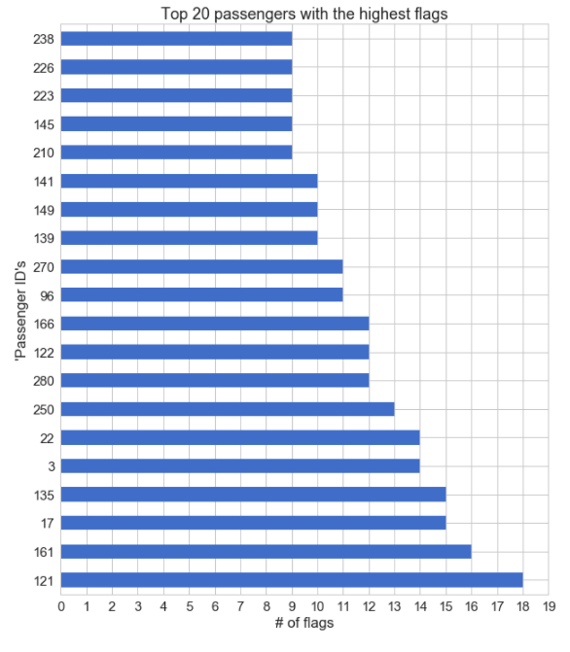
Terrorist Suspect Identification
Number of flags aggregated based on unique passenger ID and ranked.

Slide 7
Terrorist Collaboration Network
Network Analysis on elevator trips of an terrorist suspect can reveal who could be associated with the suspect.

Slide 8
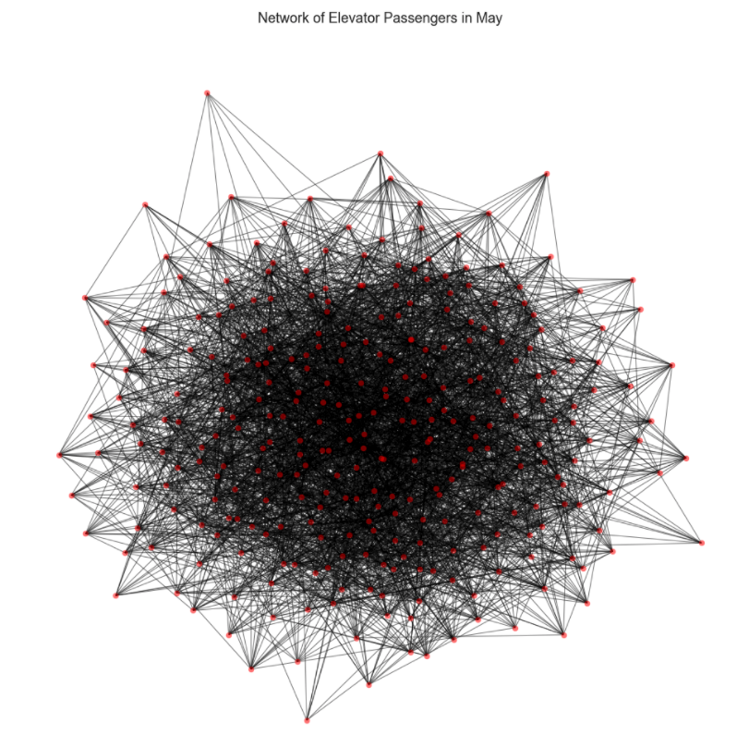

Slide 9
