Slide 1
Lesson 12: Controlling the Message
Cohesion and Prominence
English Unit 2: Natural Disasters

Slide 2
Learning Intention
I can explain how texts are made cohesive by using the starting point of a sentence to give prominence to the message.
Success Criteria:
I can identify the Theme and Rheme of a sentence.
I can explain how changing the Theme changes what is emphasised.
I can rewrite sentences to change their focus.

Slide 3
Activate: Which one flows better?
Paragraph A
Paragraph B
The Brisbane River rose quickly in 1974. Heavy rain fell for five days. Flooding hit 8,500 homes. The city changed forever after that.
In 1974, the Brisbane River rose quickly. After five days of heavy rain, flooding hit 8,500 homes. Following this disaster, the city changed forever.
What is the difference? Why does Paragraph B feel more professional?

Slide 4
Concept: Theme and Rheme
The floodwaters rose quickly.
THEME
RHEME
The starting point.
What the message is about.
The new information.
What we learn about the theme.

Slide 5
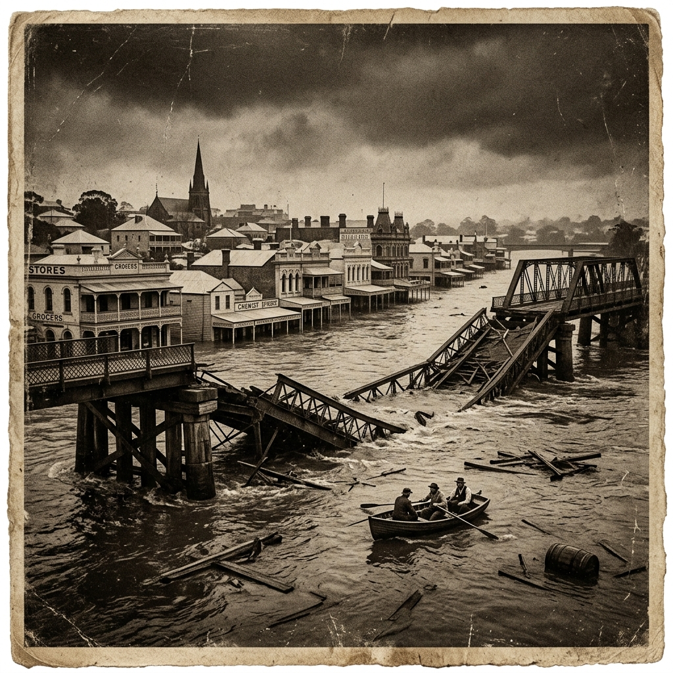
Archive Spotlight: Brisbane History
"In February 1893, three separate floods hit Brisbane within weeks of each other."
The author starts with the Time to show how unusual this wet season was.

Slide 6
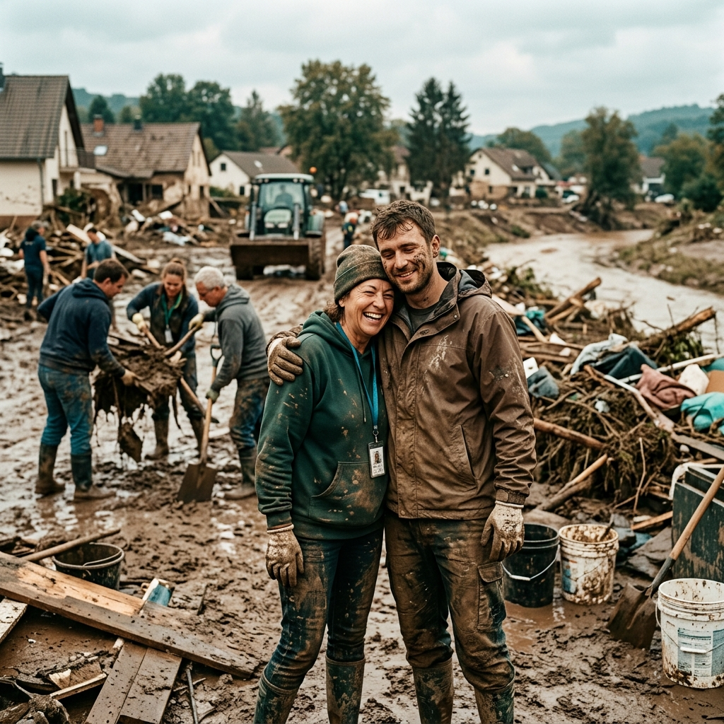
Archive Spotlight: Human Cost
"Across the 2011 and 2022 events, 46 lives were lost."
The author starts with the Context to group multiple events together and show the total impact.

Slide 7
Types of Themes (Starting Points)
Time
Place
"In 1974..."
"During the disaster..."
"At the City Gauge..."
"In the Lockyer Valley..."
Reason / Condition
Authoritative Source
"Because of the rain..."
"If the levee breaks..."
"According to the BoM..."
"Evidence shows that..."
Different starting points give prominence to different ideas!

Slide 8
Modelling: Rewriting for Emphasis
Fast-moving water is deceptive and lethal.
Goal: Emphasise the reason for the danger.
Because it is so deceptive, fast-moving water can be lethal.
By starting with "Because...", we tell the reader why it's dangerous before we tell them what the danger is.

Slide 9
Your Task: Lesson 12 Handout
Identify the Theme in the archive sentences.
Rewrite the five sentences to change their starting point.
Check: Does your new sentence start with the suggested words?
Main Focus:
Rewriting for Prominence

Slide 10
Controlling the Message
Tomorrow we explore: Visual Features & Image Sequences
Lesson 12 Complete

