Slide 1
Finding Missing Numbers
Mastering Inverse Operations, Balancing Scales, & the Distributive Law
Year 6 Mathematics | Number & Algebra Framework

Slide 2
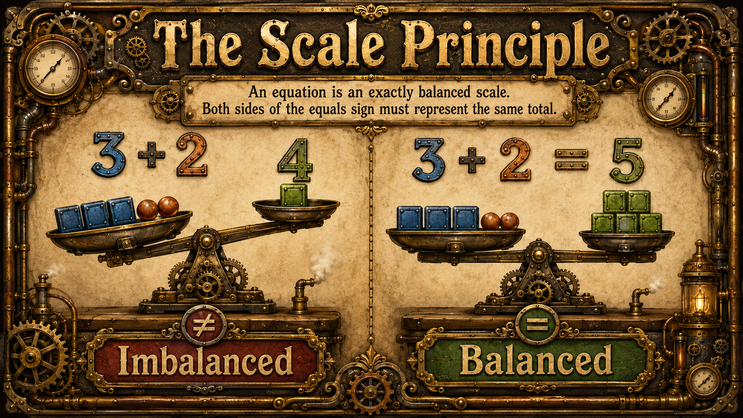
The Golden Rules of Balancing
• The Scale Principle: An equation is an exactly balanced scale. The values on both sides of the equals sign MUST represent the identical total.

Slide 3
The Golden Rules of Balancing
• Addition ↔ Subtraction: They are inverse operations (exact opposites). If a missing number sentence adds a value, subtract it from the total to work backwards!
• Multiplication ↔ Division: They form closely linked fact families. Use known multiplication facts to rapidly uncover unknown division components.

Slide 4
Solving Single-Step Sentences
ADDITION
[ ] + 8 = 15
Inverse Operation: 15 - 8 = 7 Missing Number: 7
SUBTRACTION
[ ] - 3 = 7
Inverse Operation: 7 + 3 = 10 Missing Number: 10
MULTIPLICATION
8 × [ ] = 40
Fact Family: 40 ÷ 8 = 5 Missing Number: 5

Slide 5
Mastering Division & Square Numbers
DIVISION INSIGHTS
24 ÷ [ ] = 3
Think methodically: What shares 24 into groups of 3? 24 ÷ 3 = 8 Missing Number: 8
SQUARE NUMBERS
[ ] squared = 64
Definition: Multiply a number by itself. What × What = 64? 8 × 8 = 64 Missing Number: 8

Slide 6
Strategy: Simplify Known Steps First
When facing multiple operations:
1. Find the parts with complete numbers. 2. Calculate their combined total immediately. 3. Rewrite the simplified sentence. 4. Solve using standard inverse logic.
Target Sentence: 6 + 7 + [ ] = 15
Step 1 (Combine): 13 + [ ] = 15
Step 2 (Inverse): 15 - 13 = 2
Final Answer: Missing Number is 2

Slide 7
Unlocking the Distributive Law
RULE: A factor outside brackets distributes across added terms inside.
5 × (4 + 6) = (5 × [ ]) + (5 × 6)
Look at the pattern matching without computing large totals: • The factor 5 multiplies both the 4 and the 6. • The right side displays (5 × 6), leaving the matching pair (5 × 4). Therefore, the missing number is precisely 4.

Slide 8
Your Turn: Independent Practice
1. Open your worksheet: Extra Support 18 (Finding missing numbers) 2. Work systematically through Sections 1 to 6. 3. Show clear working steps for multi-operation sentences. 4. Pro-Tip: Check answers for reasonableness by substituting them back in!

