Slide 1
Lesson 6: Characteristic Text Structures
Learning Intention:
I can explain how characteristic text structures support the purpose of an informative text.

Slide 2
Recap: Cyclone Archive
Last lesson, we looked at how authors adapt standard structures.
Different Cyclones: Tracy, Mahina, Larry, Althea.
Each page looks a bit different but follows the same basic blueprint.
Today, we will focus on why authors use specific structural features to present information.

Slide 3
Structure 1: Headings
Description: Large, bold text that separates sections of an article.
Why is it used?
Headings allow readers to skim the text and quickly locate specific information without reading every word.

Slide 4
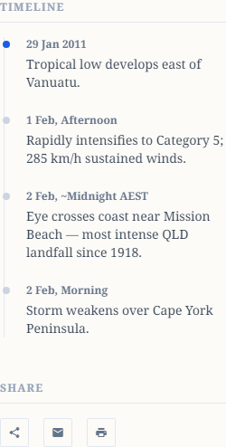
Structure 2: Timelines
Description: A chronological list of events placed in a sidebar or ordered list.
Why is it used?
Timelines condense a sequence of events into an easy-to-read format, helping the reader understand cause-and-effect and chronological order.

Slide 5
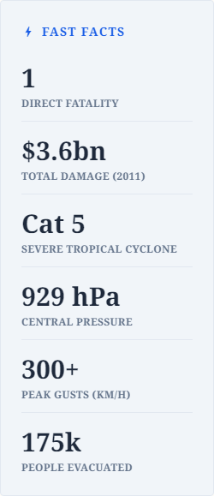
Structure 3: Fast Facts
Description: A breakout box highlighting key statistics and data points.
Why is it used?
It pulls out the most critical data so readers can grasp the scale of the event instantly without searching through dense paragraphs.

Slide 6
Your Turn: Structural Mapping
We've looked at the structures in the Cyclone Mahina page.
Now, map the structures of one sub-page of your choice using your graphic organiser handout.
Think about: What is the structure? Where is it located? Why did the author use it?

