Slide 1
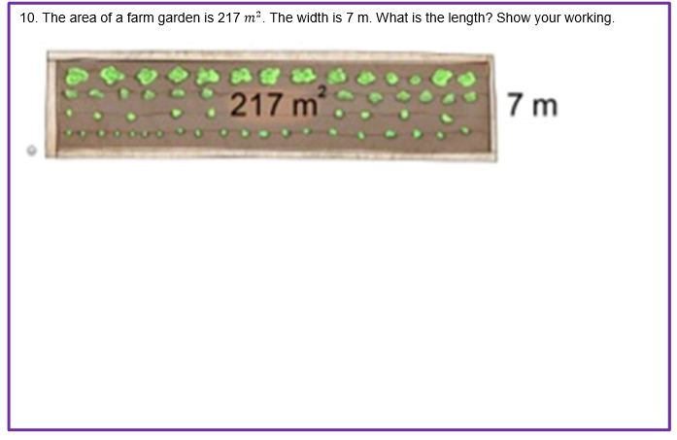
GREAT GARDEN
Find the missing side
Use area, division and a convincing check.
Year 5 mathematics
Notes:
Before revealing any method, ask: What might the missing length be? Students silently estimate and record a range. Then invite two estimates with reasons. Do not confirm the answer yet. (3 minutes)

Slide 2
GREAT GARDEN • YEAR 5
What do you notice — and what is hidden?
I notice…
I wonder…
02
Notes:
Students complete two silent stems: I notice… / I wonder… Then pair-share. Listen for: rectangle, area is 217 m², one side is 7 m, length is unknown. Ask which information describes space covered and which describes distance. (5 minutes)

Slide 3
GREAT GARDEN • YEAR 5
Three clues tell us what operation to choose
217 m²
7 m
? m
the whole area
one known side
the missing side
space covered
a length
another length
03
Notes:
Have students read each clue aloud with a partner. Ask: Which clue rules out multiplication? Establish that we know the whole area and one equal side-length factor, so division finds the missing factor. (4 minutes)

Slide 4
GREAT GARDEN • YEAR 5
Which equation matches the garden?
1
2
3
217 × 7 = ?
217 ÷ 7 = ?
217 − 7 = ?
Choose. Justify. Be ready to change your mind.
04
Notes:
Students vote with 1, 2 or 3 fingers, then justify to a partner using: I chose ___ because ___. Ask a student who changed their mind to explain what changed it. Correct choice: 217 ÷ 7 = ?. Misconceptions revealed: multiplying all visible numbers; subtracting because a number is missing. (5 minutes)

Slide 5
GREAT GARDEN • YEAR 5
Area is a product: rows × length
217 m²
7 m
? m
05
Notes:
Trace the rectangle: 7 metres wide means 7 equal rows across the width. The unknown length tells how many metre-columns fit along it. Connect A = l × w to 217 = ? × 7. Avoid saying 'move the 7'; name the inverse relationship. (5 minutes)

Slide 6
GREAT GARDEN • YEAR 5
Think in chunks: 217 ÷ 7
217 = 210 + 7
Why this works
210 ÷ 7 = 30
Break 217 into friendly multiples of 7. Divide each part. Recombine the quotients.
7 ÷ 7 = 1
30 + 1 = 31
So the length is 31 m.
06
Notes:
Model the complete solution once, narrating decisions. Then revisit each line and ask students to name its job. 217 = 210 + 7; 210 ÷ 7 = 30; 7 ÷ 7 = 1; 30 + 1 = 31. This uses known multiplication facts and place-value partitioning. (7 minutes)

Slide 7
GREAT GARDEN • YEAR 5
A reliable solution has four moves
1 • Name
2 • Relate
3 • Solve
4 • Check
Known: 217 m² and 7 m Unknown: length
217 = 7 × ? so ? = 217 ÷ 7
217 ÷ 7 = 31
31 × 7 = 217 Answer: 31 m
07
Notes:
Students point to the matching line in the worked example as each move appears. Emphasise that 'show your working' means the equation and division reasoning are visible, not only the answer. (3 minutes)

Slide 8
GREAT GARDEN • YEAR 5
Which student has convinced you?
Response A
Response B
217 × 7 = 1519 The length is 1519 m².
217 ÷ 7 = 31 Check: 31 × 7 = 217 The length is 31 m.
Revise one line in the weaker response.
08
Notes:
Pairs compare the two responses using the success criteria. Response B is stronger: correct operation, working, check and correct linear units. Ask students to revise Response A rather than merely label it wrong. (5 minutes)

Slide 9
GREAT GARDEN • YEAR 5
m² measures area; m measures length
m²
m
space covered
distance along a side
The unknown is a side length → 31 m
09
Notes:
Use a quick call-and-response: area? square metres; side length? metres. Ask why 31 m² cannot label one side. Students annotate the units on Worksheet 2. (3 minutes)

Slide 10
GREAT GARDEN • YEAR 5
We do: prove the missing side
Garden A
Garden B
Area = 168 m² Width = 6 m Length = ?
Area = 216 m² Length = 24 m Width = ?
Show an equation. Show division. Check by multiplying.
10
Notes:
Students solve on mini-whiteboards. Require the four moves: name, relate, solve, check. Reveal solutions only after partner comparison. A: 168 ÷ 6 = 28 m. B: 216 ÷ 24 = 9 m. Use B to check whether students can identify whichever side is missing. (7 minutes)

Slide 11
GREAT GARDEN • YEAR 5
You design: a garden with one hidden side
Choose one area
180 m² 224 m² 315 m²
Draw • label • calculate • check
Choose one known side
6 m 7 m 9 m
Make sure your choices divide exactly.
11
Notes:
Students complete Worksheet 3 independently. They choose one area and one side from the menu, calculate the missing side, draw and label the garden, and write a check. Support: use the 180 m², 6 m option and the partition strip. Extend: create a different factor pair for the same area and compare perimeters. (10 minutes)

Slide 12
GREAT GARDEN • YEAR 5
Swap, test, revise
Reviewer
Feedback that helps
Equation matches the story
Division working is visible
“Your equation shows…” “To make your proof clearer…”
Check returns the area
Final unit is metres
Revise one thing now.
12
Notes:
Partners exchange one solution. Reviewer checks each item and gives one precise comment. Creator immediately revises one element. Stems: Your equation shows… / To make your proof clearer… (4 minutes)

Slide 13
GREAT GARDEN • YEAR 5
Assessment rehearsal: show enough to convince
Your proof must include
• an equation • division working • a multiplication check • the answer in metres
Work independently.
13
Notes:
Students now complete the original assessment item independently in the boxed space on Worksheet 4. Give quiet time and do not scaffold the operation. Collect evidence of readiness against the four criteria. Expected: 217 ÷ 7 = 31; check 31 × 7 = 217; length 31 m. (6 minutes)

Slide 14
GREAT GARDEN • YEAR 5
Exit ticket: explain the decision
A rectangular garden has an area of 252 m² and a width of 7 m. Find its length.
Why is division the correct operation?
Show working • check • label the answer
14
Notes:
Students answer on Worksheet 4: A rectangle has area 252 m² and width 7 m. Find the length and explain why division is the correct operation. Expected length 36 m; explanation identifies area as the product/whole and 7 as a known factor. Use responses to group next lesson: secure, calculation support, or concept/operation support. (4 minutes)

Slide 15
The garden mystery is solved.
Area ÷ known side = missing side
31 m × 7 m = 217 m²
Name it. Relate it. Solve it. Check it.
Notes:
Close by returning to the opening estimate. Ask: Was 31 m reasonable? What evidence now makes us certain? Celebrate changed thinking, not speed. (1 minute)

