Slide 1

Tarampa State School
Term 2, Week 3

Slide 2

We acknowledge the Traditional Custodians of the lands, seas, skies and waterways from across Queensland. Here we acknowledge the Jagera, Yuggera and Ugarapul people. We pay our respect to the Elders, past, present and emerging, for they hold the memories, traditions, the culture and hopes of Aboriginal and Torres Strait Islander peoples across Queensland and Australia.

Slide 3
Here is the land,
Here is the sky,
Here are my friends, and here am I.
We thank the Jagera, Yuggera and Ugarapul people for the land on which we learn and play.
Hands up, hands down, we’re on Jagera, Yuggera and Ugarapul ground.

Slide 4


Our Koala values

Slide 5


Our school Oath
We are the Tarampa Koalas,
We show kindness throughout the day,
Make appropriate choices in learning and play
We are respectful in every way
Everyone is different and that’s okay.
Koalas own what we do,
Great decisions through and through
Safe, accepted, Tarampa hooray!

Slide 6
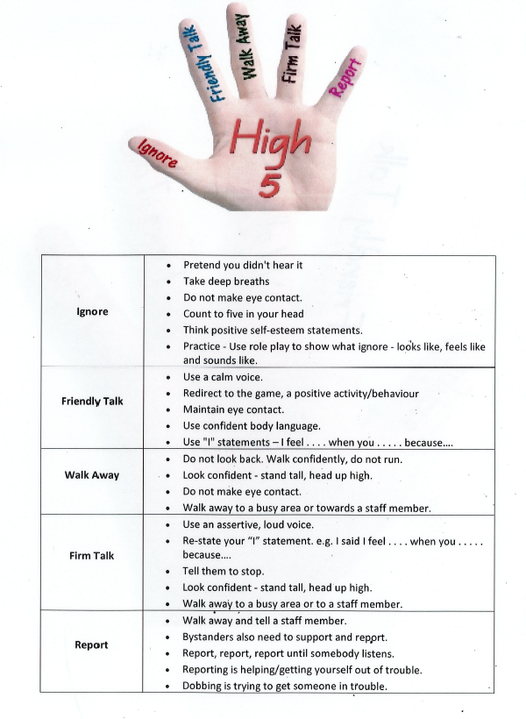

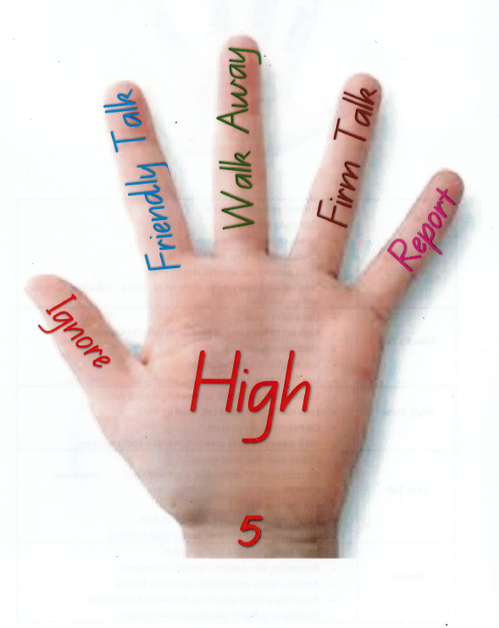
Tarampa Behaviour Expectations
and Strategies

Slide 7


WHATS ON THIS WEEK
WEEKLY FOCUS: I HAVE THE RIGHT JUMPER, AND I PUT IT IN THE RIGHT PLACE.
MONDAY
TUESDAY
WEDNESDAY
THURSDAY
FRIDAY
Public Holiday
Year 5 Picnic tables
2nd Break Netball
3/4 Picnic tables
Western Rangers Cross Country
Max’s Birthday!
1/2 Picnic tables
2nd Break Games Club
Book Fair opens
P/1 Picnic tables
2nd Break Gardening
2nd Break Zooper Doopers
Book Fair

Slide 8

Book Fair
Book Fair runs Thu 7th of May - Tue 12th of May
Open daily: 8:30 - 9:00am & 3:00 - 3:30pm
Classes will each visit the book fair at teacher-suitable times so students can create a Wish List
4 × $15 vouchers to be won, receive 1 entry into the voucher draw for each $10 spent
Voucher winners drawn Mon 11th of May so they have time to shop before book fair ends
Parents can order online using Wish Lists, you will need to bring your Wish List to library to collect purchases

Slide 9

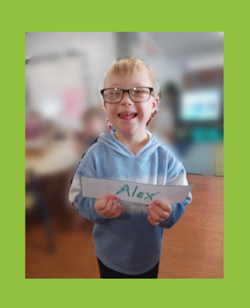
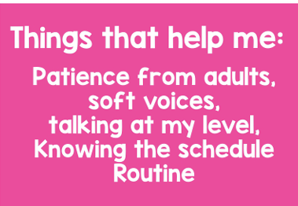
Guidance to help Alex
This is Alex. Alex has Down Syndrome and is in Prep this year. Alex loves playing ball games, in the sandpit or outside with his friends. Alex communicates using Auslan, gestures, sounds and body language.

Slide 10


Attendance matters
Whole school attendance rate: | 91.01%
P-1 Attendance Rate | 90.18%
1-2 Attendance Rate | 90.47%
3-4 Attendance Rate | 88.76%
5 Attendance Rate | 93.57%
6 Attendance Rate | 92.10%
Congratulations year 5, you were the Attendance winners of week 2!
Make sure you are at school on time, every day!​

Slide 11
Book Fair
Book Fair runs Thu 7th of May - Tue 12th of May
Open daily: 8:30 - 9:00am & 3:00 - 3:30pm
Classes will each visit the book fair at teacher-suitable times so students can create a Wish List
4 × $15 vouchers to be won, receive 1 entry into the voucher draw for each $10 spent
Voucher winners drawn Mon 11th of May so they have time to shop before book fair ends
Parents can order online using Wish Lists, you will need to bring your Wish List to library to collect purchases

