Slide 1
Draw It to Solve It!
Maths Unit 2 • Lesson 11
VISUALISING NATURAL DISASTER WORD PROBLEMS ON WHITEBOARDS

Slide 2
INTRODUCTION
Why Draw the Problem?
A word problem is a story first!
Before doing any addition, subtraction, multiplication, or division, we must understand the action taking place in that story.
Our Goal Today:
Read the natural disaster scenario.
Draw the people, items, and action.
Label the numbers on the diagram.
Write the number sentence.
Explain your picture to your partner.
If you can draw it, you understand it.
Your whiteboard is a sketchpad to show the people, the objects, and the mathematical action (distributing, taking away, grouping, or combining).

Slide 3
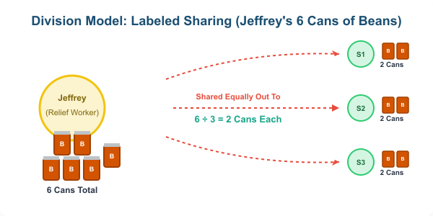
MODEL 1: DIVISION
Jeffrey's Canned Beans (Flood Relief)
Read the Scenario:
"Jeffrey is a disaster relief worker. He has 6 cans of beans to share equally between 3 flood survivors. How many cans does each survivor receive?"
Notice the Action:
Start with a whole group (6 cans of beans).
Share out equally to 3 different groups.
Action: Splitting a whole into equal parts = Division!

Slide 4
DIAGRAM BREAKDOWN
How to Draw Division
Steps to Draw on your Whiteboard:
Draw the Starter (The Giver): Sketch Jeffrey and the 6 cans of beans together.
Draw the Receivers: Draw 3 separate survivor figures.
Draw the Action (Arrows): Group the beans and draw sharing arrows from the beans to each person.
Label and Write: Label how many beans each person got (2). Write 6 ÷ 3 = 2.
Student Whiteboard Check:
Did you draw 6 items?
Did you draw 3 target groups?
Did you divide them evenly?
Is your final answer labelled (2 cans)?

Slide 5
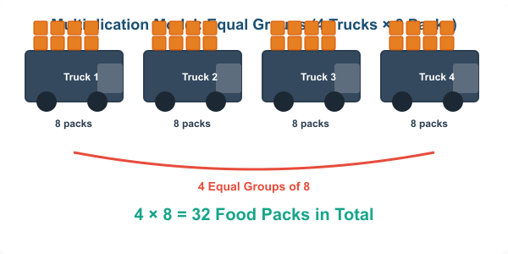
MODEL 2: MULTIPLICATION
Flood Supply Trucks (Equal Groups)
Read the Scenario:
"After the flood, 4 emergency supply trucks each carried 8 food packs to the disaster zone. How many food packs arrived in total?"
Notice the Action:
We have 4 trucks (4 groups).
Each truck has exactly 8 packs (equal items per group).
Action: Repeated addition of equal groups = Multiplication!

Slide 6
DIAGRAM BREAKDOWN
How to Draw Multiplication
Steps to Draw on your Whiteboard:
Draw the Groups: Sketch 4 simple trucks (rectangles with wheels are perfect!).
Draw the Items inside: Draw 8 small box shapes inside/near each truck.
Label the Quantities: Write "8" under each truck to represent the equal quantity.
Draw the Total Bracket: Bracket them together and write the sum: 4 × 8 = 32.
Student Whiteboard Check:
Are all your groups equal (8 in each)?
Do you have exactly 4 groups?
Did you label the numbers?
Is your final answer labelled (32 packs)?

Slide 7
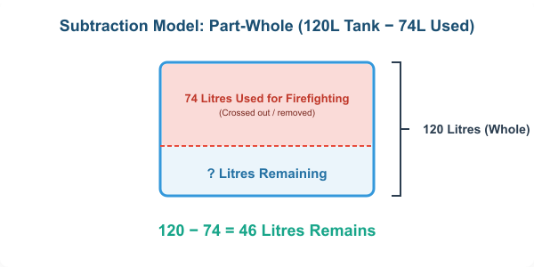
MODEL 3: SUBTRACTION
Bushfire Water Reserves (Taking Away)
Read the Scenario:
"Before the bushfire, the town's reserve tank held 120 litres of water. After three days of firefighting, 74 litres had been used. How much water remains in the tank?"
Notice the Action:
We start with a whole amount (120 Litres).
We take a part of it away (74 Litres used).
Action: Removing a part to find what is left = Subtraction!

Slide 8
DIAGRAM BREAKDOWN
How to Draw Subtraction
Steps to Draw on your Whiteboard:
Draw the Whole (The Tank): Draw a big box/cylinder and label the side "120 L".
Mark the Part Taken: Partition the tank. Shade/cross out the top part and label it "74 L used".
Label the Unknown Part: Put a "?" in the unshaded bottom part.
Write the Math sentence: Solve for the remaining part: 120 − 74 = 46.
Student Whiteboard Check:
Did you start with the full amount (120)?
Did you clearly separate the part taken away?
Is the remaining part labeled "? remains"?
Is your final answer labelled (46 litres)?

Slide 9
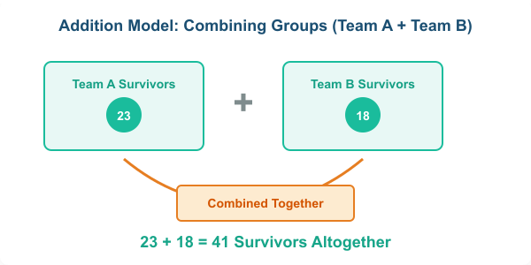
MODEL 4: ADDITION
Cyclone Evacuation (Combining Groups)
Read the Scenario:
"Team A rescued 23 survivors from the cyclone damage. Team B rescued 18 survivors. How many survivors were rescued altogether?"
Notice the Action:
We have two separate parts (23 and 18).
We want to find the total combined amount.
Action: Putting two unequal groups together = Addition!

Slide 10
DIAGRAM BREAKDOWN
How to Draw Addition
Steps to Draw on your Whiteboard:
Draw the Parts: Draw two separate boxes or circles side-by-side.
Label the Groups: Label one "Team A: 23" and the other "Team B: 18".
Draw the Action (Combine): Draw arrows from both circles leading down into a larger "Altogether" container.
Write the Math sentence: Calculate the sum: 23 + 18 = 41.
Student Whiteboard Check:
Did you keep the two starter groups separate at first?
Did you draw arrows showing them combining?
Did you label both numbers?
Is your final answer labelled (41 survivors)?

Slide 11
PRACTICE TIME
Your Turn! (Pair Whiteboard Practice)
Directions:
Whiteboard Quality Guide:
1. Work in pairs. Take a Disaster Card.
2. **Partner A:** Draw the scenario on the whiteboard. Focus on the action (people, items, movement).
3. **Partner B:** Identify the operation (+, −, ×, ÷) and write the matching number sentence below the drawing.
4. **Both:** Explain your choices to each other, erase, and swap roles!
Sketch simple blocks, circles, or stick figures.
Use arrows to show sharing, taking away, or combining.
Label all numbers in the drawing.
Circle the operation symbol clearly at the bottom.

Slide 12
Reflecting on our Diagrams
How did your whiteboard drawing help you?
"Your picture is your proof!"
Sharing is Caring
If you're stuck on a word problem, don't guess. Draw the characters, draw the items, and do what the story tells you to do.
Explain your drawings to your peers! Speaking mathematically builds your brain's connection to word problems.

