Slide 1
Lesson 2
Stages of an Informative Text
Cyclone Archive Hub and Cyclone Tracy
Year 5 English — Unit 2 — Sequence 1, Week 1
Tarampa State School · Term 2, 2026

Slide 2
Learning intention
Learning intention
I can describe the characteristic stages and phases of an informative text.
Success criteria — I am successful when I can:
• Name the parts of a PEEL structure. .
• Match parts of the Cyclone Archive hub page to a PEEL stage. .
• Annotate the Cyclone Tracy sub-page in pairs using stage labels.

Slide 3
Activate — Purpose and audience (rom Lesson 1)
What is the purpose of the Cyclone Archive hub page?
Who is a likely audience? What clues did you use?
Today we ask: How is the information organised in stages?

Slide 4
Explore — Characteristic stages
Informative texts often move through stages that help readers learn in a logical order.
In this lesson we use four stages:
1. Point
2. Explain.
3. Evidence
4. Link

Slide 5
Stage reference — what each stage does
Point— names the topic and scope; tells what kind of information to expect.
Explanation — sets the scene; introduces key parts, places, or categories.
Elaboration— adds precise detail: numbers, dates, evidence, explanation.
Link — pulls key ideas together; highlights main findings or takeaways.

Slide 6
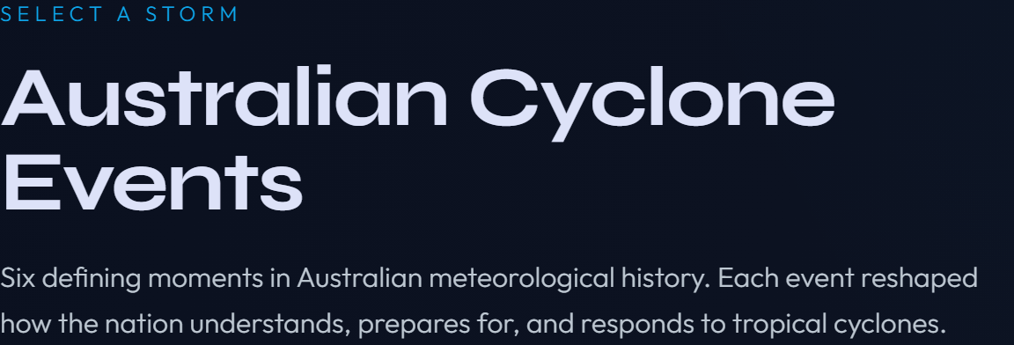
Hub — Point. (editorial intro)
1. Which stage fits this block best — mostly classification, or mostly factual elaboration? Why?
2. What phrases show the topic and scope (what the archive is about)?
3. Why might the writer place this overview before the cyclone cards?

Slide 7
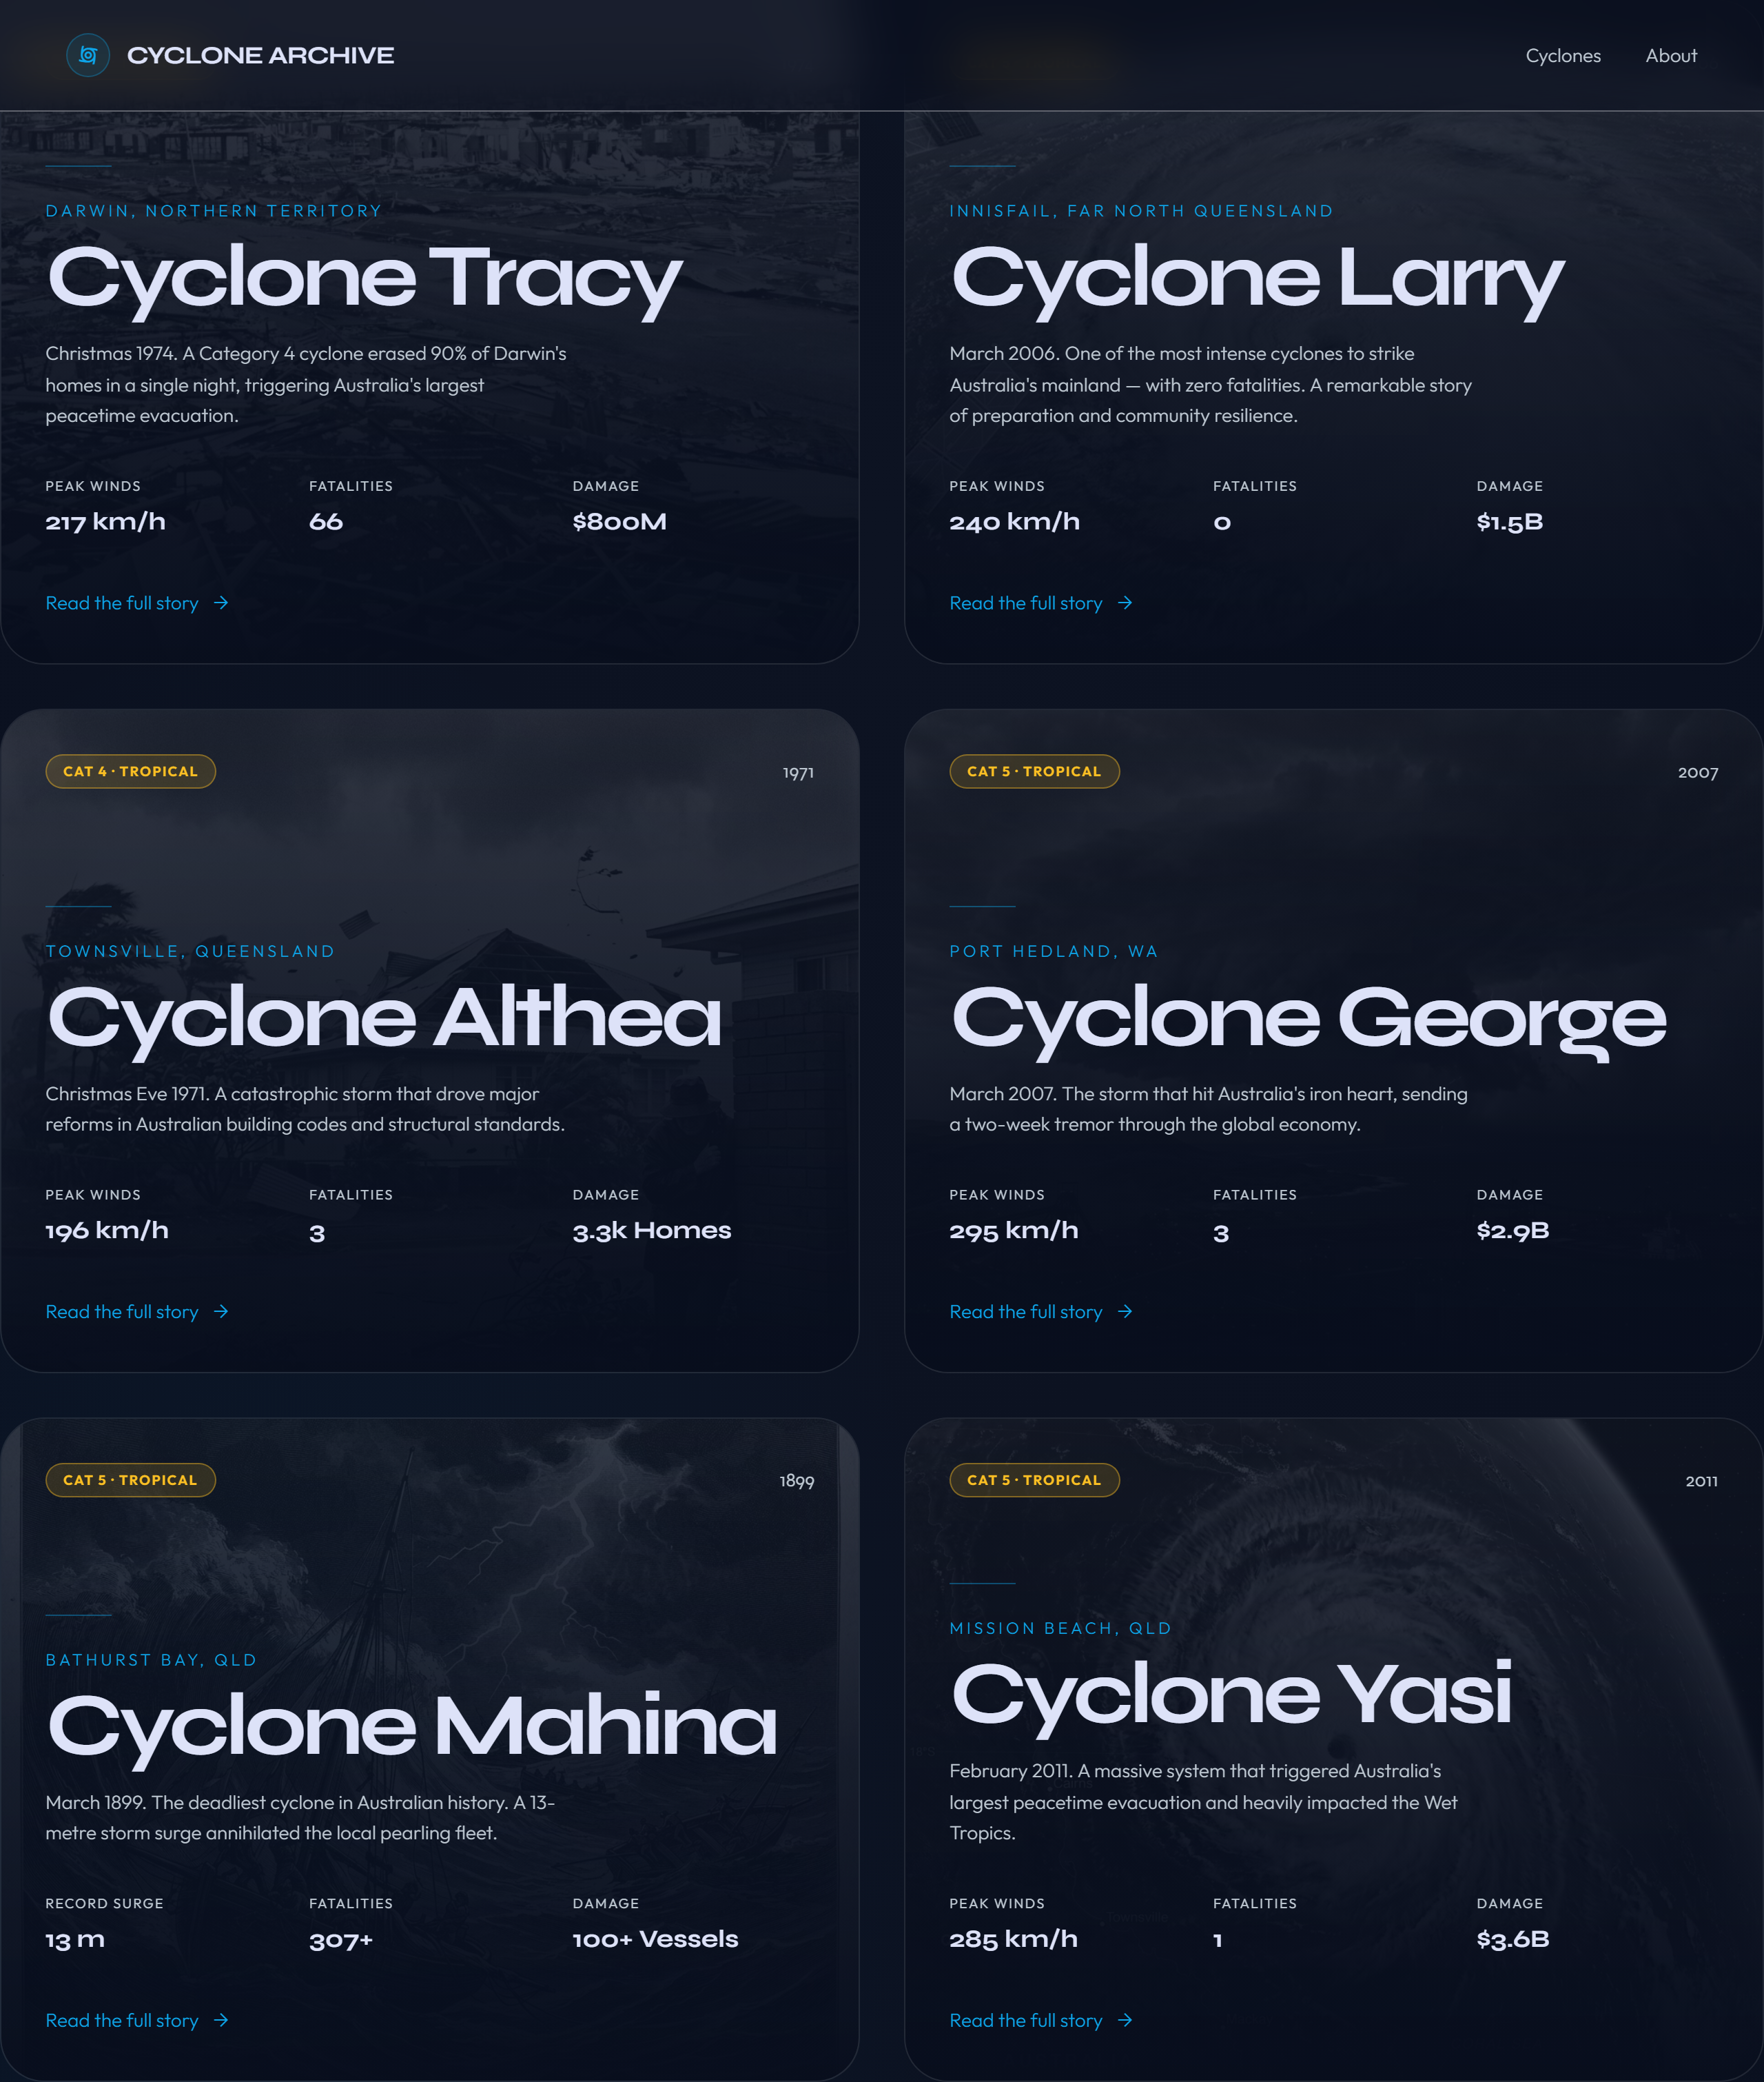
Hub — Explain (chapter cards)
1. How do the cards help describe the archive in parts rather than one long chunk?
2. What is repeated on each card (year, place, teaser, data) — and why repeat it?
3. Which stage is this mainly doing — description or factual elaboration? Defend your choice with one clue.

Slide 8
1. What factual details can you read straight from the numbers?
2. How do statistics support the informative purpose before you read full stories?
3. Pick one number. What does it prove or illustrate?
Hub — Evidence (statistics strip)

Slide 9
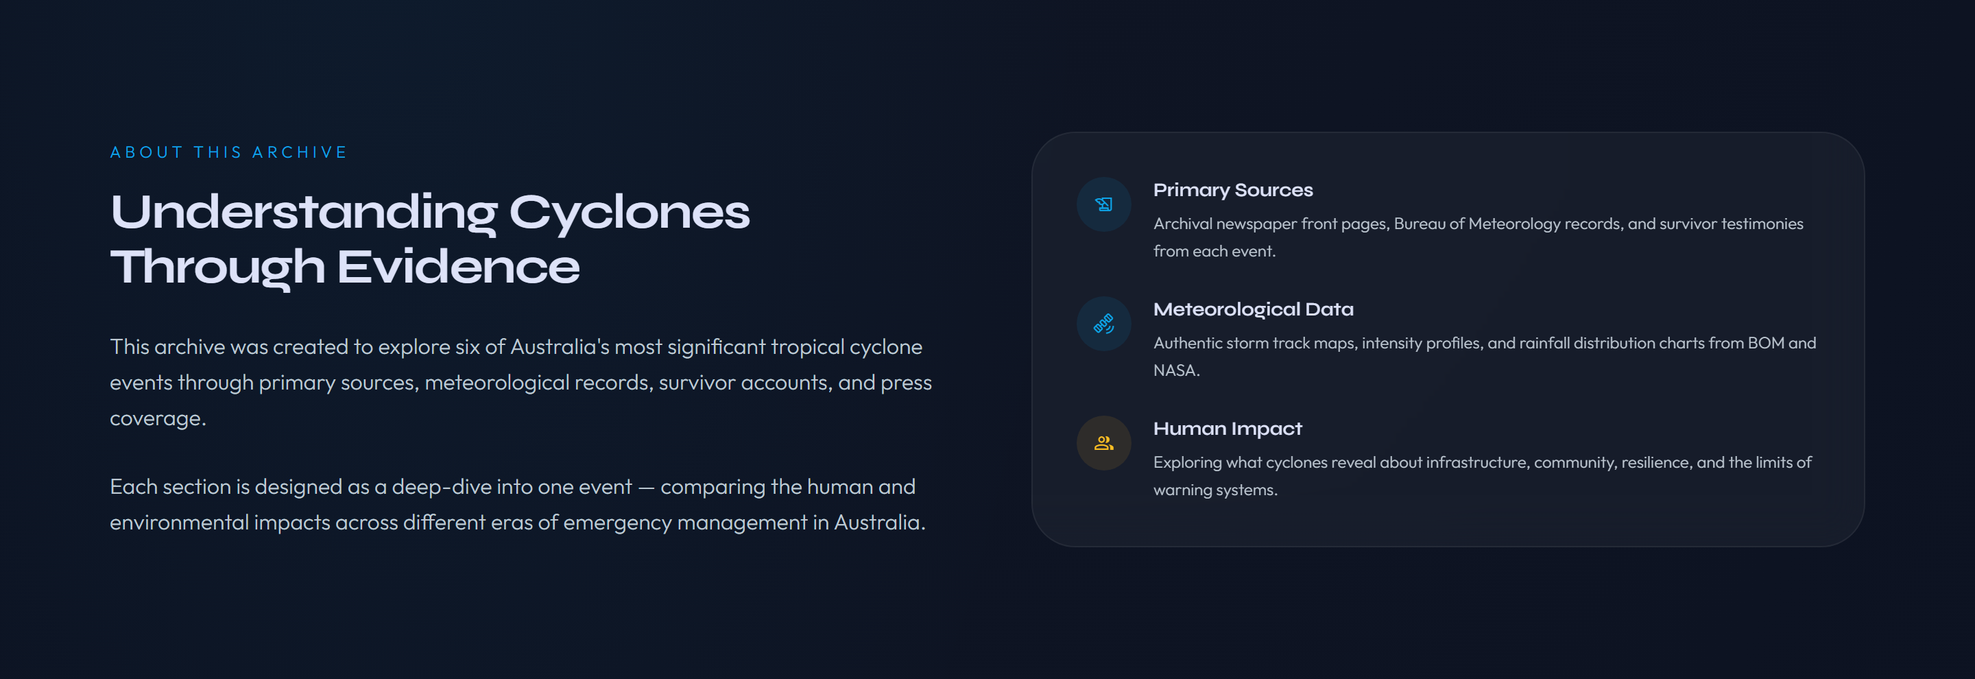
Hub — Link.
1. How does this section pull together what the archive offers readers?
2. Where do you see synthesis (bringing lenses together) rather than a single new fact?
3. Could this work like a conclusion on a webpage? Why or why not?

Slide 10
Model — Annotating the hub page
Teacher think-aloud:
• "This paragraph mainly classifies the topic because…"
• "These cards mainly describe the parts because…"

Slide 11
Now — Cyclone Tracy sub-page
Open: Cyclone Archive → Cyclone Tracy (or your printed copy).
We will use the same four stages on a chapter page.
Look for: hero title, intro paragraphs, section headings, sidebar facts.
Question to hold in mind: Does every section fit only one stage, or can stages overlap?

Slide 12
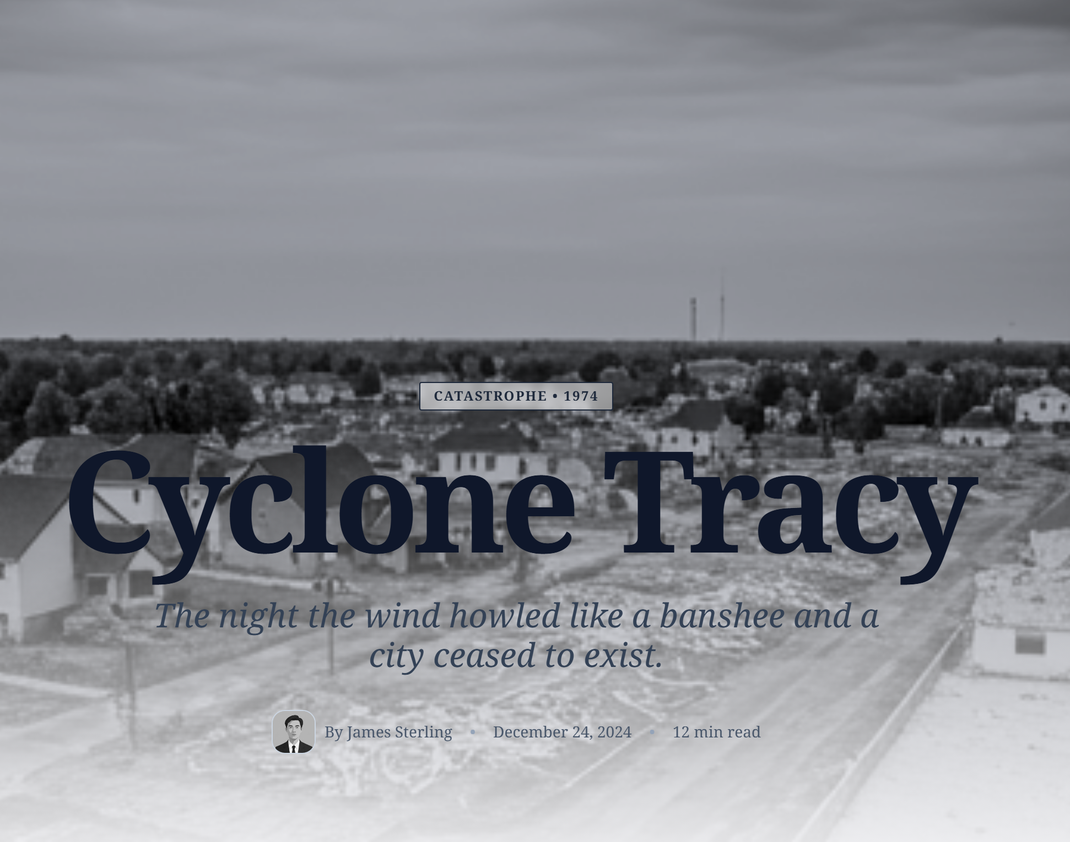
Tracy — Classification (hero)
1. What tells you the topic and time period in one glance?
2. How does the deck line under the title shape what kind of text this is?
3. Who is this hero section for — quick scanners or deep readers? How do you know?

Slide 13
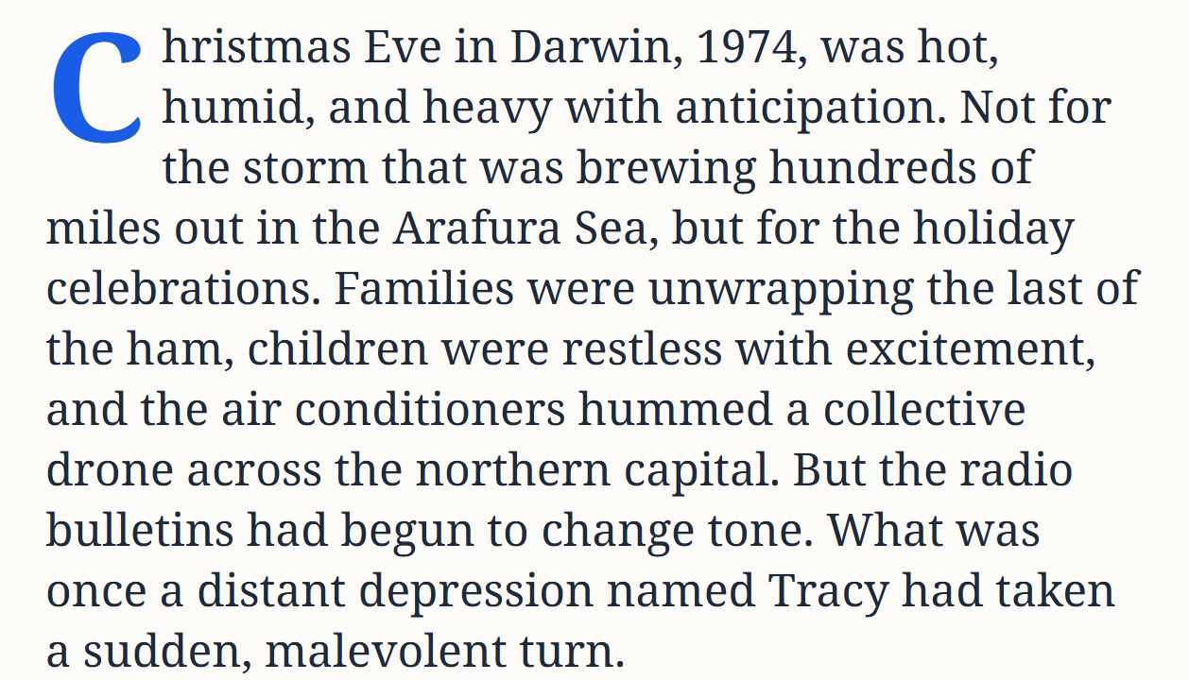
Tracy —(intro paragraphs)
What scene does the writer set before giving detailed impacts?
2. Which details are observational (conditions) versus measured (e.g. wind speed)?
3. Is this mainly description or already factual elaboration? Why might pairs disagree?

Slide 14
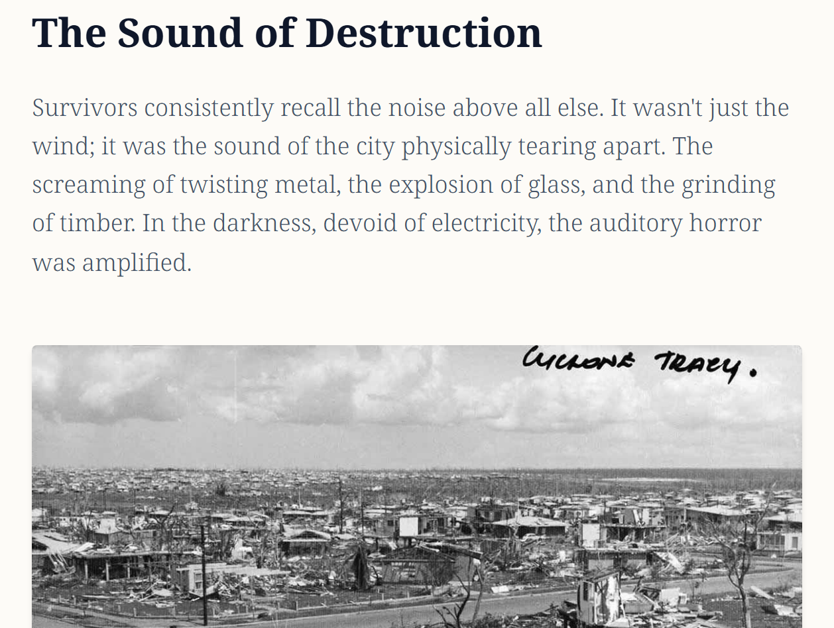
Tracy — (The Sound of Destruction)
1. What factual claims can you find about damage and loss?
2. How do image and caption add information the paragraphs do not?
3. Which numbers or specifics would you underline as evidence?

Slide 15
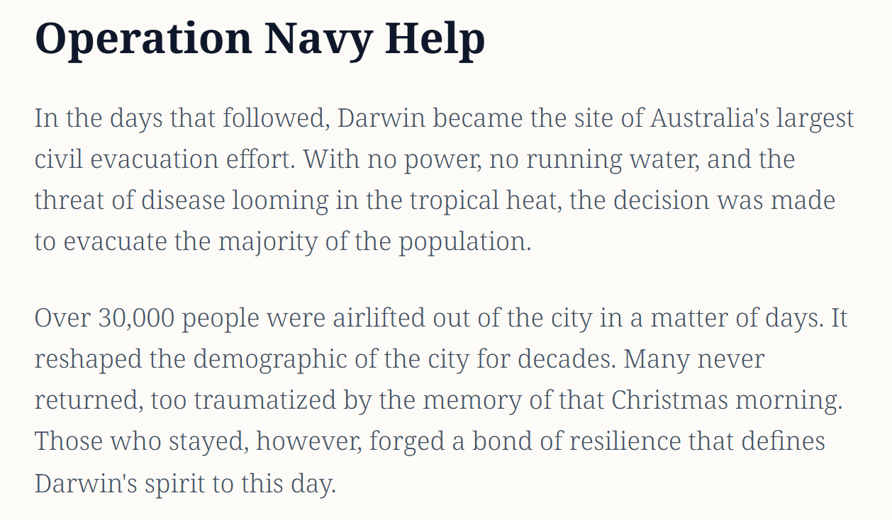
Tracy — (Operation Navy Help)
1. What response facts are given (evacuation, time span)?
2. How does this section extend the timeline after landfall?
3. Is this still elaboration, or does it begin to summarise the human response? Discuss.

Slide 16
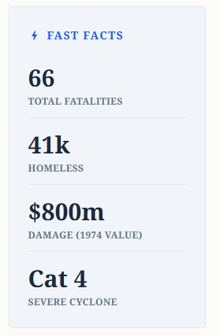
Tracy — Summary-style takeaways (Fast Facts)
1. How is information compressed compared with the long article?
2. Which facts would a reader use to compare Tracy to another cyclone?
3. Why place Fast Facts in the margin instead of only at the bottom?

Slide 17
In pairs, complete the Cyclone Larry grid on your worksheet.
For each Section
Decide the best-fitting stage.
Write one evidence clue copied from the page.
Connect — Pair task

Slide 18
Students: On your worksheet, complete the exit ticket:
• The four stages in order: ___, ___, ___, ___.
• The stage I was most confident about was ___ because ___.
Extension (core): find one extra sentence of factual elaboration on the Tracy page and read it aloud.
Hide or mask the teacher block if you export a student PDF.
Exit ticket

