Slide 1
Lesson 1
Why Do People Write?
Purpose and Audience in the Cyclone Archive
Year 5 English — Unit 2 — Sequence 1, Week 1
Tarampa State School · Term 2, 2026

Slide 2
Welcome to Unit 2 — Learning intention
Unit focus: Examining, creating and sharing informative texts.
Learning intention
I can identify the purpose and audience of an informative text.
(AC9E5LY03, AC9E5LA03)
Success criteria — I am successful when I can:
• Say what this text is trying to do (its purpose).
• Say who the text is written for (its audience).
• Give at least one clue from the Cyclone Archive hub page that supports my ideas.

Slide 3
Activate — Prior knowledge
Think, pair, share:
• What do you already know about cyclones?
• What informative texts have you read before (websites, brochures, reports, news explainers)?
You will use your worksheet: K (Know) and W (Want to know) columns.
Teacher note: Record a few class ideas on the board to refer back to at the end (L column).

Slide 4
Our assessment — Parts A, B and C
Part A (Week 7): Short written responses about an informative archive text.
Part B (Weeks 5–7): Written multimodal information report on a natural disaster topic.
Part C (Week 8): Multimodal presentation to an audience.
Today we begin with reading like writers: we study the Cyclone Archive so we can later create our own informative texts.

Slide 5
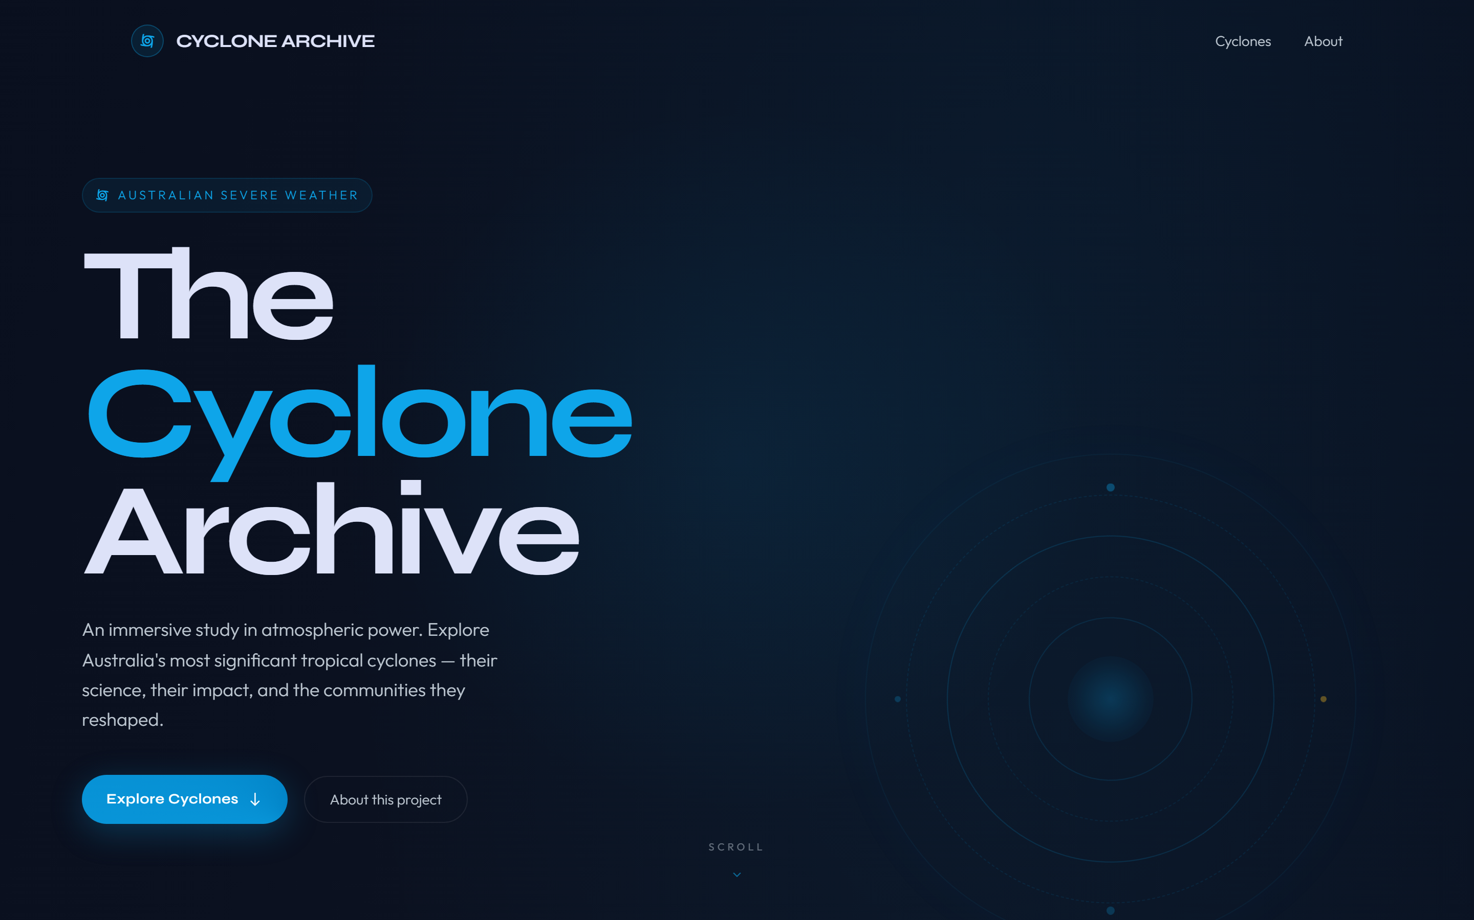
Meet the Cyclone Archive — hub page
We are viewing the home page (hub) of the archive.
As we explore, ask:
• What is this site for?
• Who is meant to read it?

Slide 6
Aspect 1 — Hero banner (title and deck)
1. Why might the writer open with "An immersive study in atmospheric power"?
2. Who do you think this website is for — primary students, secondary students, or the general public? What clues help you decide?
3. Does the headline sound more like a storybook, an advertisement, or an information source?

Slide 7
Aspect 2 — Statistics strip
1. Why place big numbers (6 events, 295+ km/h, 112 years, Cat 5) near the top?
2. What message do these statistics send about the topic before you read further?
3. How does this connect to the purpose of an informative text?

Slide 8
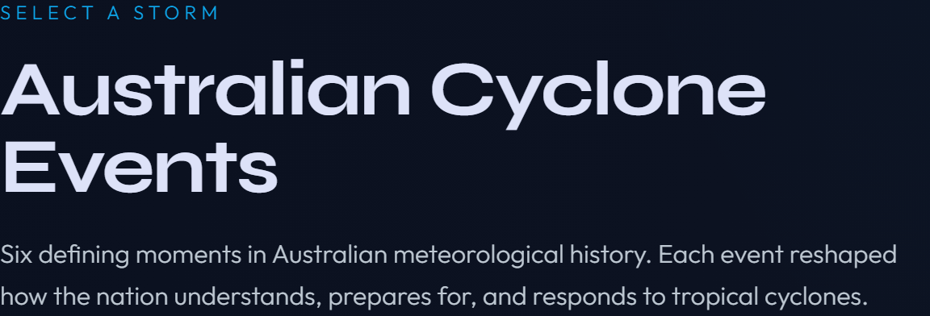
Aspect 3 — Section introduction (Australian Cyclone Events)
1. Is this section mainly trying to entertain us, persuade us, or inform us? How can you tell?
2. Pick one phrase that sounds factual rather than opinionated.
3. Who would need this overview before reading the individual cyclone stories?

Slide 9
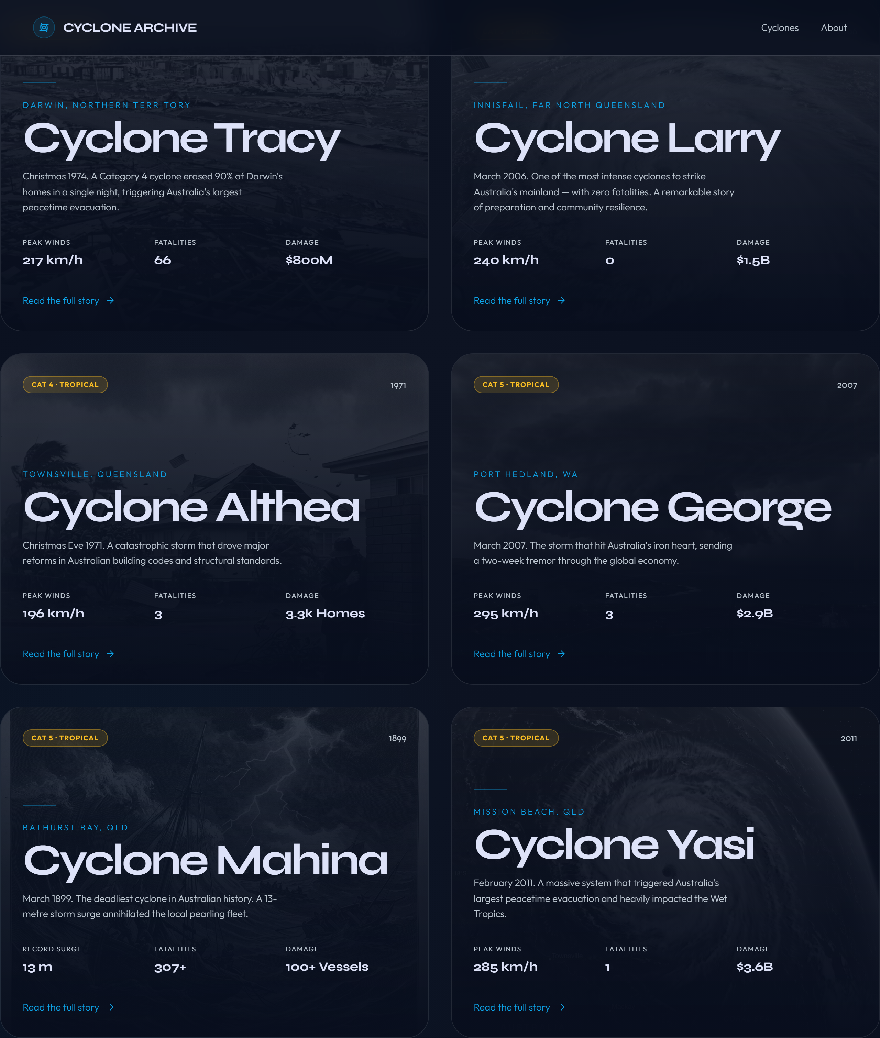
Aspect 4 — Chapter cards (six events)
1. Why split the archive into six separate events instead of one long page?
2. How do the cards help a reader choose where to go next?
3. What do the cards have in common (layout, data, link)? Why would the designer repeat that pattern?

Slide 10
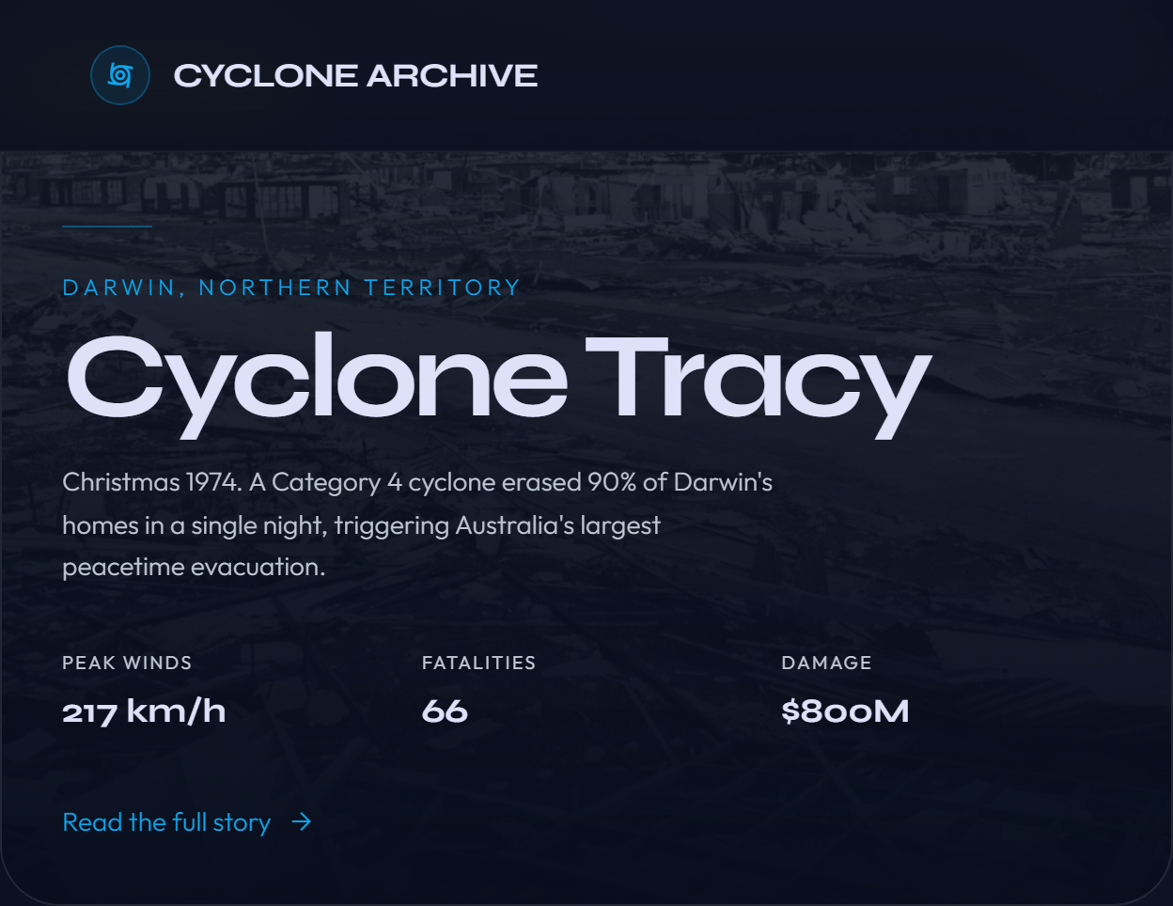
Aspect 5 — One card in detail (Cyclone Tracy)
1. What information is repeated on each card (winds, damage, links, teaser text)?
2. Why give a short teaser before the reader clicks through to the full story?
3. How does the image in the background support meaning, even when it is faint?

Slide 11
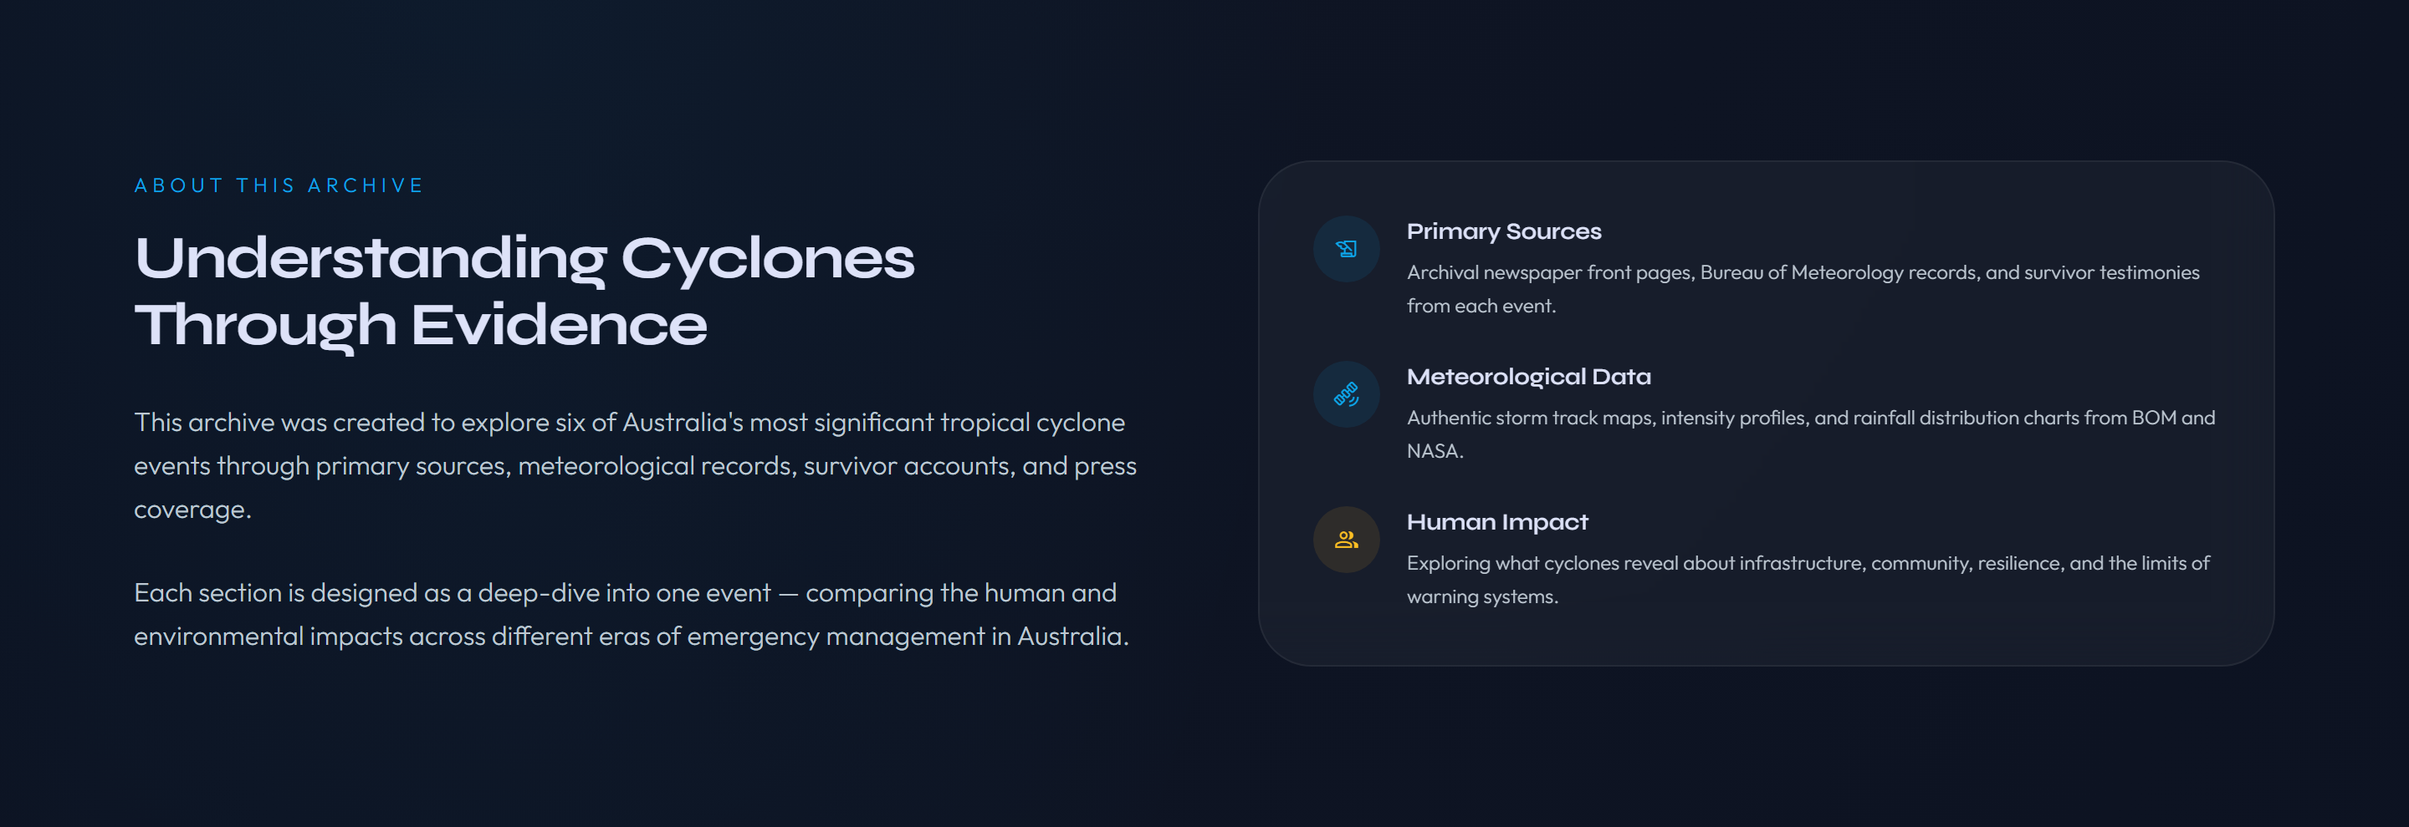
Aspect 6 — Understanding cyclones through evidence
1. What three kinds of evidence does the archive promise (look at the three labelled blocks)?
2. Why would an informative text bring together primary sources, meteorological data, and human impact?
3. Which block would a scientist care about most? Which might a historian care about most?

Slide 12
Aspect 7 — Navigation: header and footer links
1. How do you move around this website using the header?
2. How does the footer compare to an index in a book?
3. What is similar or different to navigating a printed information book?

Slide 13
Think-aloud checkpoint
Teacher models asking:
• Who wrote this? (We may not know the exact person — what kind of creator is it?)
• Who is it for?
• What is its purpose?
Sentence stem for students:
The purpose of this hub page is to ___ and the audience is likely ___ because ___ .

Slide 14
Informative, imaginative, or persuasive?
Read each snippet. Decide as a class: informative, imaginative, or persuasive — and why.
A) The Cyclone Archive explains six historical storms using data, timelines, and documented impacts.
B) The wind screamed through the broken window like a wild animal hunting in the dark.
C) Donate now — every dollar helps families rebuild after the storm.
(Teacher: see Lesson_01_Teacher_Answer_Key.docx for model classifications.)

Slide 15
What makes THIS text informative?
Co-construct a class checklist (add to your anchor chart):
• Focuses on real events, people, places, or phenomena
• Uses factual detail readers can check (numbers, dates, documented sources)
• Organises information so readers can find and compare sections
• Aims to explain and inform more than to sell or to invent a fictional plot
Students: note two features you saw on the hub page that match this list.

Slide 16
Connect — KWL: What did we learn?
Return to your worksheet. Complete the L column (Learned).
Examples of learning you might record:
• What a hub page does
• How cards and statistics help readers
• A first idea about purpose and audience
Pair share: one thing you learned about informative texts today.

Slide 17
Exit ticket
On your worksheet, finish this sentence in your own words:
The purpose of the Cyclone Archive is ___ and its audience is ___ .
Teacher collects or spot-checks exit tickets as formative data for Lesson 2.

Slide 18
(Teacher only) Differentiation — Lucas (Year 2 pathway)
• Sit with Lucas for the hero and one card. Point to one photograph or diagram.
• Ask: What is this text about? Who might read it?
• He draws and labels the image. Offer sentence starters:
– "This text is about ___."
– "A ___ might read this."
AC9E2LY03, AC9E2LA08 — keep task oral/drawn if writing load is high.
Hide or skip this slide in student-facing mode if you export PDFs.

