Slide 1
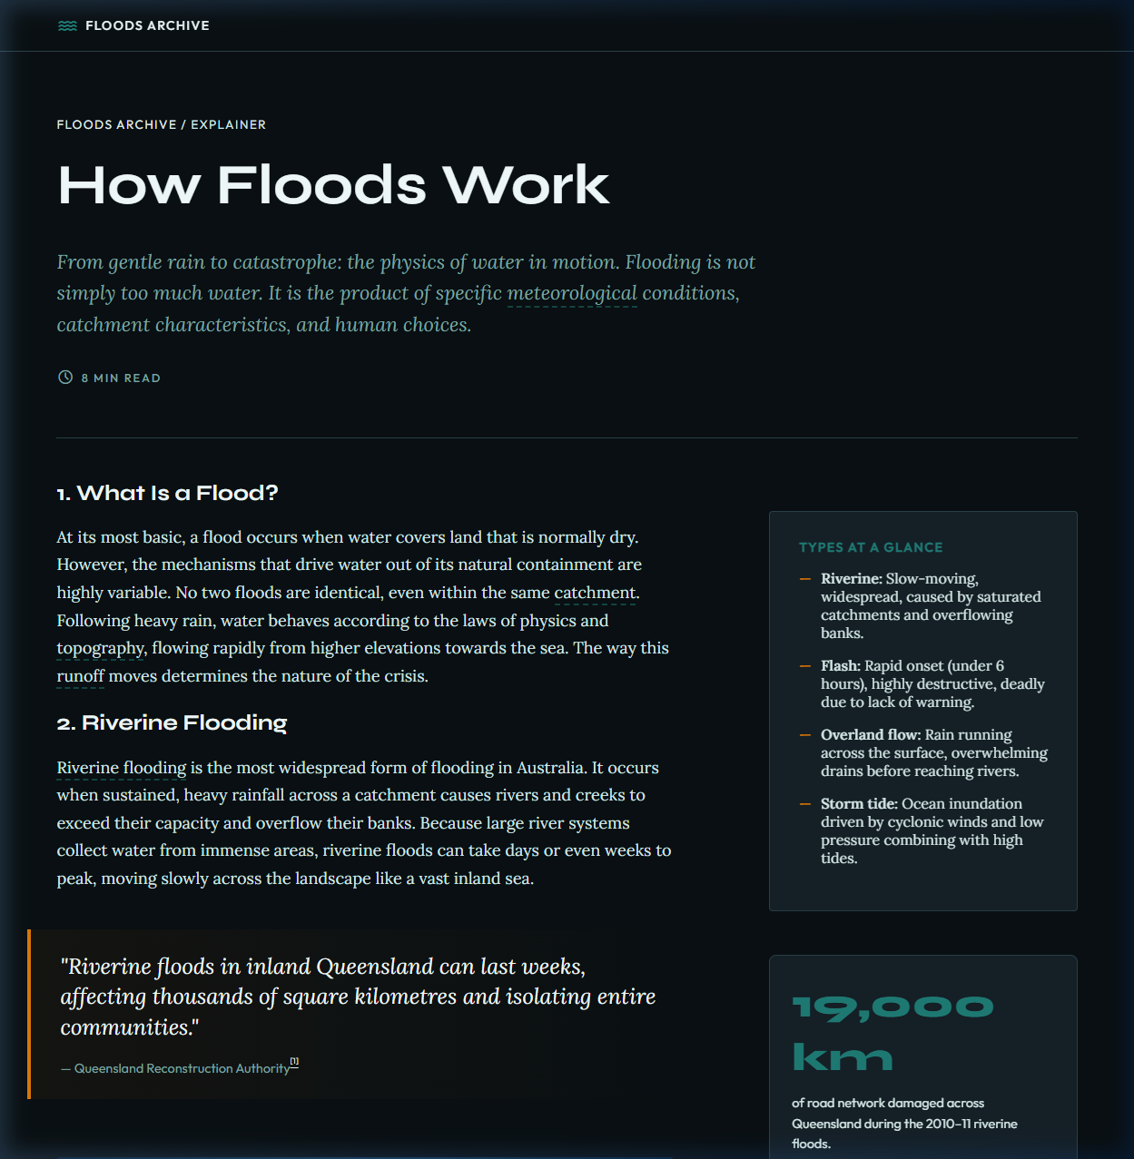
Go to Website

Slide 2
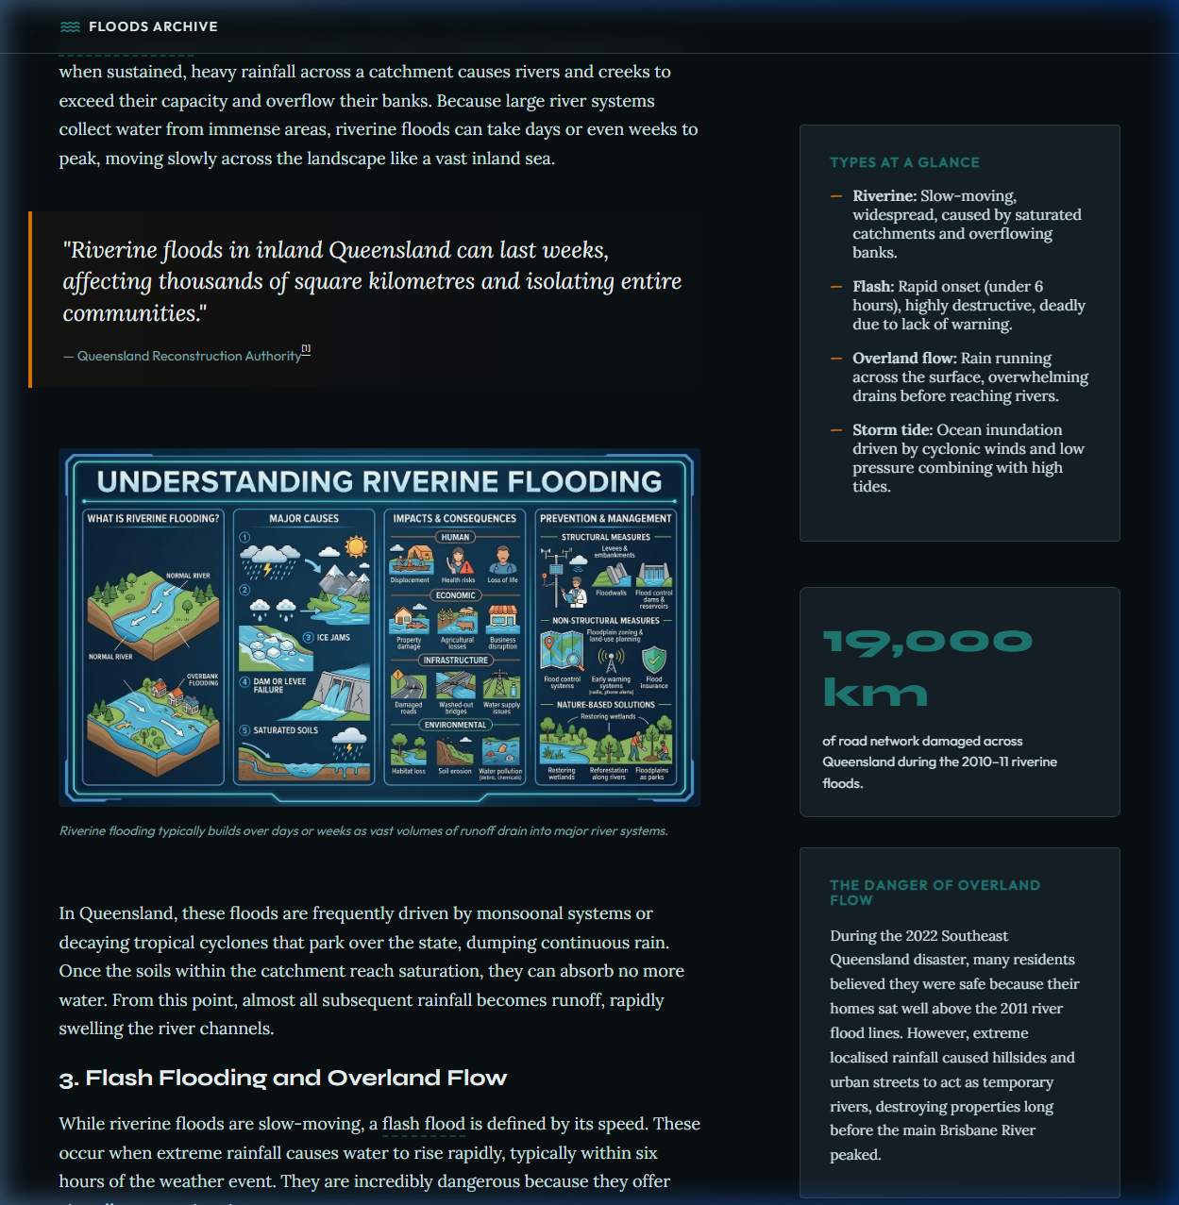

Slide 3
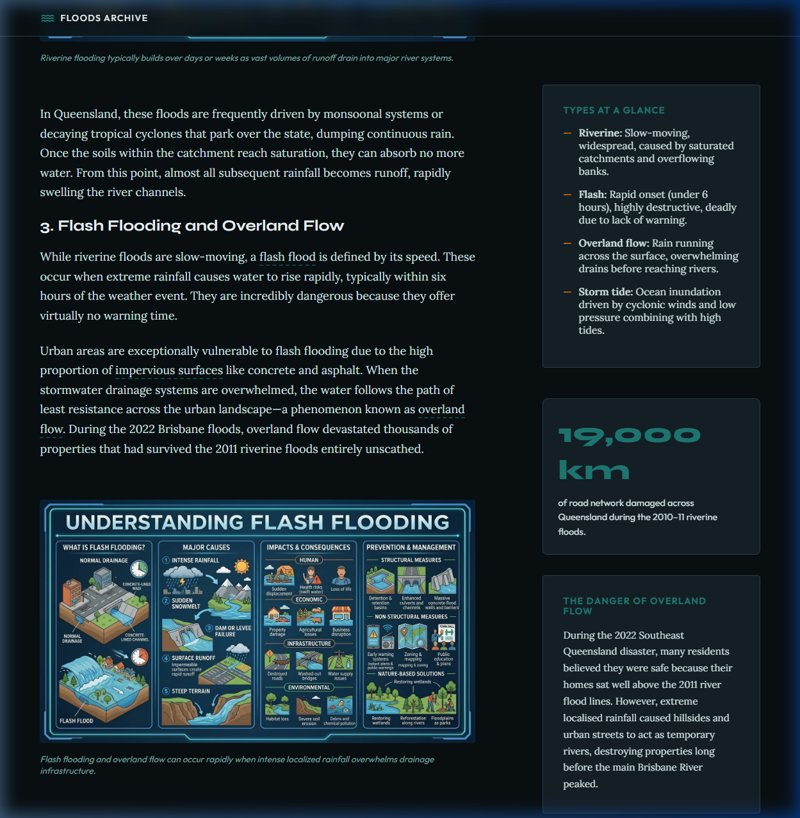

Slide 4
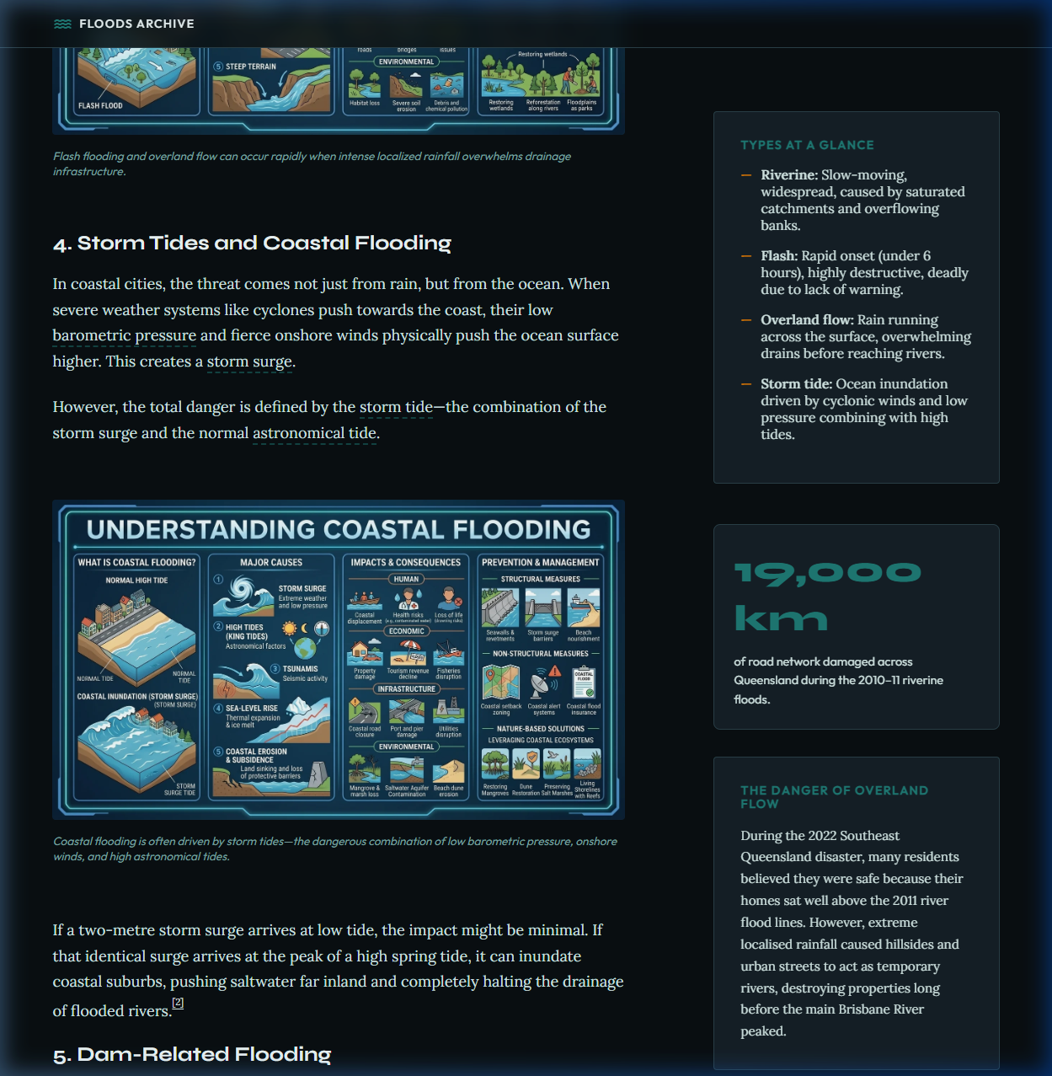

Slide 5
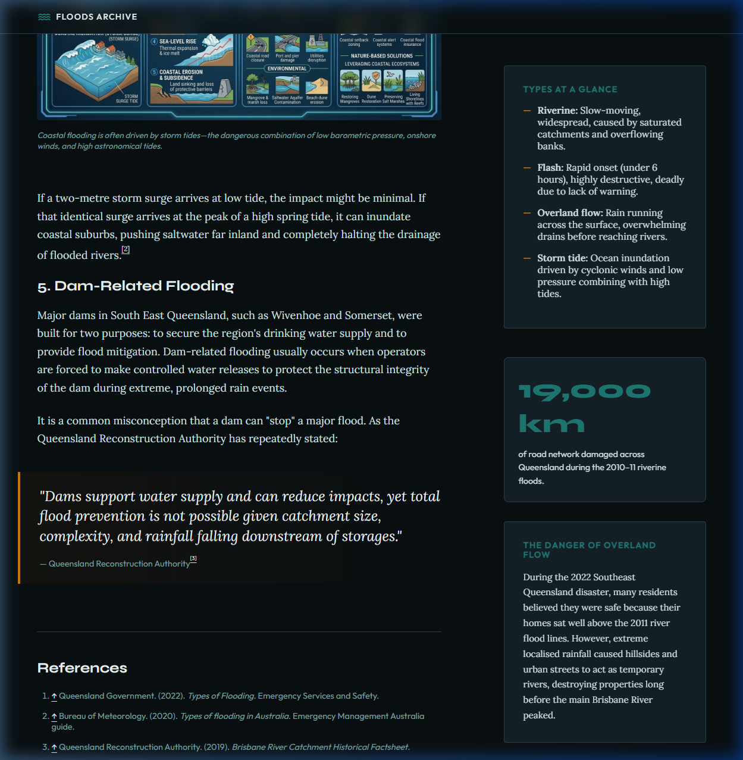

Slide 6
PRECISION OF VOCABULARY
Words carry power. Technical words carry precision.
Today we dive deep into the Floods Archive.

Slide 7
WHY PRECISION MATTERS?
Instead of: 'The water was everywhere.'
We use: 'The inundation affected 75% of Queensland.'
One word tells us the exact nature of the event.

Slide 8
CORE TERM: CATCHMENT
Catchment: The entire area of land from which rainfall drains into a single river system.
Found in: Hub Page (A City Built on a Floodplain)

Slide 9
CORE TERM: RUNOFF
Runoff: Water from rain or snowmelt that flows across the surface of the land rather than soaking in.
Found in: How Floods Work (What Is a Flood?)

Slide 10
CORE TERM: INUNDATION
Inundation: The act of covering land with a large amount of water; flooding.
Found in: Hub Page (About This Archive)

Slide 11
CORE TERM: RIVERINE
Riverine: Relating to or situated on the banks of a river.
Found in: How Floods Work (Riverine Flooding)

Slide 12
CORE TERM: OVERLAND FLOW
Overland Flow: Water that flows across the surface of the land, often overwhelming stormwater drains.
Found in: How Floods Work (Flash Flooding)

Slide 13
MORE PRECISE TERMS
Meteorological: Related to weather conditions.
Hydrological: Related to the properties of water and its movement.
Topography: The shape and features of land surfaces.

Slide 14
MORE PRECISE TERMS
Impervious: Not allowing water to pass through (like concrete).
Morphology: The study of the form and structure of landforms.
Barometric: Related to atmospheric pressure.

Slide 15
THE HUMAN COST
Flooding is more than just property damage.
Mental Health: The social cost of the 2022 floods was estimated at $4.5 Billion—double the cost of property damage.

Slide 16
WRITING WITH PEEL
Point: Your main idea.
Evidence: A fact or quote from the Archive.
Explanation: Why the evidence matters.
Link: Connect back to your point.

Slide 17
VOCABULARY HUNT
1. Open the Floods Archive.
2. Find the 5 Core Terms.
3. Complete the PEEL Paragraph on Human Costs.
4. Use the Tooltips for definitions!

