Slide 1

SRM INSTITUTE OF SCIENCE AND TECHNOLOGY Ramapuram, Chennai – 600 089 DEPARTMENT OF COMPUTER SCIENCE AND ENGINEERING
21CSC203/ADVANCED PROGRAMMING PRACTICE
Campus Swap- Book, Belongings Exchange Platform
REG.NO & STUDENT NAME | MENTORS NAME
Tanmay RA2511003020066 M Punith Reddy RA2511003020090 DSVG Pranay RA2511003020115 | Mr.C.Santhosh Kumar,AP/CSE Ms.M.Ramaprabha , AP/CSE

Slide 2
INTRODUCTION TO PARADIGM
Our project follows a Multiple programming paradigm approach, combining different programming styles to make the application more structured, flexible, and maintainable
Paradigm / Approach | Description | How We Use It
Object-Oriented Programming (OOP) | Organizes a program using objects and classes that combine data and functionality. | We use SQL Alchemy classes such as User and Item to represent database entities.
Imperative/Procedural Programming | Executes a sequence of instructions to perform a specific task. | Our Flask routes and JavaScript handle operations step-by-step, such as processing form data, validating inputs, managing user actions, and updating application data.
Declarative Programming | Describes what the desired result should be rather than specifying every step to achieve it. | We use HTML to define the structure of web pages, CSS to describe their presentation and styling, Jinja to dynamically render database data, and SQL to specify the data required from the database.
.

Slide 3
Campus Swap- Book, Belongings Exchange Platform
.

Slide 4
ABSTRACT
Campus Swap is a student-focused platform that enables students to easily buy, sell, exchange, and donate items within their campus community. The website provides a convenient and trusted space for students to list unused items and discover affordable products from fellow students.
By promoting reuse and reducing unnecessary purchases, Campus Swap encourages sustainability while making item exchange simple, accessible, and cost-effective.
.

Slide 5
SCOPE AND MOTIVATION
Motivation
To create a simple and trusted platform for students to exchange items within the campus.
To help students save money by providing affordable second-hand products.
To promote reuse and reduce waste by giving unused items a second life.
Scope
Students can list, search, buy, sell, and exchange items easily.
The platform can cover categories like books, electronics, stationery and other campus essentials.
It can be expanded to support multiple colleges, ratings, secure payments, and item tracking.

Slide 6
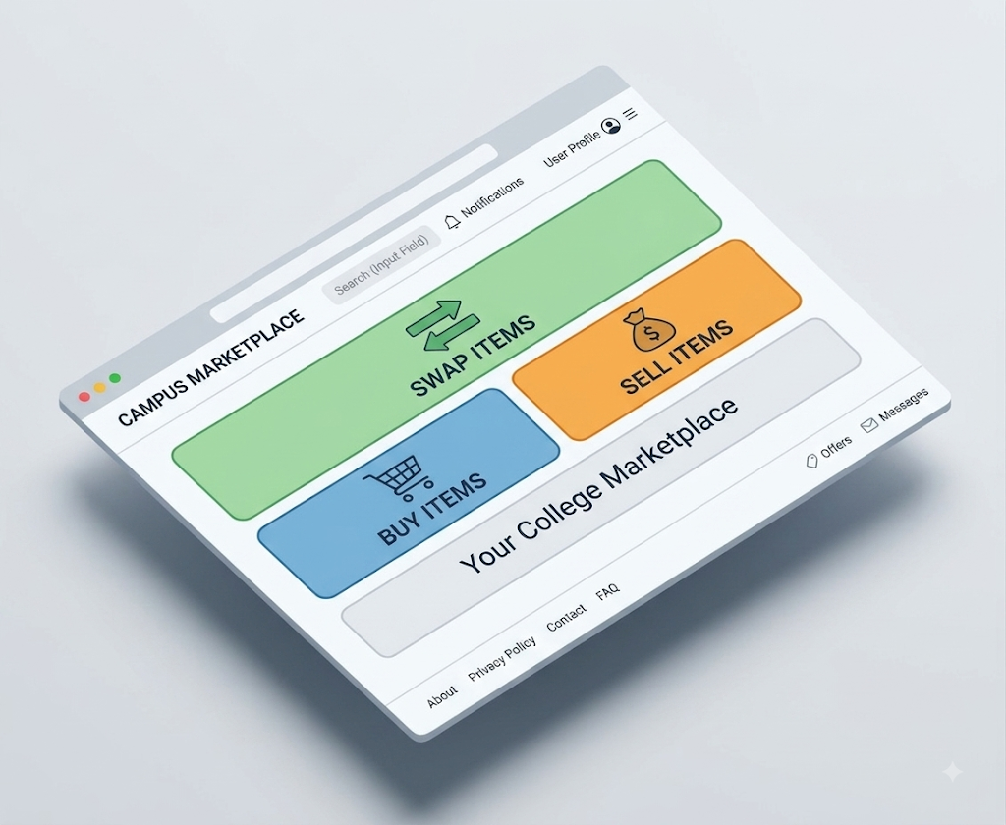
INTRODUCTION
Campus Swap is a technology-driven campus marketplace that connects students through a centralized platform for buying, selling, and exchanging pre-owned items.
Campus-Centric Ecosystem: Focuses on student-to-student transactions, making exchanges more relevant than generic marketplaces.
Real-Time Information: Provides updated item availability, pricing, condition, and seller details.
User-Friendly Platform: Streamlines the complete process from listing an item to connecting with a potential buyer.
Scalable Architecture: Can be extended with features such as recommendation systems, notifications, ratings, secure authentication, and online payments.

Slide 7
SOFTWARES USED
Visual Studio Code (VS Code) – Code development
GitHub Desktop – Git repository management and synchronization
MySQL Workbench – Database design and management
Postman – API testing
Figma – UI/UX design and prototyping
Chrome Dev Tools – Debugging and frontend testing
DB Browser for SQLite – Database inspection

Slide 8
LIST OF MODULES
HTML – Used to structure the webpages and organize content such as item listings, forms, and user information.
CSS – Used to design the interface, improve visual appearance, and create a responsive layout.
JavaScript – Used to add interactivity and provide a smoother user experience.
Flask – Used as the backend framework to handle user requests, routing, authentication, and application logic.
SQL Alchemy – Used as an ORM to efficiently interact with the database using Python objects instead of writing SQL for every operation.
MySQL – Used to store user accounts, item details, listings, and other application data.
Jinja2 – Used to dynamically display database content on HTML pages and create reusable templates.
Git & GitHub – Used for version control, collaboration, and maintaining the project's source code.
Bootstrap – UI components and responsive design

Slide 9
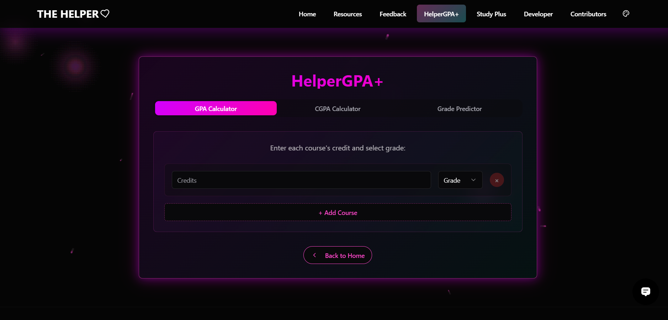
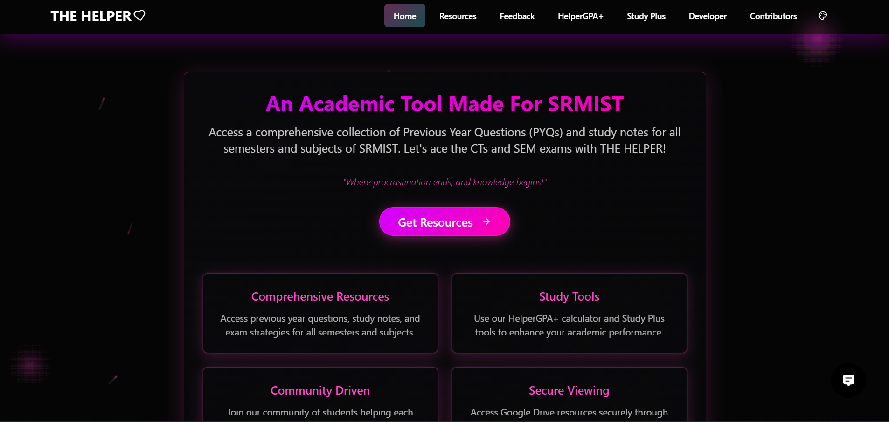
SIMILAR PROJECTS IDENTIFIED
Helper Platform: A college-focused digital platform that provides students with academic resources such as CGPA calculation and previous-year question papers.
Campus Swap: Similar in its student-centric and college-specific approach, but focuses on buying, selling, and exchanging items among students rather than academic resources.

Slide 10
WEBSOURCES REFEREED
Flask SQL Alchemy Documentation: https://flask-sqlalchemy.readthedocs.io
Bootstrap UI/UX Designing: https://getbootstrap.com/docs/5.3
DB Browser: https://sqlitebrowser.org/about/
MDN Web Docs: https://developer.mozilla.org/
Jinja2 Template: https://jinja.palletsprojects.com/

Slide 11
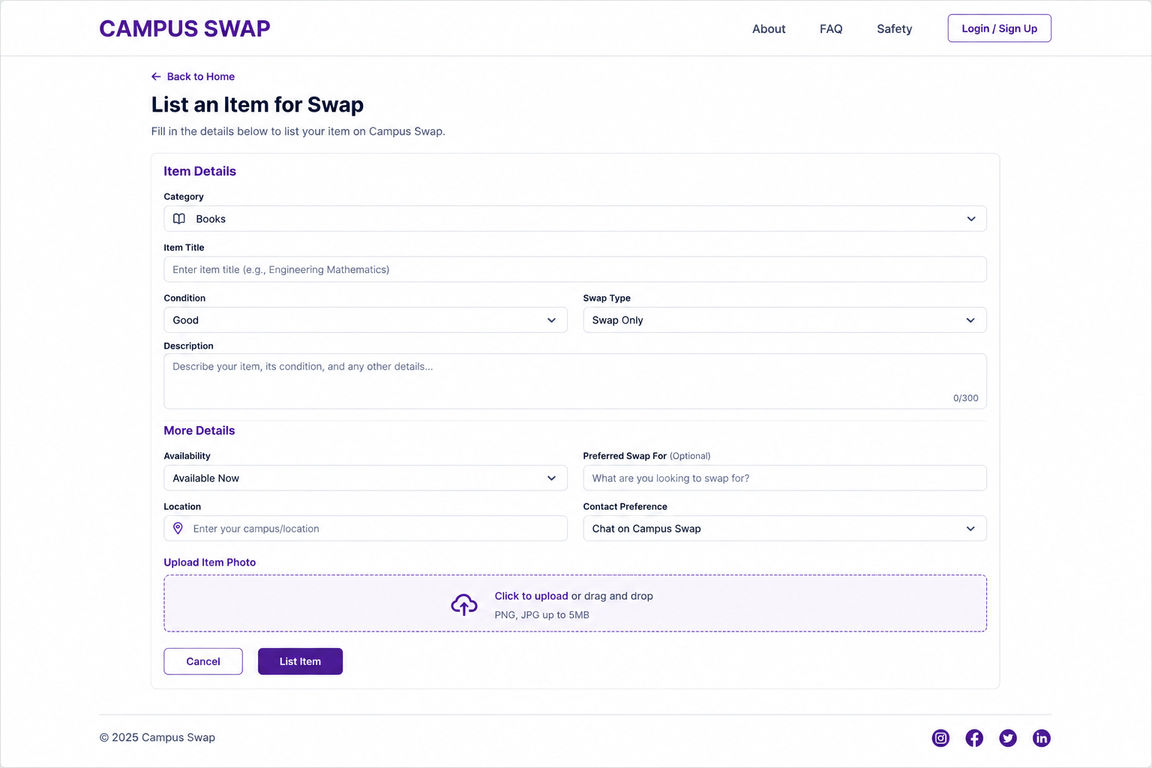
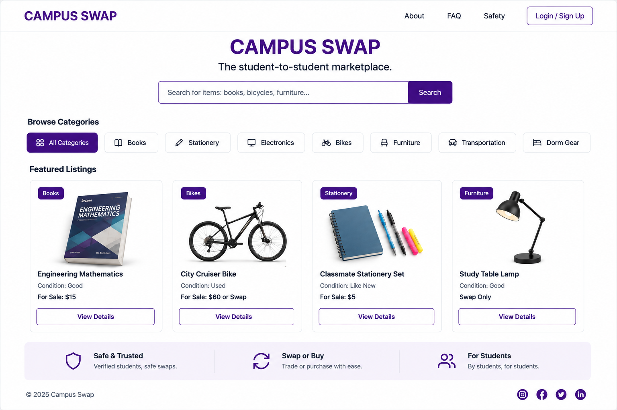
SAMPLE INPUT &OUTPUT
Input: User Entering the Item to be listed Output: Available Listings

