Slide 1
Predicting Hospital Length of Stay (LoS)
Devon Svoboda
Data Science Capstone #2
February 2026

Slide 2

What is LoS?
Length of Hospital Admission in Days
Metric of Hospital Performance
Length of Stay (LoS) determines:
Cost of Treatment
Bed Availability
Health Care Staff Required
Treatment Outcomes
https://www.epicshare.org/tips-and-tricks/q-how-can-we-decrease-hospital-length-of-stay-for-patients-needing-post-acute-placementn-_a-optimize-your-system-to-streamline-communication-with-community-partners-_

Slide 3
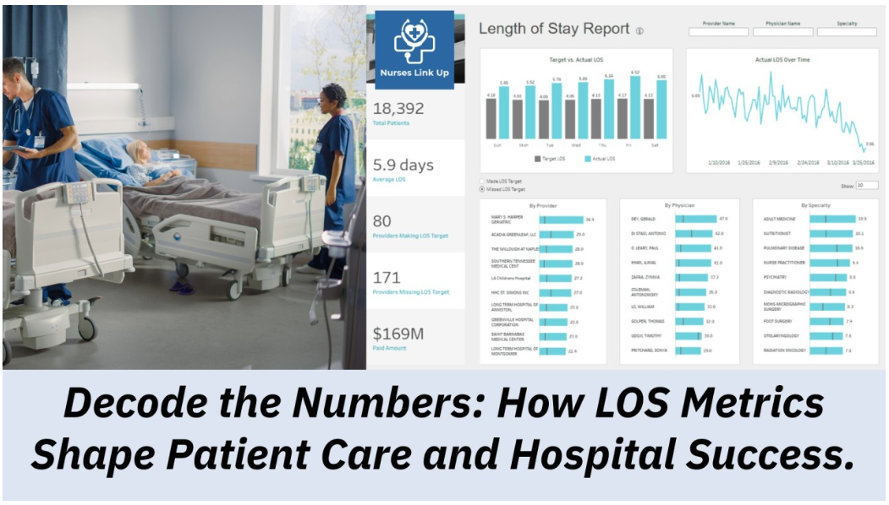

Slide 4
Who is Interested in LoS tracking?
Hospitals
Health Care Professionals
Insurance Companies

Slide 5
Who is Interested in LoS tracking?
Hospitals
Health Care Professionals
Insurance Companies
Staffing
Bed Allotments
Managing Costs
Assessing Performance
Optimizing Care
Managing Patient and Family Expectations
Increasing Efficiency
Payout Predictions
Optimizing Risk

Slide 6
What Factors Affect LoS?
Medical History
Test Results
Number of Prior Readmissions
Does the patient have….?
Psychological Disorders
Kidney Failure
Pneumonia
Malnutrition
etc
Vital Signs
Blood Cell Counts
Kidney Function
Blood Creatinine
Blood Urea Nitrogen (BUN)
Metabolism
Blood Sodium
Blood Glucose
12 Points of Medical History
9 Test Results

Slide 7
EDA and Feature Engineering

Slide 8
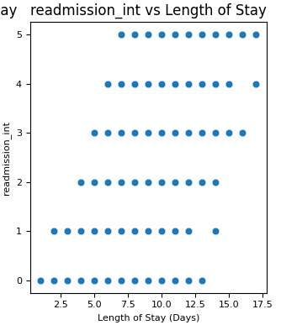
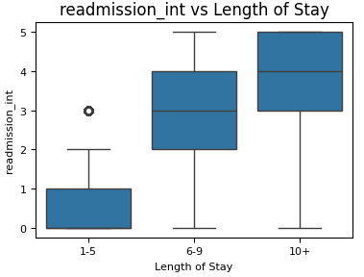
Number of Prior Readmissions
Number of Previous Admissions vs Length of Stay
Number of Previous Admissions vs Length of Stay

Slide 9
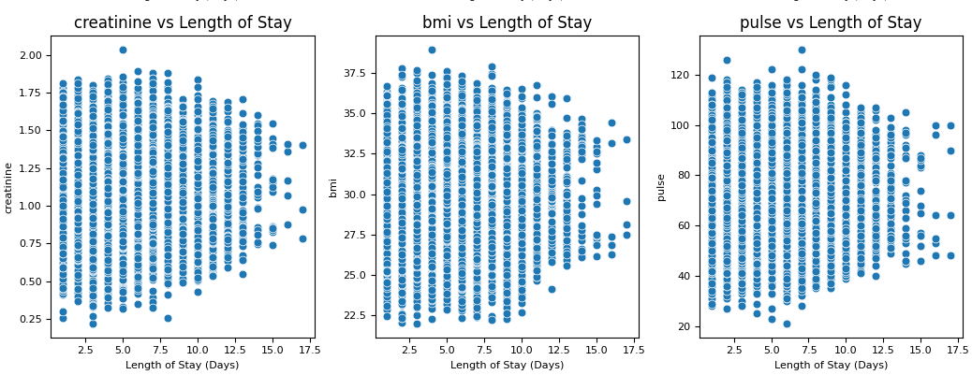
Data For Test Results Shows Common Pattern
Extreme values are associated with shorter stays.

Slide 10
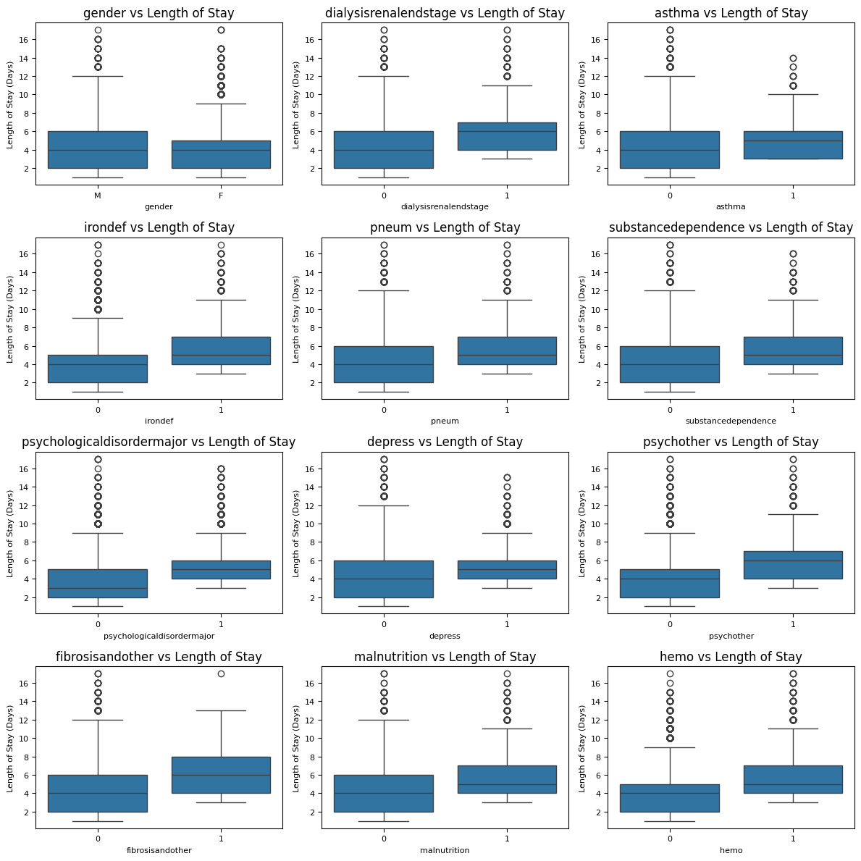
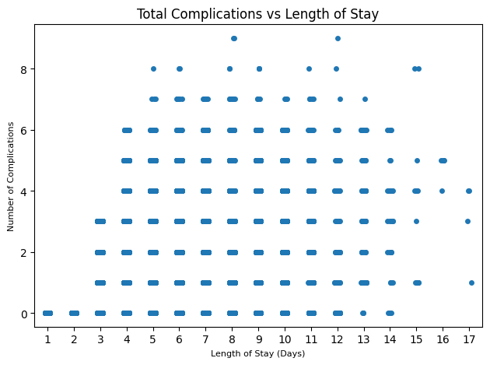
Many Health Complications are Associated with Longer LoS
Psychological Disorder
Substance Abuse
Depression
Malnutrition
Iron Deficiency
Blood Disorder
Weak correlation of 0.471

Slide 11
Model Development

Slide 12
Model Development
Data Preprocessing
Screen Learners
Optimize Top Three Models
One-Hot Encode Categorical Variables
Split data into 80% training and 20% testing datasets
Scale Train and Test sets with StandardScaler.
Multiple Linear Regression
Support Vector Regressor
Random Forest Regressor
Gradient Boost Regressor
XGBoost Regressor
CatBoost Regressor
Select Top Models
Hyperparameter Tuning
RandomSearchCV with 5-fold cross validation
Metric = Negative Mean Absolute Error
Select Model with Lowest Error

Slide 13
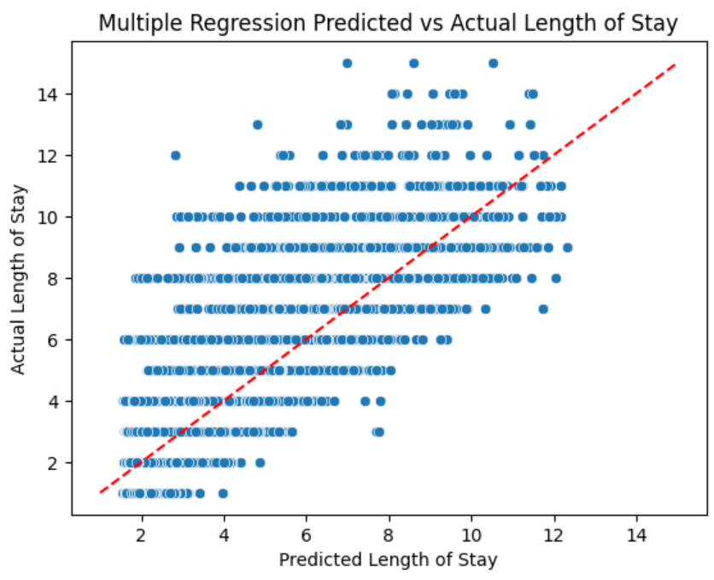
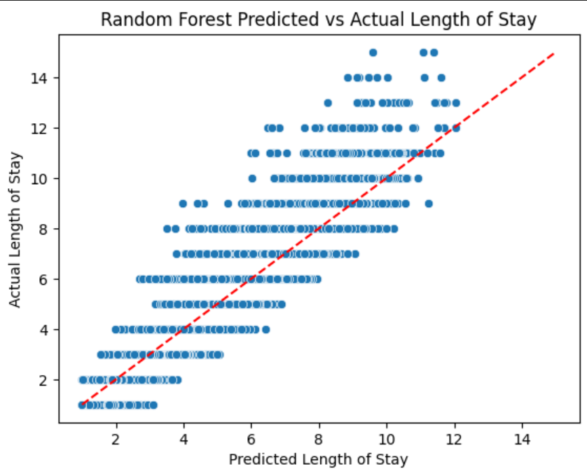
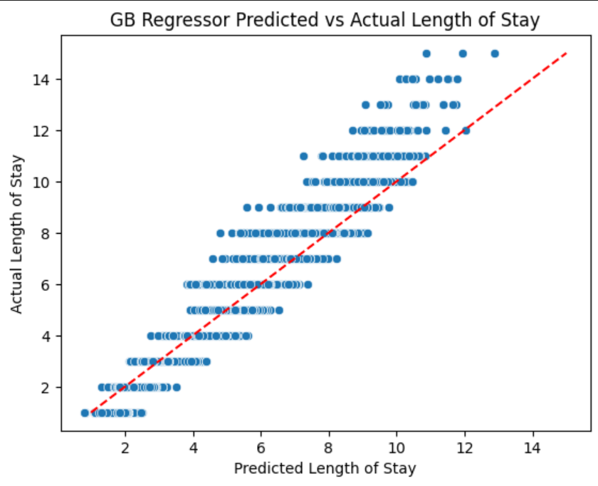
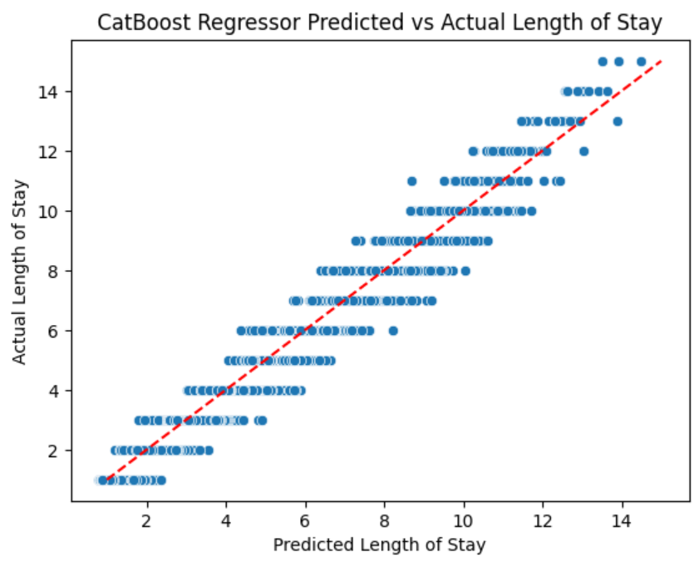
Results Varied Widely Across Learners
Random Forest Regressor
Multiple Regression
Gradient Boost Regressor
CatBoost Regressor

Slide 14
Summary of Screening Learners
Algorithm | MAE | R-Squared | Accurate for Long Stays?
Multiple Linear Regression | 0.877 | 0.763 | No
SVM Regressor | 0.854 | 0.750 | No
Random Forest Regressor | 0.334 | 0.991 | No
Gradient Boost Regressor | 0.370 | 0.959 | No
XGBoost Regressor | 0.306 | 0.979 | Yes
LiteGBM Regressor | 0.309 | 0.972 | Yes
CatBoost Regressor | 0.280 | 0.979 | Yes

Slide 15
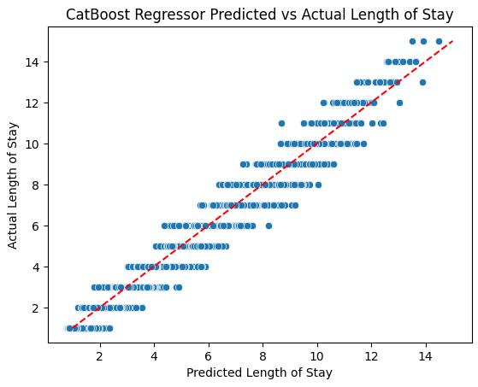
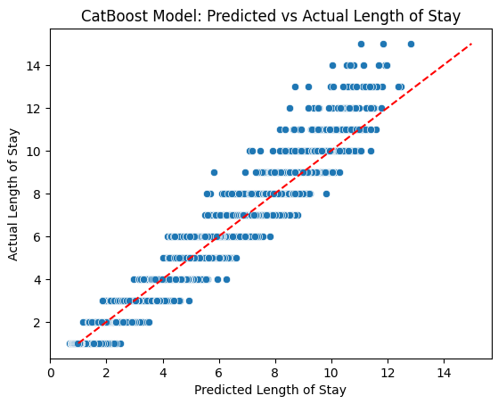
Optimizing Top Three Models
 | Random Forest | XGBoost | CatBoost
R-Squared | 0.991 | 0.982 | 0.988
MAE | 0.334 | 0.294 | 0.274
Optimized Models might lose accuracy for patients with longer LoS.

Slide 16
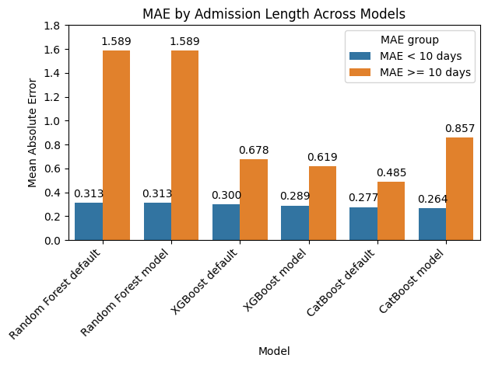
Model Results for Stays Over 10 Days
Final Model Selection
CatBoost Regressor with Default Parameters

Slide 17
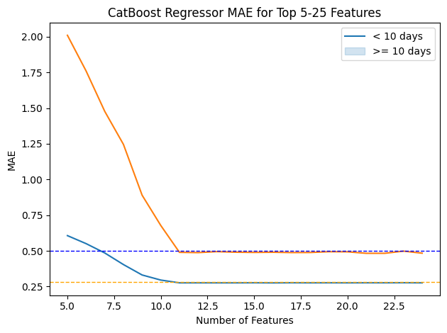
Top Features for CatBoost Regressor
Number of Readmission
Total Health Complications
Hematocrit
BMI
Creatinine
Blood Glucose
Blood Sodium
Pulse
Respiration
Neutrophil Count
Blood Urea Nitrogen

Slide 18
Future Work

Slide 19
Future Work: Engineer Features Combining Related Complications
Psychological Disorder
Substance Abuse
Depression
Number of Readmission
Total Health Complications
Hematocrit
BMI
Creatinine
Blood Glucose
Blood Sodium
Pulse
Respiration
Neutrophil Count
Blood Urea Nitrogen
Malnutrition
Iron Deficiency
Blood Disorder
Feature 1: Depression, Substance Abuse and Psychological Disorder
Feature 2: Malnutrition and Iron Deficiency
Feature 3: Pneumonia and Asthma…..etc

Slide 20
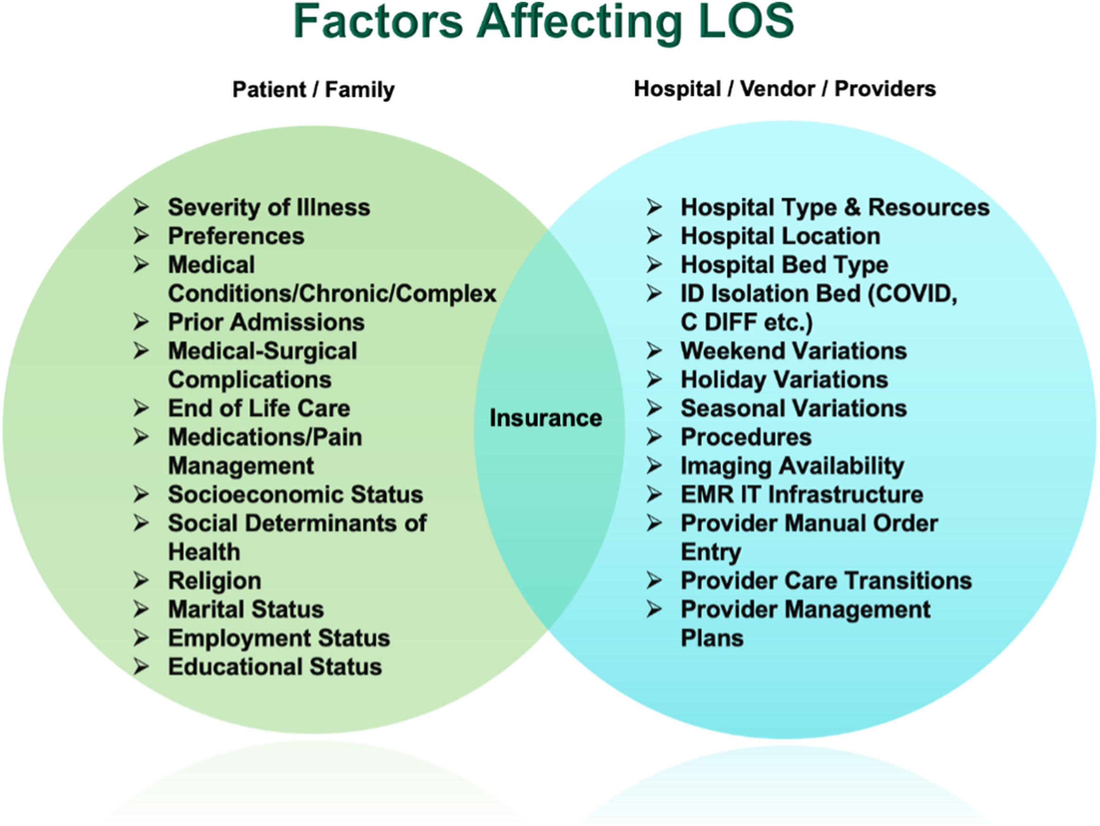
LoS is a Complicated Problem
Charles Den et al., Forecasting length of stay: Will it be clear or cloudy today?, Intelligence-Based Medicine, Volume 6, 2022, 100078, ISSN 2666-5212, https://doi.org/10.1016/j.ibmed.2022.100078.

Slide 21


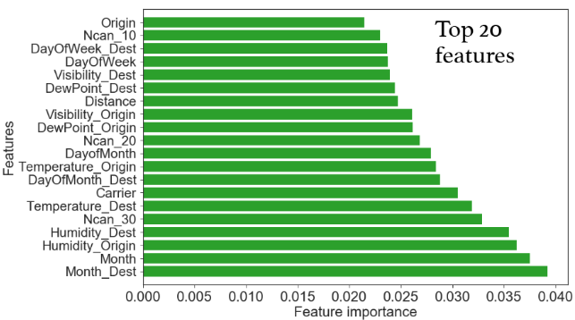
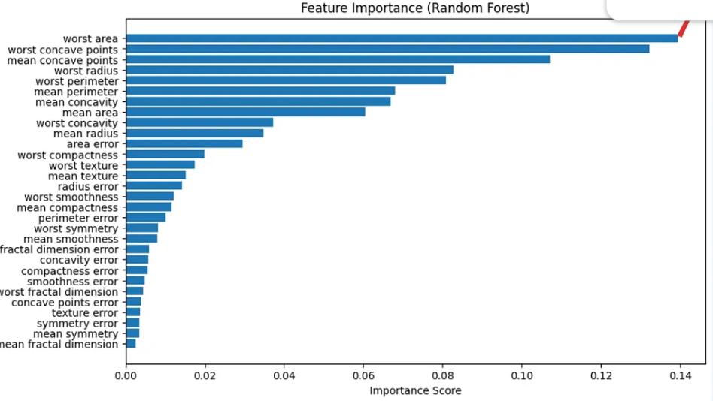
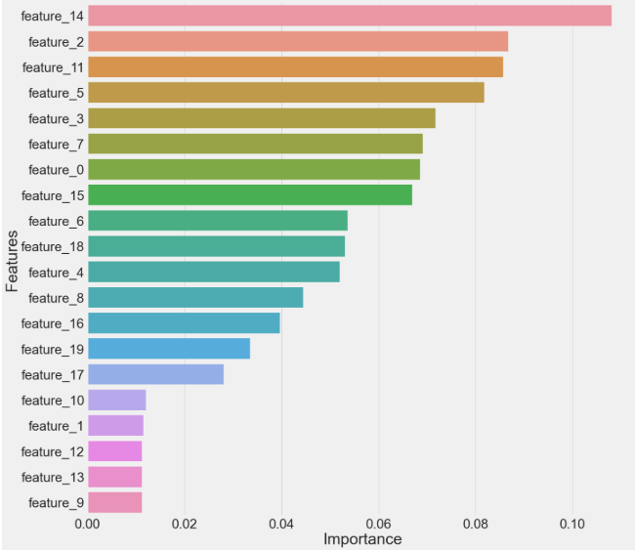
Metastudy to find the best features for predicting LoS
Most Useful Features for LoS Prediction

Slide 22
Metastudy to find the best features for predicting LoS
Test Model Durability across multiple hospitals, wards or diagnoses
Compare optimal features between ICU vs non-ICU stays
Compare and evaluate facilities within multi-hospital systems
Compare real-world efficacy of models built from medical data vs socio-economic data

Slide 23
Questions?

Slide 24
Hyperparameter Tuning
Random Forest
XGBoost
CatBoost
Number of Estimators
Minimum Samples per Split
Minimum Samples per Leaf
Maximum Features
Maximum Depth
Number of Estimators
Learning Rate
Minimum Child Weight
Columns Sampled By Tree
Maximum Depth
Iterations
Learning Rate
Random Strength
L2 Leaf Reg
Maximum Depth

Slide 25

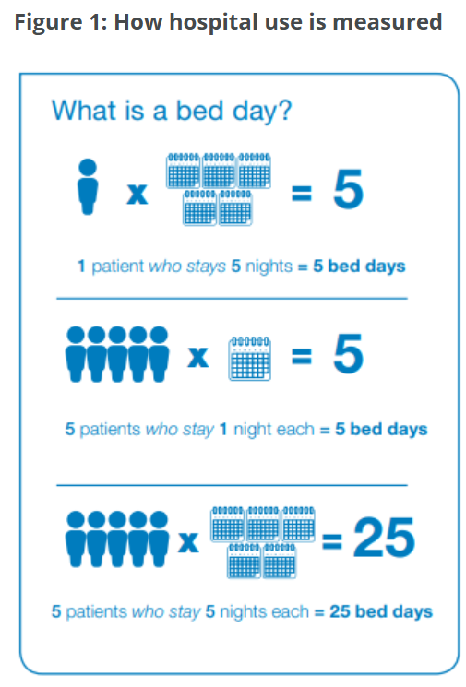
What is LoS?
https://www.epicshare.org/tips-and-tricks/q-how-can-we-decrease-hospital-length-of-stay-for-patients-needing-post-acute-placementn-_a-optimize-your-system-to-streamline-communication-with-community-partners-_

