Slide 1

New Ticket Pricing Strategy: Big Mountain Resort
Devon Svoboda
October, 2025

Slide 2
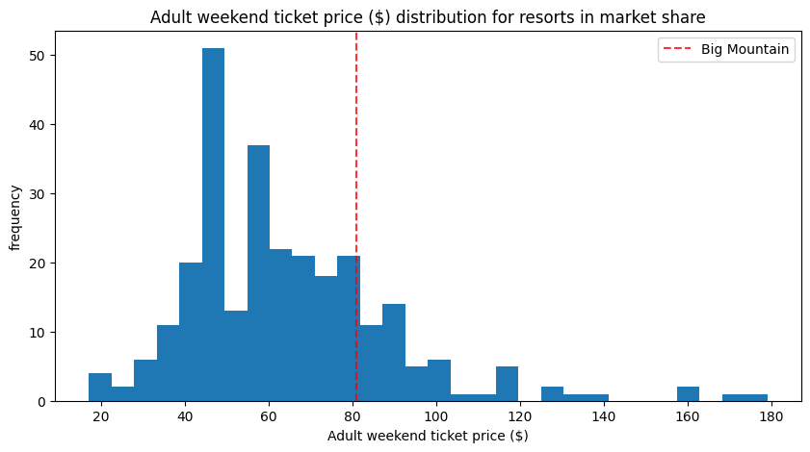
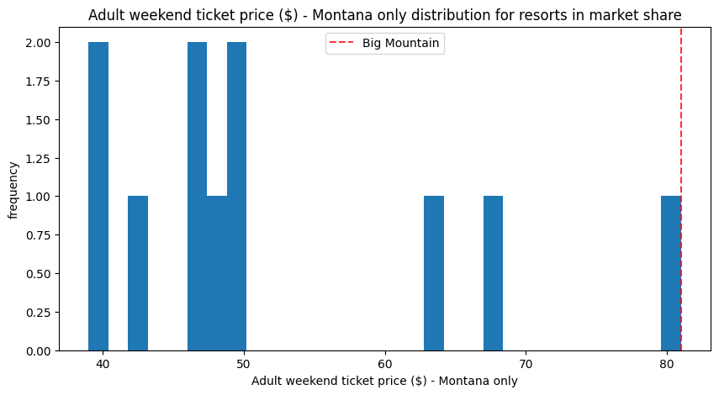
Big Mountain Resort’s Adult ticket is underpriced within the Market
Ski Resort Ticket Price Distribution
USA market
Big Mountain resort is a premium ski resort in Montana
Top-tier facilities
Exceptional size and land features offer superior skiing experience
Current ticket price is $81 per day
Management believes that current ticket price does not reflect the value that Big Mountain offers
Facilities construction and upkeep are costly
New chair life has annual operations budget of $1.54 million
Goal of Analysis:
Develop data driven approach for setting a new ticket price
Minimum goal: Recoup the $1.54 million for the newly added chair lift
Assess how selected changes to Big Mountain facilities could further improve revenue
Resort Frequency
Montana market
Resort Frequency
Adult Ticket Price ($)

Slide 3
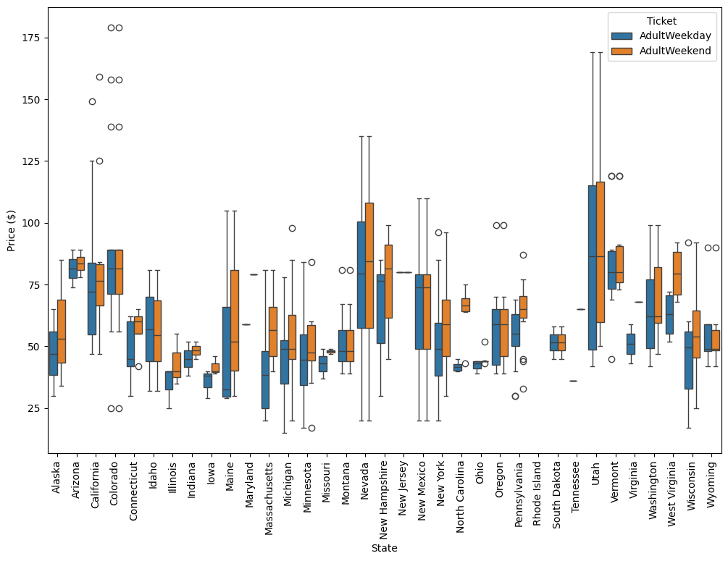
Ticket pricing a Big Mountain is held back by Montana Market
Ski Resort Ticket Price Variance by State
Current pricing strategy
Charge a premium above other results in the same market segment
Same Market Segment = Montana
Problem: Montana resorts have low ticket prices
Charging a premium above the Montana average is still underpriced relative the national market
Solution: Predict the optimal ticket price with a model that ignores the resort’s home state
Big Mountain Resort
Price $
State
Figure 1: The variance of ticket prices by state are shown in this box Plot. Outliers are represented as open circles. The circles representing Big Mountain Resort are indicated.

Slide 4
Model Predictions for an Optimal Ticket Price
Model prediction: $98.76 per ticket
Error is 10.25$
Range $88.51 to $109.01
Team Recommendation: $89 per ticket
An $8 increase should increase seasonal revenue by $14 million
This price is low risk while providing well above the desired return in revenue
An increase from $81 to $89 minimizes psychological resistance among visitors

Slide 5
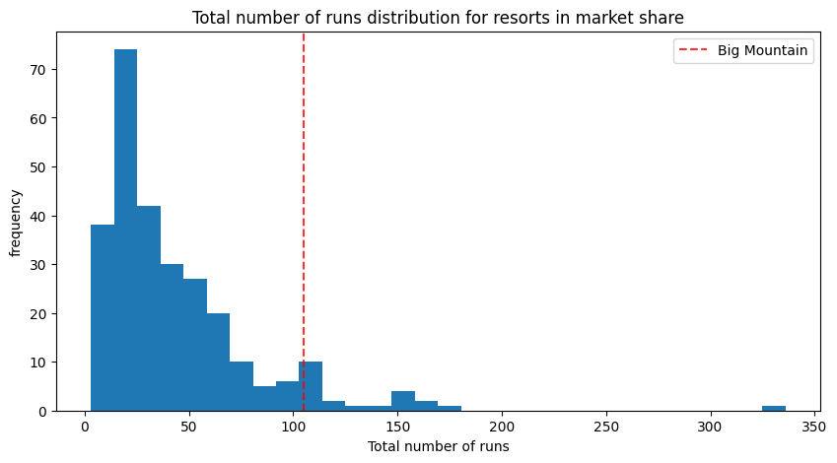
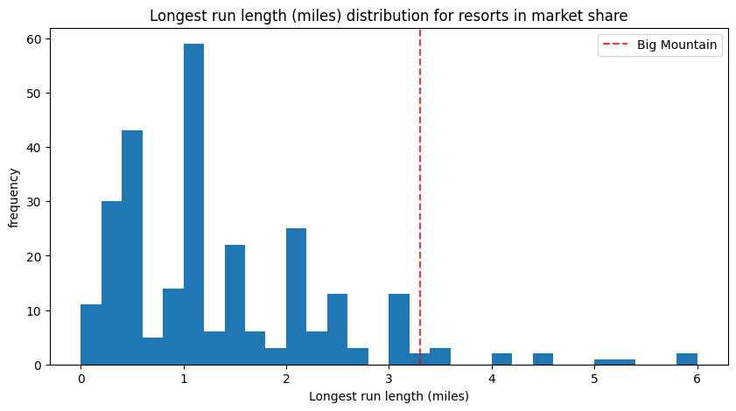
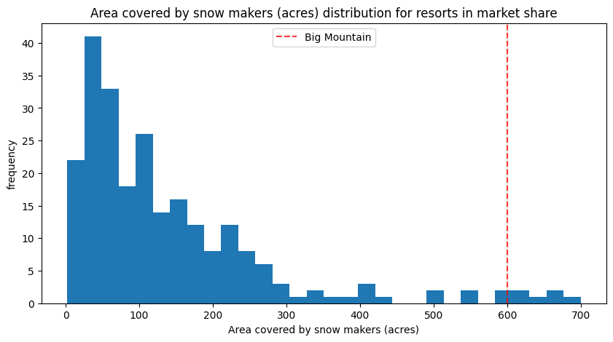
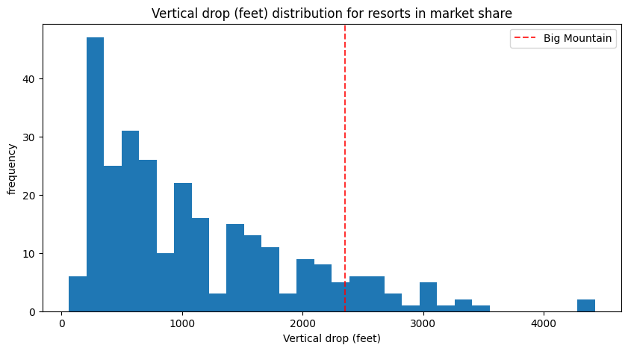
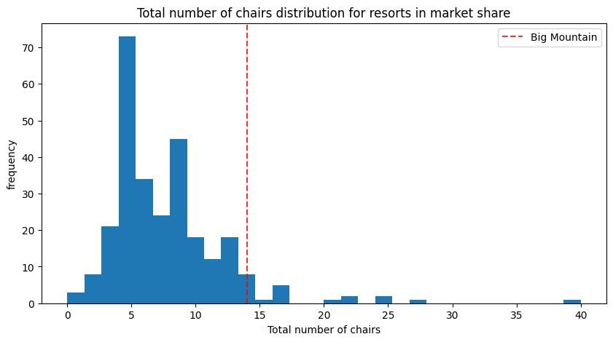
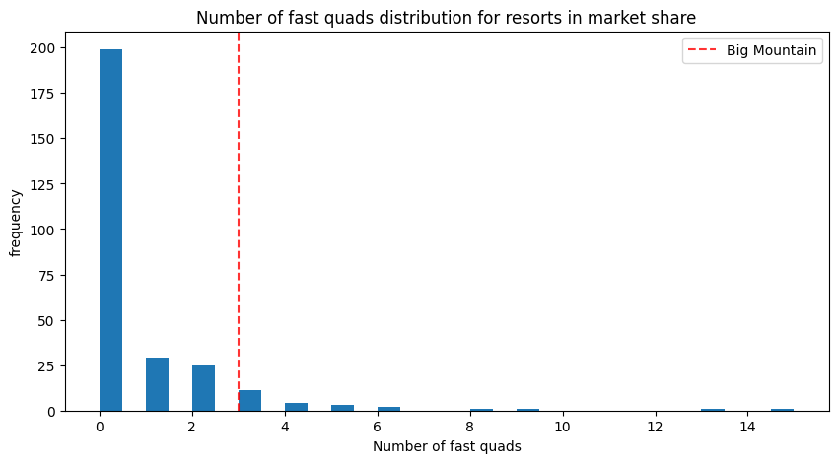
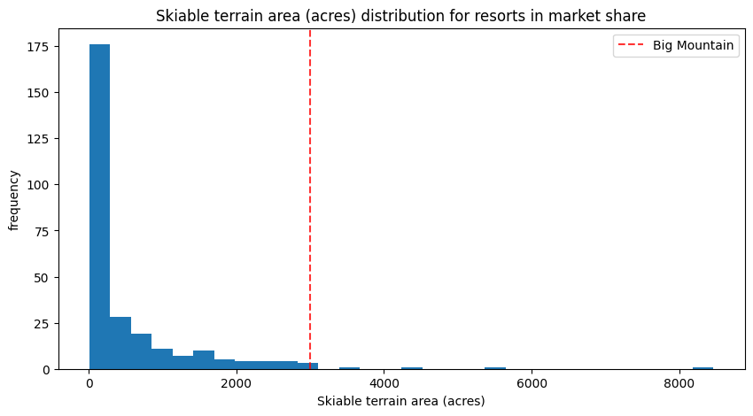
Big Mountain Resort’s Facilities Justify an Increase in Ticket Price
Ticket Price
Number of Runs
Longest Run (miles)
The Model identified 8 key features influential to ticket price:
Number of Runs
Length of Longest Run
Vertical Drop
Area with Snow Makers
Total Number of Chairs
Total Number of Fast Quads
Area of Skiable Terrain
Big Mountain resort is in a higher percentile for each key feature than it is for ticket price.
This supports the conclusion that Big Mountain Resort is underpriced relative to the features it offers.
81^{rst} Percentile
93rd
96th
Snow Making Area (acres)
Vertical Drop (feet)
Total Number of Chairs
97th
90th
94th
Number of Fast Quads
Skiable Terrian (acres)
93rd
98th

Slide 6
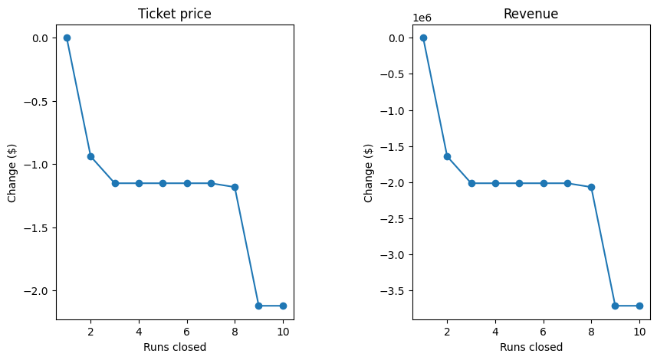
Options for Infrastructure changes to increase resort value
Option #1: Close up to 10 runs
Closing 1 run: No difference in predicted ticket price
Closing 2-8 runs: Decrease of $1.25
Closing 9-10 runs: Decrease of $2.00

Slide 7
Options for Infrastructure changes to increase resort value
Option #2: Increase the resort’s vertical drop by 150 feet with one run and one chair lift
New ticket price is now $99 and total revenue is $31.5 million
Option #3: Same as option #2, but with 2 acres of snowmaking
New ticket price is now $100.50 and increased revenue is $34 million.
Option #4: Increasing the longest run by 0.2 miles and adding 4 acres of snow making
No change in ticket price

Slide 8
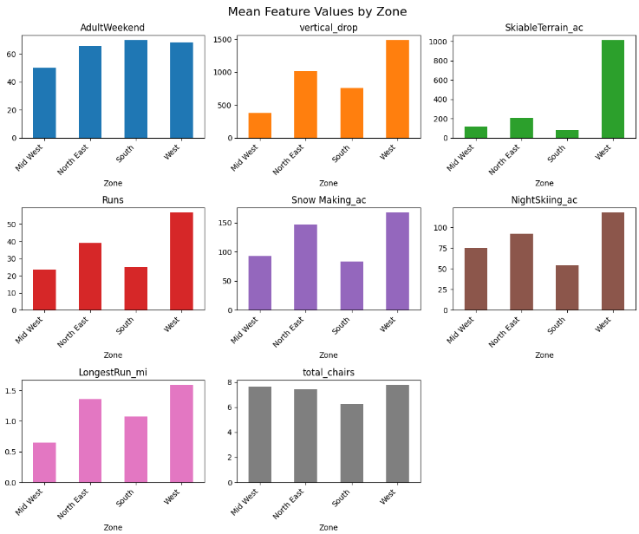
Inclusion of Zone in Future Model Versions
States were grouped by geographical zone in the continental US.
By looking at the zone averages for features influential to ticket price, we see:
Resorts in different zones have different characteristics.
The West is higher than other zones in most features.
Including zones in our analysis could make the model more accurate at predicting the optimal ticket price for resorts in different parts of the US.

Slide 9
In Summary
Scenario #1: Increase ticket price to $89 per ticket
No changes to Big Mountain facilities
Anticipated increased revenue of $14 million
Scenario #2: Increase ticket price to $99 per ticket
Increase the resort’s vertical drop by 150 feet with one run and one chair lift
Anticipated increased revenue of $31.5 million

