Slide 1
iPSC Donor Selection by Modelling Differentiation Efficiency
Devon Svoboda
Data Science Capstone #3
April 2026

Slide 2
Cell Therapy Development
https://www.evotec.com/solutions/next-gen-platforms/ipsc-cell-therapies

Slide 3
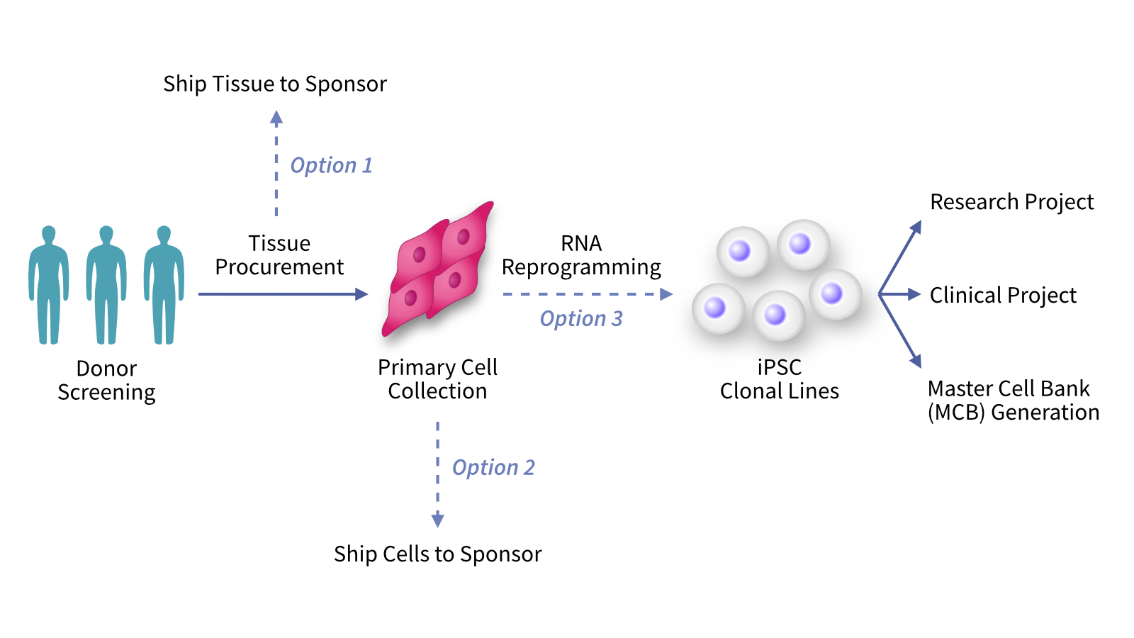
Cell Therapy Development: Donors
https://www.reprocell.com/blog/key-challenges-in-clinical-ipsc-applications-how-reprocell-helps-you-succeed

Slide 4
Problem Statement
Can we use iPSC data to the success of differentiated cells?
Which donor or clone will differentiate with the greatest efficiency?
Which clone will have the more robust function in our key assay?
Which clone will do the best in animal or human trials?
Project Goal
Build a model that can predict differentiation efficiency of iPSC donors into definitive endoderm cells.

Slide 5

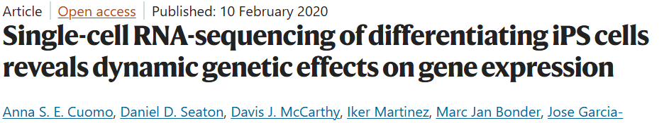
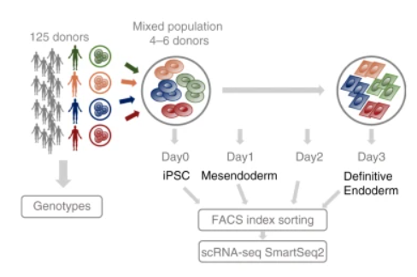
Data Wrangling: Dataset
Build a model that can predict differentiation efficiency of iPSC donors into definitive endoderm cells.
36,000 cells from 125 donors
11,000 genes in dense matrix
Relevant Metadata: day, donor

Slide 6
Project Pipeline
Data Wrangling
Exploratory Data Analysis
Data Preprocessing
Dimension Reduction
Screening Learners
Optimizing Feature Selection
Target Design

Slide 7
Data Wrangling: Data Cleaning
Downloaded as raw counts
Quality control performed prior to publication
Removed dead cells
Removed cells with insufficient depth
Removed genes with 0 counts
Converted to ScanPy object called adata
Standard library for handling single cell RNAseq data in Python
adata objects have three matrices
adata.X hold counts data
adata.obs holds metadata including cell IDs
adata.var hold gene names (aka column names)
Normalize
Scale data (Standard Scaler equivalent in ScanPy)
Log Transform

Slide 8
Exploratory Data Analysis

Slide 9
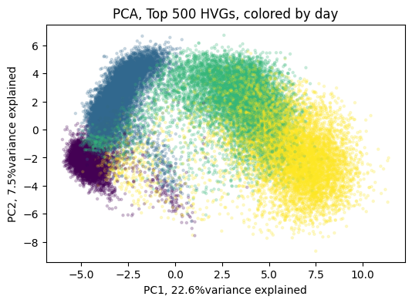
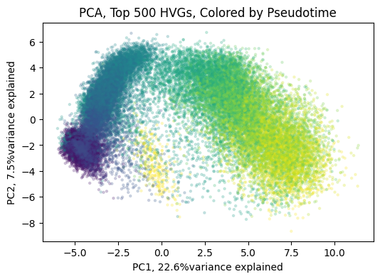
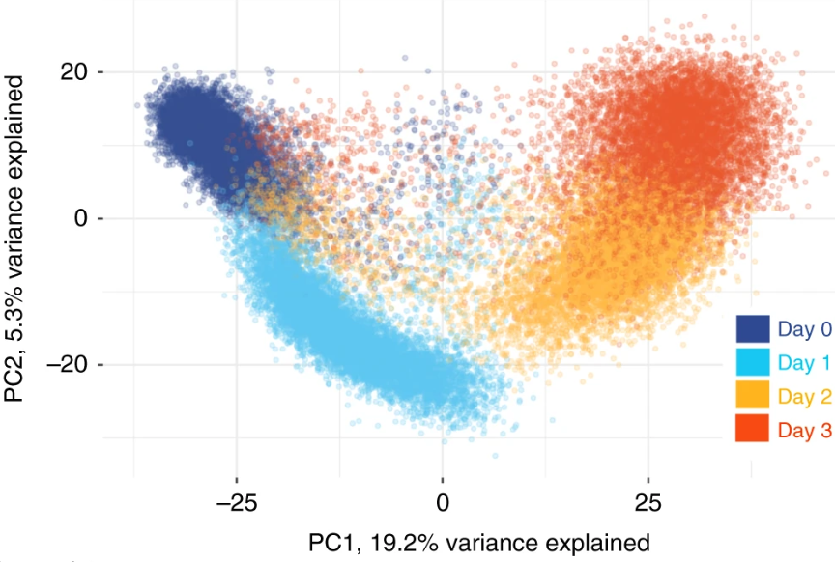
EDA: Reproduce PCA from publication
Corresponding PCA, from Cuomo et al
Pseudotime: A score based on how far a cell has progressed in the differentiation relative to a starting point (random day0 cell). Calculated using the ScanPy function dpt.
Successful reproduction of this PCA plot with separate of cells by day of differentiation assures us that we understand the data organization and normalization correctly. We can now safely move on with analysis.
Notes:
Figure 1: Top Left: PCA from top 500 HVGs, colored by day in real time. Purple=day0, Blue=day1, Green=day2, Yellow=day3. This PCA satisfactorily replicates the original PCA from Cuomo et al. (top right). Small differences are expected as the original published figure (right) was made in R using Seurat while replication was done in Python using ScanPy. Bottom Left: PCA pseudotime shows a similar pattern as when the PCA is colored in real time (top left).

Slide 10
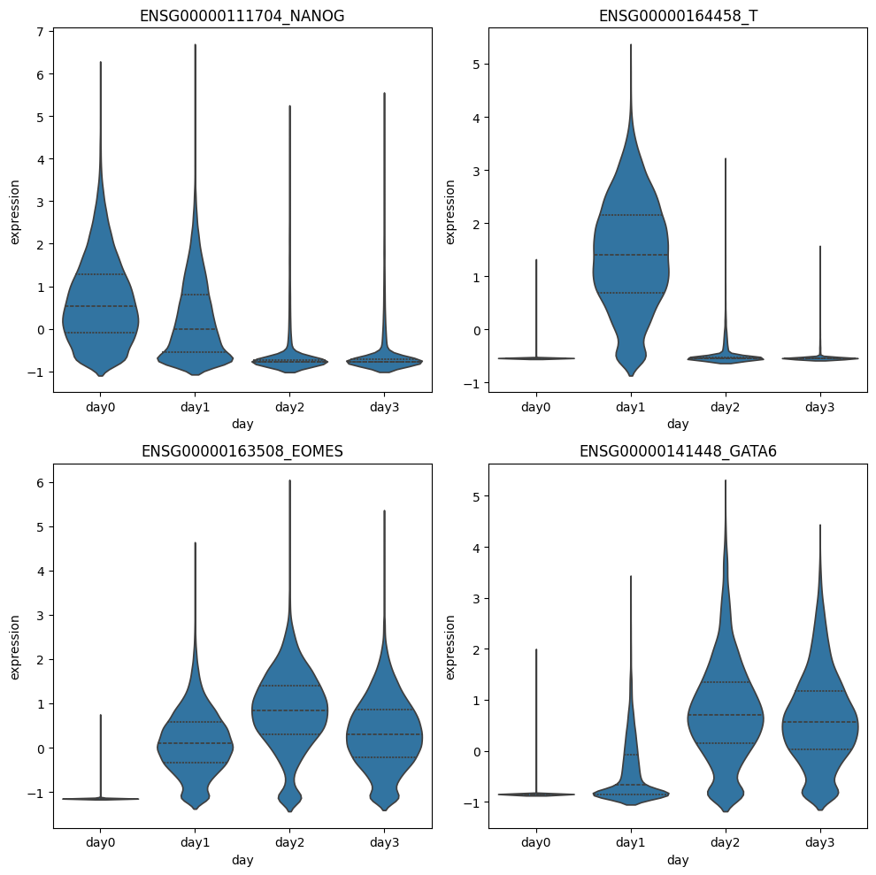
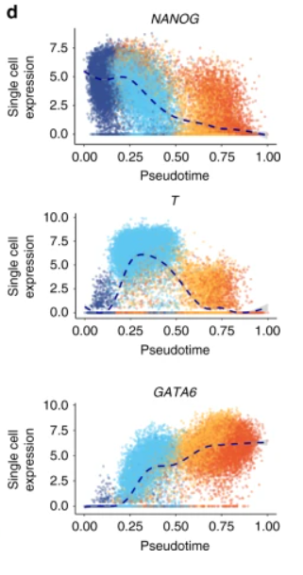
EDA: Variable Gene Expression
NANOG
T
Crucial Step
Verify expected changes in gene expression
iPSC markers should be highest on day0, endoderm cells should be highest on day3.
If expected changes don’t occur, the differentiation didn’t work and dataset if not usable.
EOMES
GATA6
Figure 1d, Cuomo et al

Slide 11
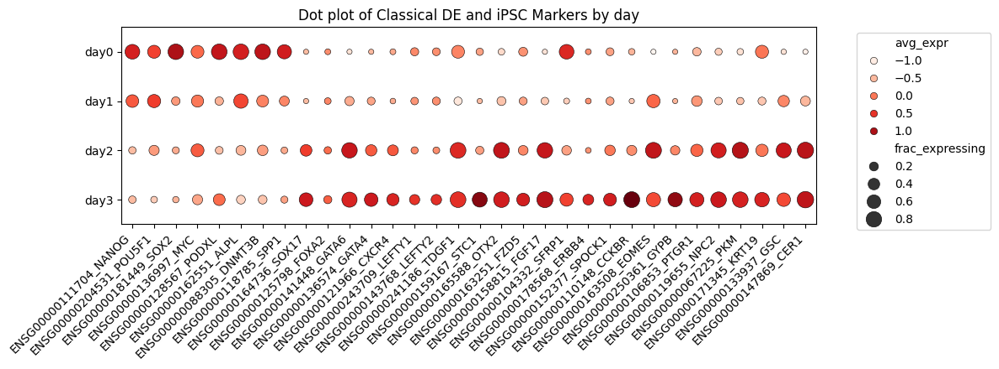
EDA: Variable Gene Expression
iPSC and DE Marker Expression by Day of Differentiation
iPSC Markers
Definitive Endoderm Markers
Notes:
Figure 1: Top Left: PCA from top 500 HVGs, colored by day in real time. Purple=day0, Blue=day1, Green=day2, Yellow=day3. This PCA satisfactorily replicates the original PCA from Cuomo et al. (top right). Small differences are expected as the original published figure (right) was made in R using Seurat while replication was done in Python using ScanPy. Bottom Left: PCA pseudotime shows a similar pattern as when the PCA is colored in real time (top left).

Slide 12
Target Design aka Donor Ranking
Pseudorank
DE Score Short
Calculate pseudotime for each cell
Average day3 cell pseudotime by donor
Map day3 average to all cells (regardless of day) by donor
DE Score Long
Create lists of iPSC markers and endoderm markers
Use score_genes to calculate iPSC score and Endoderm score
DE Score_short = Endoderm score – iPSC score
Used similar dataset (Chu et al) and found genes 10+ fold change higher in DE samples compared to iPSC samples.
Repeat with current dataset (Cuomo et al)
Use score_genes to calculate iPSC score and Endoderm score
Endoderm Markers = intersection between Chu list and Cuomo list
Repeat to make iPSC Markers
DE Score_long = Endoderm score – iPSC score

Slide 13
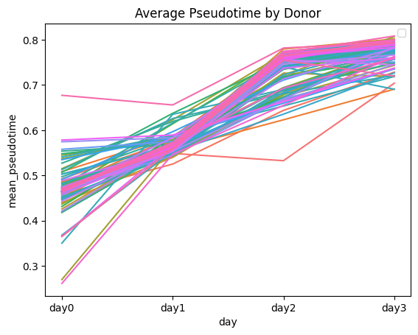
Donor Ranking: Pseudorank
Pseudotime prediction of day of differentiation resembles real time.
Mean Pseudotime increases by day across donors as expected.
Notes:
Figure 1: Top Left: PCA from top 500 HVGs, colored by day in real time. Purple=day0, Blue=day1, Green=day2, Yellow=day3. This PCA satisfactorily replicates the original PCA from Cuomo et al. (top right). Small differences are expected as the original published figure (right) was made in R using Seurat while replication was done in Python using ScanPy. Bottom Left: PCA pseudotime shows a similar pattern as when the PCA is colored in real time (top left).

Slide 14
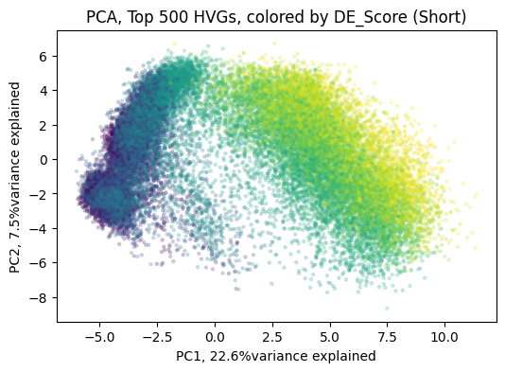
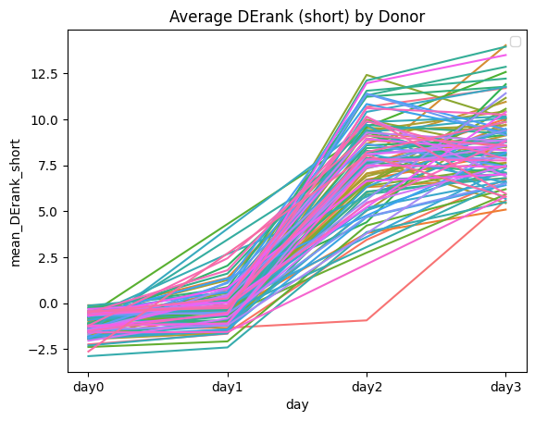
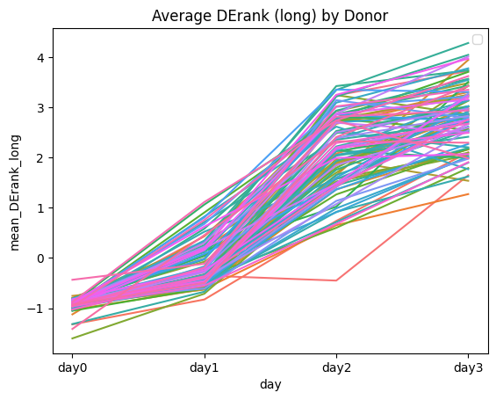
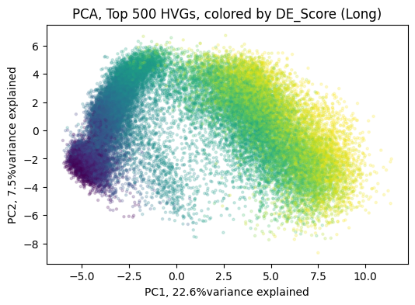
Donor Ranking: DE Score
DE score_long prediction of day of resembles real time, while DE score_short mixes day0 and day1.
Mean DE score_long increases by day across donors as expected, while DE score_short decreased from day2 to day3 in some donors.
Notes:
Figure 1: Top Left: PCA from top 500 HVGs, colored by day in real time. Purple=day0, Blue=day1, Green=day2, Yellow=day3. This PCA satisfactorily replicates the original PCA from Cuomo et al. (top right). Small differences are expected as the original published figure (right) was made in R using Seurat while replication was done in Python using ScanPy. Bottom Left: PCA pseudotime shows a similar pattern as when the PCA is colored in real time (top left).

Slide 15
Data Preprocessing
Select relevant data from adata
Dimension Reduction
Multiple methods of diumension reduction were attempted and will be discussed in the following section.
Single Cell data is too noisy for accurate predictions
Standard Protocol is to sum raw counts for all cells from each donor.
Split and Normalize
Convert to Bulk counts
Separate days into four separate data frames
Remove cells from donors without >=10 cells in both day0 and day3 (92 donors remaining)
Model development required multiple iterations of splitting and normalizing data due to high variability within splits.
For each iteration, date was reduced, split and then normalized to prevent data leakage

Slide 16
Model Building

Slide 17
Dimension Reduction
PCA
Molecular Pathways
Used curated gene lists from Human MSigDB Collections
Calculated the Spearman Coefficient for each gene relative to Pseudorank or DE Score
Performed PCA on normalized donor counts
Collected top 10 PCs for features
For each pathways, calculated the score for each donor using the score_genes function
Top 100 Genes
Find 100 genes with the highest absolute correlation
Collect raw counts of top 100 genes in new dataframe for Pseudorank (donor_rank) and DE Score (donor_score)
Described the genes which go up in 50 different standard cell types or processes
Common approach to describing a cell’s state
Calculated the correlation between the pathway and Pseudorank or DE score
Collected the pathways with correlations greater than 0.1 in a dataframe
Combined these pathways with PC1-PC10 to make the donor_pathways dataset

Slide 18
Model Screening Results: MAE and MAPE
Learner | genes_DE_MAE | genes_PR_MAE | pathways_DE_MAE | pathways_PR_MAE
Multiple Linear Regression | 0.568602 | 0.047347 | 0.630935 | 0.036782
Random Forest Regressor | 0.404805 | 0.016204 | 0.477658 | 0.020233
Gradient Boost Regressor | 0.401236 | 0.015706 | 0.474108 | 0.019064
XGBoost Regressor | 0.456879 | 0.016859 | 0.532262 | 0.021314
CatBoost Regressor | 0.410011 | 0.015049 | 0.510991 | 0.019033
 | genes_DE_MAPE | genes_PR_MAPE | pathways_DE_MAPE | pathways_PR_MAPE
Multiple Linear Regression | 0.204038 | 0.062277 | 0.302210 | 0.048444
Random Forest Regressor | 0.151211 | 0.021715 | 0.215585 | 0.026956
Gradient Boost Regressor | 0.150670 | 0.021009 | 0.216221 | 0.025477
XGBoost Regressor | 0.173794 | 0.022656 | 0.230050 | 0.028511
CatBoost Regressor | 0.153956 | 0.020189 | 0.230386 | 0.025454

Slide 19
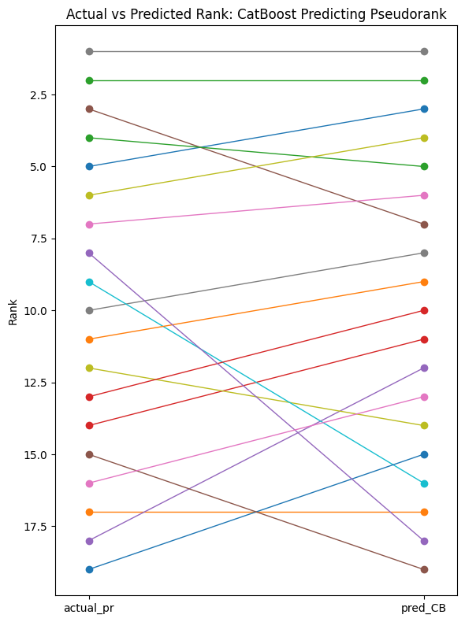
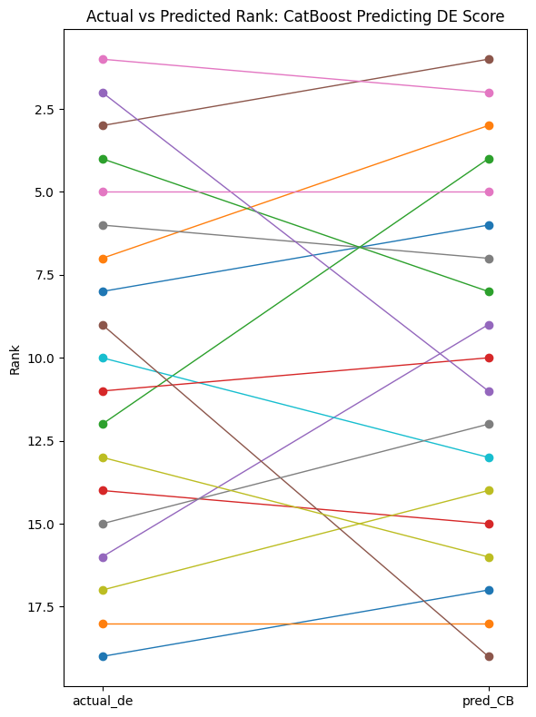
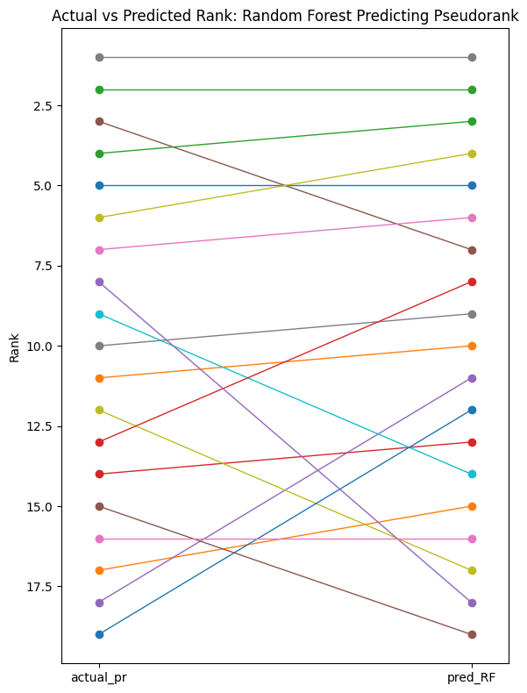
Model Screening Results: Donor Order
CatBoost: Pseudorank
CatBoost: DE Score
Random Forest: Pseudorank
Rank
Actual
Predicted
Actual
Predicted
Actual
Predicted
CatBoost learner trained on top genes predicting Pseudorank is the best at finding the top donors.

Slide 20
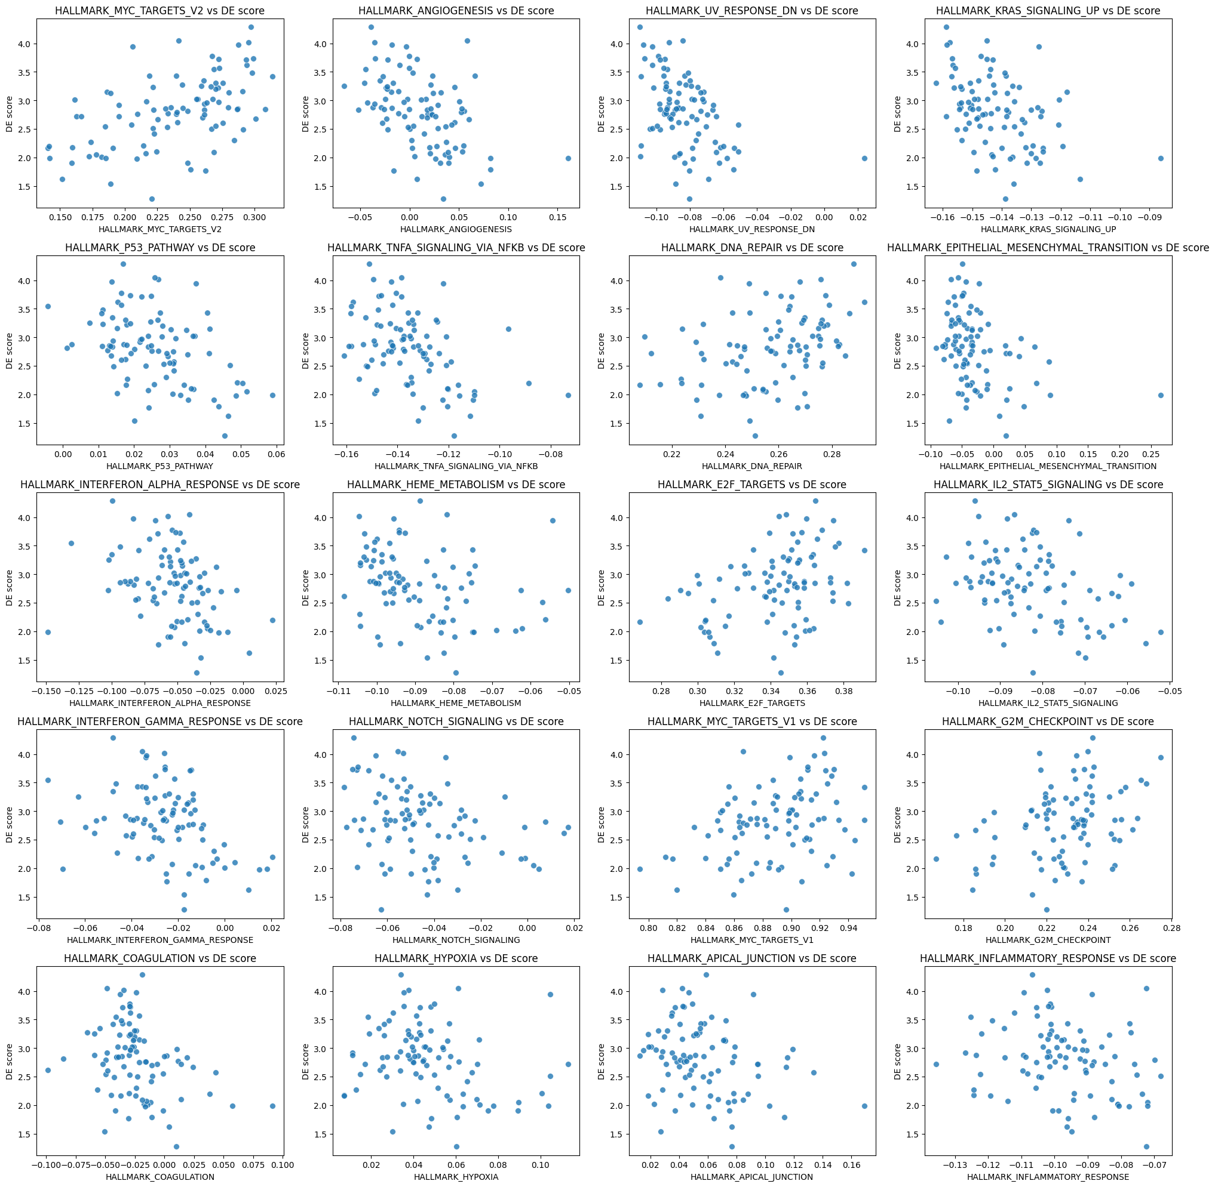
Molecular Pathways Make Biological Sense
Pathway (Pos) | Correlation DE | Correlation PR | Pathway (Neg) | Correlation DE | Correlation PR
Myc Targets V2 | 0.539 | 0.327 | Interferon_Alpha_Response | -0.360 | -0.531
DNA Repair | 0.376 | 0.315 | Apoptosis | -0.225 | -0.511
E2F Targets | 0.353 | 0.162 | Inflammatory Response | -0.273 | -0.479
Myc Targets V1 | 0.333 | 0.167 | TNFA Signaling via NFKB | -0.430 | -0.441
G2M Checkpoint | 0.327 | 0.148 | P53 Pathway | -0.430 | -0.431
Despite not being the most useful data for model building, these results show us the type of donors that have high ranks.
E2F, Myc driven gene expression
Proliferation
Low Apoptosis
Low Inflammation
This makes biological sense and validates our approach to donor ranking.

Slide 21
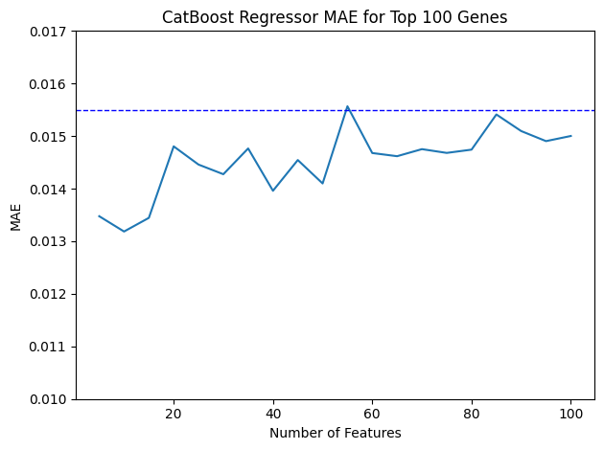
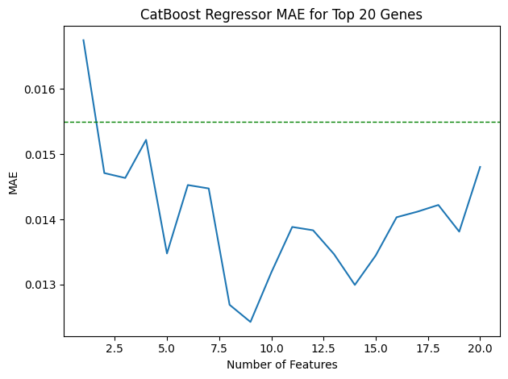
Feature Selection: Optimal Gene Number
CatBoost MAE with 5 to 100 Features
CatBoost MAE with 1 to 20 Features
These plots suggest high variability in the error from different models.
Anything less than 50 genes could work, but it’s hard to tell the optimal value.
Notes:
Figure 1: Top Left: PCA from top 500 HVGs, colored by day in real time. Purple=day0, Blue=day1, Green=day2, Yellow=day3. This PCA satisfactorily replicates the original PCA from Cuomo et al. (top right). Small differences are expected as the original published figure (right) was made in R using Seurat while replication was done in Python using ScanPy. Bottom Left: PCA pseudotime shows a similar pattern as when the PCA is colored in real time (top left).

Slide 22
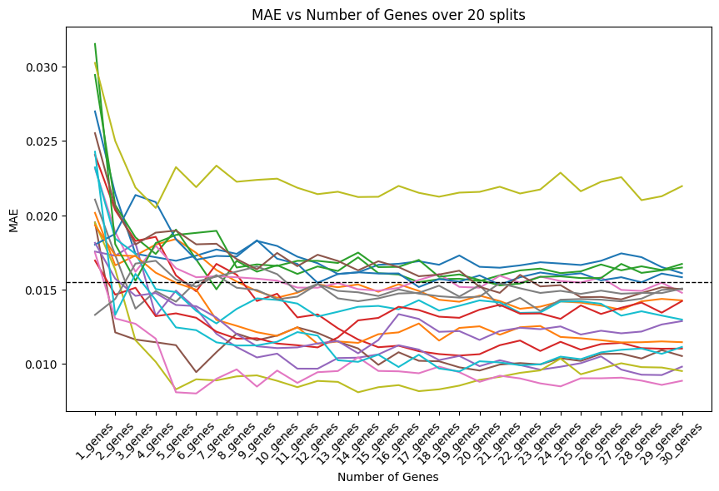
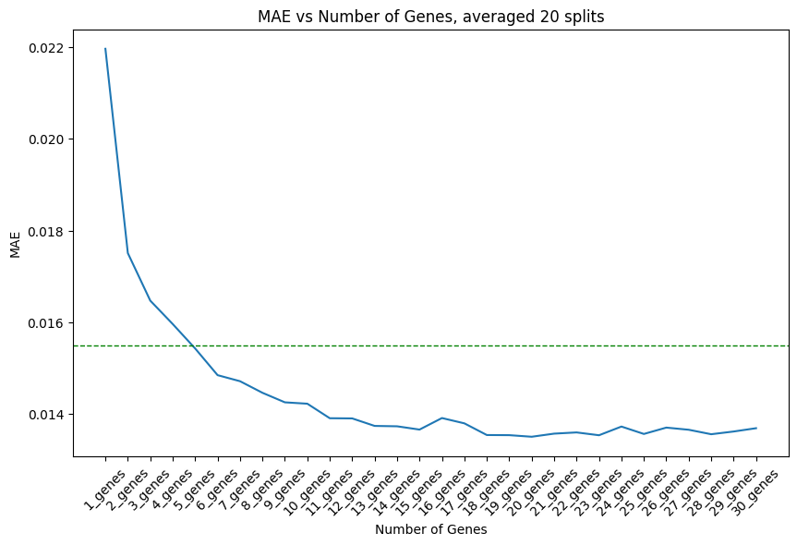
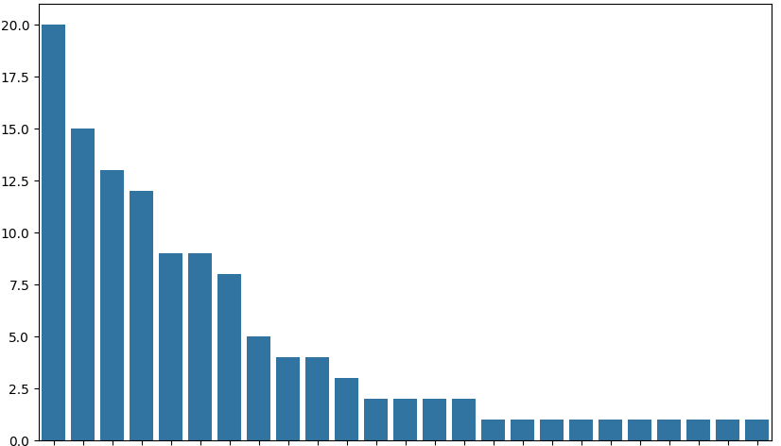
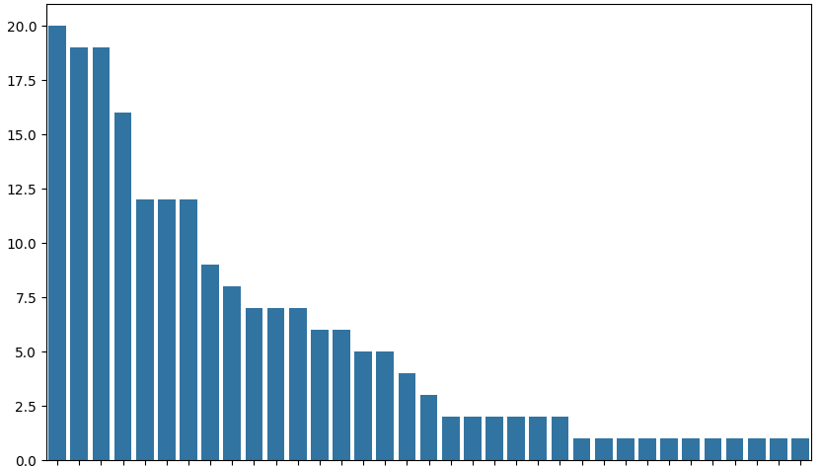
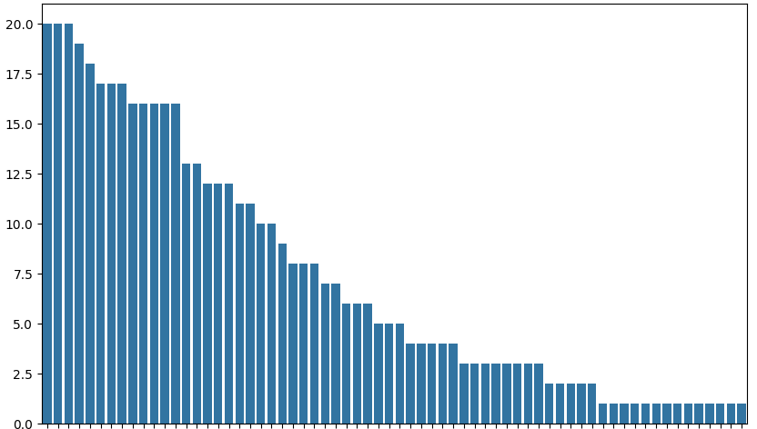
Feature Selection: Optimal Gene Number
CatBoost MAE with 1 to 30 Features, N = 20 Splits
CatBoost MAE with 1 to 30 Features, Mean of 20 Splits
MAE
17-26 genes
Top 6 Genes, Summed over 20 Splits
Top 10 Genes, Summed over 20 Splits
Top 24 Genes, Summed over 20 Splits
N=25
N=35
N=66
Count
Count
Count
Optimal Feature Number = 22
Notes:
Figure 1: Top Left: PCA from top 500 HVGs, colored by day in real time. Purple=day0, Blue=day1, Green=day2, Yellow=day3. This PCA satisfactorily replicates the original PCA from Cuomo et al. (top right). Small differences are expected as the original published figure (right) was made in R using Seurat while replication was done in Python using ScanPy. Bottom Left: PCA pseudotime shows a similar pattern as when the PCA is colored in real time (top left).

Slide 23
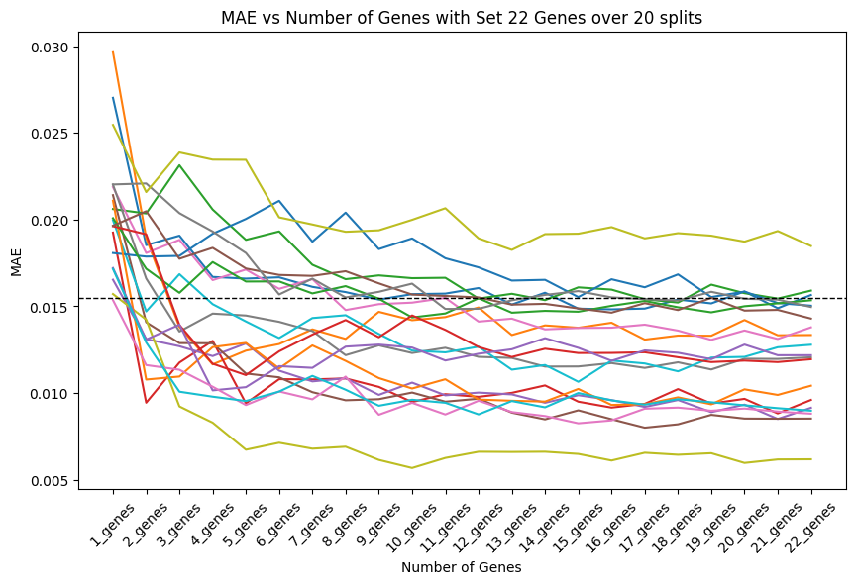
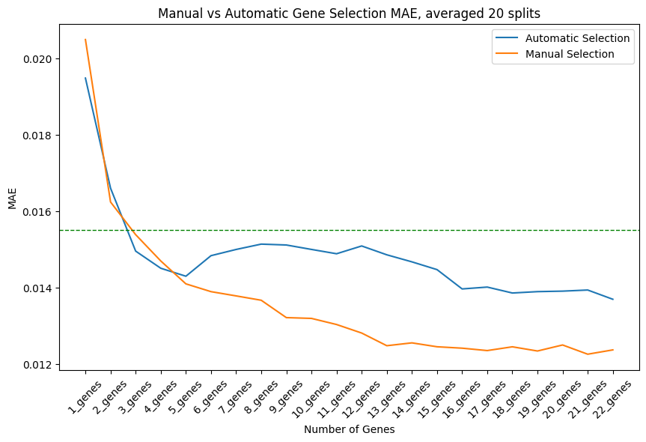
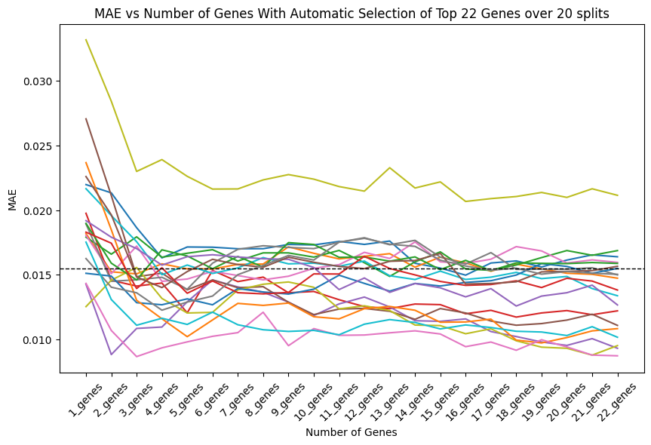
Feature Selection: Manual vs Automatic
Manual Feature Selection
Manual vs Automatic Feature Selection, Mean over 20 splits
Automatic Feature Selection
Automatic Features Selection offers robust method of handing variability between splits.
Notes:
Figure 1: Top Left: PCA from top 500 HVGs, colored by day in real time. Purple=day0, Blue=day1, Green=day2, Yellow=day3. This PCA satisfactorily replicates the original PCA from Cuomo et al. (top right). Small differences are expected as the original published figure (right) was made in R using Seurat while replication was done in Python using ScanPy. Bottom Left: PCA pseudotime shows a similar pattern as when the PCA is colored in real time (top left).

Slide 24
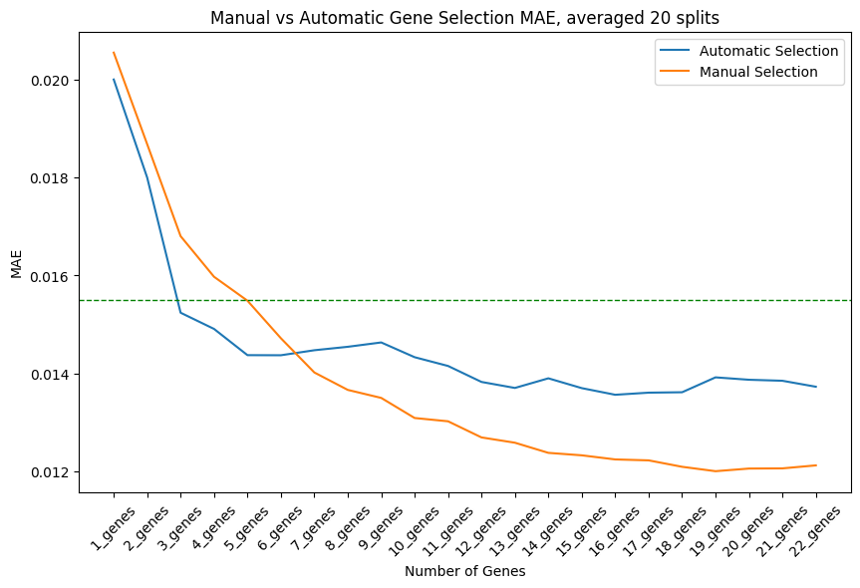
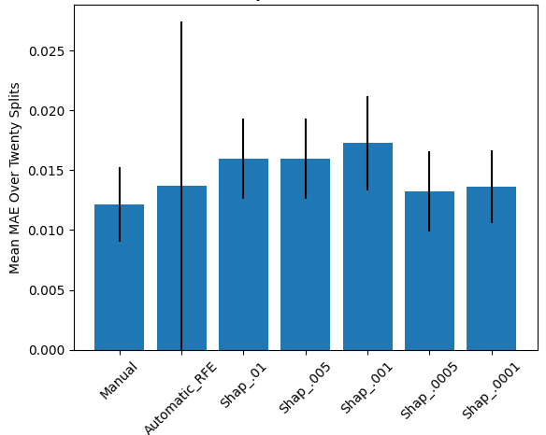
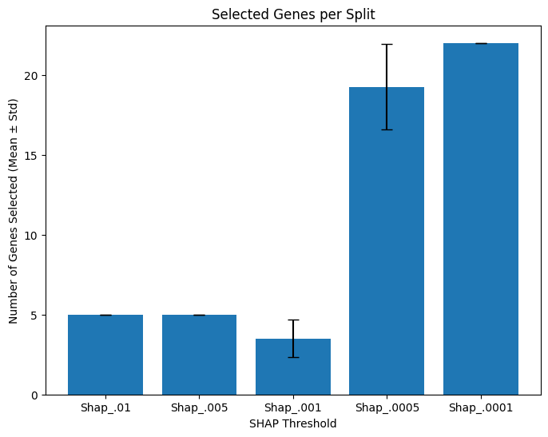
Feature Selection: Optimal Gene Number
Manual vs Automatic Feature Selection, Mean over 20 splits
Number of Genes Selected by Shap Threshold
MAE By Feature Selection Method
Automatic Features Selection through selecting up to 22 genes with SHAP values above 0.005 is the most robust method.
Notes:
Figure 1: Top Left: PCA from top 500 HVGs, colored by day in real time. Purple=day0, Blue=day1, Green=day2, Yellow=day3. This PCA satisfactorily replicates the original PCA from Cuomo et al. (top right). Small differences are expected as the original published figure (right) was made in R using Seurat while replication was done in Python using ScanPy. Bottom Left: PCA pseudotime shows a similar pattern as when the PCA is colored in real time (top left).

Slide 25
Final Model
Manual Version
Specific genes are selected after the train/test split.
CatBoost Regressor with default parameters
Automatic Version
Only the top twenty-two genes are included in the training dataset
Use a selector model trained on the entire dataset to determine feature importance
Select the genes with Shap Values of 0.005 or higher
Gene list is capped at 22
Calculate Shap Values for each gene
Train a second predictor model with the selected gene list

Slide 26
Future Work

Slide 27
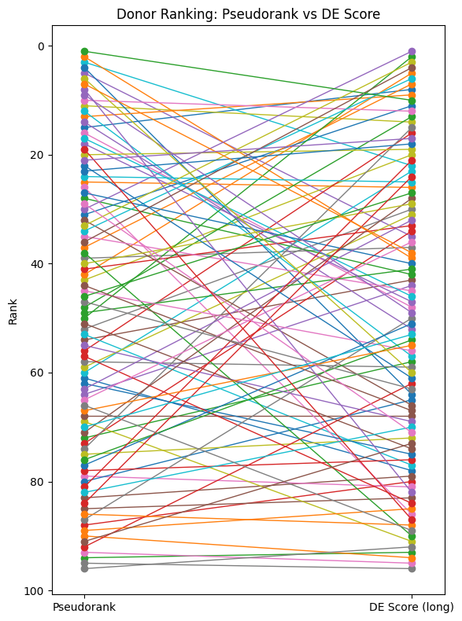
Future Work: Pseudorank vs DE Score
Notes:
Figure 1: Top Left: PCA from top 500 HVGs, colored by day in real time. Purple=day0, Blue=day1, Green=day2, Yellow=day3. This PCA satisfactorily replicates the original PCA from Cuomo et al. (top right). Small differences are expected as the original published figure (right) was made in R using Seurat while replication was done in Python using ScanPy. Bottom Left: PCA pseudotime shows a similar pattern as when the PCA is colored in real time (top left).

Slide 28
Future Work
Validate on Similar Datasets
Clone Selection in Cell Therapy Development
Cell types relevant to cell therapies include:
In Vivo Result Prediction
Correlating iPSC clone data with results from animal studies.
“Single-cell RNA-seq reveals novel regulators of human embryonic stem cell differentiation to definitive endoderm”
“Population-scale single-cell RNA-seq profiling across dopaminergic neuron differentiation”
These are two examples of similar datasets on which this approach could be tested and improved.
Determine the target variable
Test predictions with MAE and donor ranking as metrics.
Convert single-cell data to bulk counts if necessary.
Use the CatBoost Regressor run on the to pick the top 20-25 genes.
Train the model with the top genes.
Neurons for treating neurodegenerative diseases
Immune cells for treating cancers or autoimmune diseases
Beta islet cells for treating diabetes
The model could be used to better understand the features which impact iPSC clone performance

Slide 29
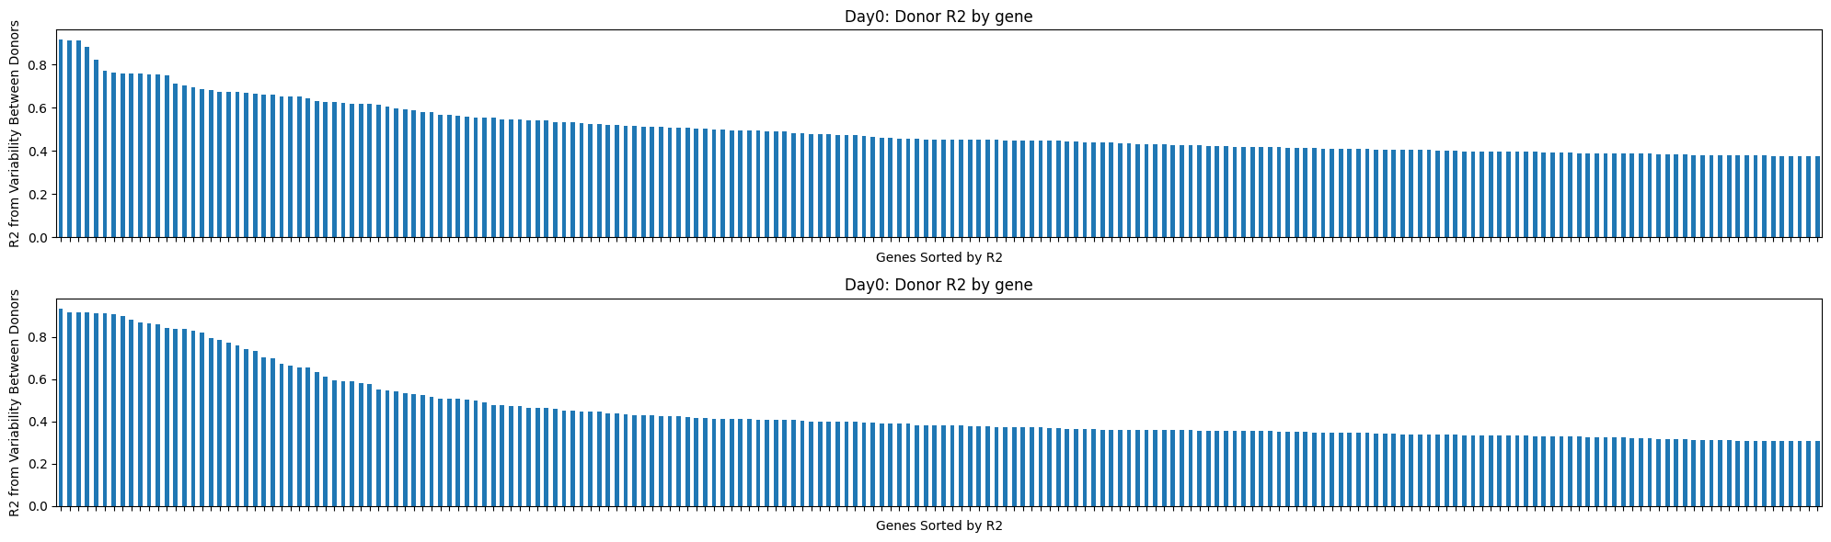
Variable Gene Expression Between Donors
Differential Gene Expression Between Donors
Day 0
Day 3
Notes:
Figure 1: Top Left: PCA from top 500 HVGs, colored by day in real time. Purple=day0, Blue=day1, Green=day2, Yellow=day3. This PCA satisfactorily replicates the original PCA from Cuomo et al. (top right). Small differences are expected as the original published figure (right) was made in R using Seurat while replication was done in Python using ScanPy. Bottom Left: PCA pseudotime shows a similar pattern as when the PCA is colored in real time (top left).

Slide 30
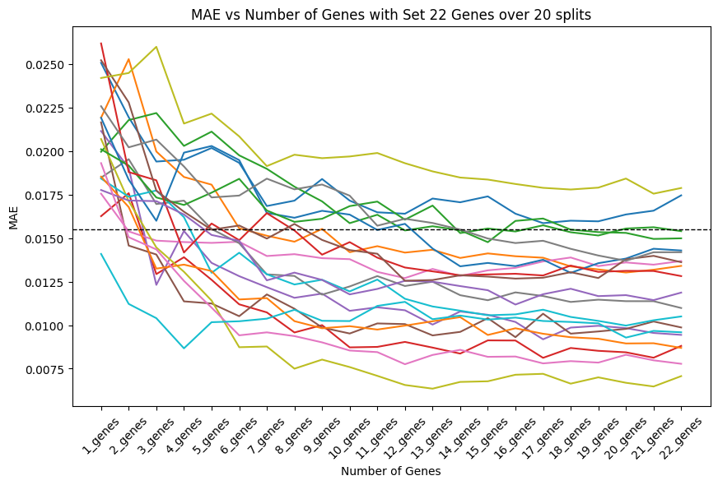
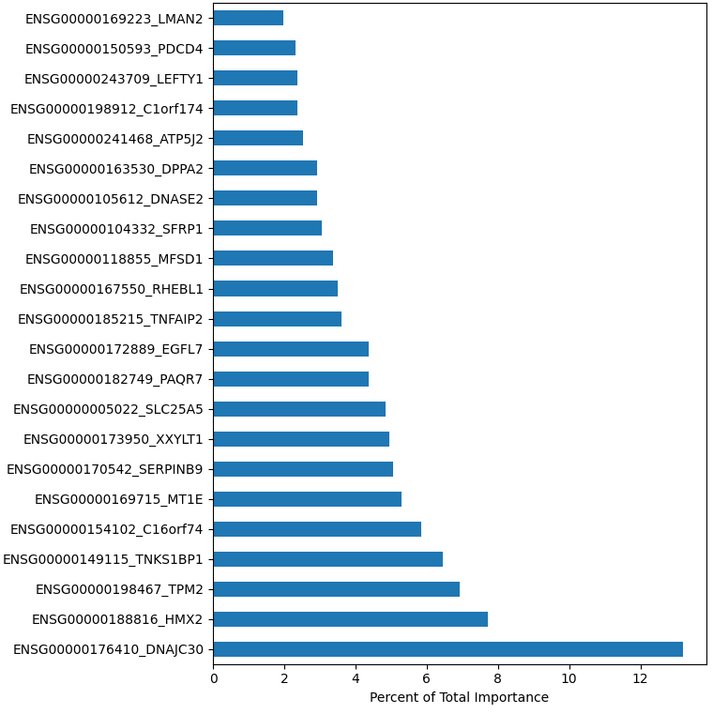
A
MAE for up to 22 genes, Manual Feature Selection
D
Feature Importance for Manual Gene Selection
B
MAE for up to 22 genes, Automatic Feature Selection
E
MAE By Feature Selection Method
C
Manual vs Automatic Feature Selection, Mean over 20 splits
F
Number of Genes Selected by Shap Threshold

