Slide 1
Domain Decomposition

Slide 2
An Example 1-D PDE IBVP
1-D advection equation:
Domain:
Initial data:
Boundary values:

Slide 3
An Explicit Discretization
1-D advection equation:
Discretized equation:
FV Space-time mesh:

Slide 4
Boundary Conditions
Boundary conditions are implemented with extra cells called ghost zones

Slide 5
Domain Decomposition
When number of cells becomes large:
  The computational burden on a processor may be too large!
  The memory requirement may be too large for a single processor!
Solution: split problem up over multiple processors by having each processor host subset of mesh cells corresponding to a part of the domain of the problem
Each subset of cells is called a subdomain or patch
This is called spatial domain decomposition

Slide 6
Parallel Implementation
Let different processors “own” a subset of mesh cells
Ideally we would like each processor to own about the same number of cells
  Allows for most efficient use of parallel architecture
This is called load balancing
Processor 1
Processor 2
Processor P

Slide 7
Parallelism I
Naively, it seems like we could write independent programs to update each subset of cells
Each program would run independently:
  Such a parallelism scenario is referred to as embarrasingly parallel
  It is trivially easy to implement in parallel
But…

Slide 8
Time Advancement I
Let's consider what happens when we advance discretized equations in time:
Process 1
Process 2
Process P

Slide 9
Time Advancement II
Now consider the equation for cell 5:
Not all the data required lives on cell 5!
  Updating cell 5 requires data from cell 6 which lives on processor 2
  Updating cell 6 requires data from cell 5 which lives on processor 1
This requires communication between processors
Process 1
Process 2
Process P

Slide 10
Time Advancement III
We can think of each subset of cells as a set of patches which cover the spatial domain
The processes are arranged (in this case) in a 1-D process topology
Each time advancement to a new time requires information exchange between nearest neighbors in the process topology
  In general, process j will require data from neighboring process j-1 and from process j+1
This is called nearest-neighbor communication or nearest-neighbor message passing
Typically implemented using MPI message passing library
No longer embarrassingly parallel!!
Process 1
Process 2
Process 3
Information
exchange
Information
exchange

Slide 11
Guard Cells
In practice the exchanged information is stored in guard cells
The number of guard cells needed depends on the stencil of the discretization scheme (our example PDE has a 3-point stencil)
Information arriving from neighboring processes is placed into these guard cells
Once information has arrived in guard cells, the neighboring cells can then be advanced in time
If possible, information exchange should be done asynchronously
  This is called asynchronous message passing or communication hiding
  Advance tile interior cells while cells while waiting for information to arrive on exterior edge of tile
  Note: Many AMR libraries do not support asynchronous information exchange
Process 1
Process 1
Process 2
Process 3

Slide 12
Computational Costs...
For the PDE we are considering the update of each cell requires ~ 10 floating point operations
  On a current generation chip the computational time cost is approximately ~ (# cells in process) x (a few nanoseconds)
The nearest neighbor communication is much more expensive!
  On typical architectures communication time cost ~ microseconds
Notice: Communication time >> Computation time per cell
Goal: minimize communication where possible
Process 1
Process 2
Process 3
Information
exchange
Information
exchange

Slide 13
A 2-D Example
Consider a 2-D advection equation:
Explicit Discretization:
  Five-point stencil

Slide 14
The 2-D Spatial Domain
For the PDE we are considering the update of each cell requires ~ 10 floating point operations

Slide 15
The 2-D Slab Decomposition
One way to achieve parallelism for the 2-D spatial domain is by decomposing it into slabs
Process 1
Process 1
Process 2
Process 3

Slide 16
The 2-D Slab Decomp. Message Passing
Information for time advancement of equations is obtained via exchange of guard cell information
Process 1
Process 2
Process 3
Information
exchange
Information
exchange

Slide 17
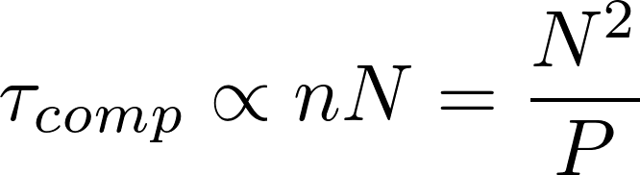

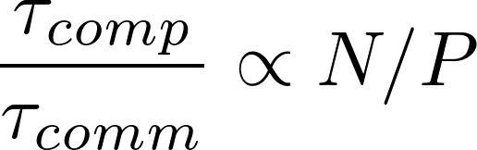

Slab Decomposition Message Passing Cost
The parallel efficiency is proportional to the ratio of the time spent computing to the time spent communicating
Time spent computing is proportional to number of zones in a tile
Time spent communicating is proportional to number of guard cells that must be exchanged
Parallel efficiency:
For a fixed problem size, as # processes, P, goes up, goes down and parallel efficiency decreases!
Slab i
N
zones
n=N/P zones

Slide 18

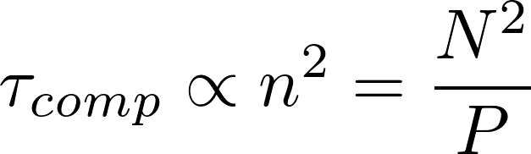
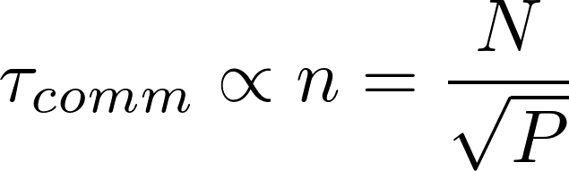

The 2-D Tile Decomposition
Break problem up into two dimensions
Parallel efficiency
Parallel efficiency scales better with P for fixed problem size!

Slide 19
Implicit Methods & Domain Decomposition
Consider 2-D advection equation:
Implicit Discretization:
  Five-point stencil
System of equations must be solved
  Could be non-linear
  Message passing pattern depends on algorithm for solving systems of equations (multigrid, Krylov subspace, Newton-Krylov, etc.)

Slide 20

Integro-PDEs & Domain Decomposition
1-D transport equation:
We can still decompose spatially, but the integral term makes decomposing in angle (direction) daunting
  Requires summations over angles that would necessitate global reduction operations (global summations)
  Information exchanged between all processes in angle dimension which is very costly!
  Best avoided unless absolutely necessary

