Slide 1
Predicting Home Run Counts
Presented By Diedrich Swetlik and JP Richmond

Slide 2
Introduction
Attempting to predict home run count for Y2021
Datasets & Methods Used
Believable Outcome

Slide 3
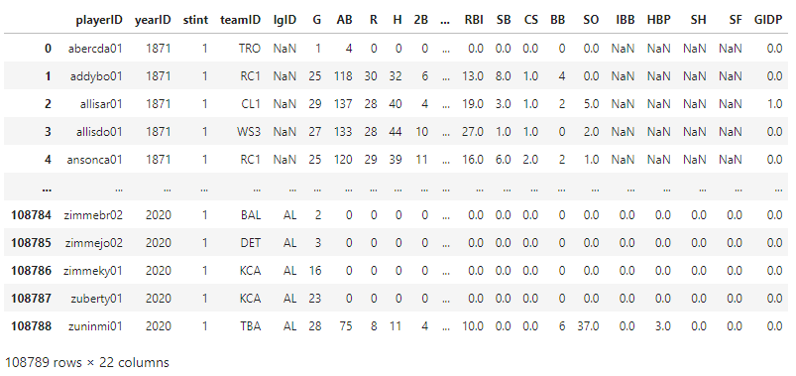
Training Data
Sourced from http://www.seanlahman.com/baseball-archive/statistics/

Slide 4
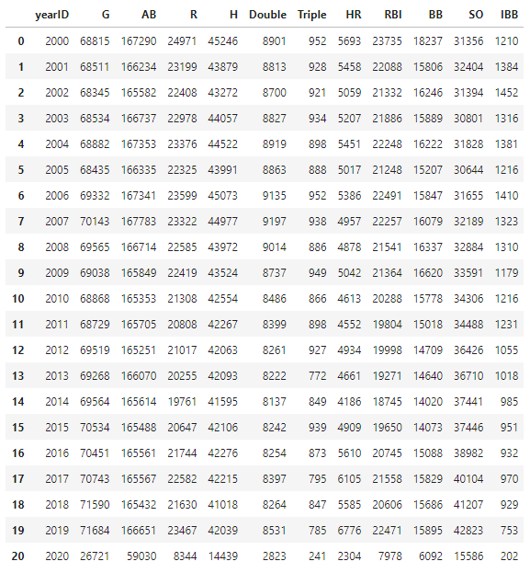
Edited Training Data
Removed years 1871 - 1999
Condensed remaining 29523 rows into 21
Dropped 10 superfluous predictors

Slide 5

Testing Data
Sourced from https://www.baseball-reference.com/leagues/majors/2021.shtml
Took totals from site, removed unneeded rows in .csv editor before uploading

Slide 6
Methods
Forward Subset Selection for selecting predictors from a pool of 11
Leave One Out Cross Validation to determine what degree of polynomial to use, testing accuracy of model
Linear Regression for the model

Slide 7
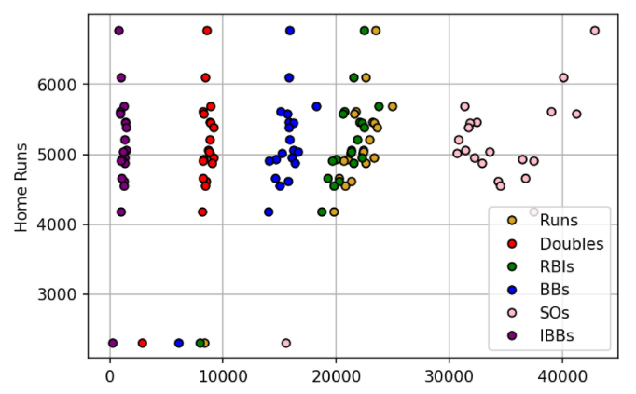
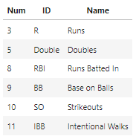
Forward Subset Selection
We settled on using Forward Subset Selection using BIC
We attempted to use Best Subset Selection, but the runtime was too long for our liking
6 predictors chosen through Forward Subset Selection:

Slide 8
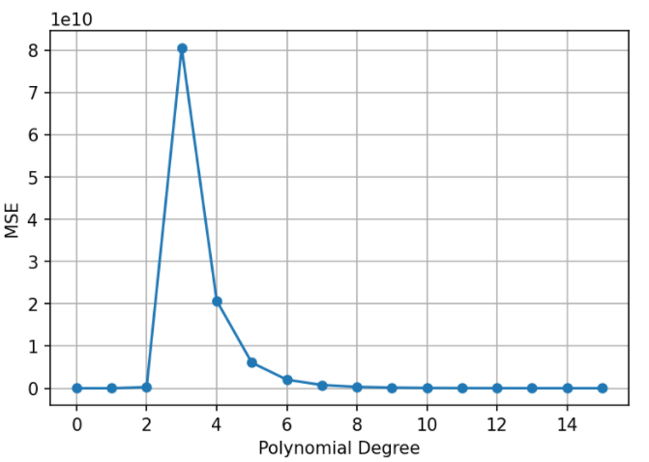
Leave One Out Cross Validation
Used to determine which polynomial degree should be used
LOOCV shows that the best polynomial to use is a first degree polynomial.

Slide 9
Testing and Conclusion
Our model predicted a total of 6204 home runs for the 2021 MLB Season
Actual count for the 2021 Season was 5944, making our prediction 260 off.
We are quite enthusiastic about how close our prediction got to the actual count.

