Slide 1
Model Updates & Map
Week 7

Slide 2
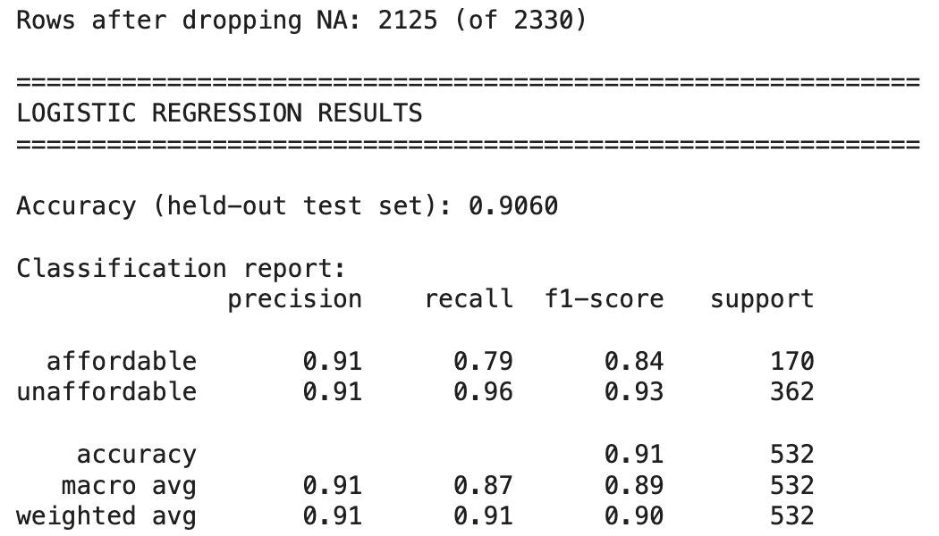
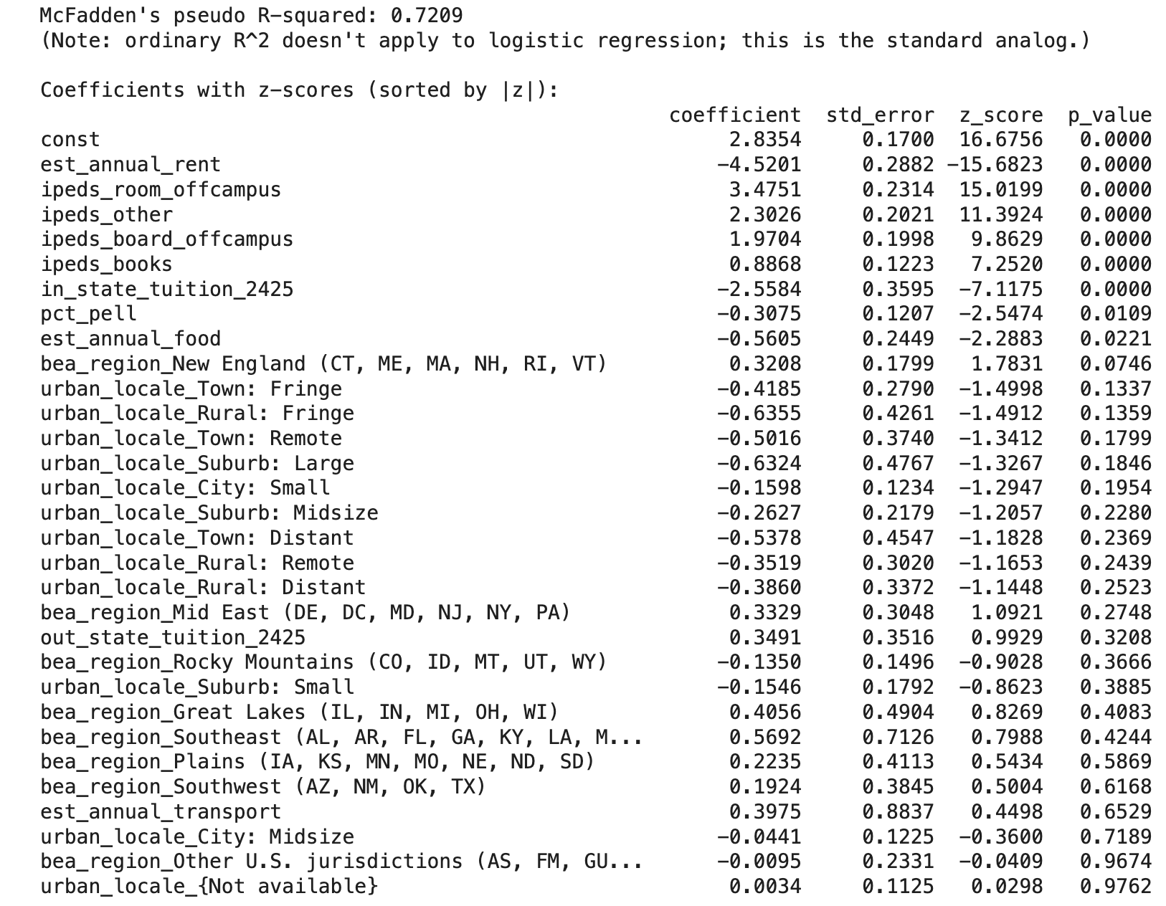
Logistic Regression
Dropped NA rows
90.6% accuracy, 0.72 r-squared

Slide 3
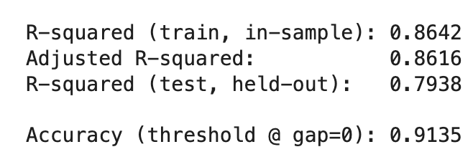
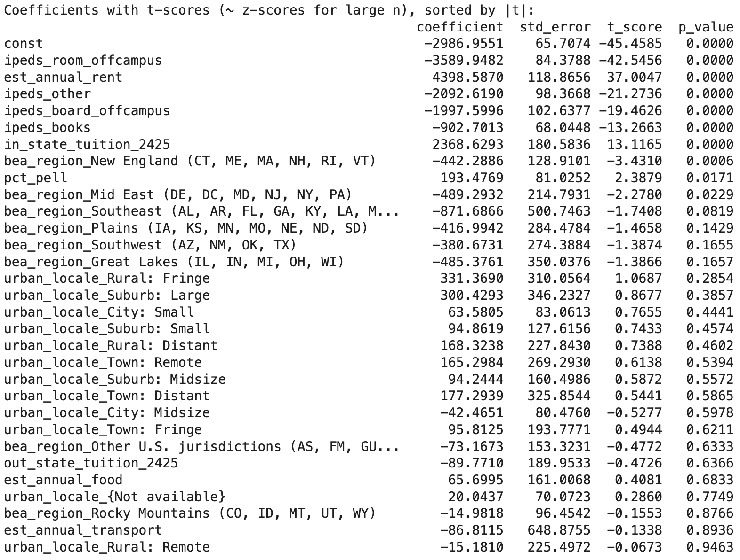
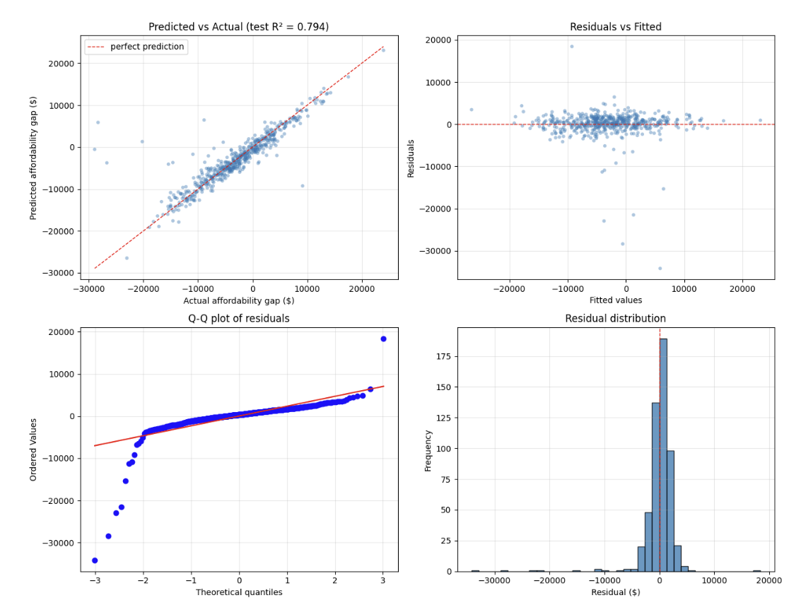
OLS Regression
91.35% accuracy, 79.38 r-squared

Slide 4
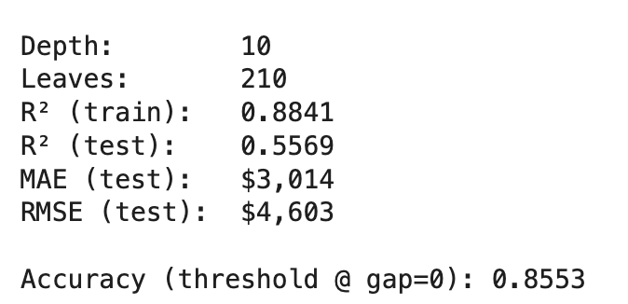
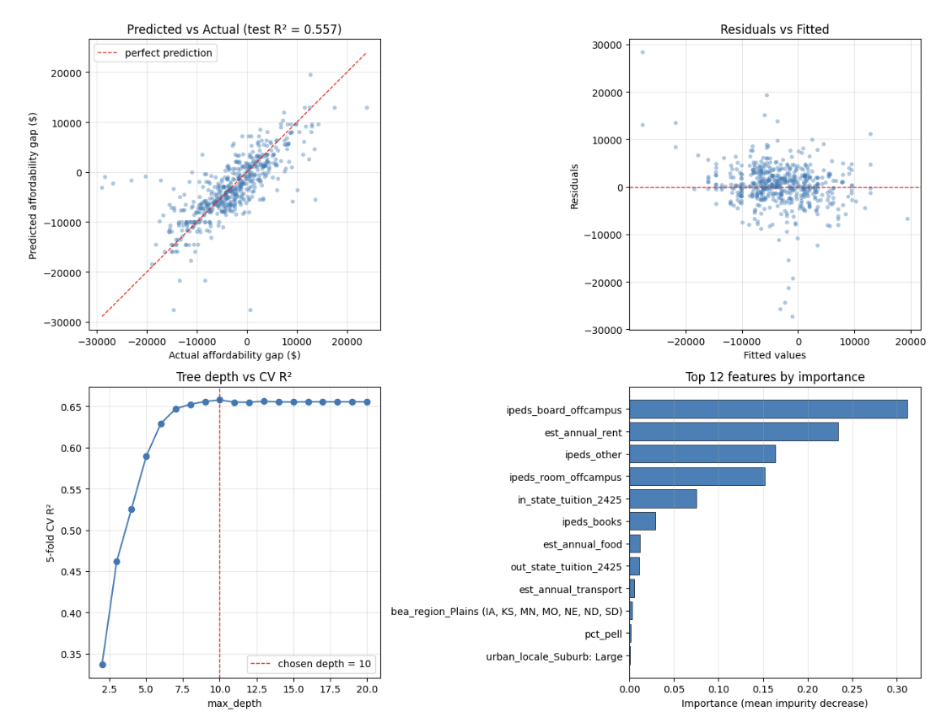
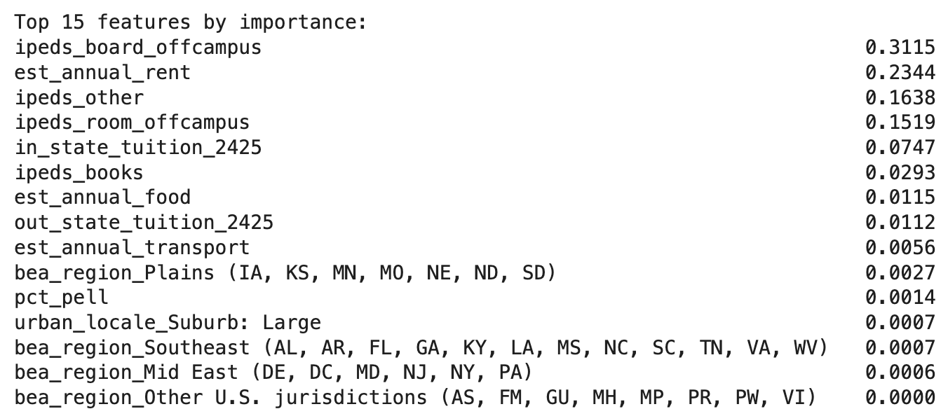
Decision tree (regression)
85.53% accuracy, 0.88 r-squared
Most important features
IPEDs
Annual rent

Slide 5
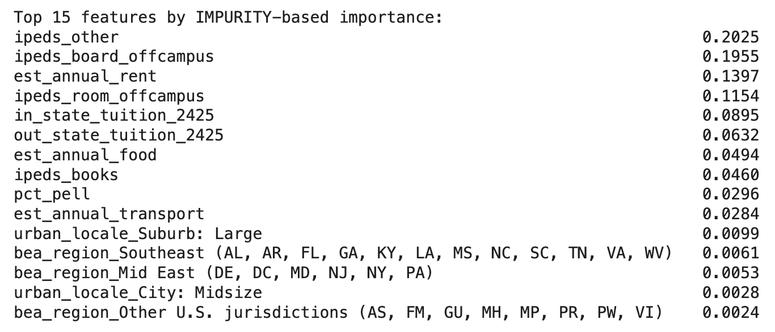
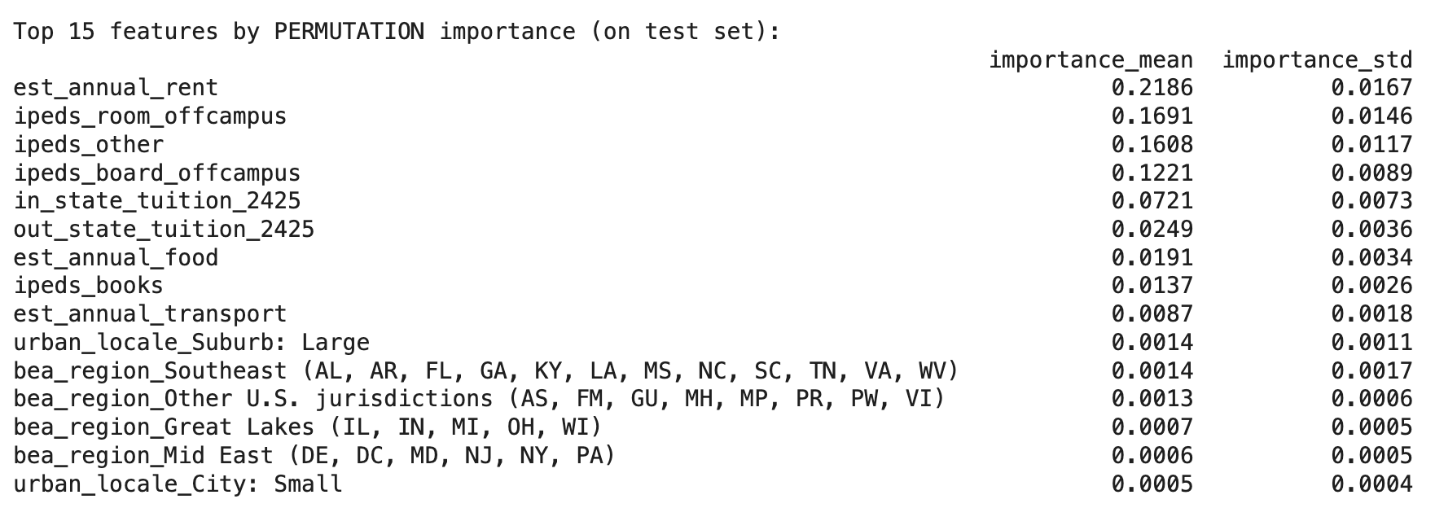
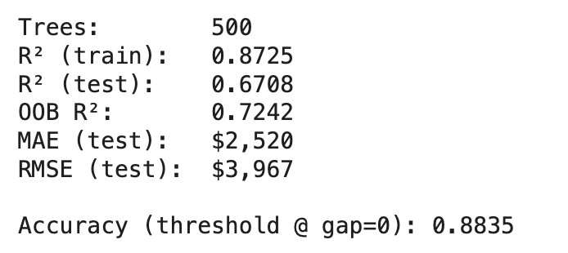
Random forest (regression)
Drop rows with NAs
88.35% accuracy, 87.25 r-squared
Most important features
IPEDs
Annual rent
Notes:
Look for differences in models: one variable is important for one model but not important for the other, which model we endorse and why

Slide 6
Random forest NA
Did not drop rows with NAs
R-squared lower than it is with dropping NA, same accuracy

Slide 7
Prototype of heat map
Steps
Download the zip files for state/ county borders
Interactive component..

Slide 8
Updates
Random forest regression with dropping NAs most accurate/ highest R squared
Removed annual rent from x (independent variable) to avoid circular model
466 rows dropped with NA
Notes:
Goal for monday meeting
Andrew, chloe: Fix comments on model approach
Anna, delaney: Create map prototype
Independent posters: can be the same or different parts of the project
Finals: Policy brief

