Slide 1
Ansible

Slide 2
What is Ansible
Ansible is automation tool which performs
Configurations, (Chef, puppet)
Example: export JAVA_HOME, install IIS
Provisioning, (terraform, cloudformation)
Example: EC2, RDS, Lambda in AWS, Create VM
Orchestration (Jenkins, Vagrant)
Example: Process of state
Ad-Hoc/Application deployments (Jenkins, Fabric, teamcity)
Example: Deployment of code, Patching of servers.

Slide 3
Why Ansible?
Easy to write, read, maintain and evolve- without writing scripts or custom code.
Fast to learn and setup.
Uses YAML format which is easy to read and understand as playbook to describe automation tasks.
Above all, it is clean to use without agent and connects to other VMs/nodes securely using SSH as default.

Slide 4
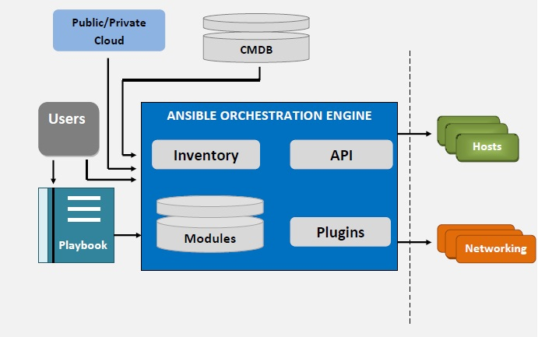
Architecture
Modules,
Inventory,
Module utilities (APIs)
Playbook

Slide 5
Ansible Architecture contd..
Modules:
Ansible works by connecting to nodes by pushing the automated scripts called
Ansible Modules. Modules has the parameters which sets the desired state of system.
Module Utilities:
Module utilities are fill in gap to minimize the duplication and maintenance of same code.
Example: to use code to data parse in multiple modules, we can use python developed scripts lib/ansible/module_utilities/fetch_table.py

Slide 6
Ansible Architecture
---
Inventory:
Ansible represents the machines/nodes that it manages in a file (INI, YAML, etc) or `/etc/ansible/hosts` that has details of servers that we choose as groups.
Once inventory host are listed the variables can be assigned to simple text files in group_vars/ or host_vars/
Example: Below is sample inventory file that has details of servers DNS to perform SSH as group
---
[application] → groups
www1.example.com → servers
www2.example.com

Slide 7
Playbooks
Playbooks can be defined as multiple slices of infrastructure topology for orchestration, automation or configuration.
Sample playbook
---
hosts: application
vars: group_vars
roles:
- common
Webapps
Tasks:
-name:
command: sudo yum install tomcat

Slide 8
Install ansible
sudo easy_install pip
sudo pip install ansible

Slide 9
Structure
main.yml / site.yml - # master playbook
provisioning.yml # to use as executioner of roles
Roles/
Install_software/
Main.yml
Var.yml
Group_vars/ - #Assigns variables to particular group
Install_software.yml
Files/ # to store any files or module utilities

Slide 10
Masterplaybook.yml -- (site.yml)
---
name: web installation
include: web.yml
name: app installation
include: app.yml
name: db installation
include: db.yml

Slide 11
Provisioning.yml # integrates with roles or execute a task
---
- host: webservers
vars:
- version: 2.7
tasks:
- name: install apache
command: “sudo yum install apache:{{version}}”

Slide 12
App.yml
---
- host: appservers
vars:
- version: 3.5
tasks:
- name: install apache
command: “sudo yum install tomcat:{{version}}”

Slide 13
Masterplaybook.yml
- include: provisioning.yml
Provisioning.yml
- hosts:
roles:
- install_software
roles/
install_software/
main.yml
---
name: install tomcat
command: “sudo yum install tomcat”
Files/
.exe, .txt, .py
Vars/

Slide 14
Useful links
https://docs.ansible.com/ansible/latest/user_guide/playbooks_best_practices.html#id19
https://docs.ansible.com/ansible/latest/dev_guide/overview_architecture.html
https://docs.ansible.com/ansible/latest/installation_guide/intro_installation.html

