Slide 1

Stephen Boris, Garbo Cheng Ye, Connor Cheong, Steph Colen, Frank Manns, David Yang

Slide 2
Background
Who is JAUNT?
Transportation service with a focus on those with disabilities
Provides over 300,000 trips per year to Central Virginia residents
Current System
Reservations by phone and email
Paper-based time off

Slide 3
StarPort
Requirements
Reservation management system
Time negotiation
Multilingual
Time-off request management system
PDF generation
Changes
Technology Stack
Notes:
Mention requirements change (no real time, no Trapeze, add time off)

Slide 4
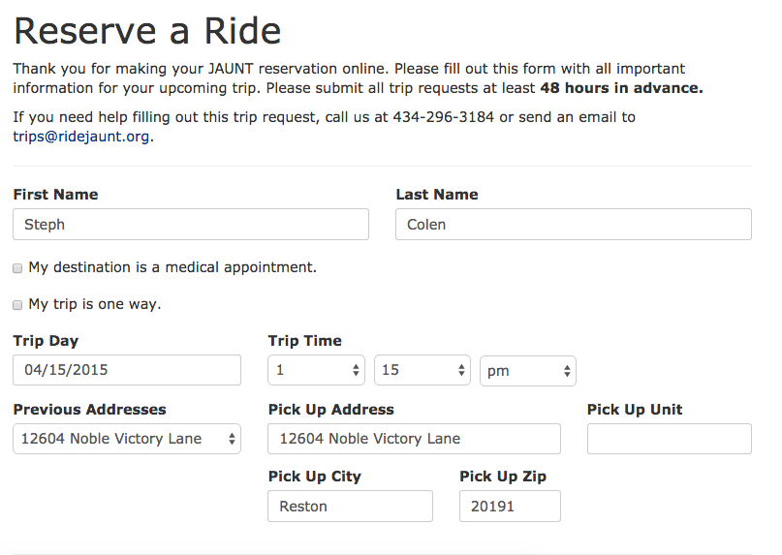
Submitting a Reservation
Notes:
Form asks for:
Can edit name to make reservations for other people
Automatically associated with a client ID that references the same client in the external Trapeze database so that data can be distributed to drivers
Name, day, time, pickup address
Day must be at least 2 days in the future
Pickup address is pulled from previously entered addresses and auto-fills the fields
Comments, additional passengers (IE children, personal care attendants, etc)

Slide 5
Submitting a Reservation
Notes:
Medical appointment
opens up a checkbox farther down that lets the return trip be “will call”
client calls when the appointment is finished
multi-leg trips booked as multiple one way trips
No return time required for either of these trips

Slide 6
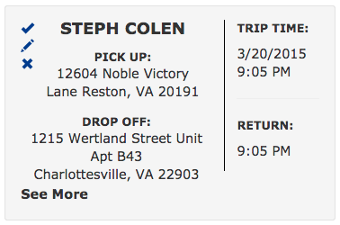
Handling a Reservation
Notes:
Can approve or deny reservations, even if already approved or denied
“See More”
Generate PDF of reservation request
Client ID
Comments
Extra passengers
Can sort pending, approved, and denied reservation requests separately
Sory by last name, trip date, request date
pagination - 5-30 by increments of 5

Slide 7
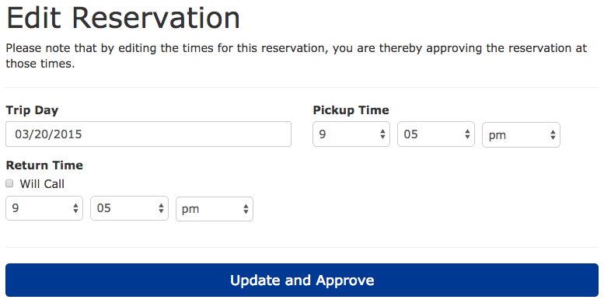
Negotiation
Notes:
Can also edit a reservation - simulates negotiating
Allows JAUNT staff to call client on phone to agree on a time and enter it in the reservation
Trip time, day
return time, will call
Can’t edit trip locations
Negotiating a trip and saving the changes approves it
Client receives an email when trip is approved

Slide 8
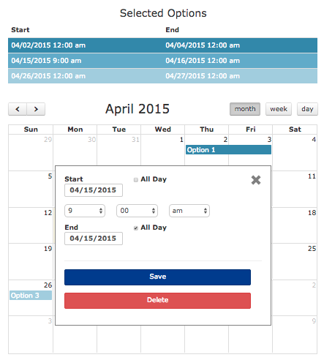
Submitting a Time-off Request
Notes:
Click and drag table rows
“All Day” checkbox

Slide 9
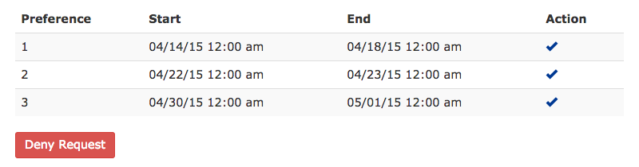
Approving a Time-off Request

Slide 10
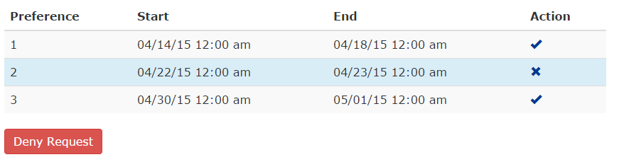
Approving a Time-off Request

Slide 11
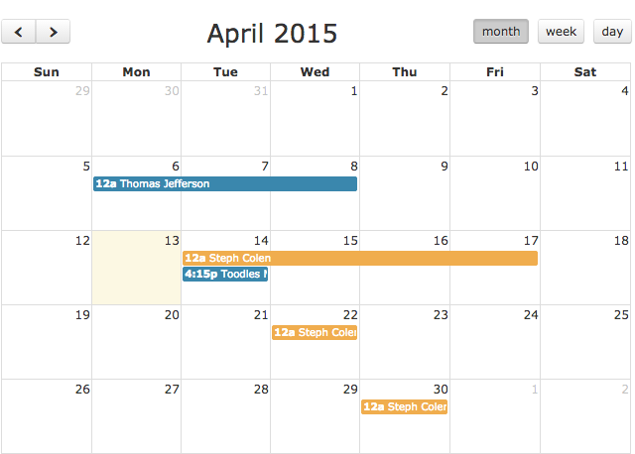
Approving a Time-off Request

Slide 12
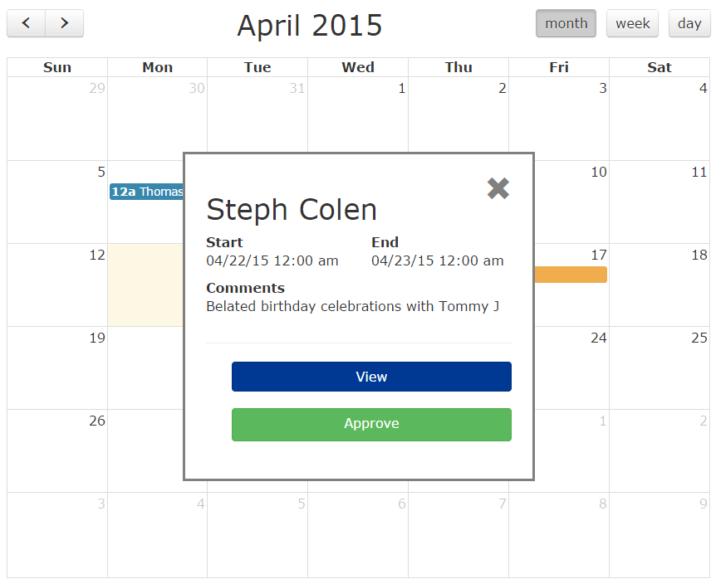
Approving a Time-off Request

Slide 13
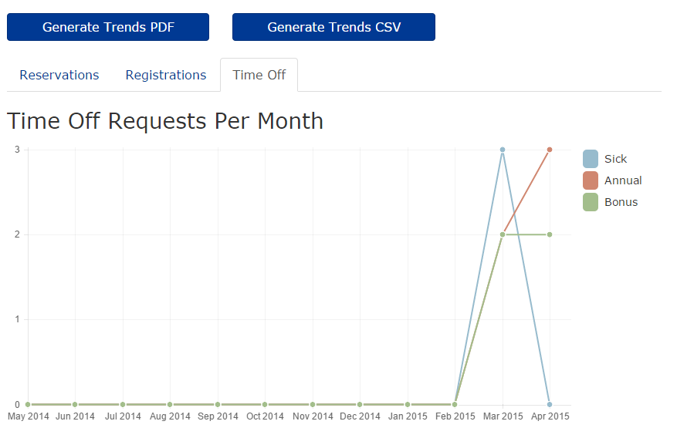
System Metrics
Notes:
-how system is being used
-export the metrics into CSV(spreadsheets)
-let them see what type of request are made during different time period

Slide 14
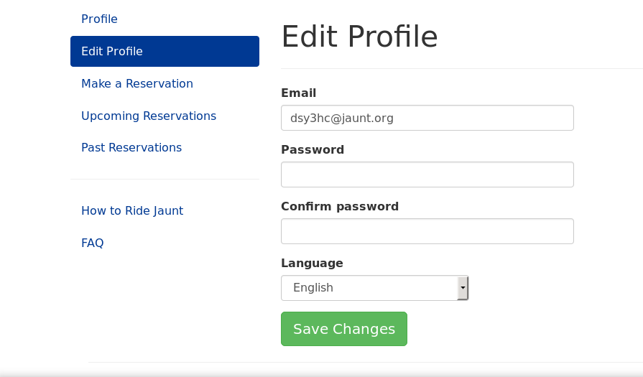
Changing Languages

Slide 15
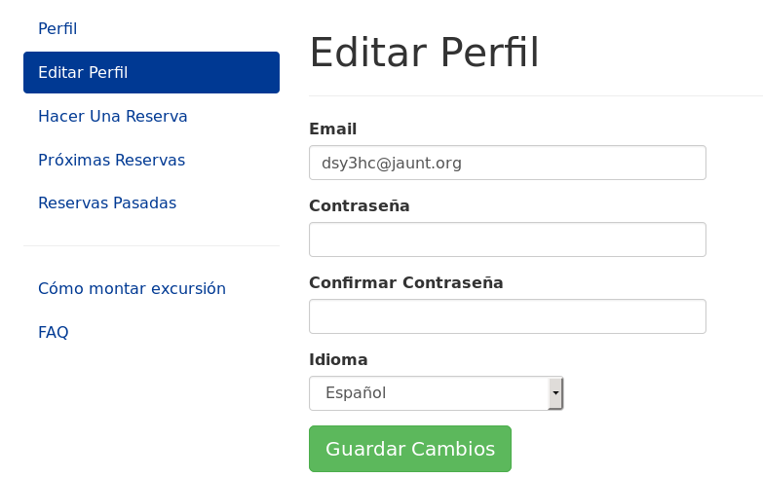
Changing Languages

Slide 16
Wrap Up
Reservations can be made outside of business hours
Generated reports save time for the director
Email updates keep staff updated on activity and ease transition to our system

