Slide 1
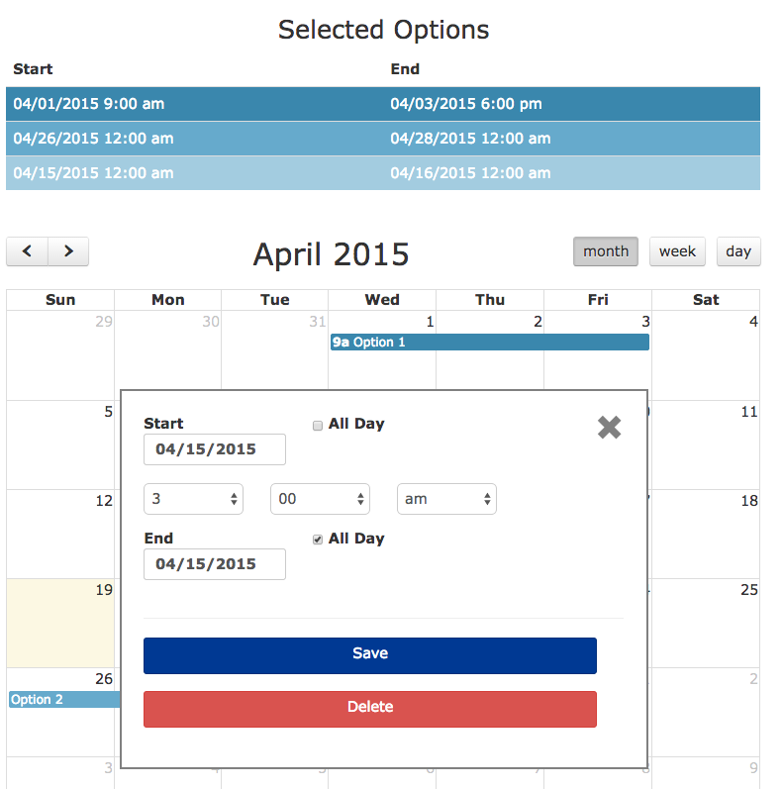
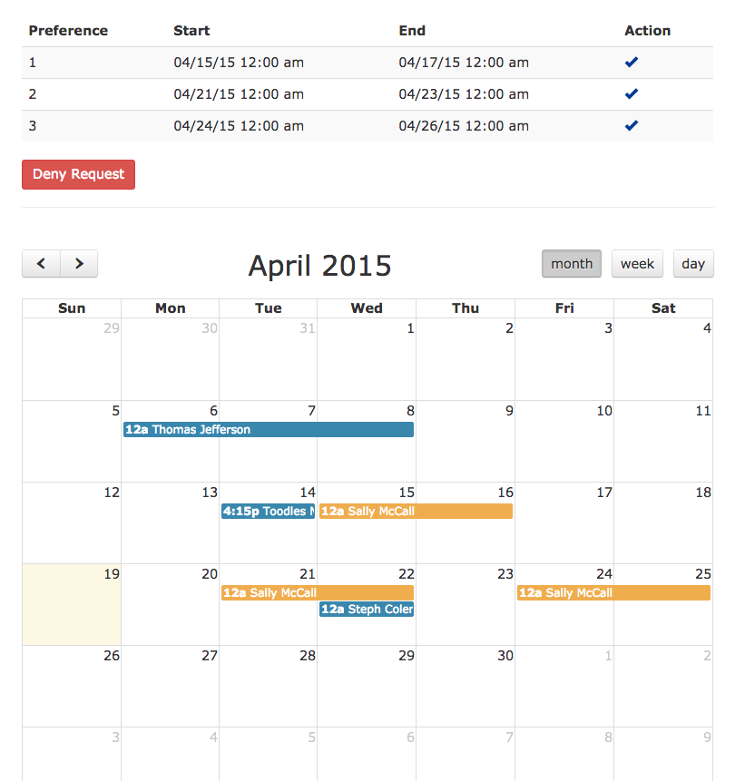
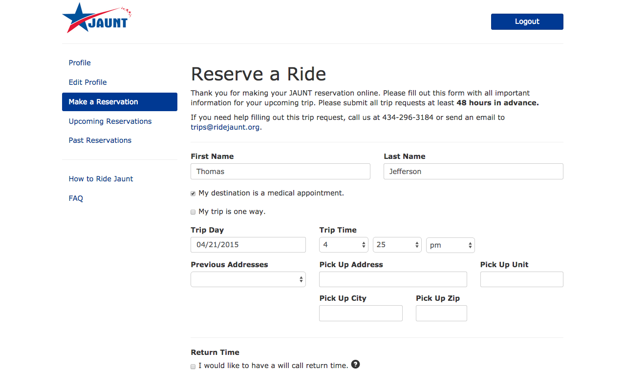
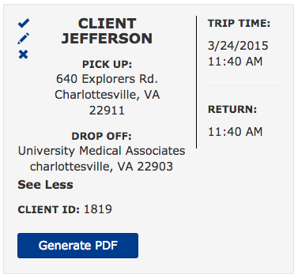
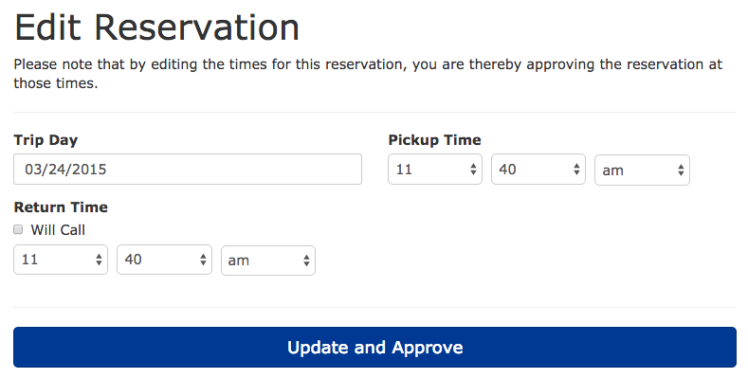
Service Learning Practicum: JAUNT Reservation and Time-Off Management System
CS 4791: SLP
2015
Stephen Boris, Garbo Cheng Ye, Connor Cheong,
Stephanie Colen, Frank Manns, David Yang
Background
Time-Off Request Management
The team worked with JAUNT, a local nonprofit paratransit company, to produce a CakePHP web application named “StarPort.” Whereas clients previously could only submit reservations by phone or email, StarPort streamlines JAUNT’s reservation process by allowing clients to submit reservations online. Using a custom calendar app, StarPort allows employees to request time off, eliminating the need for paperwork. By allowing reservations and time off requests to be submitted electronically, StarPort empowers JAUNT to more efficiently serve the local community.
Reservation Management
1
2
Employees select up to three options for a time-off request via a calendar interface, which are displayed in a table. These options can be rearranged in order of preference.
Administrators can approve only one option submitted with any given time-off request. Each option is shown in yellow on a calendar of all approved requests (in blue) to show an administrator how many employees have off on a given day.
Results
1
2
Staff members can create reservations up to 9 minutes faster, saving 6.8 hours over the course of one week
Employees can submit a time-off request form 150 seconds faster, saving 1.6 hours per week
Administrators can process a time-off request 60 seconds faster, saving 40 minutes per week
Clients can reserve two way trips, one way trips, or trips to medical appointments via a simple online form.
Once a reservation is submitted, schedulers see a reservation summary card and can approve, edit, or deny reservations.
Administrators can edit reservations to negotiate the trip date or time and ensure that the ride can be accommodated with JAUNT’s schedule.
Acknowledgments
The group would like to extend a special thank you to Lucas Lyons, John Overton, David Parks, and the entire JAUNT organization for their support over the past year.
3

