Slide 1
Case Study: Packet Mining
The behaviour of aggregated network services

Slide 2

The Packet Mining Problems
The Data:
  4+ TB of packet captures from a one month period (headers).
  Data spread over 9000 files of ~500Mb each.
Task:
  Study real world network usage.
  Mine data for performance and usage information.
Code:
  Packet reader and de-multiplex library in F#.
Development time (code):
  1 week.
Performance:
  F# reads packets at 80,000 packets / second.
  Live capture processing a possibility . . .

Slide 3
Example: computing flows
Flows:
  Flows are sequences of related packets.
  For example, a series of POP3 packets from a session.
Task:
  Group packets into flows.
  Generate a summary dataset of flow, protocol and bandwidth.
Problems:
  The volume of data.
  Linking flows that cross capture boundaries.
Attempts:
  Python was too slow to read/process the data.
  C is fast but prototyping flow algorithms is hard work
F#:
  Access to high performance .NET libraries.
  Rapid prototyping of mining algorithms.

Slide 4
Example: who talks to who?
Connectivity:
  Packets have source and destination IP
  What is the connectivity graph?
  Count packets and data.
  How does it break down by protocol?

Slide 5
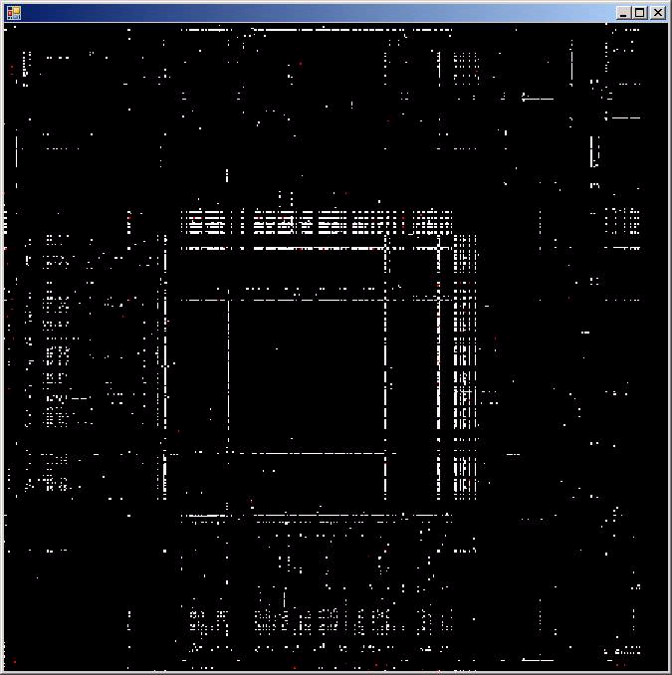
Who talks to who? – srcIP x destIP

Slide 6
Who talks to who? – what is shown
Image shows:
  Summary of 500Mb capture. (10 min of traffic).
  Servers with high connectivity.
Next steps:
  Determine IP connectivity over time. (video).
  Determine IP availability over time.
  Determine traffic patterns per IP.
  Determine irregular traffic incidents per IP.
The requirements:
  Each experiment suggests another.
  Require rapid prototype of tests.
  Require code that is easy to adapt.

Slide 7
What they say…
When asked “Why F#”, in short . . .
  “Speed and Type-checking”
In more detail . . .
  “It lets me write terse code using rich datatypes and libraries (like python) but is faster at runtime and is type-checked.”
Notes:
During the project I found coding in F# fun, and really enjoyed the brevity of the resultant code due to F#’s type inference and extensive collection functions.
I found the resultant F# code easy to maintain and evolve as new requirements came in, and even produced a reusable graph drawing library along the way.
The main challenges were to crunch through hundreds of gigabytes of data for 3 days using an array of 15 computers, and then to present the huge results in a usable and responsive way.
The succinctness of F# combined with the .Net framework helped me to focus on the ends and not the means.
The UI code was able to stream a 100Mb CSV file from disk in around 5 seconds, while simultaneously calculating and drawing a histogram as it loaded
Performance of the F# code was excellent.
Plus the best optimisations come from better algorithms and with F# constructs like lazy enumerations, you can focus there.

Slide 8
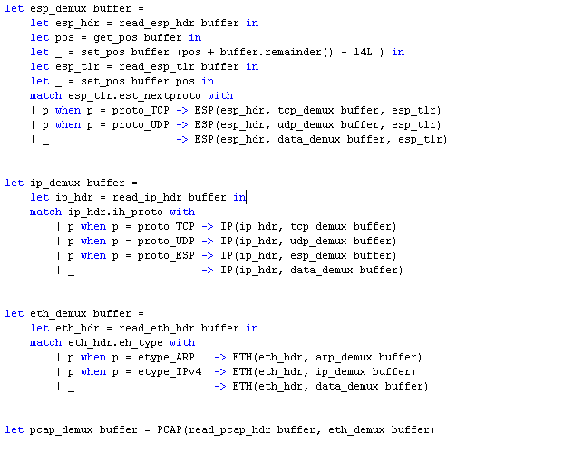
F# demux reader code
Notes:
During the project I found coding in F# fun, and really enjoyed the brevity of the resultant code due to F#’s type inference and extensive collection functions.
I found the resultant F# code easy to maintain and evolve as new requirements came in, and even produced a reusable graph drawing library along the way.
The main challenges were to crunch through hundreds of gigabytes of data for 3 days using an array of 15 computers, and then to present the huge results in a usable and responsive way.
The succinctness of F# combined with the .Net framework helped me to focus on the ends and not the means.
The UI code was able to stream a 100Mb CSV file from disk in around 5 seconds, while simultaneously calculating and drawing a histogram as it loaded
Performance of the F# code was excellent.
Plus the best optimisations come from better algorithms and with F# constructs like lazy enumerations, you can focus there.

Slide 9
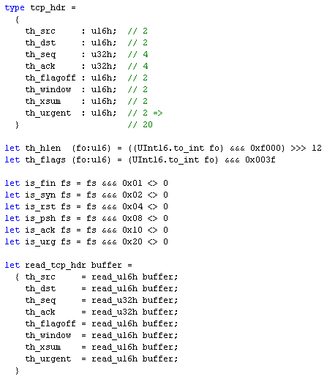
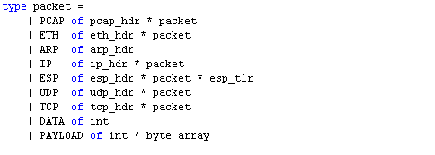
F# TCP header code and packet type
Short code!!
Strong type checking
Notes:
During the project I found coding in F# fun, and really enjoyed the brevity of the resultant code due to F#’s type inference and extensive collection functions.
I found the resultant F# code easy to maintain and evolve as new requirements came in, and even produced a reusable graph drawing library along the way.
The main challenges were to crunch through hundreds of gigabytes of data for 3 days using an array of 15 computers, and then to present the huge results in a usable and responsive way.
The succinctness of F# combined with the .Net framework helped me to focus on the ends and not the means.
The UI code was able to stream a 100Mb CSV file from disk in around 5 seconds, while simultaneously calculating and drawing a histogram as it loaded
Performance of the F# code was excellent.
Plus the best optimisations come from better algorithms and with F# constructs like lazy enumerations, you can focus there.

