Slide 1
Extract-Edit-Apply

Slide 2
Philosophy
“words”
topic
THING

Slide 3
Philosophy
“blue”
color
THING

Slide 4
Philosophy
“cube”
shape
THING

Slide 5
Philosophy
“words”
“changed words”
topic
topic
THING
CHANGED THING

Slide 6
Philosophy
blue
dark green
color
color
THING
THING

Slide 7
Philosophy
cube
heart
shape
shape
THING

Slide 8
Philosophy
“words”
“changed words”
Summarize/Extract w.r.t. topic
ApplySummaryChange w.r.t. topic
THING
CHANGED
THING

Slide 9
Rationale
Edit > Create-from-scratch
(also, create-from-scratch is a special case of editing)
People lack the terms of discourse to describe the change they want
The pivot pins us down to a particular slice
The extraction describes the thing as it is
The edit describes how we want it to be

Slide 10
Principles
Change is described in language
Specifications are ephemeral
There are many specifications, one for each topic
The model both hides and fills in the details

Slide 11
Demo

Slide 12
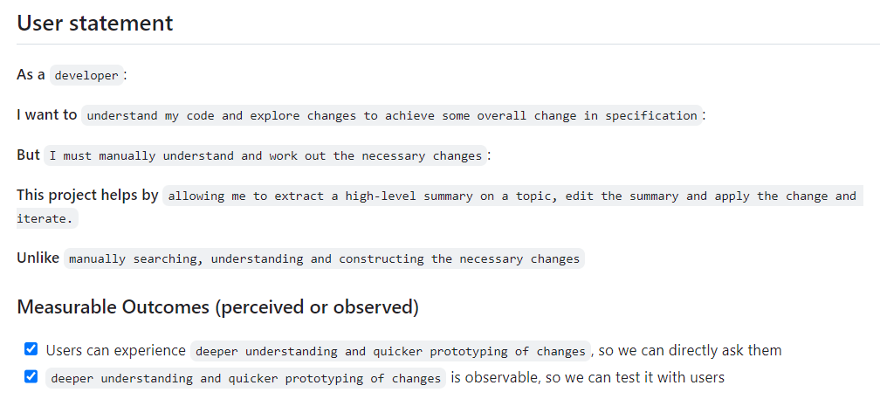
User Statement
https://github.com/github/next/issues/139

Slide 13
Notes
Summarization the inverse of generation (thanks Eddie!)
“Extract” is summarization w.r.t. topic
“Extract” seems independently useful
has similarity with Chat
“Apply” utilises hallucination well!
“Fill in the details, I’ll check what you do”
Is this a new software methodology/modality?
Almost. Sometimes struggle to find a pivot, prefer imperative language - “add this feature”.
But this is likely inaccurate, like hacking with a saw not a scalpel.

Slide 14
Challenges
Deliveries?
A general form of semantic search & replace in VS Code?
A new IDE?
Performance
“Extract” is summarization and relatively fast
“Apply” is code-rewriting and slow. UX helps, picking files helps, planning helps. UX
Performance
“Extract” is summarization and relatively fast
“Apply” is code-rewriting and slow. UX helps, picking files helps, planning helps.

