Slide 1
F#
Combining Functional Programming, Objects and Meta-Programming in the context of .NET 2.0
Don Syme
Microsoft Research, Cambridge
http://research.microsoft.com/fsharp
Google/MSN for “F#”

Slide 2

Today…
F# - an overview
Some design details
  type inference
  objects
  meta-programming
  recursion
Summary

Slide 3
Which functional language:
Has 100s of Microsoft and open source developers working on its runtime systems, JIT compilers and libraries?
Has concurrent GC and SMP support?
Has CPU profilers, memory profilers, debuggers, test, doc tools?
Lets you publish types and code accessible by 100,000s of developers?
Consists of only ~25K LOC

Slide 4
F# = ML as an equal partner
.NET Common
Language
Runtime
C#
VisualStudio
Shell, Projects
GUI Libraries,
DirectX etc.
Visual Basic
ML
F#
ML
Visual Studio,
Debuggers,
Profilers etc.
Languages are central, but must interoperate;
A language is judged on its connectivity;
System.I/O
System.Net etc.
Sockets etc.
Databases

Slide 5
Introducing F#...
A .NET language
Aims to combine much of Lisp, ML, Scheme and Haskell in the context of .NET
Functional, math-oriented, scalable
Aimed particularly at the "Symbolic Scripting and Programming" niche at Microsoft
  e.g. Static Driver Verifier, Terminator, Machine Learning, Vision and more

Slide 6
F# as a Language
Common core language
Core
ML
Core
ML
“OCaml-Objects”
and other extensions
Modules-as-
values, functors
.NET API
Access
Other
extensions
+ tools
+ tools
OCaml
F#

Slide 7
Some Sample F# Programming

Slide 8
Less is More?
It's easy to forget what real programming can be like …
Take a look and see…

Slide 9
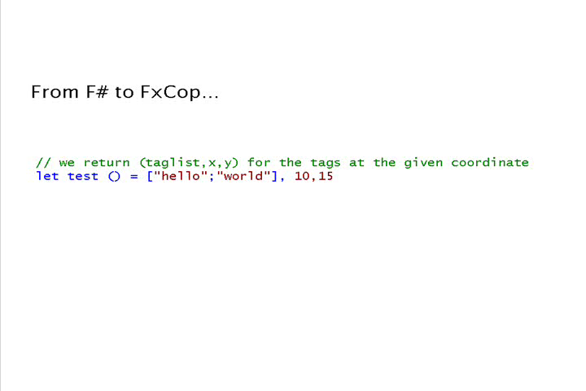
Orthogonal & unified = less code…

Slide 10
Orthogonal & Unified Constructs
100s of "delegate" types
in .NET platform
effectively unified away
Functions: unified and simple
(fun x -> x + 1)
let f x y = x * y
let g x y = x + y
let p = (f,g)
predicate = 'a -> bool
send = 'a -> unit
threadStart = unit -> unit
comparer = 'a -> 'a -> int
hasher = 'a -> int
equality = 'a -> 'a -> bool

Slide 11
Effective abstractions
(as if you didn't know)
Type parameters
Discriminated unions
Pattern matching
Type inference
Recursion (Mutually-referential objects)
Map<’a,’b>
List<’a>
Set<’a>
type expr =
| Sum of expr * expr
| Prod of expr * expr
….
match expr with
| Sum(a,b) -> ...
| Prod(a,b) -> ... ….
let rec map = ...

Slide 12
What of OCaml does F# omit?
Omitted Language Features:
  Modules-as-values
  Labelled or default arguments
  OCaml-style objects (row-polymorphism)
  Variants (column-polymorphism)
Why?
  Some platform limitations (.NET CIL)
  Some features conflict too strongly with .NET objects and other related .NET idioms
  Some we plan to add

Slide 13
Some Design Details

Slide 14
Some Design Details...
F# as a multi-paradigm language
  Integrating a nominal object with ML
  Type Inference
  Classes and all that
Quoted Expressions and LINQ
Mutually referential objects via initialization graphs

Slide 15
F# as a Multi-paradigm Language

Slide 16
Untying the OO puzzle
What's OO really all about?
  Type-directed name resolution (overloading)
  Encapsulated mutation
  Existentials
  Large recursive scopes
  Default parameters via inheritance
  Classification
  Dynamic discovery ("casting")

Slide 17
The F# approach to OO programming
Type inference through HM(X)-style constrained polymorphism with subtype and operator overloading constraints
Embrace a nominal type system
  Object types are named, not structured (except through the use of generics, e.g. Pair<A,B>)
Embrace the "." notation
  Type directed resolution based on left-to-right type inference analysis
  Can be used with regular F# types, e.g. unions and records
Somewhat reluctantly permit the full .NET single-inheritance OO model
  necessary for interoperability and ".NET-style" library design

Slide 18
1. Type-Directed Name Resolution
A mix of type-directed adhoc overloading and constrained monomorphism
Inference order matters, type annotations may be needed. Seems to work well in practice
Adhoc, based on all H-M inferred type information, outside-in, left-to-right
Type.Property
Type.MethodName
expr.MethodName
expr.Property
Name resolution
new Type(args)
expr.MethodName(args)
expr.IndexerProperty(args)
Method overloading

Slide 19
2. Subtyping, inference and constraints
The basic mechanism:
This function accepts any thing that is a subtype of “Stream”
MemoryStream
FileStream
val mkWriter : #Stream -> StreamWriter
Stream
NetworkStream
val mkWriter: 'a -> StreamWriter when 'a :> Stream
Flexibility represented through polymorphism + constraints
StreamWriter(_ :> Stream)
Equivalent to this more verbose form
let g x = mkWriter x, mkReader x
Constraints propagate to the inferred type of "g"

Slide 20
2. Subtyping, inference and constraints
From .NET we get constraints of the form
  'a :> System.IDisposable
  'a :> System.IComparable<'a>
  _ :> System.IDisposable -- implicit variable
  #System.IDisposable -- implicit variable
  others solved to this form -- think "limited Haskell type classes"
  Constraints 'a :> 'b do not arise (language currently being revised to ensure this is the case)
ty :> obj holds for all types
e :> ty need not preserve identity, e.g. may box/repackage

Slide 21
Augmentation and type-directed name resolution
Type Definition
type point = { x: float; y: float }
let mkPoint x y = {x=x;y=y}
let getX p = p.x
let getY p = p.y
type point
with
static member Create(x,y) = {x=x; y=y}
static member Origin = { x=0.0; y=0.0 }
member p.Add(dx,dy) = { x=p.x+dx; y=p.y+dy }
member p.X = p.x
member p.Y = p.y
end
let p = point.Create(3.14,6.28);;
p.X;;
p.Y;;
type point = { x: float; y: float }
let mkPoint x y = {x=x;y=y}
let getX p = p.x
let getY p = p.y
type point
with
static member Create(x,y) = {x=x; y=y}
static member Origin = { x=0.0; y=0.0 }
end
type point = { x: float; y: float }
let mkPoint x y = {x=x;y=y}
let getX p = p.x
let getY p = p.y
type point
with
…
end
type point = { x: float; y: float }
type point = { x: float; y: float }
let mkPoint x y = {x=x;y=y}
let getX p = p.x
let getY p = p.y
Type Augmentation
(~instance declaration for adhoc-dot-notation)
We haven't compromised the basic way of writing code in the language
// point.mli (signature)
type point
with
static member Create : float * float -> point
static member Origin : point
member X : float
member Y : float
member Add : float * float -> point
end
Method member
Property members
(can compute)
But OO presentation techniques are available if needed
This can now be understood and used by any .NET programmer

Slide 22
Classes and interfaces
The full .NET OO model is also supported
type point = class
val x: float
val y: float
new(x,y} = { x=x;y=y }
static member Create(x,y) = {x=x; y=y}
static member Origin = { x=0.0; y=0.0 }
member p.Add(dx,dy) = { x=p.x+dx; y=p.y+dy }
member p.X = p.x
member p.Y = p.y
end
// point.mli (signature)
type point
with
static member Create : float * float -> point
static member Origin : point
member X : float
member Y : float
member Add : float * float -> point
end
This can now be understood and used by any .NET programmer

Slide 23
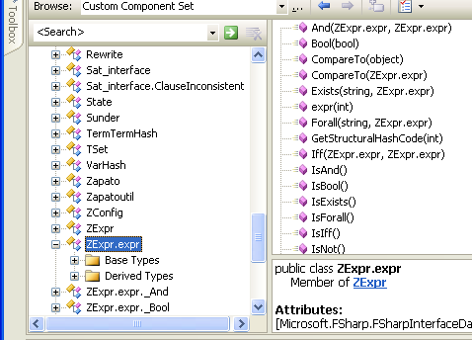
Interoperation: publishing code
Mechanism 1: All ML public types and code have accessible, reliable compiled forms
  e.g. ML type names, type representations and values have predictable, stable, public representations
Lib.expr b = Lib.expr.True;
switch (b.Tag)
{
case Lib.expr.tag_Bool:
Console.WriteLine(“B({0})“,b.Bool1);
break;
case Lib.expr.tag_Term:
Console.WriteLine(“T({0})“,b.Term1);
break;
}
type expr = Bool of bool
| Term of Term.term
| Not of expr
| And of expr * expr
| Or of expr * expr
| Iff of expr * expr
| Forall of string * expr
| Exists of string * expr
match (b) with
| Bool(b) -> ...
| Term(t) -> ...

Slide 24
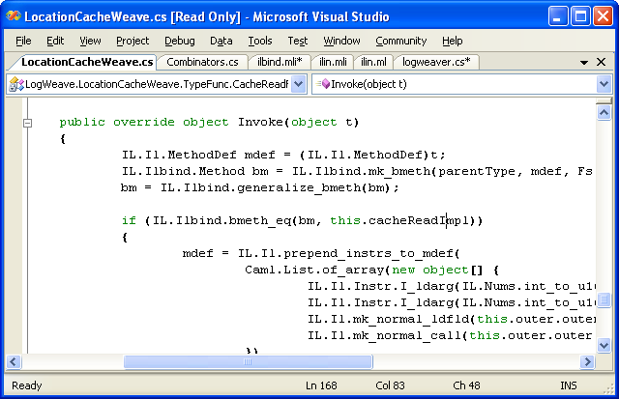
Interoperation: publishing code
LogWeave (Office XAF Optimization Tool)
4000 lines C#, using Abstract IL library
Using types defined in F#
Using functions defined in F#
ilbind.mli
type Method
val bmeth_hash : Method -> int
val bmeth_eq : Method -> Method -> bool
val bmeth_compare : Method -> Method -> int
val mk_bmeth : Type * MethodDef * Types -> Method
val mk_generalized_bmeth : Type * MethodDef -> Method
val generalize_bmeth : Method -> Method

Slide 25
LINQ: Data Integration through simple meta-programming

Slide 26
Language Integrated Meta-Programming and LINQ
LINQ is a set of features and libraries for C# and Visual Basic
The aim is "Language Integrated Queries", e.g.:
Results =
myDatabase
.Select("fun row -> row.Name, row.Street")
.Where("fun row -> row.Town=Brisbane")
Results =
from myDatabase
select (Name,Street)
where Town=Brisbane
Simple LISP-like expressions
Combinators for these

Slide 27
Language Integrated Queries with F#/LINQ
db.Customers
|> where « fun c -> c.City = "London" »
|> select « fun c -> c.ContactName »
["Thomas Hardy"; "Victoria Ashworth";
"Elizabeth Brown"; "Ann Devon";
"Simon Crowther"; "Hari Kumar"]
SELECT [t0].[ContactName]
FROM [Customers] AS [t0]
WHERE @p0 = [t0].[City]

Slide 28
The Vision: Heterogeneous Execution
Today languages use homogeneous execution:
  The CPU
The natural extension of the LINQ vision is heterogeneous execution, leveraging
  The database
  The server
  The GPU
  The web browser (ala AJAX)
  Symbolic execution
Write your code in one language, execute it in many completely different ways

Slide 29

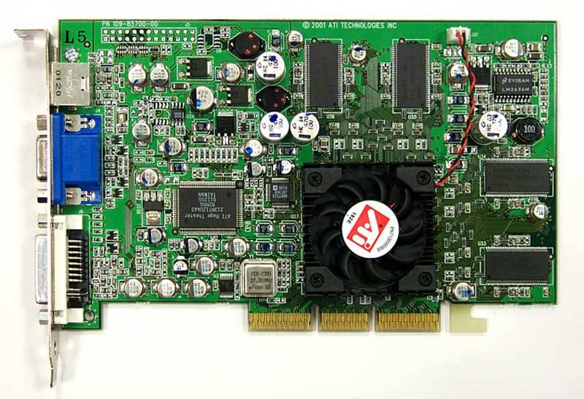
Accelerate ahead with F# Quotations!
let nextGeneration(a) =
let sum = rot a (-1) (-1) .+ rot a (-1) 0 .+ rot a (-1) 1
.+ rot a 0 (-1) .+ rot a 0 1
.+ rot a 1 (-1) .+ rot a 1 0 .+ rot a 1 1 in
(sum .= three) .|| ((sum .= two) .&& a);;
nextGeneration a
accelerate <@ nextGeneration @> a
Accelerator.dll
Metaprogram
Program
GPU assembly code
CPU
Graphics Card

Slide 30
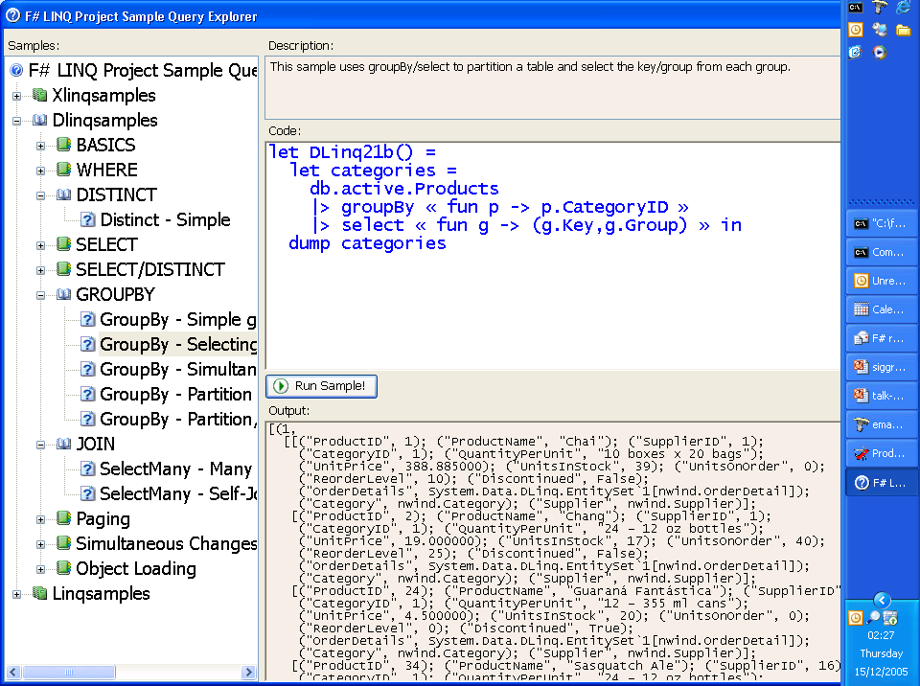

Slide 31
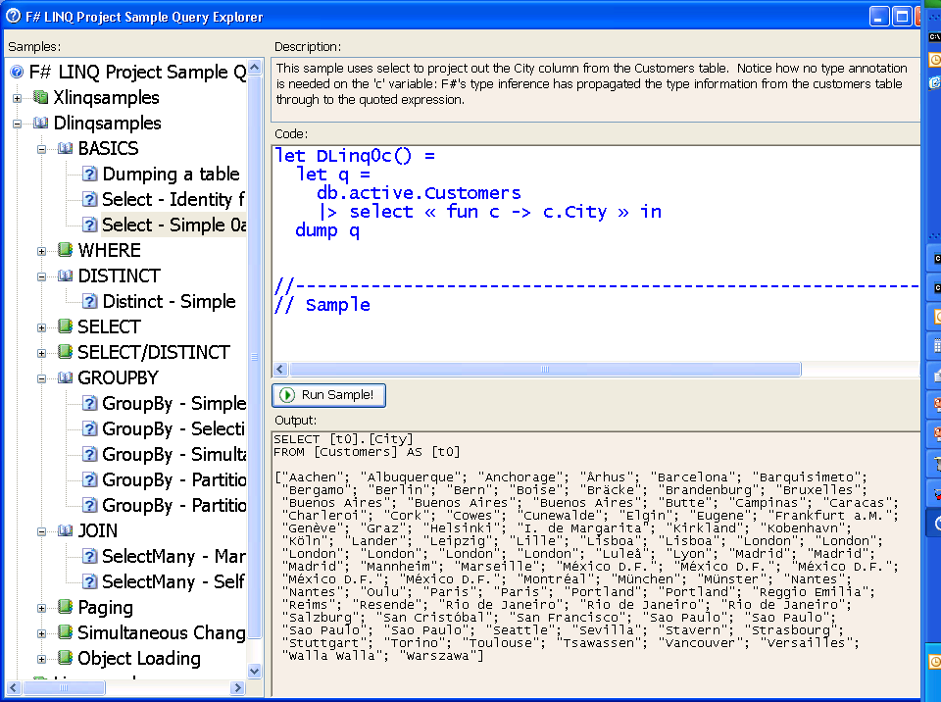

Slide 32
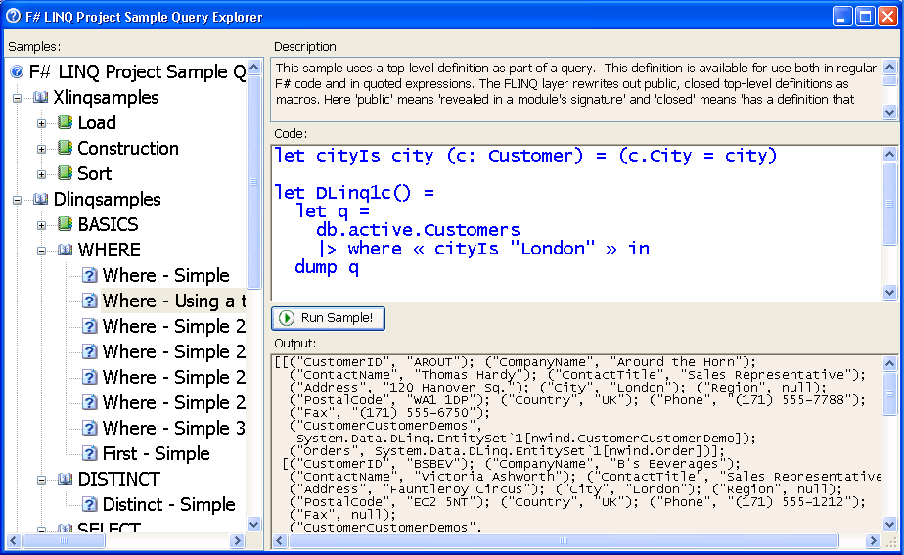
This allows definitions to be shared between meta-language and object-language
Quotations can refer to top level definitions

Slide 33
Quoted Expressions
Much like LISP’s `(1 + 2), with holes, interior binding and types
‘eval’ provided via LINQ's Expression.Compile
No type generalization (inner polymorphism) inside quoted expressions
Currently mapped to name carrying terms
Closed “up to top-level, public definitions”
Piggy-back of the assembly/namespace/type structure of .NET and F# for model of linking/references
May reference object model goop (some incompletenesses here)
« 1 + 2 »;;
« 1 + _ »;;
« _ + _ »;;
« _ + _ »;;
type exprSpec =
| ConstExpr of constSpec * typeSpec list
| VarExpr of varName
| LambdaExpr of varSpec * exprSpec
| AppExpr of exprSpec * exprSpec
| QuoteExpr of exprSpec
| HoleExpr of typeSpec
and typeSpec =
| VarType of tyvarIdx
| AppType of tyconstSpec * typeSpec list
type 'a expr = Expr of exprSpec
Runtime
Compile
F# Internal
Compiler Trees
Linq’s
System.Expression
Pickle to bytes
bytes
Unpickle from bytes
SQL
etc.

Slide 34
F# Quotations & LINQ
Related work: LISP, Meta-OCaml, ReFLect, MetaML, Template Haskell
  No syntax extensions
  Can use top definitions as macros (i.e. can factor common fragments of queries)
  F# makes quotation, splicing and lifting explicit but relatively painless
LINQ has some of the world’s first multi-language meta-programming components
  Gives meta-programming a much less ‘introverted’ feel
  Indeed interoperability at this layer is much easier than at the IL layer (it’s just programming and transformation)

Slide 35
F# and Mutually Referential Objects

Slide 36
Mutually Referenctial Obejcts
ML Restriction: Only recursive functions:
  "let rec" can only bind lambda expressions
  also recursive data in OCaml
ML Restriction: No polymorphic recursion
  "let rec" bindings must be recursively used at uniform polymorphic instantiations
ML Restriction: Value restriction
  limits on the generalization of polymorphic bindings that involve computation

Slide 37
Recursive definitions in ML
Core ML
let rec f x = if x > 0 then x*f(x) else 1
Recursive function
OCaml
let rec ones = 1 :: ones
Recursive data
✗ ✗
let cons x y = x :: y
let rec ones = cons 1 ones
Immediate dependency
✗
type widget
let rec widget = MkWidget (fun ... -> widget)
Possibly delayed dependency

Slide 38
Example 1: Typical GUI problem
Widgets
Evolving behaviour
A specification:
form
form = Form(menu)
menu = Menu(menuItemA,menuItemB)
menuItemA = MenuItem(“A”, {menuItemB.Activate} )
menuItemB = MenuItem(“B”, {menuItemA.Activate} )
✓
menu
Assume this
abstract API
Assume:
menuItemA
type Form, Menu, MenuItem
val MkForm : unit -> Form
val MkMenu : unit -> Menu
val MkMenuItem : string * (unit -> unit) -> MenuItem
val activate : MenuItem -> unit
…
menuItemB

Slide 39
Example 1: The Obvious Is Not Allowed
✗ Construction computations
on r.h.s of let rec
The obvious code isn't allowed:
let rec form = MkForm()
and menu = MkMenu()
and menuItemA = MkMenuItem(“A”, (fun () -> activate menuItemB)
and menuItemB = MkMenuItem(“B”, (fun () -> activate menuItemA)
…
nb. Delayed self-references

Slide 40
Example 1: Explicit Initialization Holes in ML
So we end up writing:
let form = MkForm()
let menu = MkMenu()
let menuItemB = ref None
let menuItemA = MkMenuItem(“A”, (fun () -> activate (the(!menuItemB))
menuItemB := Some(MkMenuItem(“B”, (fun () -> activate menuItemA))
…
✓ML programmers understand ref, Some, None.
✗ Most programmers hate this. Why bother using ML if you end up doing this?
✗ The use of explicit mutation is deeply disturbing.

Slide 41

An alternative: Initialization Graphs
let rec form = MkForm(menu)
and menu = MkMenu(menuItemA,
menuItemB)
and menuItemA =
MkMenuItem(“A”,
(fun () -> activate menuItemB)
and menuItemB =
MkMenuItem(“B”,
(fun () -> activate menuItemA)
in
...
Write the code the obvious way, but interpret the "let rec" differently

Slide 42
Initialization Graphs: Compiler Transformation
let rec form = lazy (MkForm(force(menu)))
and menu = lazy (MkMenu(force(menuItemA),
force(menuItemB)))
and menuItemA =
lazy (MkMenuItem(“A”,
(fun () -> force(menuItemB).Toggle()))
and menuItemB =
lazy (MkMenuItem(“B”,
(fun () -> force(menuItemA).Toggle()))
in
...
In principle laziness inserted at all recursive nodes

Slide 43
Initialization Graphs: Compiler Transformation
let rec form = lazy (MkForm(force(menu)))
and menu = lazy (MkMenu(force(menuItemA),
force(menuItemB)))
and menuItemA =
lazy (MkMenuItem(“A”,
(fun () -> force(menuItemB).Toggle()))
and menuItemB =
lazy (MkMenuItem(“B”,
(fun () -> force(menuItemA).Toggle()))
in
let form = force(form)
and menu = force(menu)
and menuItemA = force(menuItemA)
and menuItemB = force(menuItemB)
form
menu
With some caveats, the initialization graph is NON ESCAPING. No “invalid recursion” errors beyond this point
menuItemA
Explore the graph left-to-right
The lazy computations are now exhausted
menuItemB

Slide 44
Example 1: GUIs
This is the natural way to write the program
// Create
let rec form = MkForm()
and menu = MkMenu()
and menuItemA = MkMenuItem(“A”, (fun () -> activate menuItemB)
and menuItemB = MkMenuItem(“B”, (fun () -> activate menuItemA)
…

Slide 45
Performance
Take a worst-case (streams)
  OCamlopt: Hand-translation of IGs
Results (ocamlopt – F#'s fsc.exe gives even greater difference):
Notes:
  Introducing initialization graphs can give huge performance gains
  Further measurements indicate that adding additional lazy indirections doesn't appear to hurt performance
This uses an IG to create a single object wired to itself
let rec threes = Stream.consf 3 (fun () -> threes)
suck threes 10000000;;
0.52s
let rec threes () = Stream.consf 3 threes
suck (threes()) 10000000;;
4.05s

Slide 46
Further Examples
Picklers
  Mini-objects: pairs of functions once again
  Again, abstract types make things worse
Automata
  Recursive references to pre-existing states
Streams (lazy lists)
  Very natural to recursively refer to existing stream objects in lazy specifications
Just about any other behavioural/co-inductive structure

Slide 47
Issues with Initialization Graphs
Failure:
  Recursive self-reference errors are possible during initialization
  c.f. all other languages where evaluation and recursion mix
Compensation (try-finally)
Concurrency
  Need to prevent leaks to other threads during initialization (or else lock)
  Raises broader issues for a language
Continuations:
  Initialization can be halted. Leads to major problems

Slide 48
Initialization Graphs: Static Checks
Simple static analyses detect most direct (eager) recursion loops
Optional warnings where runtime checks are used
let rec x = y
and y = x
mistake.ml(3,8): error: Value ‘x’ will be evaluated as part of its own definition. Value 'x' will evaluate 'y' will evaluate 'x'
ok.ml(13,63): warning: This recursive use will be checked for initialization-soundness at runtime.
let rec menuItem =
MkMenuItem("X", (fun () -> activate menuItem))

Slide 49
Finishing up…

Slide 50
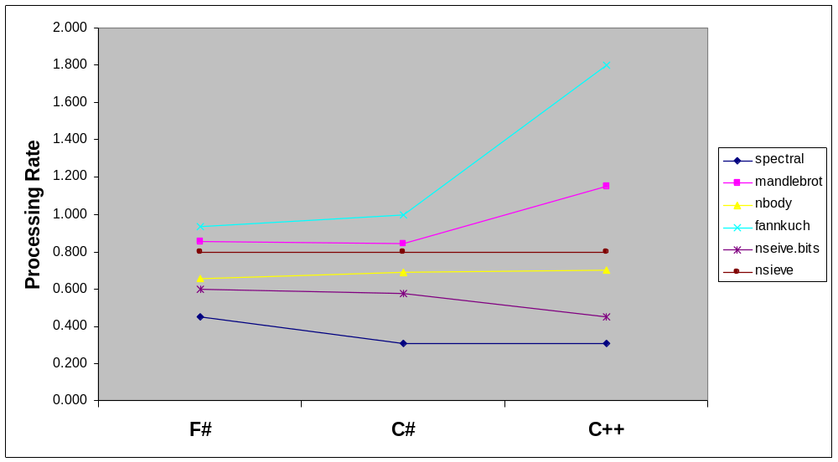
Benchmark Performance by Language
MS Confidential

Slide 51
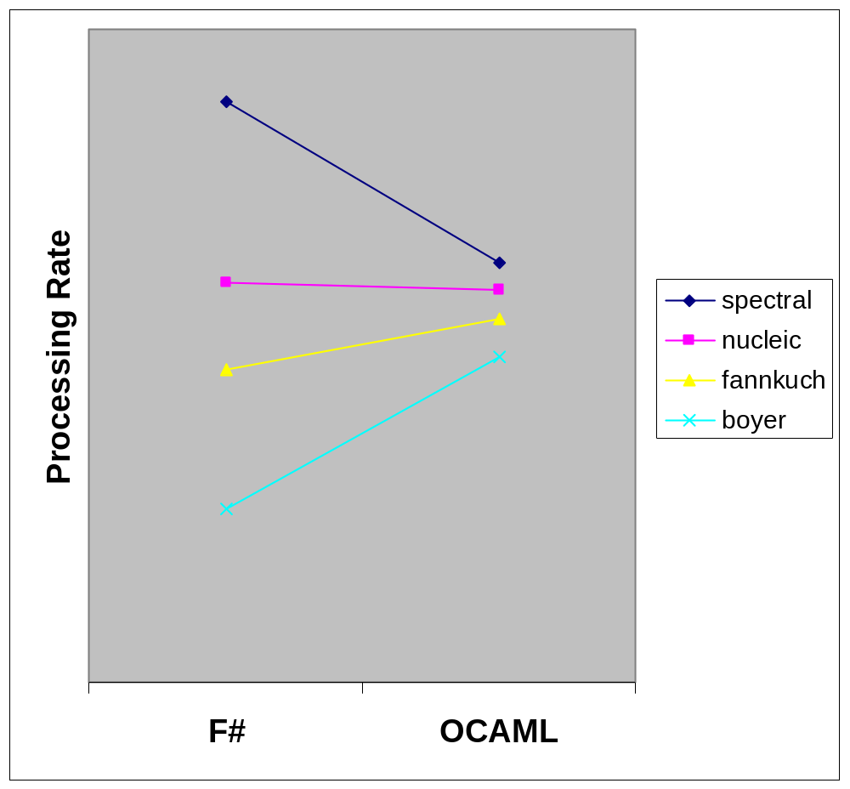
F# and OCAML benchmarks
MS Confidential

Slide 52
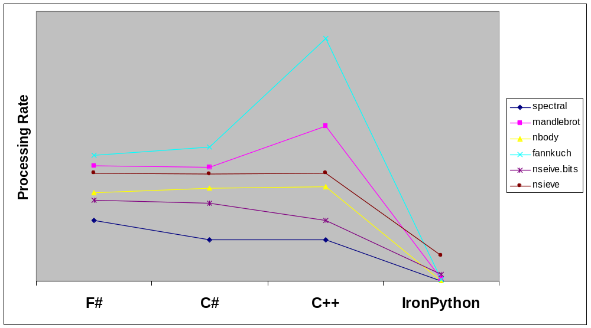
Benchmark Performance by Language
MS Confidential

Slide 53
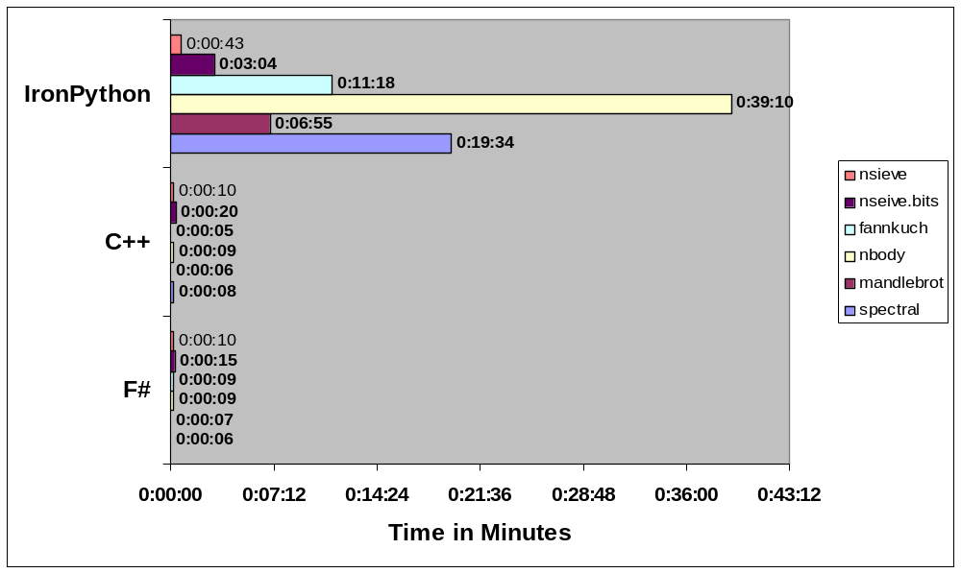
Running times for benchmarks
MS Confidential

Slide 54
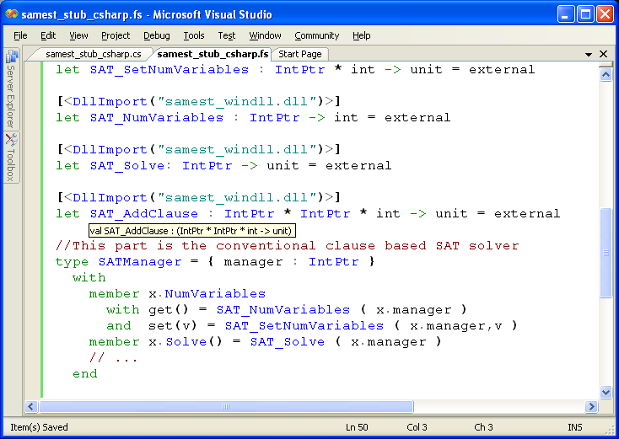
#1: Calling C/C++
C SAT Solver
Accessed from F#
Type-safe F# wrapper

Slide 55
Summary

Slide 56
What's it all about…
ML has simple, effective abstractions with the right defaults for many tasks…
ML has scripting WITH performance…
What it is has always needed is synergy with a platform
F# gives this

Slide 57
F# and Some Other Languages
MLj/SML.NET
  First decent language on JVM ☺
  Excellent whole-program optimizing compiler
  Claudio Russo's VS Mode acted as prototype for F# VS mode
  SML.NET didn't hit the niche F# is aiming for (scalable, typesafe scripting)
Haskell
  Haskell is the most beautiful functional language
  I did a prototype Haskell.NET in 2001
  By .NET standards Haskell doesn't interoperate well
  But I'm very interested in enabling Haskell-like programming on .NET

Slide 58
Related work…
Formal computer science
  Long history of polymorphism
  HM(X) type inference (Odersky et al.)
  Monadic & operational approaches to recursion
  Long history of record calculii
  Semantics for Java-like languages
  HOL, Isabelle, logic/meta-programming
Languages/Systems
  ML, MLj, SML.NET, Haskell, Scala, Clean, Mercury, ReFLect
  Java, C#, Nemerle, Visual Basic, Python

Slide 59
Languages, the CLR & .NET Generics
...and here.
VB
VC++
C#
...
F#
also here...
Common IL
F# is a related project
that works with or
without generics
We’ve added support for
generics/polymorphism...
Common Language Runtime
Loader
JIT
Verifier
...
GC
Native
Code

Slide 60
Thank you
Resources:
  http://research.microsoft.com/fsharp
  http://blogs.msdn.com/dsyme
  MSN Search for “fsharp”, Google for “F#” ☺
New Community Site: http://www.hubfs.net

