Slide 1
Introduction to F#
Scalable, Type-safe, Succinct, Interoperable, Mathematically-oriented Programming for .NET
Don Syme
MSR Cambridge
http://research.microsoft.com/fsharp
Google for “F#”, MSN for “fsharp”

Slide 2

Today…
F# overview
Some introductory F# programming
Two case studies

Slide 3
Which functional language:
Connects with all Microsoft and most Open Source foundation technologies?
Has 100s of Microsoft and open source developers working on its runtime systems, JIT compilers and libraries?
Has concurrent GC and SMP support?
Has CPU profilers, memory profilers, debuggers, test, doc tools?
Lets you publish types and code accessible by 100,000s of developers?
Consists of only ~25K LOC

Slide 4
F# = ML in the world of .NET
.NET Common
Language
Runtime
C#
VisualStudio,
SharpDevelop
GUI Libraries,
DirectX etc.
Visual Basic
F#
Debuggers,
Profilers etc.
Languages are central, but must interoperate;
A language is judged on its connectivity;
System.I/O
System.Net etc.
Sockets etc.
Database
Libraries

Slide 5
Introducing F#...
A .NET language
Aims to combine much of Lisp, ML, Scheme and Haskell in the context of .NET
Functional, math-oriented, scalable
Aimed particularly at the "Symbolic Scripting and Programming" niche at Microsoft
  e.g. Static Driver Verifier, Terminator, Machine Learning, Vision and more

Slide 6
F# as a Language
Common core language
Core
ML
Core
ML
“OCaml-Objects”
and other extensions
Modules-as-
values, functors
.NET API
Access
Other
extensions
+ tools
+ tools
OCaml
F#

Slide 7
Some Simple F#
NOTE: type inferred
val data: int * int * int
let data = (1,2,3)
let sqr x = x * x
let f (x,y,z) = (sqr x, sqr y, sqr z)
let sx,sy,sz = f (10,20,30)
printf "hello world"; 1+2
let show (x,y,z) =
Console.WriteLine("hello world");
let sx,sy,sz = f (x,y,z) in
printf “Results = %d,%d,%d“ (sx,sy,sz);
sqrs
let (|>) x f = f x
val sqr: int -> int
pattern
matching
parentheses optional on application
sequencing
let pastaProducts =
productList
|> Set.filter (fun x -> x.Contains("Ravioli"))
|> Set.union tortelliniProducts
|> Set.to_array
local binding, sequencing
pipelining operator

Slide 8
Some Sample F# Programming

Slide 9
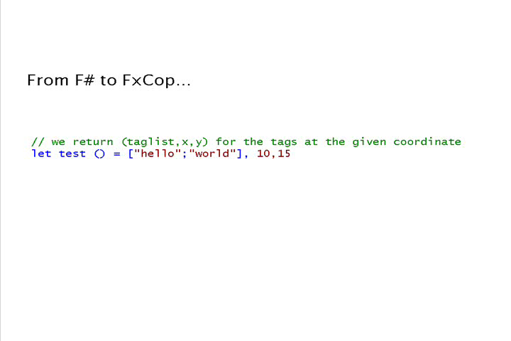
Orthogonal & unified = less code…

Slide 10
Orthogonal & Unified Constructs
100s of "delegate" types
in .NET platform
effectively unified away
Functions: unified and simple
(fun x -> x + 1)
let f x y = x * y
let g x y = x + y
let p = (f,g)
predicate = 'a -> bool
send = 'a -> unit
threadStart = unit -> unit
comparer = 'a -> 'a -> int
hasher = 'a -> int
equality = 'a -> 'a -> bool

Slide 11
Effective abstractions
Type parameters
Discriminated unions
Pattern matching
Type inference
Recursion (Mutually-referential objects)
Map<’a,’b>
List<’a>
Set<’a>
type expr =
| Sum of expr * expr
| Prod of expr * expr
….
match expr with
| Sum(a,b) -> ...
| Prod(a,b) -> ... ….
let rec map = ...

Slide 12
Typical F# Project Architecture
etc. etc. etc.
MATLAB
Base Tools
✓ Windows (any edition)
✓ .NET Framework 2.0
✓ F# 1.1.11
Readily Accessible Extras
✓ Visual Studio 2005
✓ SQL Server 2005
✓ Alchemi (.NET distribution framework)
✓ also many, many others
e.g. Visual C++, DirectX,
dnAnalytics, MKL,
LAPACK, MATLAB,
AJAX libraries
etc. etc. etc.
.NET Framework
libraries
Interactive
Visualization
Web
Database
Analysis
Data Access
F#
File-based
Databases
Simulation
Scripting
private
C# matrix
library
SQL
Server Database
C++ simulation
engine

Slide 13
Case Study: TrueSkill
Live game ranking algorithms in F#

Slide 14
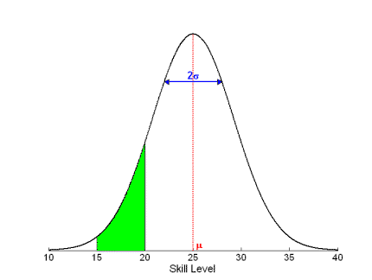
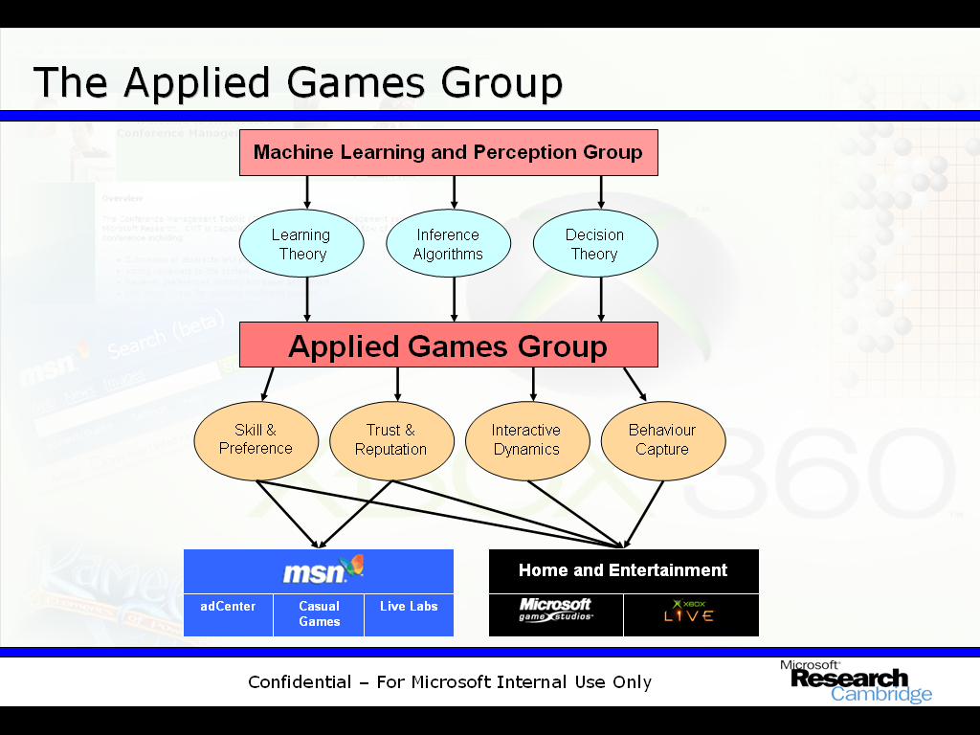
TrueSkill ™
Skill based ranking for Xbox Live! from MSR.
  Skill is a normal distribution
  Mean is the “expected skill”
  Variance is the “uncertainty”

Slide 15
F# as a Scripting Language
Problem:
  Parsing 110 GB of Xbox 360 Live matchmaking log data (12 days).
  Data spreads over 11,000 text files in over 300 directories.
Task:
  Importing data in structural form into a SQL database.
Code:
  90 lines long!
Development time (code):
  1 – 2 hours.
Performance:
  In under 18 hours = 10,000 log lines processed per second!

Slide 16
F# for Large Scale Data Analysis
Problem:
  Analysis of 4.2 million Xbox 360 Live user feedbacks (4 months worth of data).
  Data is already in a SQL database.
Task:
  Adopt TrueSkill™ model to the user feedback problem for integration into the Xbox Live service.
Code:
  100 lines long!
Development time (code):
  3 – 4 hours.
Performance:
  10 minutes runtime for the whole dataset!

Slide 17
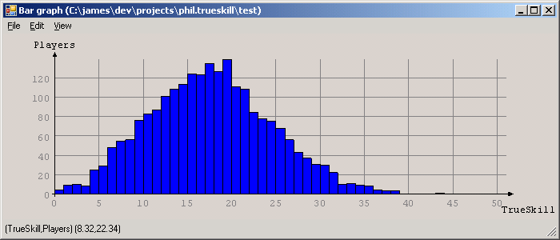
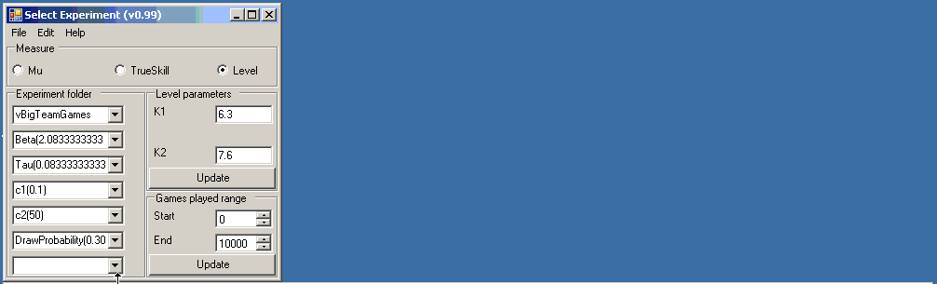
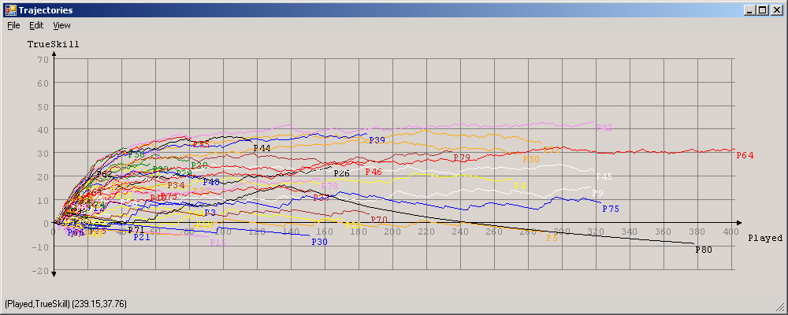
F# for Complex Scientific Modelling
Why F#?
Deep .Net Integration.
  System.IO
  System.Data.SqlClient
  Custom TrueSkill™ C# libraries.
  Custom C# Matrix library.
Interactive development.
Full Visual Studio integration.
Built-in type inference.
Anonymous functions.
Pattern matching.
Problem:
  Framework for probabilistic inference (research).
Task:
  Extensible and “thin” factor graph library.
Code:
  400 lines long (comparable C# code: ≈2000 lines)
Development time (code):
  2 weeks.
Performance:
  Excellent

Slide 18
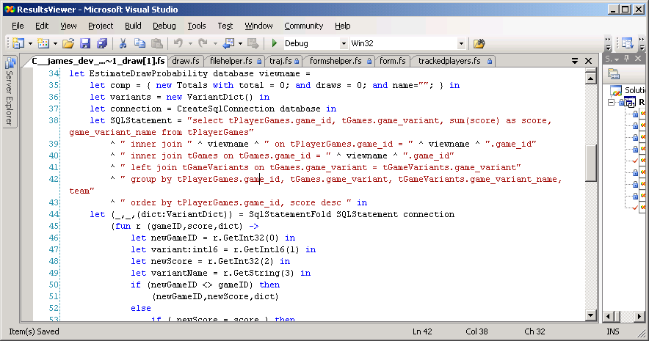
F# code - data processing

Slide 19
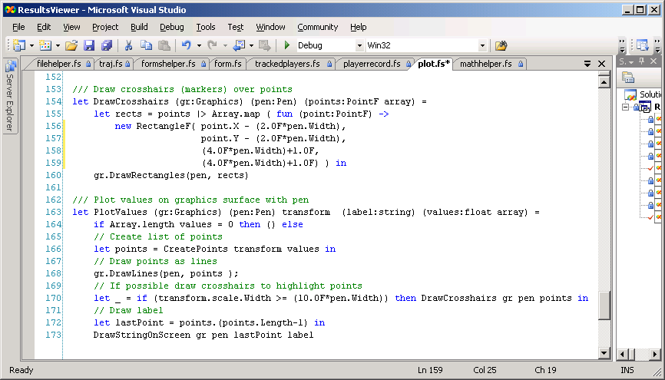
Code – plotting v. TrueSkill

Slide 20
What they say…
New F# user (experienced OO programmer)
"We crunched 400Gb of data, scripting over smaller sets then finally running 3 days with 15 computers. The UI code streams a 100Mb CSV file from disk in around 5 seconds, while simultaneously calculating and drawing a histogram."
“The F# code has excellent performance.”
“F# is fun!”
“I really enjoyed the brevity of the resulting code. It helped me focus on the ends, not the means.”
“The F# code was easy to maintain and evolve”
Notes:
During the project I found coding in F# fun, and really enjoyed the brevity of the resultant code due to F#’s type inference and extensive collection functions.
I found the resultant F# code easy to maintain and evolve as new requirements came in, and even produced a reusable graph drawing library along the way.
The main challenges were to crunch through hundreds of gigabytes of data for 3 days using an array of 15 computers, and then to present the huge results in a usable and responsive way.
The succinctness of F# combined with the .Net framework helped me to focus on the ends and not the means.
The UI code was able to stream a 100Mb CSV file from disk in around 5 seconds, while simultaneously calculating and drawing a histogram as it loaded
Performance of the F# code was excellent.
Plus the best optimisations come from better algorithms and with F# constructs like lazy enumerations, you can focus there.

Slide 21
Performance and related issues

Slide 22
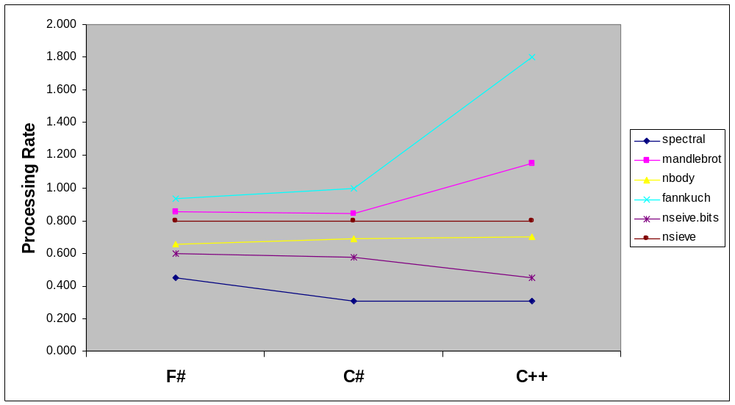
Benchmark Performance by Language
MS Confidential

Slide 23
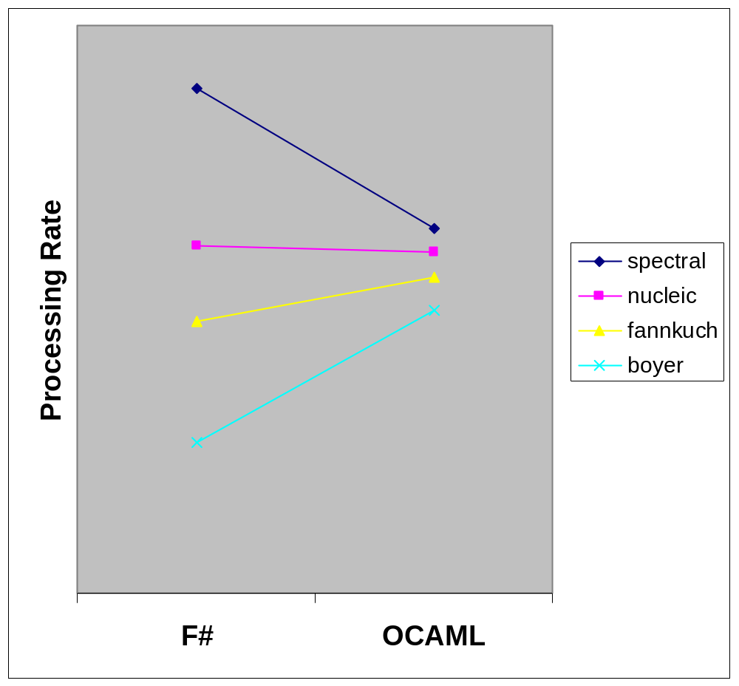
F# and OCAML benchmarks
MS Confidential

Slide 24
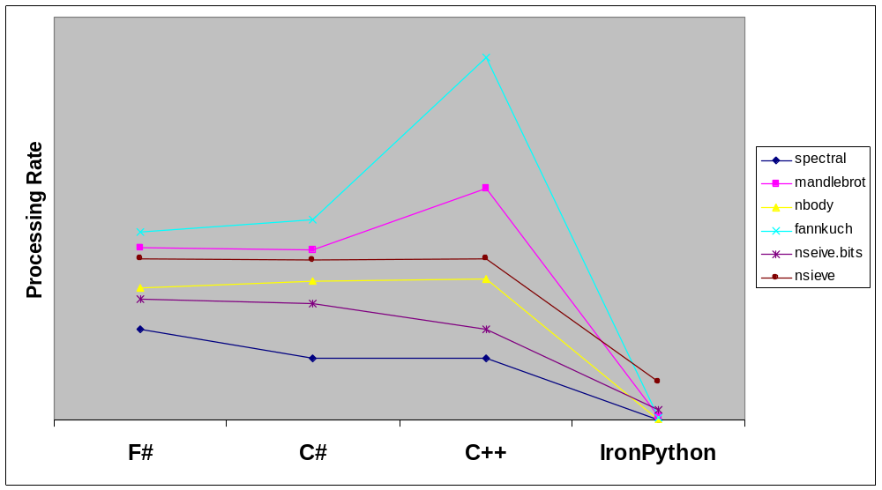
Benchmark Performance by Language
MS Confidential

Slide 25
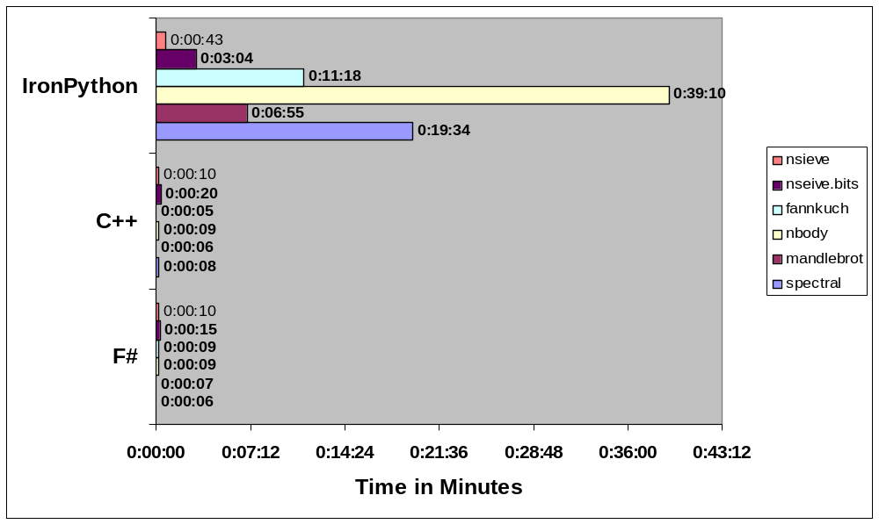
Running times for benchmarks
MS Confidential

Slide 26
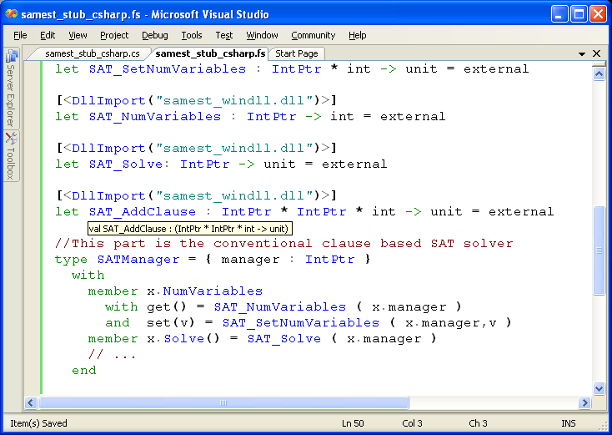
Calling C/C++
C SAT Solver
Accessed from F#
Type-safe F# wrapper

Slide 27
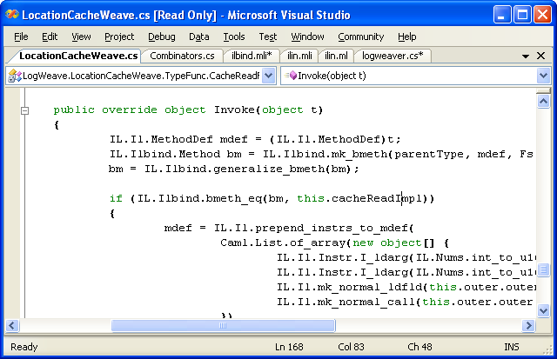
#2: Calling F# from C#
LogWeave (Office XAF Optimization Tool)
4000 lines C#, using Abstract IL library
Using types defined in F#
Using functions defined in F#
il.mli/ilbind.mli
type Method
type MethodDef
val bmeth_hash : Method -> int
val bmeth_eq : Method -> Method -> bool
val bmeth_compare : Method -> Method -> int
val mk_bmeth : Type * MethodDef * Types -> Method
val mk_generalized_bmeth : Type * MethodDef -> Method
val generalize_bmeth : Method -> Method

Slide 28
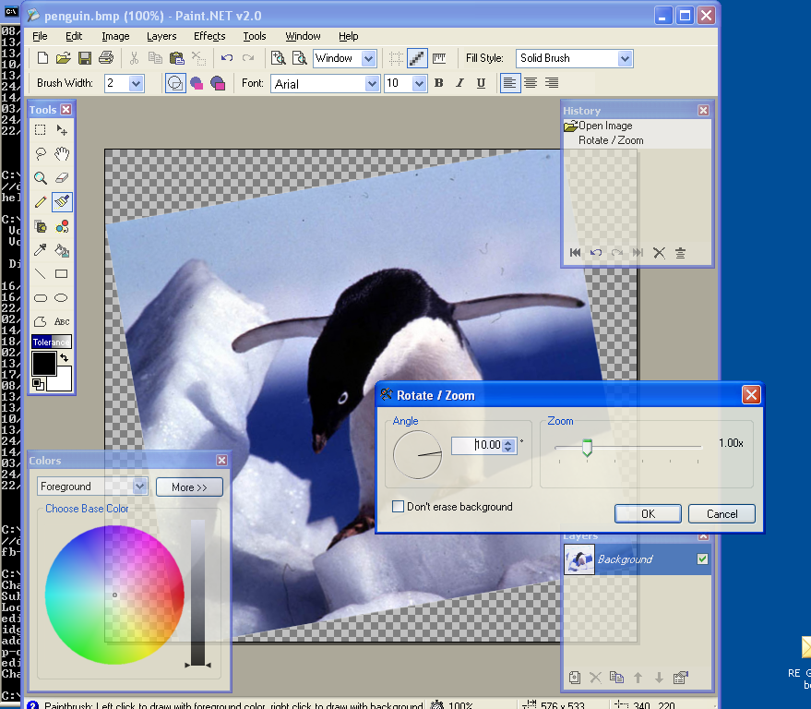
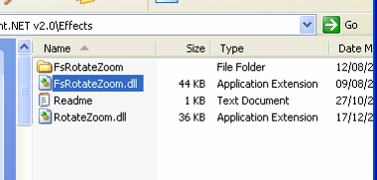
#3: Paint.NET & Plugins
Plugin written in F#
Here is the DLL

Slide 29

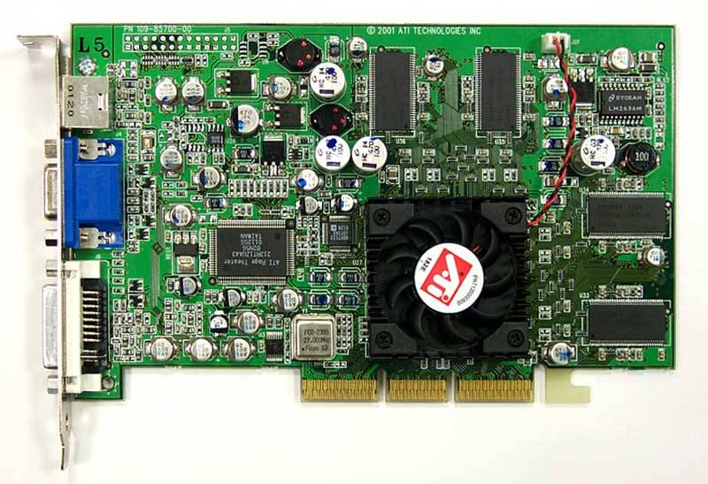
Accelerate ahead with F# Quotations!
let nextGeneration(a) =
let sum = rot a (-1) (-1) .+ rot a (-1) 0 .+ rot a (-1) 1
.+ rot a 0 (-1) .+ rot a 0 1
.+ rot a 1 (-1) .+ rot a 1 0 .+ rot a 1 1 in
(sum .= three) .|| ((sum .= two) .&& a);;
nextGeneration a
accelerate <@ nextGeneration @> a
Accelerator.dll
Metaprogram
Program
GPU assembly code
CPU
Graphics Card

Slide 30
Case Study: SPiM
Interactive Chemical/Biological Stochastic Simulation with F#

Slide 31
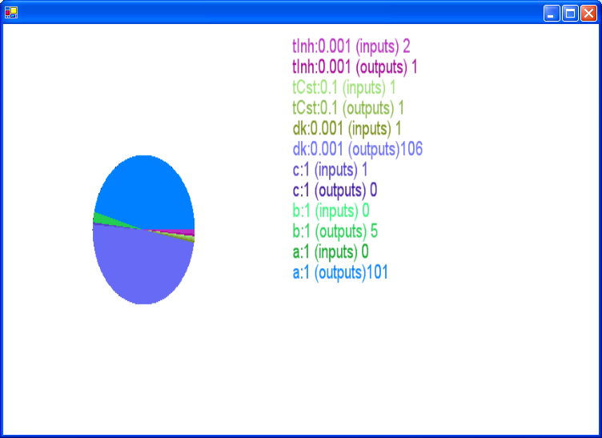
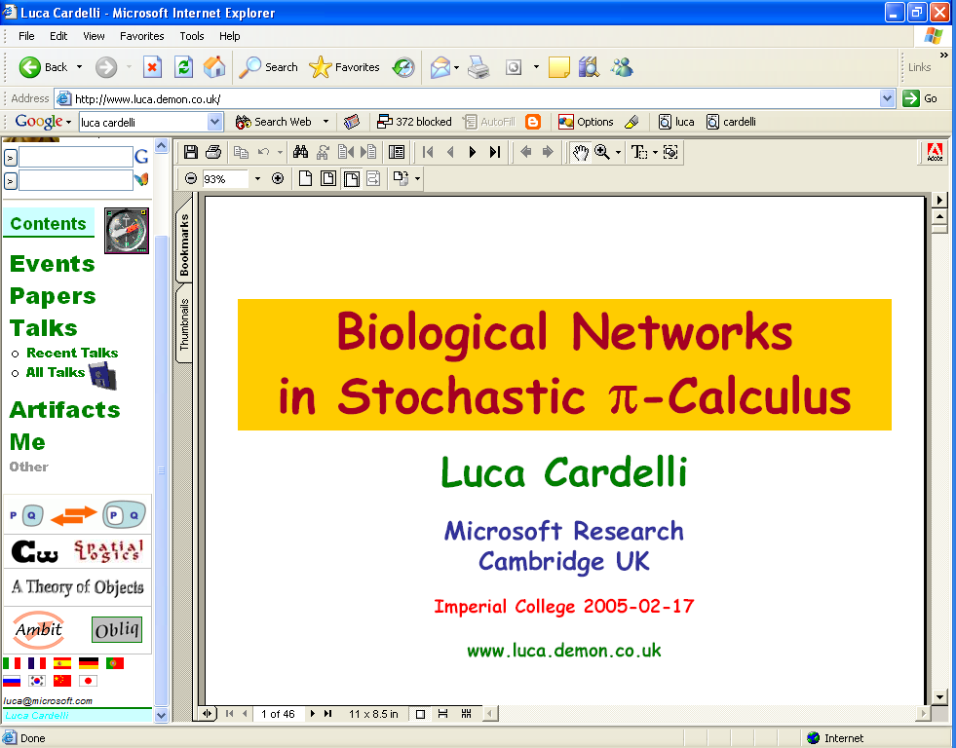

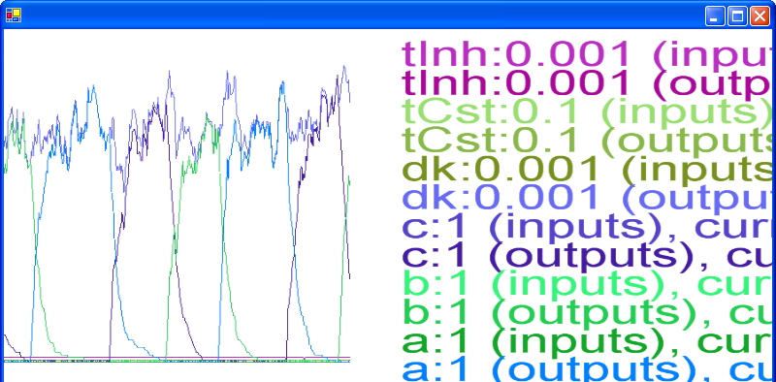
#3: SPiM: Biological Simulation and Visualization

Slide 32
Summary

Slide 33
Challenges of modern language design
Statically typed, hence
Scalable (> 100K LOC)
It’s the
combination that counts
Succinct
Safe
Efficient
Libraries
Interactive
Interoperable
Good
Platform

Slide 34
Summary
.NET 2.0 + F# 1.1
  An excellent combination for practical, applied, non-trivial scientific programming
  .NET gives you a rich software eco-system of relevant, polished components
  F# gives you scripting, performance and the beauty and productivity of functional programming
Enjoy!

Slide 35
Questions?

Slide 36
Backup

Slide 37
Language Integrated Queries with F#/LINQ
db.Customers
|> where « fun c -> c.City = "London" »
|> select « fun c -> c.ContactName »
["Thomas Hardy"; "Victoria Ashworth";
"Elizabeth Brown"; "Ann Devon";
"Simon Crowther"; "Hari Kumar"]
SELECT [t0].[ContactName]
FROM [Customers] AS [t0]
WHERE @p0 = [t0].[City]

Slide 38
The Vision: Heterogeneous Execution
Today languages use homogeneous execution:
  The CPU
The natural extension of the LINQ vision is heterogeneous execution, leveraging
  The database
  The server
  The GPU
  The web browser (ala AJAX)
  Symbolic execution
Write your code in one language, execute it in many completely different ways

